Slide 1

ENGLISH AND CREATIVE WRITING
Exploring the Humanities
HPHP4018
Dr. Sarah Reynolds

Slide 2


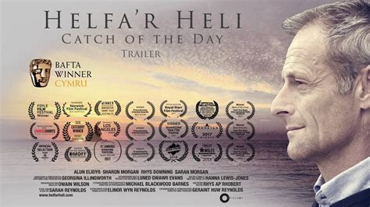
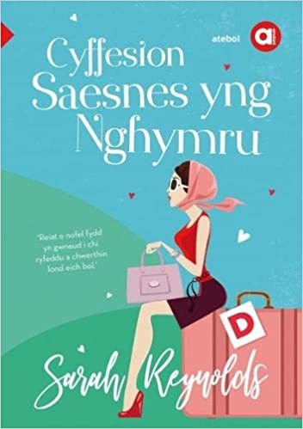
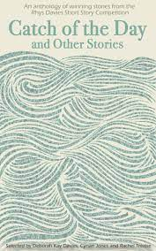
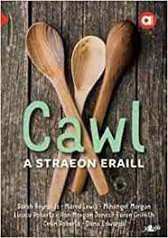
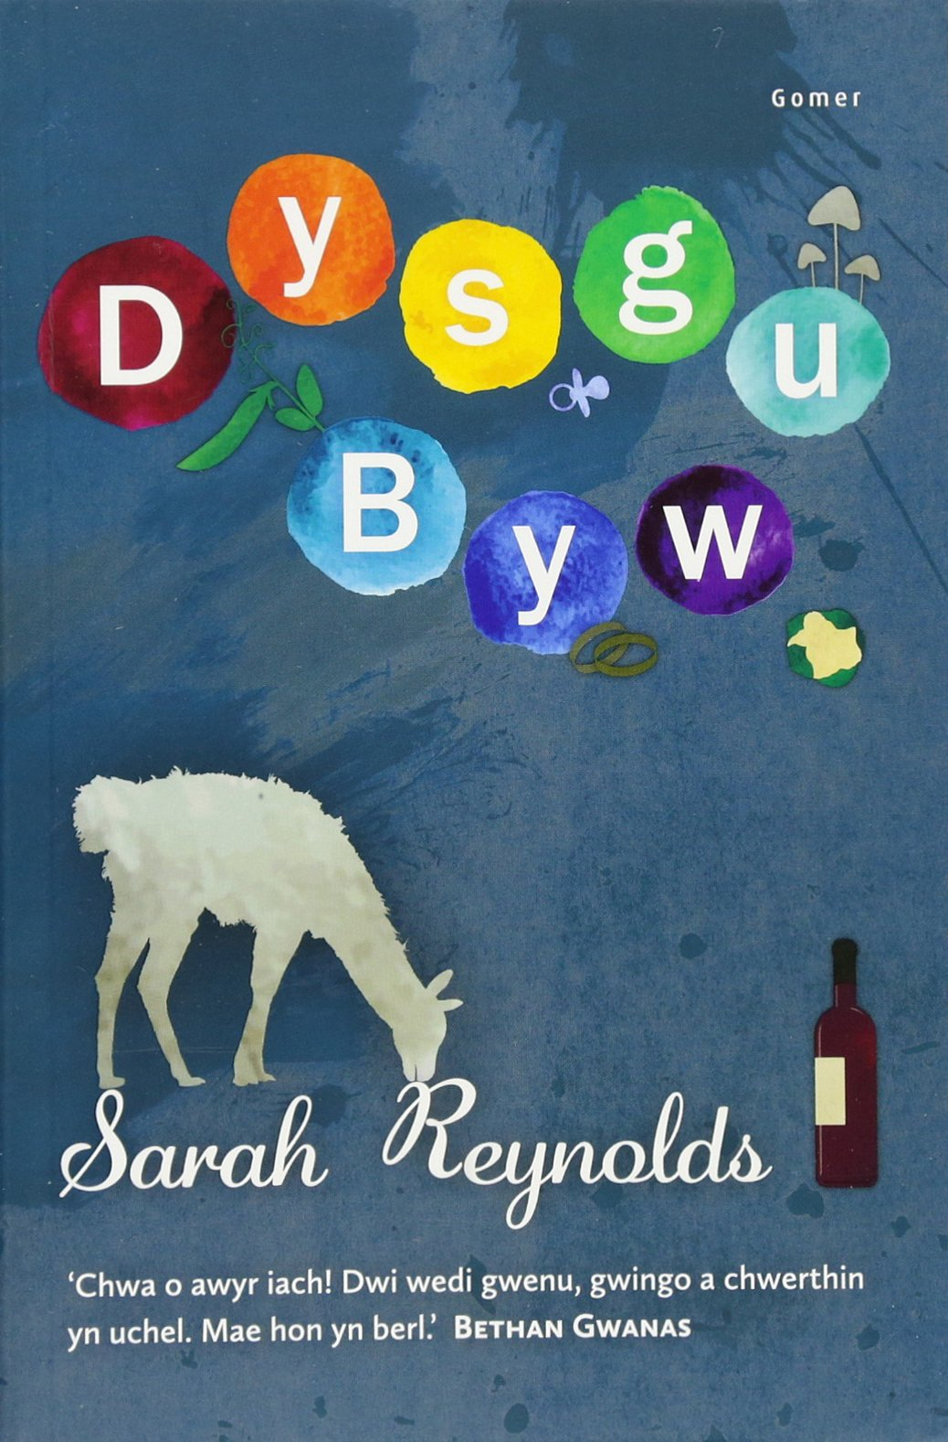
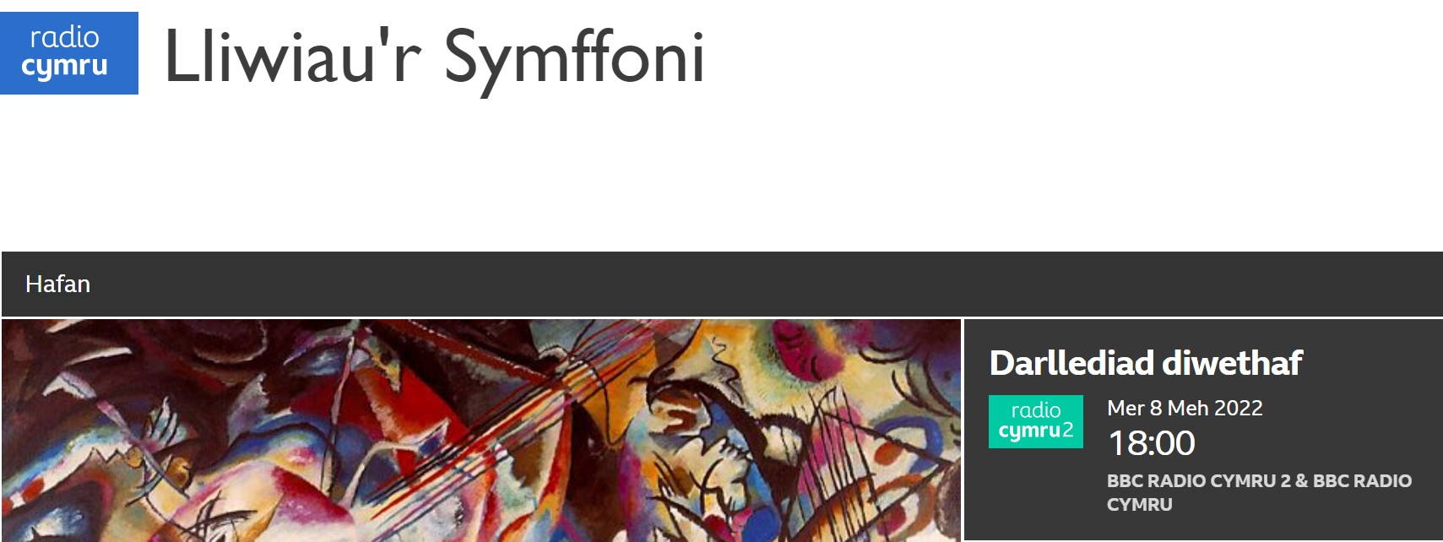
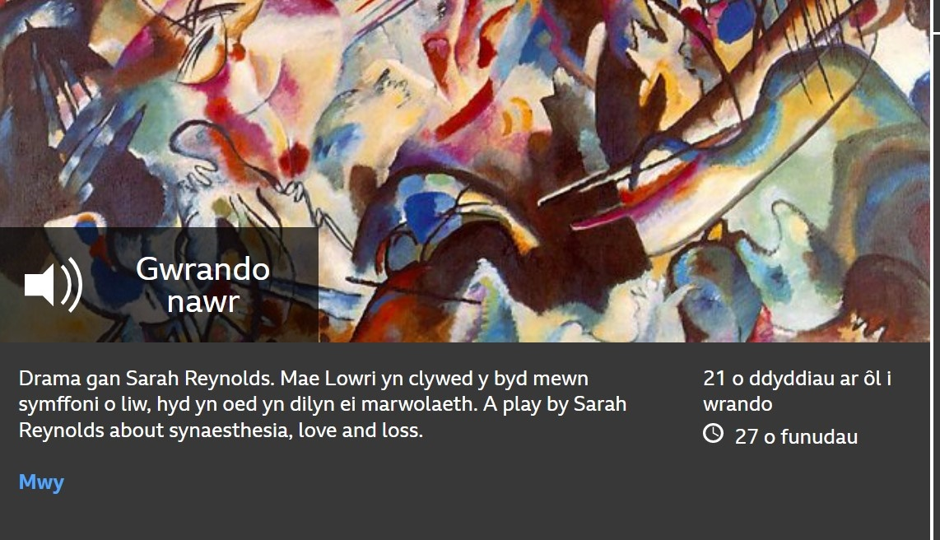
Dr Sarah Reynolds

Slide 3
What is Literature?
Words?

Slide 4
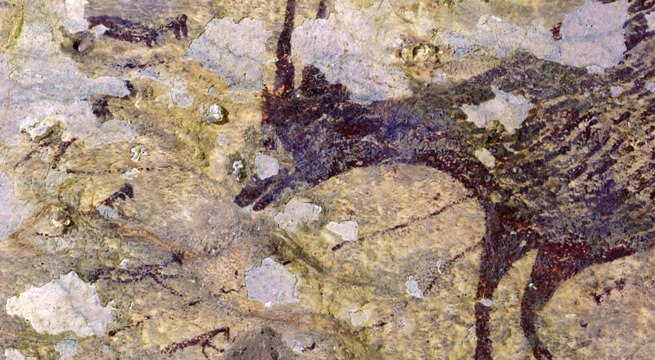
This cave painting found on the Indonesian island of Sulawesi is more than 44,000 years old.
Is this cave-wall depiction of a pig and buffalo hunt the world’s oldest recorded story?

Slide 5
What is Literature?
Words?
Writing?

Slide 6
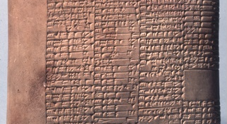
Clay Tablet, 2100–2000 BCE, Southern Iraq.
Record of workers’ wages!

Slide 7
What is Literature?
Words?
Writing?
Narrative?

Slide 8
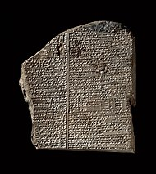
The Epic of Gilgamesh is regarded as the earliest surviving literature and the second oldest religious text, after the Pyramid texts. Carved in stone, the dates back to ancient Mesopatamia, round the 2nd millennium BCE.

Slide 9
What is Literature?
Words?
Writing?
Narrative?

Slide 10
かれ朶に烏のとまりけり秋の暮
Kare’eda ni karasu no tomarikeri aki no kure
Matsuo Bashō, 1689
A black crow
Has settled himself
On a leafless tree
Fall on an autumn day.
Translated by Nobuyuki Yuasa, 1966

Slide 11
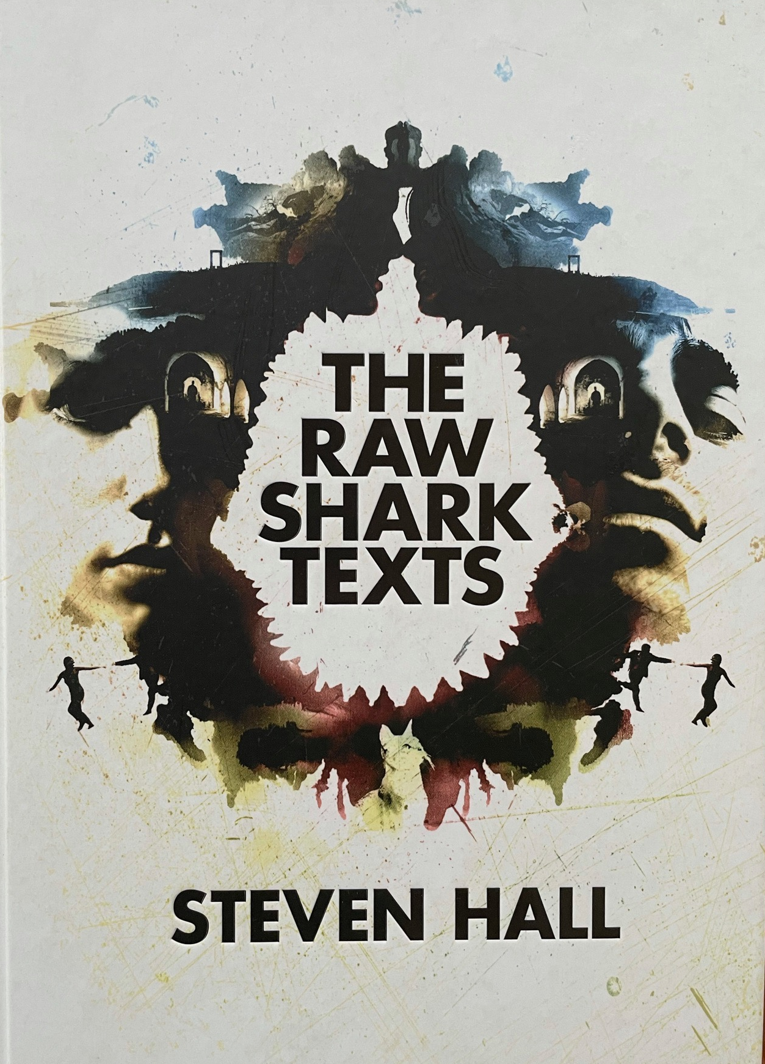
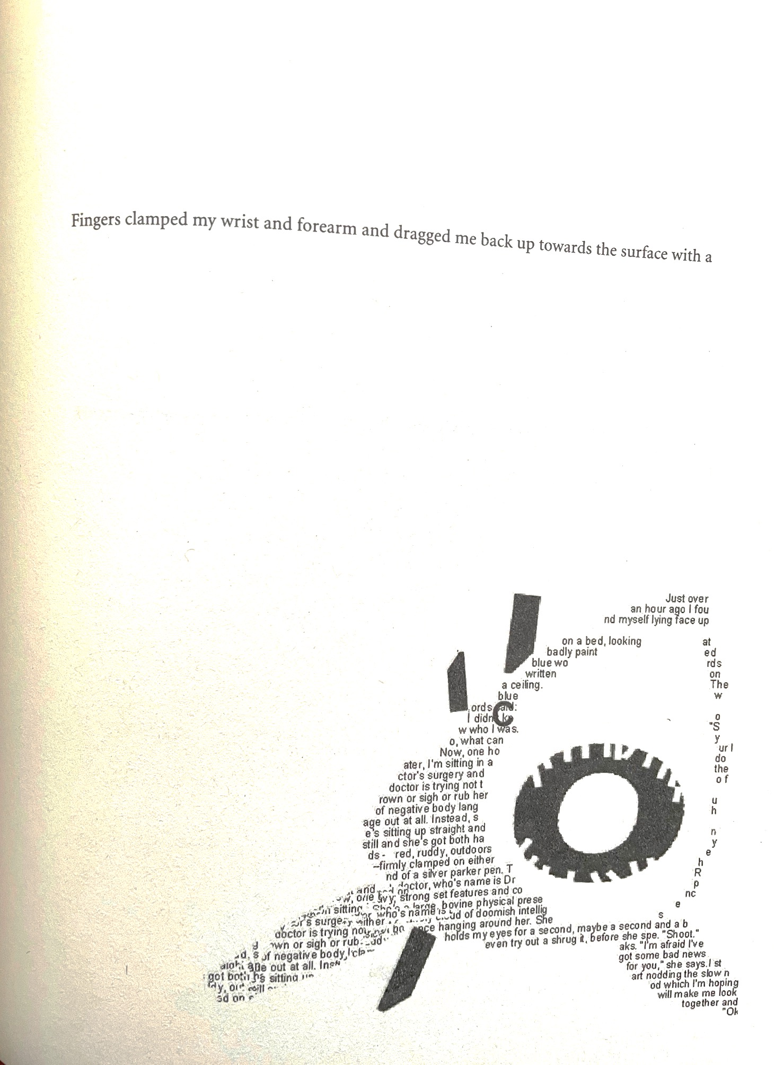

Slide 12
What is Literature?
Words?
Writing?
Narrative?
Communication?

Slide 13
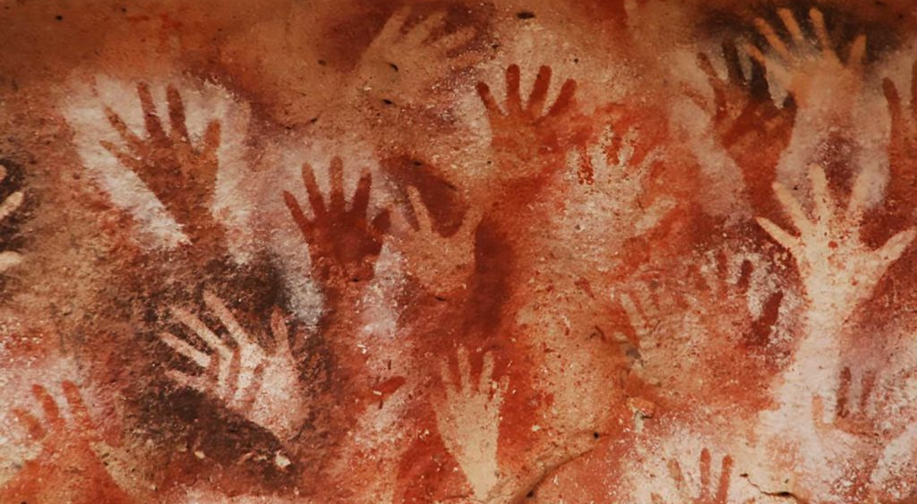
Cueva de las Manos, Santa Cruz, Argentina. The art in the cave dates from 13,000 to 9,000 years ago. Several waves of people occupied the cave, and early artwork has been carbon-dated to about 7300 BCE.

Slide 14
‘Reading a book is like re-writing it for yourself. You bring to a novel, anything you read, all your experience of the world. You bring your history and you read it in your own terms.’
Angela Carter, interviewed in Marxism Today, 1985.

Slide 15

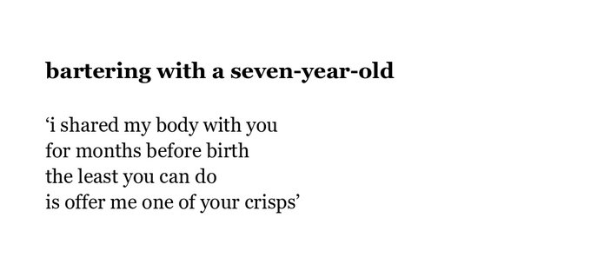

Slide 16
Frame = Form

Slide 17
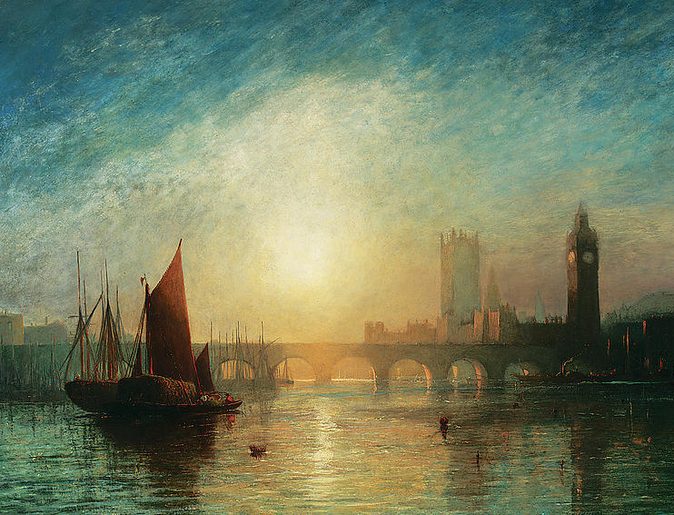
Composed upon Westminster Bridge
September 3, 1802
Earth has not any thing to show more fair:
Dull would he be of soul who could pass by
A sight so touching in its majesty:
This City now doth, like a garment, wear
The beauty of the morning; silent, bare,
Ships, towers, domes, theatres, and temples lie
Open unto the fields, and to the sky;
All bright and glittering in the smokeless air.
Never did sun more beautifully steep
In his first splendour, valley, rock, or hill;
Ne'er saw I, never felt, a calm so deep!
The river glideth at his own sweet will:
Dear God! the very houses seem asleep;
And all that mighty heart is lying still!
William Wordsworth

Slide 18
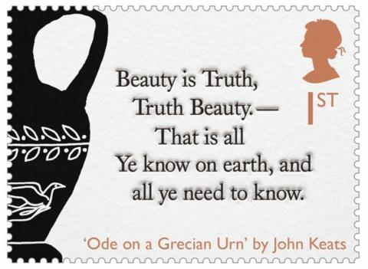

Slide 19
Literature allows us to connect disparate ideas and experiences via metaphor and allegory.
We don’t need to record literal truth to convey an emotional, moral or intellectual truth.

Slide 20
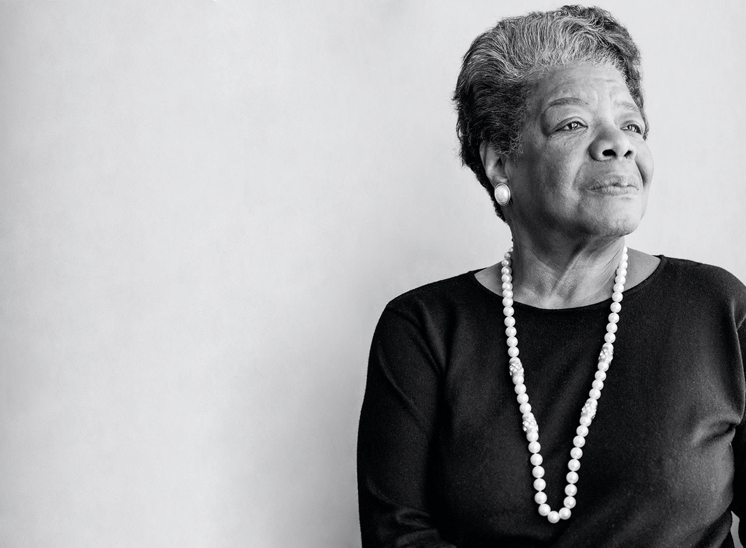
The Lesson
I keep on dying again.
Veins collapse, opening like the
Small fists of sleeping
Children.
Memory of old tombs,
Rotting flesh and worms do
Not convince me against
The Challenge. The years
And cold defeat live deep in
Lines along my face.
They dull my eyes, yet
I keep on dying,
Because I love to live.
Maya Angelou, ‘The Lesson’ in Maya Angelou: The Complete Poetry
(London: Virago, 2015) p.136

Slide 21
Literature allows us to connect disparate ideas and experiences via metaphor and allegory.
We don’t need to record literal truth to convey an emotional, moral or intellectual truth.
“Fiction reveals truth that reality obscures.”
  Ralph Waldo Emerson (1803 –1882)

Slide 22
HOW DO WE ENGAGE WITH LITERATURE?

Slide 23
How do we engage with Literature?
Consciously
Reading closely
Comparatively
Responding creatively

Slide 24
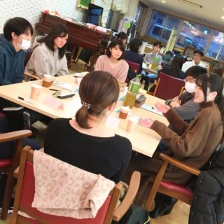

What will you learn in a Creative Writing seminar?
Craft: the techniques and tools of a professional creative writer.
Creativity: how to generate ideas and develop them into pieces of work.
Critique: how to give and receive careful, considered feedback.
Confidence: in a safe, supportive environment, you’ll learn to experiment and take risks with your writing.
Career: how to apply your writing skills to your future career.
CREATIVE WRITING WORKSHOPS

Slide 25
DOES LITERATURE MATTER?
WHY
Literature shows us who we are, who we have been, and who we might become.
Literature offers power: access to ideas, ways of seeing, ways of being in the world.
Literature offers us the joy of connection – of seeing ourselves reflected.
Literature allows us to see through another’s eyes – to imagine another way of being; it teaches us empathy.
Literature helps us make sense of human experience – it can impose order and give us perspective.
Literature matters because human connection matters – when the chips are down, human connection is all that we have.

Slide 26

ANY QUESTIONS?
A137, Arts Building, UWTSD
Lampeter Campus.
Feel free to contact me: s.reynolds@uwtsd.ac.uk

