Slide 1
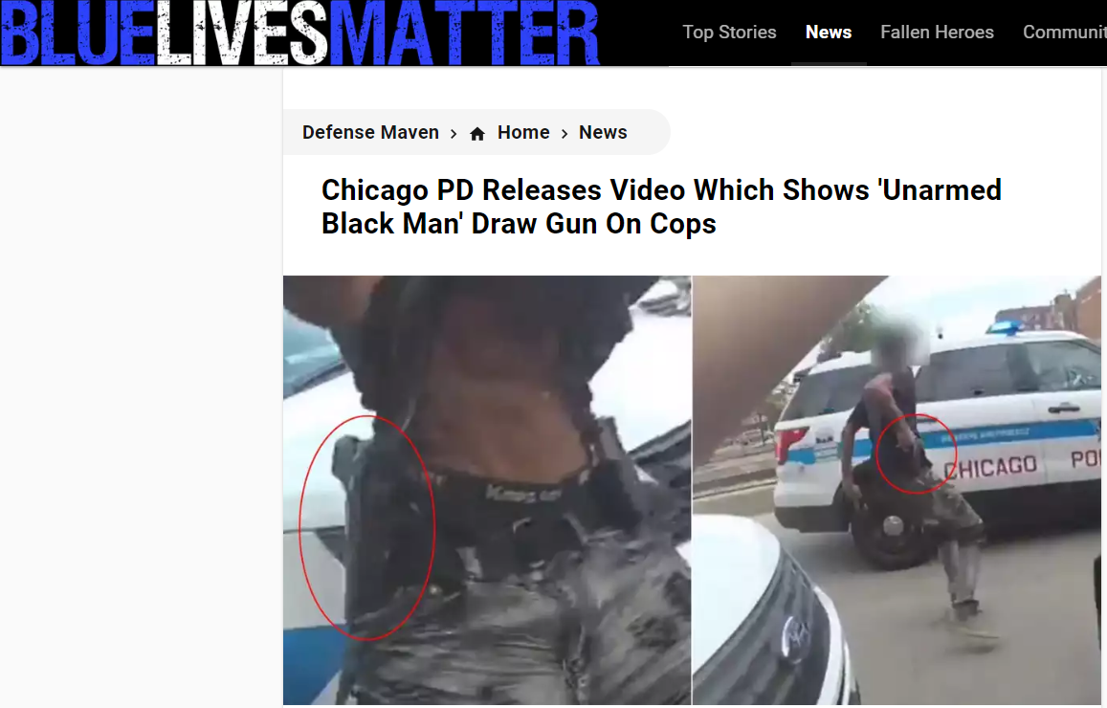
Why cops kill: the psychology of police shootings
Miller (2015)

Slide 2
Demographics
Attitudes
Personalities
The psychology of deadly force encounters
Dealing with armed suspects
Characteristics of shooting incidents
What happens in the minds of officers
Psychological responses and ‘suicide-by-cop’
3 factors to lower incidents of shootings

Slide 3
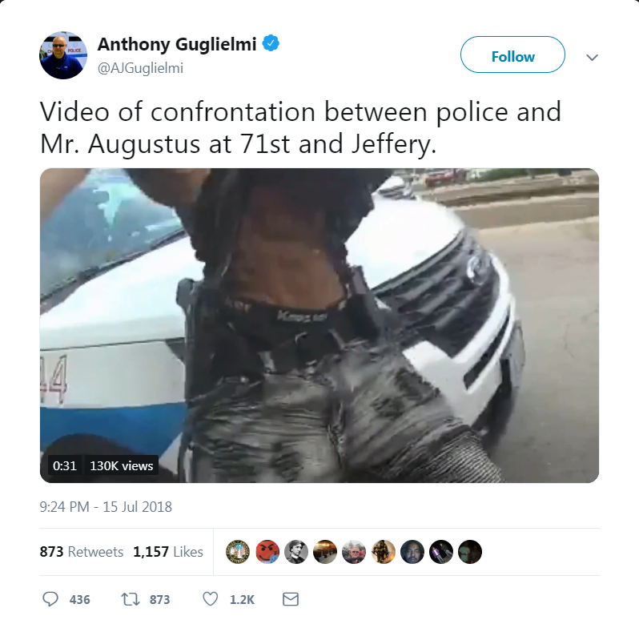
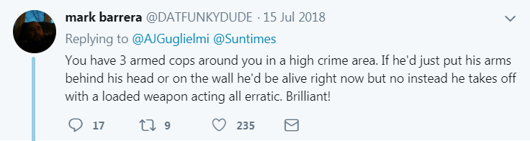
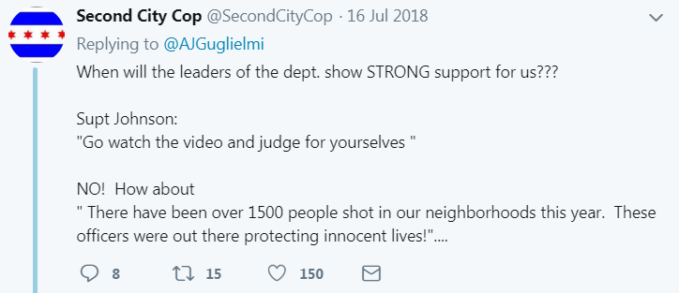
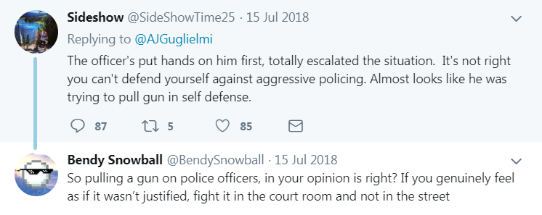

Slide 4
Demographics
Reflecting sex differences in aggressive behaviour in general, male officers are more likely to utilize deadly force than female officers
With regard to officer ethnicity, some studies find that white officers are more likely to shoot suspects of any race than are Hispanic officers
Other studies have reported that black officers are most likely to shoot

Slide 5
Demographics
Regional differences in ethnic composition of both the particular police forces and their served communities
Past history of such shootings is a strong predictor
Not clear if this represents a dispositional propensity of certain officers to more quickly resort to force or whether officers who work in more dangerous patrol areas are statistically more likely to be involved in violent confrontations with citizens
Officers who have completed a college education show a significantly lower likelihood of utilizing force than less-educated officers

Slide 6
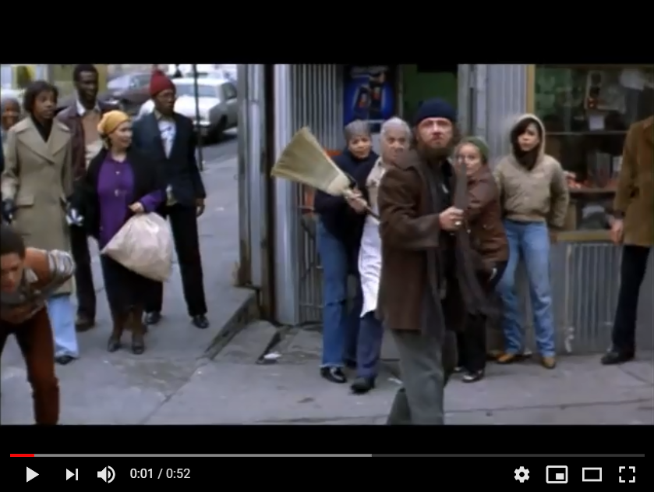
Demographics
Better education = less likelihood of shooting
  Knowledge from further and higher education
  Self-discipline
  Perseverance
  Intelligence
  Verbal skills needed for a higher curriculum
These all translate into a more reasoned and nuanced approach to communication and interpersonal problem solving on patrol.

Slide 7
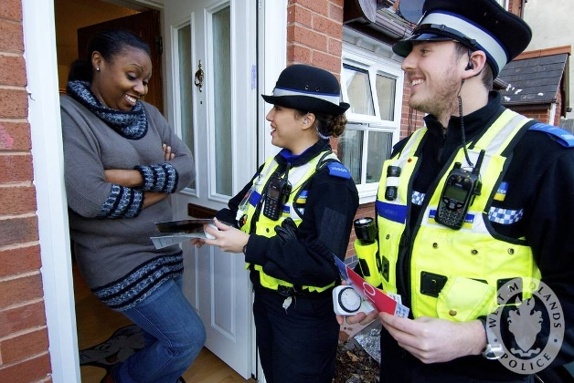
Attitudes
Especially with community policing
Need to earn the trust and cooperation of members of an officer's patrol community through relationship building
A preventive service model of law enforcement
Enforcement-based approach only as a last resort

Slide 8
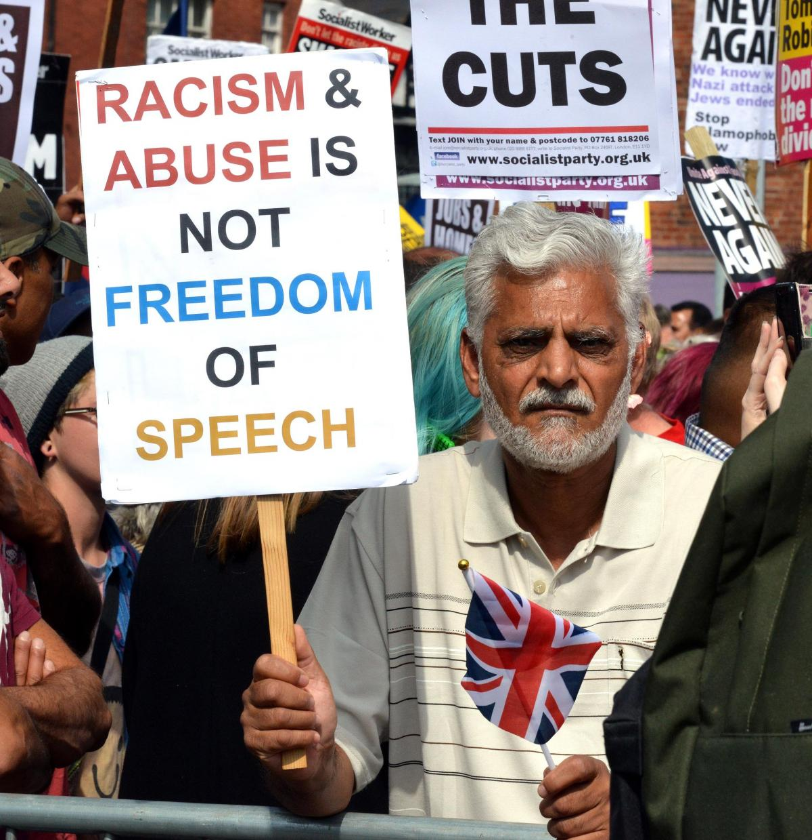
Attitudes
Police officers on the beat know that their jobs frequently put them in the position of dealing with citizens who are in a decidedly uncivil frame of mind
We often have to make people do things they do not want to do, or stop them doing things they think are ok or that they should get away with!
Yet, these officers, who on a daily basis face the public at their worst, are still expected to behave politely and courteously in every interaction with a citizen, from first contact through arrest

Slide 9
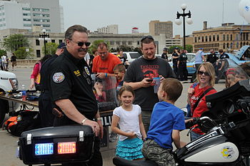
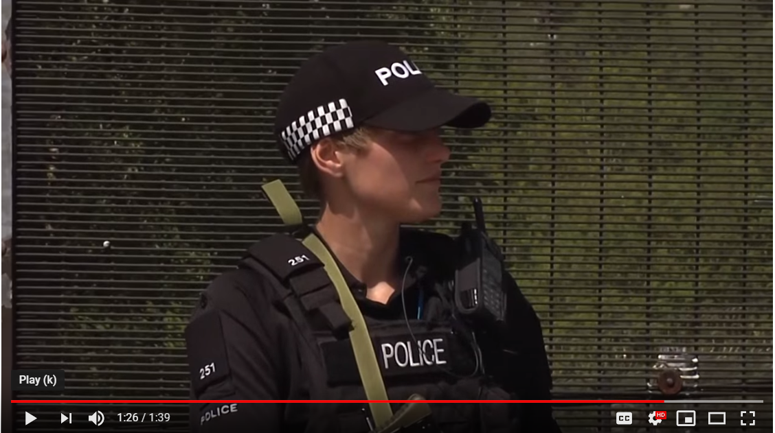
Attitudes
Officers keenly feel this irony and, in response, often develop their own unique patrol styles and attitudes to deal with what they perceive as the realities of patrolling their beats.

Slide 10
Personalities
Diverse backgrounds mean that it is not easy to categorise
Certain personality types among police officers seem to be associated with higher rates of excessive force, including deadly force
“Tough cops” hold the cynical view that people are motivated mainly by selfish impulses, they believe that the citizenry is generally hostile toward police, and they over-identify with the so-called Cop Culture.

Slide 11
Personalities
They conceive of the role of police officers as “keeping the lid on” or “drawing the line,” that is, controlling serious crime.
They also believe that personal experience and common street sense are the best guides to dealing with the realities of daily law enforcement, and that “thumping” or other forms of curbstone justice are sometimes appropriate and effective.

Slide 12
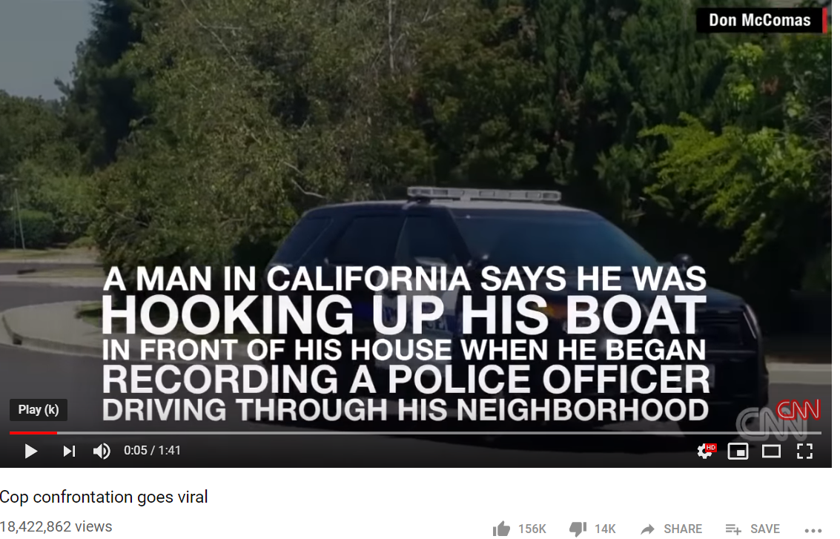
Personalities
Some may suffer from diagnosable personality disorders or other psychopathology that puts them at risk for using excessive force
Typically found to have pervasive, enduring, and extreme personality traits, largely in the antisocial, narcissistic, borderline, and paranoid categories.
Dysfunctional traits, include egocentricity, impulsivity, immaturity, inflexibility, and lack of empathy
Abusive behaviour, especially when they perceive challenges or threats to their authority by citizens
Unlikely to admit fault or learn from their mistakes, and are therefore unlikely to change their policing styles, so they tend to accumulate a disproportionate number of repeated citizen complaints

Slide 13
The psychology of deadly force encounters
Personal attitudes, personality traits, psychological disorders, and/or adverse job experiences can account for a given officer's predisposition to using excessive force,
The tipping point into an actual deadly force encounter inevitably involves the abrupt perception of a situation as life-threatening, and thereby immediately calling for a defensively lethal response
Much of the controversy over police officers using deadly force against supposedly unarmed suspects relates to confusion over precisely those issues of what is defined as mortal danger and what constitutes a proportionate response.

Slide 14
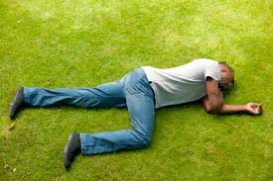
‘Armed’ suspects and ‘deadly’ force
Menace varies in size and shape
Unpredictability: anger, intoxication, delusion
Compliance to adrenalized assailant in a flash
‘An unsecured suspect lying prostrate and spread-eagled on the ground, 10 ft from an officer, head facing away, can be on top of that officer's chest in less than three seconds.’ [101]

Slide 15
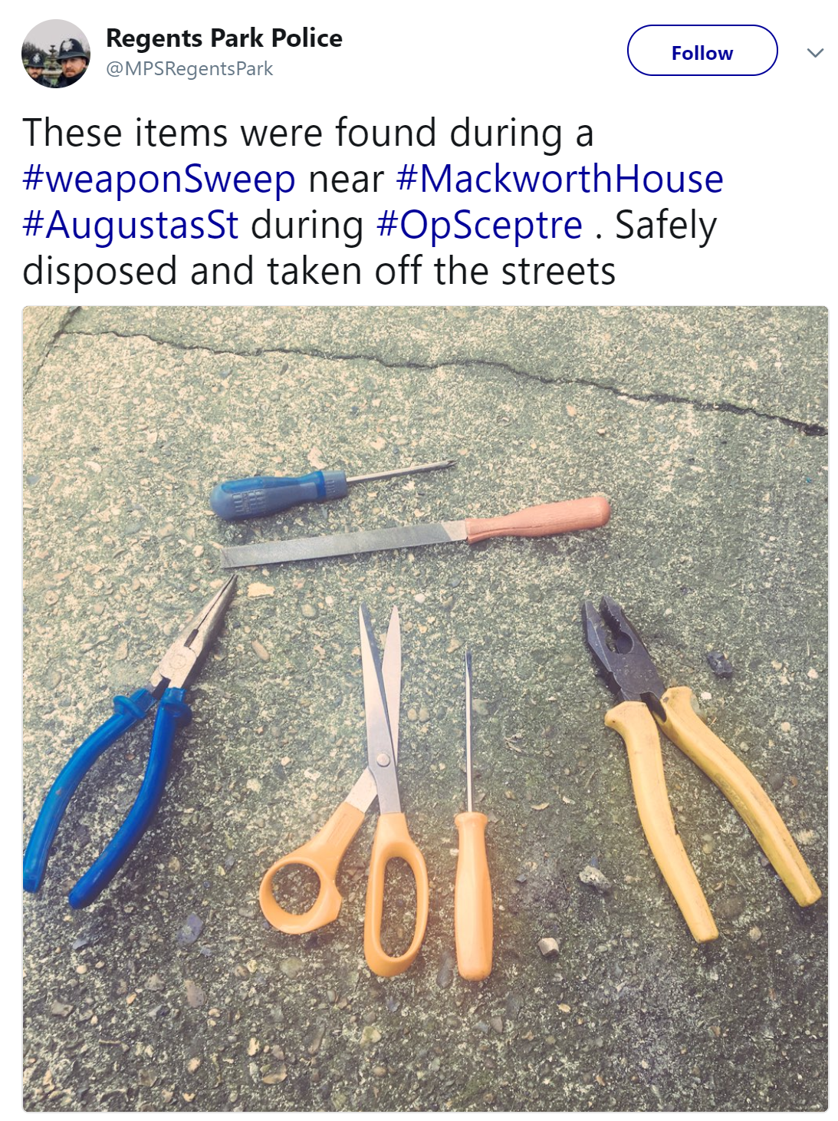
‘Armed’ suspects and ‘deadly’ force
Choked with a bathrobe sash
Brained with a flowerpot
Workshop tools or industrial chemicals hurled at them
Clawed, biting, spitting, punching, choking, urinating etc
Permanent knee damage after being kicked by a man who was literally unarmed (actually, he had one arm).
A hogtied assailant biting

Slide 16
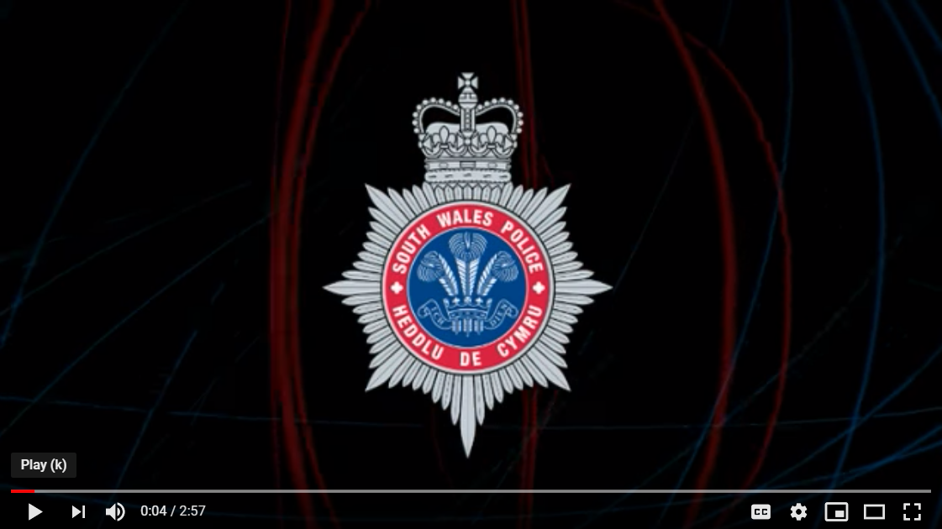
‘Armed’ suspects and ‘deadly’ force
We do not live in the fantasy land of movies
The rule for a deadly force encounters is simple:
  Do not use deadly force unless there is absolutely no choice.
  But once that decision has been made, be sure the force is as deadly as possible, as quickly as possible.
Armed police. Stop or I fire
They do not stop
You fire at the big target

Slide 17
How deadly force encounters evolve
Potential deadly force encounters can begin in a number of ways, but two trajectories are most common.
Almost always, there is an emotional and behavioural build up, an interactional dance that precedes the escalation
Tipping point: at some critical juncture in the verbal exchange, one party says or does something that triggers a behavioural reaction from the other.
Perception as an ‘asshole’ and ‘in contempt of cop’
Officers come to expect compliance

Slide 18
Characteristics of shootings
(1) Abuse of authority escalates to deadly confrontation;
(2) there is a reckless use of deadly force and/or inadequate continuum of force;
(3) there is an attempt to control an agitated or belligerent suspect;
(4) suspect is intoxicated and/or mentally ill;
(5) police retaliate against a suspect for endangering officers or for showing “contempt of cop;”
(6) deadly force is used on a suspect who is already surrendering;
(7) officer draws a gun while handcuffing a suspect;
(8) adrenalin overload occurs following a high-speed chase;

Slide 19
Characteristics of shootings
(9) Split-second syndrome: officers misperceive danger and overreact, e.g., low lighting/bad weather, misidentification of harmless object as weapon, misidentification of innocent citizen for suspect, misidentification of fellow officer or off-duty officer for suspect, officer stumbles, drops flashlight, or prematurely emerges from cover, leading to over reactive use of force by his peers;
(10) contagious fire: one officer fires, then all officers reflexively fire; however, recent research suggests that this happens rarely and that officers generally make their own decisions whether or not to shoot during a deadly force encounter (White & Klinger, 2012);

Slide 20
Characteristics of shootings
(11) failure to prevent an otherwise avoidable suicide by cop (see below);
(12) use of deadly force to prevent a subject's own suicide (i.e., you cannot kill someone just to prevent them from killing themselves);
(13) improper off-duty policies;
(14) improper vehicle operation;
(15) maintaining code of silence in failing to report peers' misconduct;
(16) inadequate training and supervision of officers.

Slide 21
What happens in the mind of officers?
Potentially dangerous scene on patrol
Internal threat radar is engaged
Many use of force encounters escalate gradually, a few erupt explosively, but most officers can clearly recall the instant when they decided to draw their weapon and when they decided to fire.
The brain does extraordinary things to allow its owner to survive

Slide 22
What happens in the mind of officers?
However, officers in a deadly force encounter must do more than survive
Their job descriptions do not give them the luxury of fleeing.
An officer's responsibility is
  To control the scene
  Preserve life and act lawfully in doing so—all in the moments where he or she could be instantly killed.

Slide 23
What happens in the mind of officers?
Most officers describe one or more alterations in perception, thinking, and behaviour that occurred during the event
Natural adaptive defensive reactions of a nervous system that is conserving energy and allocating resources under extreme cognitive and emotional demand.
Sensory distortions: slow-motion, tunnel-vision, tunnel-hearing
Magnification: in one case, an officer recalled that “I could hear the guy's blood drip” (James D. Sewell, FDLE, ret., personal communication).

Slide 24
What happens in the mind of officers?
Officers sometimes report feeling they are on the outside looking in
Freezing a delayed response
Going on ‘automatic’
Vivid ‘flashbulb’ memories
A third report significant distortion so that their recollection differs markedly from that of others present
Memory is selective and reconstructive

Slide 25
Psychological response
Impact phase: relief or exhilaration following a shooting but then guilt or self-recrimination especially in suicide-by-cop or domestic incidents
Recoil phase: officers can seem detached and preoccupied – behavioural autopilot. She wants to put it behind but others badger them constantly. Hyper-sensitivity in response to fellow officer comments and from investigation officers
Resolution phase: the action was necessary and justified. Resolution may be partial rather than total. Overall a successful return to work
Post traumatic phase: worse case where sufficient resolution may never occur. Can impede or completely derail careers. Emotional disconnect between the fantasy (cop shows as kids) and the reality which often involves petty criminals, people with mental health issues, domestic violence escalation, posturing of young teenagers. Less severe cases might see officers able to seek treatment and to get back on an even keel.

Slide 26
Suicide By Cop (SBC)
Perhaps 10% of the 600 police shooting in the USA each year are SBC
People want to die and so provoke the police into deadly force
Officers feel a sense of powerlessness and manipulation, and this is typically reported to be an especially stressful and demoralizing form of shooting trauma.
Strong links to a history of minor crime and mental health issues

Slide 27
SBC reasons
(1) Not wanting to appear weak by committing self-suicide (going out in a “blaze of glory”);
(2) wanting to “send a message” to family members or others who have hurt or betrayed the subject;
(3) fear of incompletion of self-suicide (one bullet to the head might leave me a vegetable, but dozens of police bullets will surely finish the job);
(4) religious proscriptions against self-suicide (if the police kill me, I'm technically not killing myself);

Slide 28
SBC reasons
(5) financial considerations (life insurance policy or relative's will excludes payment for suicide);
(6) Delusional motives (dying for the sins of the world); and
(7) rare cases of suicidal police officers or ex-officers who understand that drawing a weapon on fellow officers will leave them no choice but to return deadly fire

Slide 29
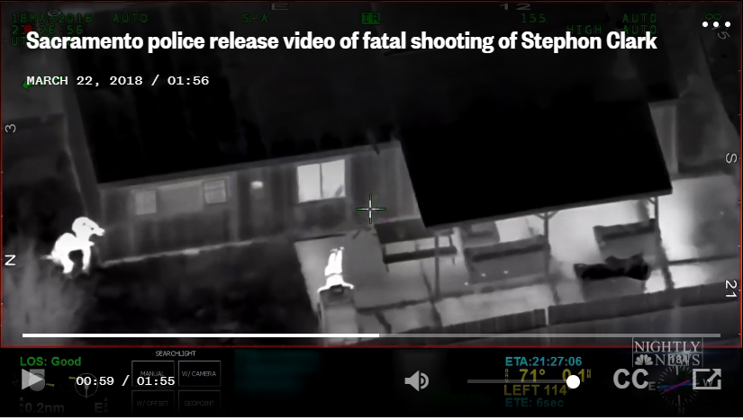
https://www.nbcnews.com/news/us-news/sacramento-police-release-video-fatal-shooting-unarmed-man-n858926?icid=related

Slide 30
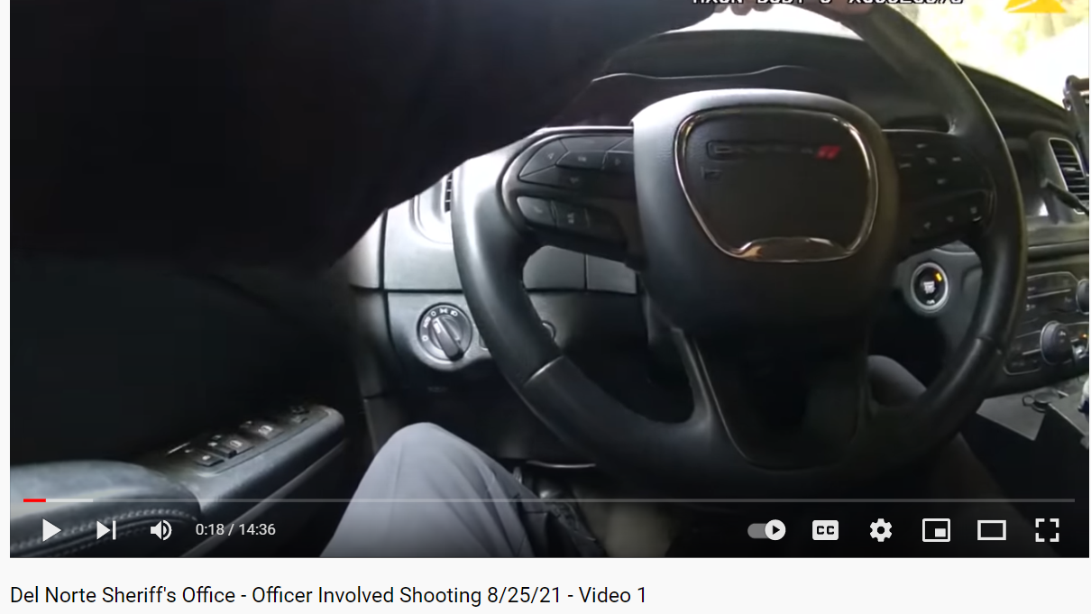
Lethal Force
25.8.21

Slide 31
Warning
The live footage taken by a body worn camera of an officer of Del Norte Sherriff’s Department is harrowing
Do not watch this is you are in any way concerned
As student in higher education you might find yourselves in roles where you have to deal with conflict, up to an including the use of lethal force
This helps us to understand the context

Slide 32
Key questions
Carefully observe the words and actions of officers and the victim
Ask yourself:
  What is the person thinking and feeling?
  What are the officers thinking and feeling?
  Are things said which cause concern?
  Do the officers conduct themselves professionally?
  What would you have done if you were present?
  How do you think and feel throughout?
  Do you notice any biological and emotional changes?

Slide 33

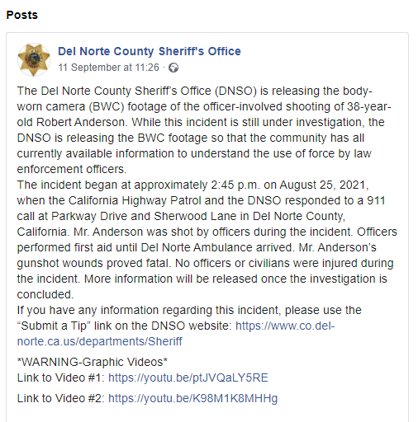
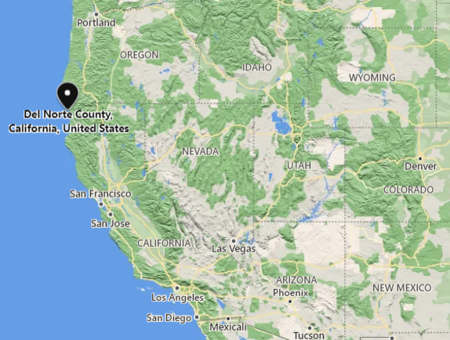

Slide 34
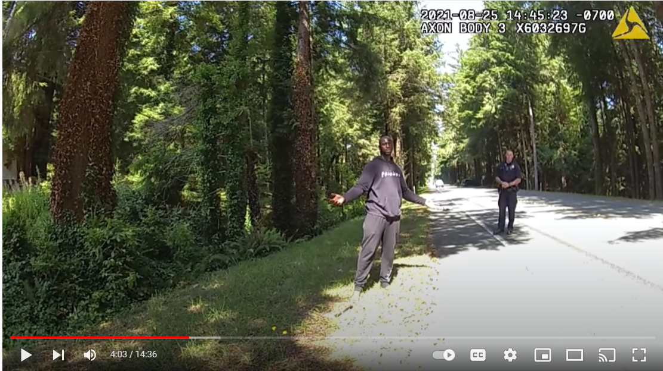

Slide 35
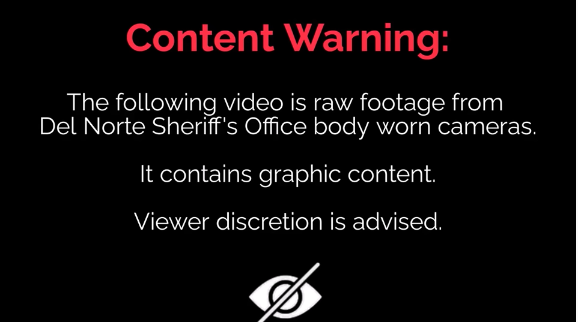

Slide 36
3 factors for lower police shootings
All things being equal, three factors have been found to be associated with lower rates of police deadly force encounters in a community:
Higher overall educational level of the rank and file patrol force;
Higher investment in mental health response and verbal crisis intervention training; and
Greater efforts at police–community relationship building.

Slide 37
Level 6 qualifications?
Compared to less-educated police, officers who complete a college degree:
  sustain fewer on-the-job injuries
  take fewer sick days
  endorse higher ethical standards
  are less authoritarian and more communicative in their policing styles
  garner fewer citizen complaints
  and receive more favourable ratings from both their department and their communities

Slide 38
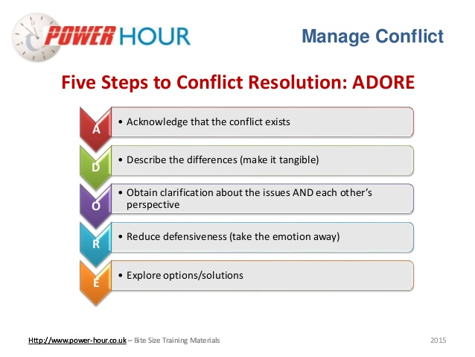
Law enforcement education and training
The most successful diplomats, combat soldiers, and trial lawyers have developed the ability to control their temper, words, and behaviour under stressful and confrontational conditions
Conflict management training enhances officers' communication skills as the primary tools for controlling potentially violent citizens

Slide 39
Law enforcement education and training
The most effective conflict resolution and negotiation training programs teach officers through role playing how to control a potentially violent encounter - defuse, deflect, and delay

Slide 40
References
Miller L (2015) Why cops kill: The psychology of police deadly force encounters, Aggressive and Violent Behaviour 22 (2015) 97-115

