Slide 1

Marketing, SALES AND CONSUMER BEHAVIOUR
BMBS5002
Segmentation, Targeting and Positioning
Gwyneth jones
SEPTEMBER 2026

Slide 2
Today’s Lecture
Lecture Topics:
Segmentation, Targeting and Positioning
Positioning Mapping
Assignment Tasks:
This relates to Assignment 1, Section 1

Slide 3

Group Discussion
In marketing what do we mean when we refer to ‘a market’?

Slide 4
Definition
“A market is the set of all actual and potential buyers of a product or service.”
Philip Kotler, Principles of Marketing (2025)

Slide 5

What is segmentation?

Slide 6
Definition
Segmentation involves dividing a market of potential customers into groups, or segments, based on different characteristics.

Slide 7
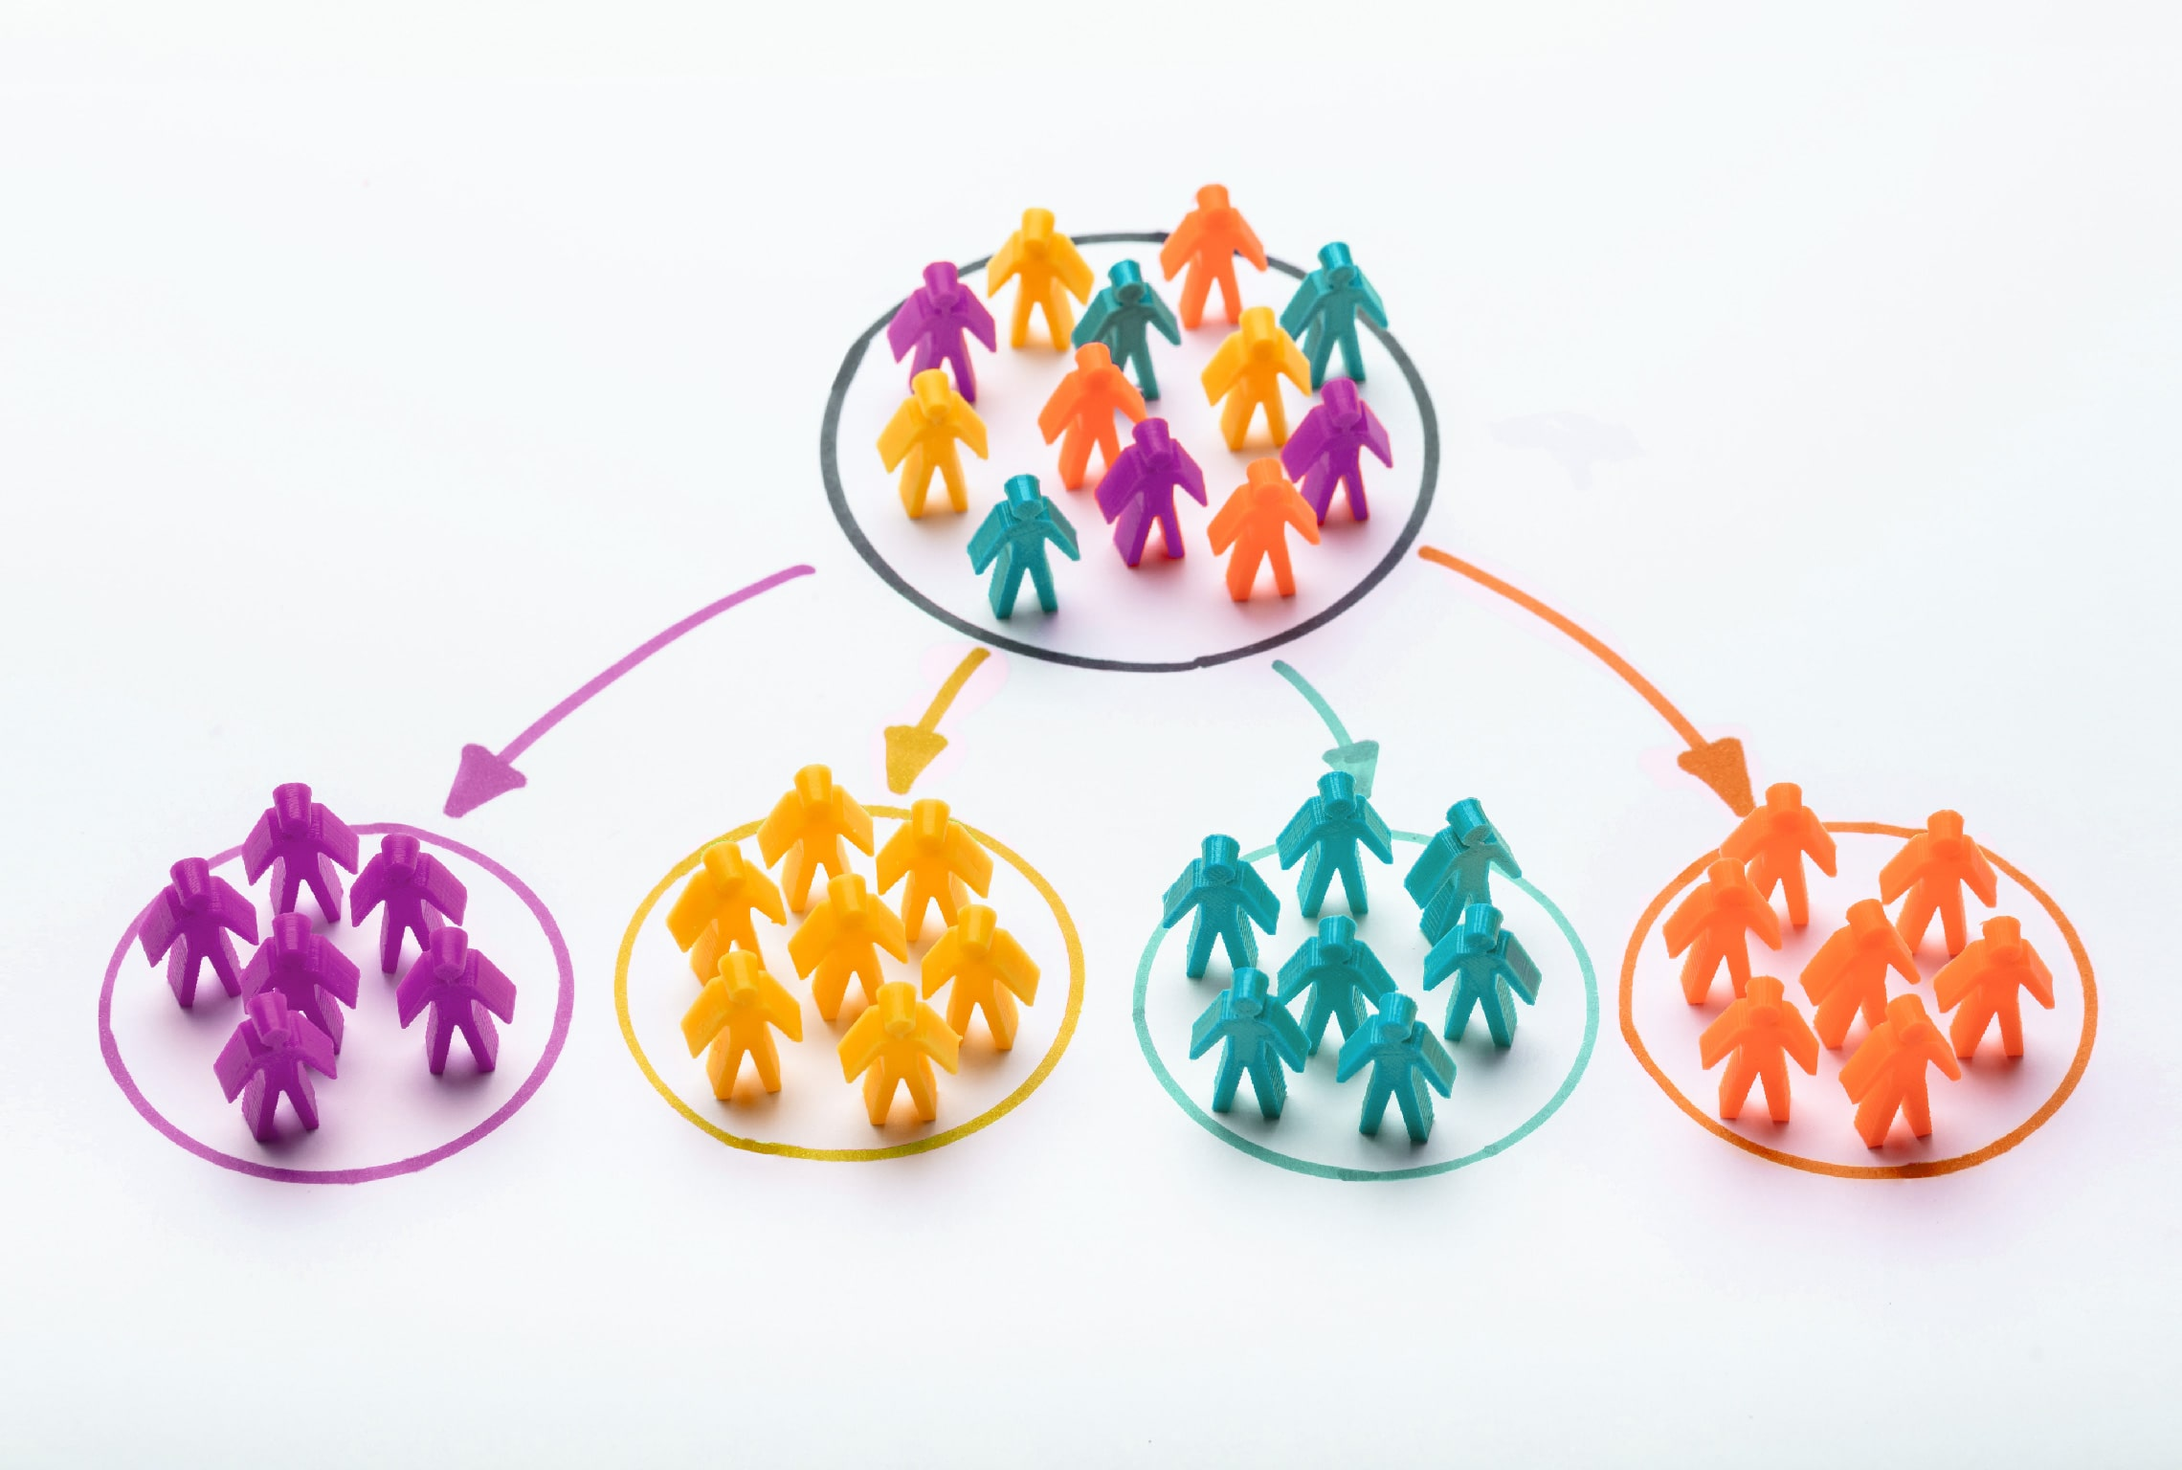
Class Discussion
Why do you think marketers would segment customers?

Slide 8
Market Segmentation
Involves the division of a diverse market into a number of smaller submarkets that have common features.
The objective is to identify groups of potential customers with similar requirements.
Market segmentation provides a commercially viable method of serving customer needs.
Segmentation is at the heart of strategic marketing.

Slide 9
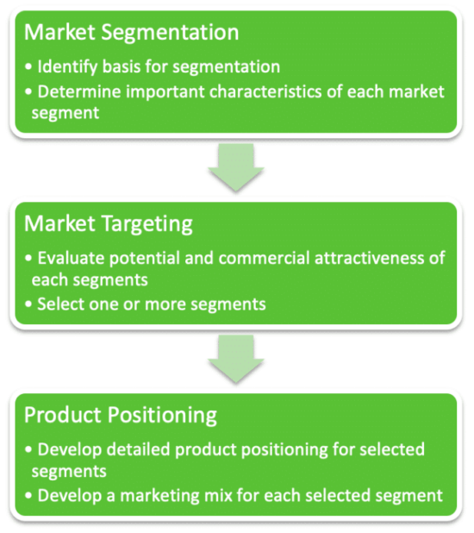
STP Strategy
Segmentation is the first stage of a segmentation, targeting and positioning strategy.

Slide 10
Stages of stp process
Identify the total market
Key steps in the Segmentation, Targeting and Positioning (STP) Process
Identify market segments
Select target market segment(s)
Establish competitors’ positions
Establish own position

Slide 11
Segmentation
The segmentation concept was first developed by Smith (1957) and is concerned with grouping consumers in terms of their needs and behaviour, that can be addressed through marketing activities.
Market segmentation involves dividing a market into smaller segments of buyers with distinct needs, characteristics, or behaviours that might require separate marketing strategies or mixes.
It allows an organisation to concentrate their marketing efforts most effectively and economically.

Slide 12

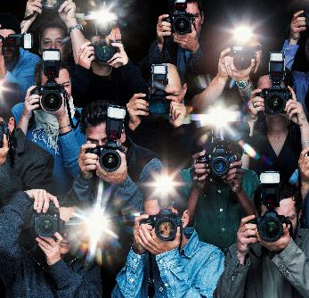


The underlying Assumptions for Segmentation
Not all buyers are alike
Groups of people with similar behaviour, backgrounds, values and needs can be identified
The groups will be smaller and more homogeneous than the market as a whole
It is easier to satisfy a small group of similar customers than to try and to satisfy large groups of dissimilar customers

Slide 13

Market Segmentation selection criteria
Criteria | Description
Measurable | Able to identify size, profiles, and purchasing power of your segment
Accessible | Able to reach your market segment effectively
Effective | Should consist of customers whose needs are relatively homogenous, but significantly different from those in other segments
Profitable | Should be large enough and have enough purchasing power to justify the cost of trying to reach them
Actionable | Company must have the resources necessary to exploit the opportunities identified through your segmentation scheme International markets may be a profitable segment but require considerable resources and knowledge…

Slide 14
1. Major Segmentation Variables
Geographic
Demographic
Psycho-graphic (also known as attitudinal)
Behavioural

Slide 15

Geographic Segmentation
Dividing a market into smaller groups based on geographic criteria, such as countries, region, city, climate, or population density.
This type of customer segmentation allows marketers to tailor their products, communication, and distribution strategies to the specific needs and preferences of customers in different geographic locations.
Allows companies to adapt marketing and focus marketing efforts on the most profitable geographic segments to maximise their return on investment (ROI) and improve their overall financial performance.
Notes:
.

Slide 16
DEMOgraphic Segmentation
Dividing a market into distinct groups based on shared characteristics such as age, gender, income, education, and family size.
By using demographic information to understand customers better, companies can offer products and services that are relevant to the specific needs and preferences of different customer groups and create marketing campaigns that are specifically designed to reach and engage the desired demographic groups.
Notes:
.

Slide 17
Demographic Segmentation
Age
Gender
Family Size
Family Life Cycle
Income
Occupation
Education
Religion
Race
Generation
Nationality

Slide 18
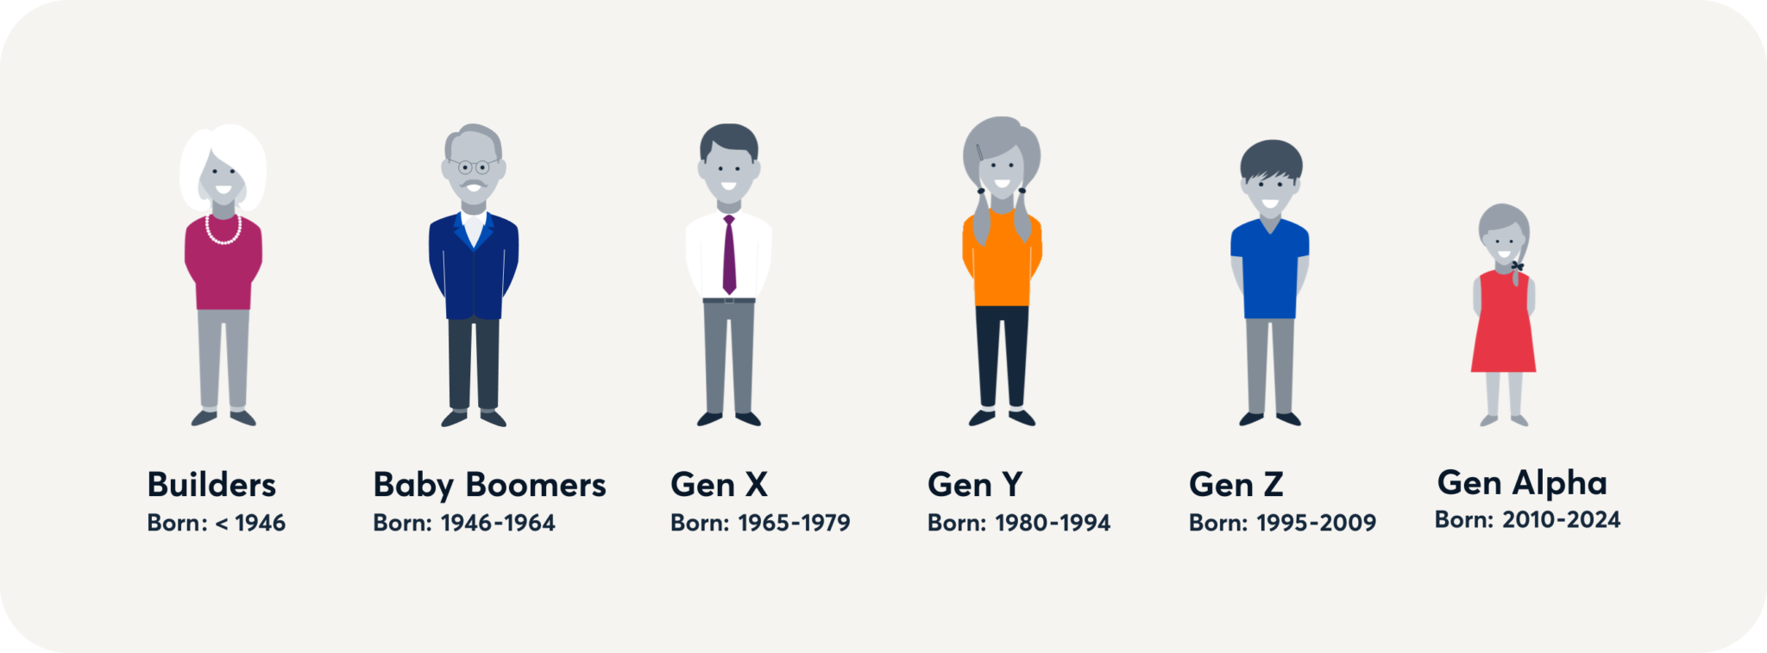
Example: Demographic Segmentation by age

Slide 19
PSYCHOgraphic Segmentation (attitudinal)
Dividing a market based on shared psychological traits, such as their values, beliefs, lifestyle, interests, and personality.
  Values and Beliefs: What a person considers right, important, or ethical.
  Lifestyle: How people spend their time and daily routines.
  Interests and Opinions: Hobbies, political views, or preferences.
  Personality Traits: Characteristics like being adventurous, or cautious
Notes:
.

Slide 20
Psychographic Segmentation
Values
Lifestyle
Personality
Notes:
Dividing your market based on different personality traits, values, attitudes, interests and lifestyle.
Perceptual

Slide 21
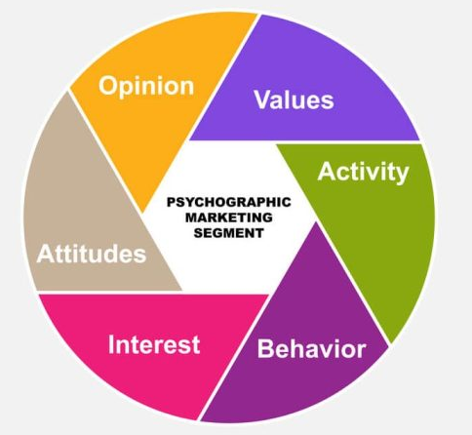
Psychographic Segmentation
Examples of Psychographic Segmentation:
Health conscious consumers
Eco-friendly consumers
Ethical consumes
Food enthusiasts (foodies)
Fitness enthusiasts
Vegans
Technical enthusiasts
Gamers
DIY enthusiasts
Can you think of any more examples?
Notes:
Dividing your market based on different personality traits, values, attitudes, interests and lifestyle.
Perceptual

Slide 22
Behavioural Segmentation
Divides markets based on how people act:
  Consumer knowledge
  Attitudes
  Uses
  Responses to a product
Occasions
Benefits sought
User Status
Usage Rate
Loyalty Status
Notes:
Benefit segmentation requires finding the major benefits people look for in the product class, the kinds of people who look for each benefit, and the major brands that deliver each benefit.

Slide 23
Activity
In groups of 3 or 4 students discuss how either a clothing retailer or car manufacturer could use each of the segmentation criteria to identify different market needs?
How could they adapt their products and services to meet the needs of different segments?
Feed back to the class.

Slide 24

Selecting Target Market Segments
The second step where a business evaluates the customer groups found during market segmentation and selects which specific group or groups to serve - The Target Market(s)

Slide 25
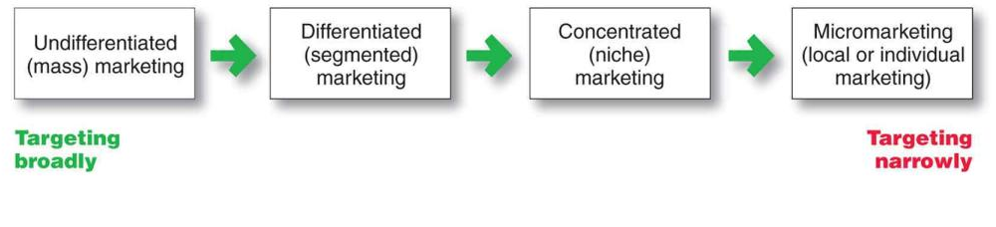
Targeting approaches
Undifferentiated (Mass): Treating the whole market the same with one offer.
Differentiated: Focusing on multiple segments with a unique plan for each.
Concentrated (Niche): Focusing on one specific group.
Personalised: Using data to target individual buyers with customised offerings
Notes:
.

Slide 26
Evaluating a segment for targeting:
Sufficient current and potential sales/profits?
Potential for sufficient future growth?
Not over-competitive?
No excessive barriers to entry or exit?
Unsatisfied needs that the company can serve well?
Notes:
What might you consider? ASK FIRST

Slide 27
Activity
In groups of 3 or 4 students discuss examples of companies you are familiar with.
  Who is their target market?
  Do they use differentiated or focussed targeting?
  What key competitors do they have?

Slide 28
3. Positioning
Positioning is the final step where you define how your target audience should perceive your product or brand relative to competitors also targeting the same segment.
Differentiation:
    Distinguishing a product or service from other competitors, to make it more attractive to a particular target market.
Positioning:
    The consumer's perception of a brand or product in relation to competing brands or products.
Notes:
A product’s position is the way the product is defined by consumers on important attributes – the place the product occupies in the consumer’s mind relative to competing products

Slide 29
positioning
Positioning is the process whereby information about the organisation and its product is communicated in such a way that the object is perceived by the consumer/stakeholder to be differentiated from the competition, to occupy a particular space in the market.
Chris Fill (2022)
Positioning is concerned with the brand’s relationship with other brands aimed at the same segment.
It is about the place the brand occupies in the minds of the consumers, relative to other brands.
Positioning is the act of designing the company’s offering and image so that they occupy a meaningful and distinct competitive position in the target customer’s minds.
Kotler (2023)

Slide 30
Differentiation and Positioning:
Choosing a Strategy
Identifying a set of differentiating competitive advantages
Choosing the right competitive advantages
Selecting an overall positioning strategy – using the 7Ps

Slide 31
Positioning strategies
  Benefit
  Heritage/Cultural symbol
  Product features
  Price
  Quality
  Use

Slide 32
Buyers’ perceptions
Positioning is about how customers perceive the product
  In terms of product attributes
  In terms of the benefits it conveys
  In relation to competitor products
  In relation to substitute products
Notes:
The organisation may wish to be perceived in a certain way, but if customer perceptions are different, there is a gap
Marketing communications can attempt to bridge that gap by changing customer perceptions

Slide 33
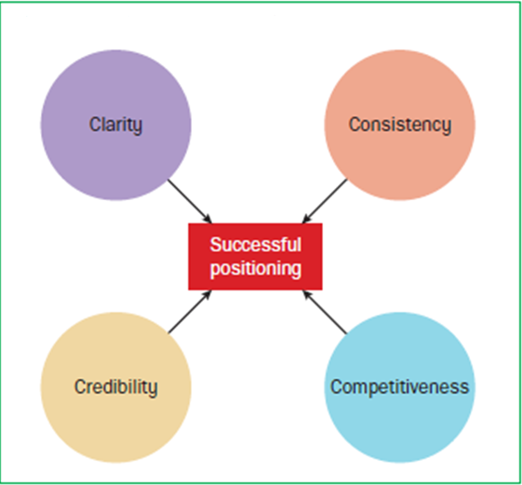
Developing a Positioning Strategy
Keys to Successful Positioning
Deciding what position to occupy in the market requires consideration of three variables:
  The customers – what attributes matter to them
  The competitors – a differential advantage that ideally cannot be easily matched
  The company – unique sustainable attributes

Slide 34
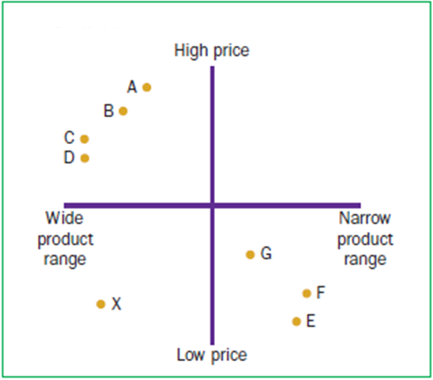
The Perceptual Map
A Perceptual Map of Supermarkets
The perceptual map is a useful tool for determining the position of a brand in the marketplace
The key steps in producing a perceptual map are:
  Identify a set of competing brands
  Identify important attributes consumers use when choosing between brands
  Conduct quantitative marketing research where consumers score each brand on all key attributes
  Plot brands on a two-dimensional map

Slide 35
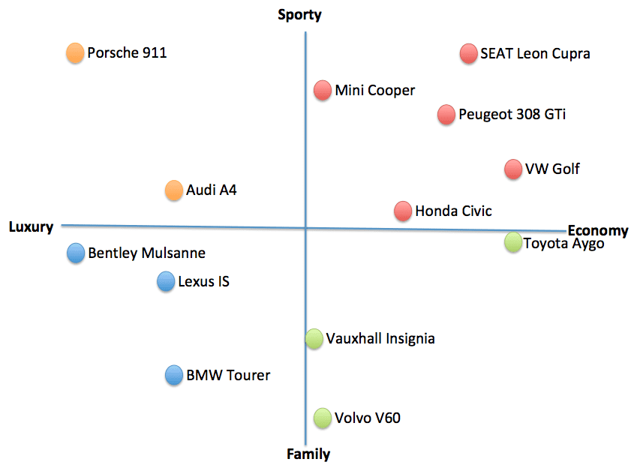
Positioning map – uk car market

Slide 36
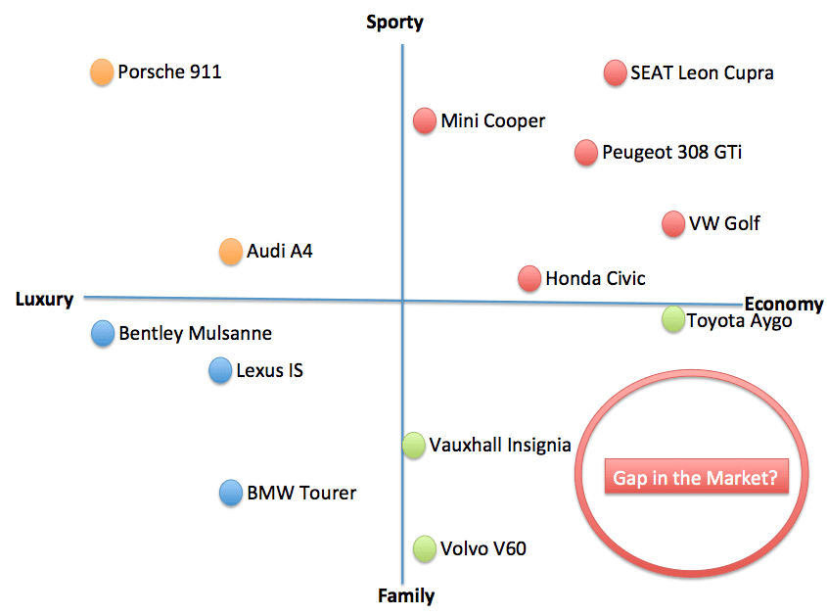
Positioning map – uk car market

Slide 37
Activity
In groups of 3 or 4 students using one of the companies from the previous exercise
  Select two key differentiating factors
  Plot the companies on a positioning map
  Discuss whether your company have a clearly differentiated market position.

Slide 38


Market segmentation – example of gymshark
Two Teachers
https://youtu.be/ZUOCx1iO8gI

Slide 39
Benefits of segmentation, targeting, positioning (STP) process
Enhancing a company’s competitive position, providing direction and focus for marketing strategies, including targeted advertising, new proposition development, and brand differentiation
Examining and identifying market growth opportunities through identification of new customers, growth segments, or proposition uses
Effective and efficient matching of company resources to targeted market segments, promising greater return on marketing investment (ROMI)

Slide 40
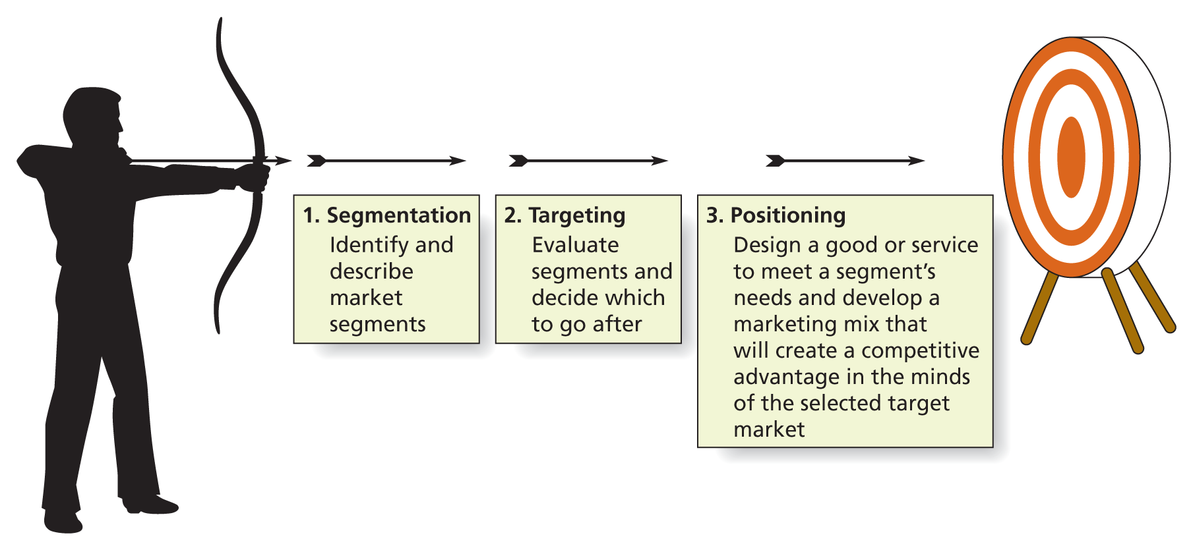
Remember….
Source: Solomon et al Marketing: real people, real decisions 2nd Ed 2014

Slide 41
Summary:
Segmentation
Targeting
Positioning
Questions?

