Slide 1
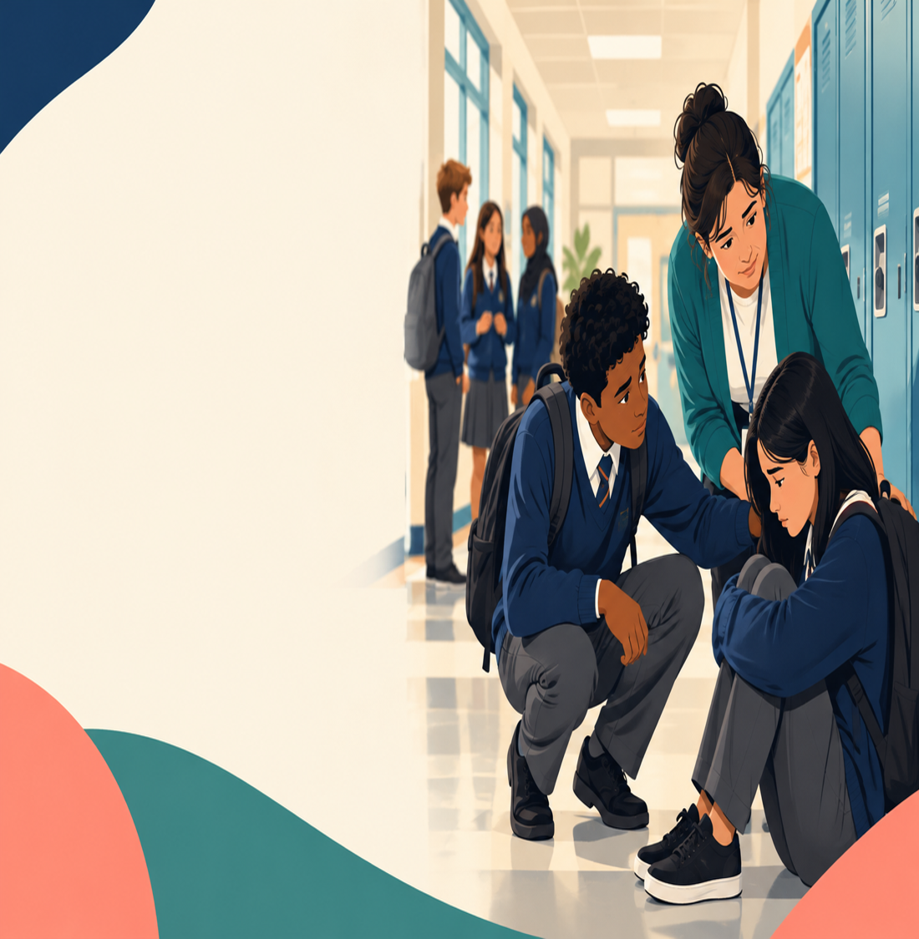
Educational Policy & Practice
Bullying and Peer Conflict in School: Policy, Impact, and Evaluation
Student Name: Mahmuda Akter Sonia
Module : ECDE 7017

Slide 2


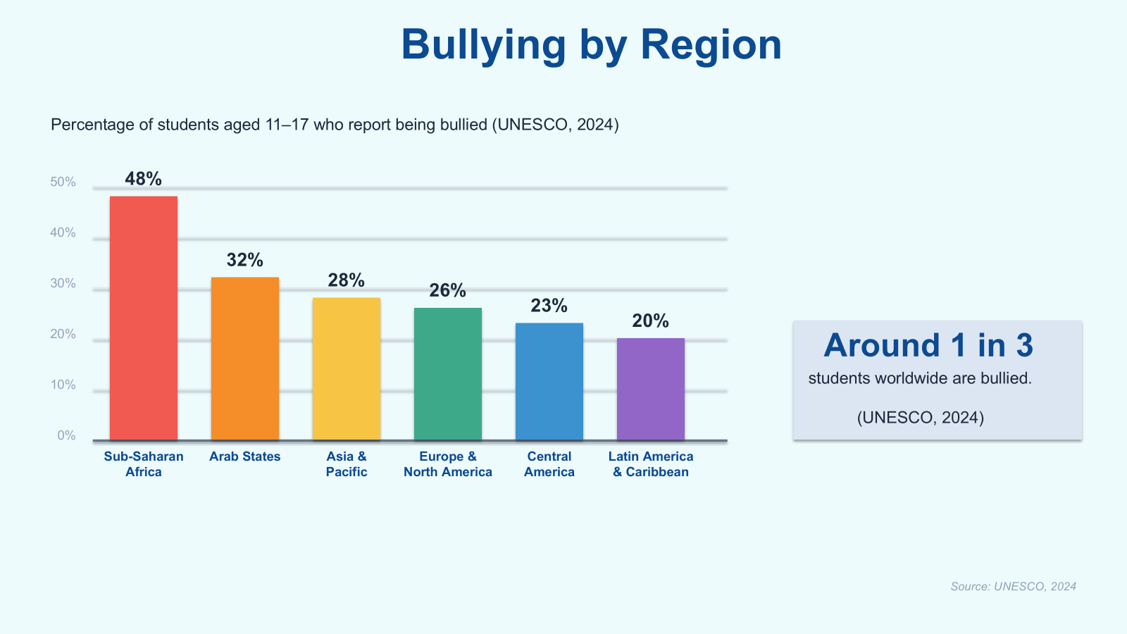

What Is the Issue? Global
Safer schools.
Brighter futures.
Globally.
BULLYING
Repeated harm + power imbalance
Physical . Verbal . Relational . Cyber
1 in 3 students worldwide bullied (UNESCO)
Highest: Sub-Saharan Africa ~48%
Lowest: Central America ~23%
Aim
Compare national policies -> evaluate impacts on children & schools -> identify transferable lessons & gaps.
Cyberbullying: rising everywhere
GLOBAL PREVALENCE:

Slide 3
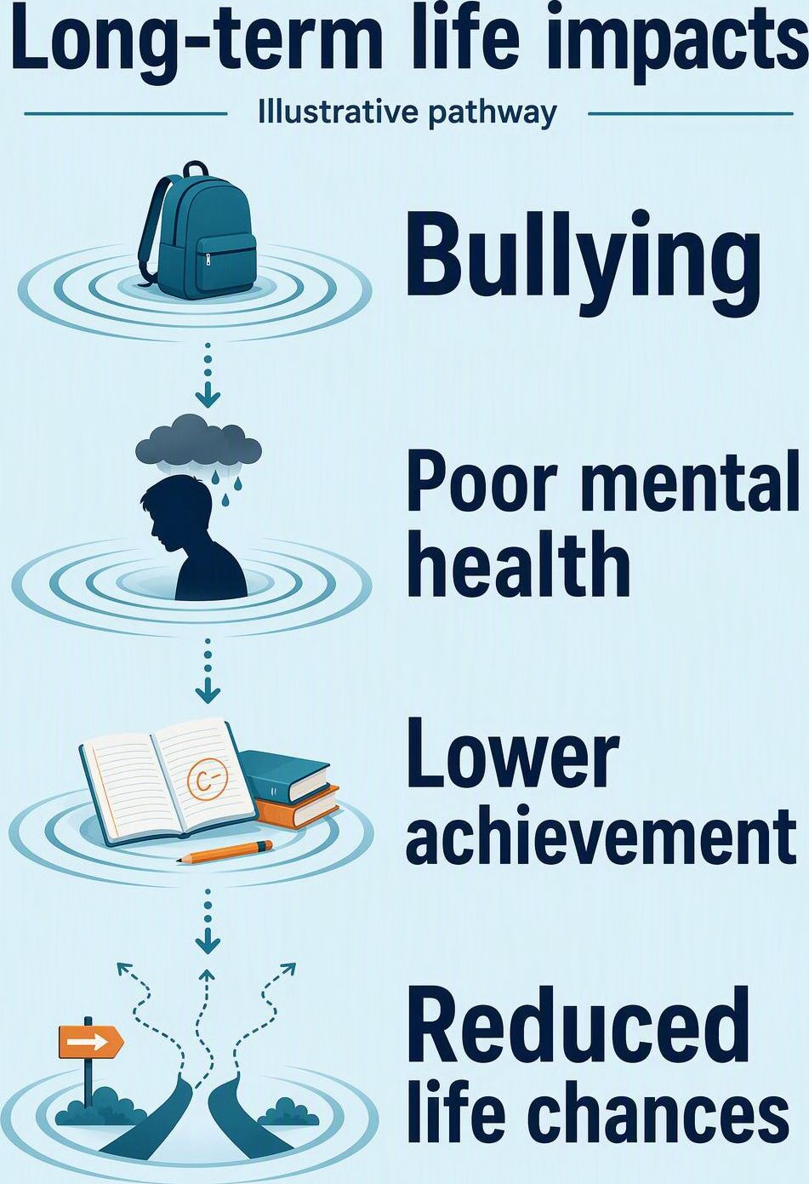
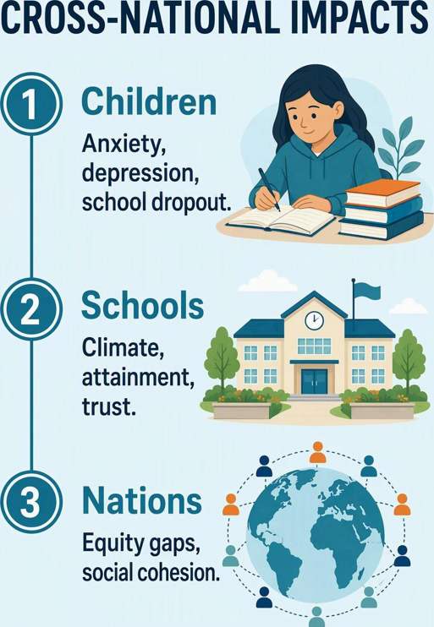
Why International Perspective Matters
Universal impact but varied responses
Sharing good practice avoids
Reinventing the wheel
Global goals: UN SDG 4 Safe, inclusive education for all
Focus: Children & Young People + Schools
Notes:
Content and UNESCO / UN 2024 attribution supplied by the user. No specific publication was provided. The AI-generated infographic illustrates the supplied possible pathway from bullying through poor mental health and lower achievement to reduced life chances. It is not an official UNESCO or UN graphic and does not imply an inevitable outcome for every child.

Slide 4
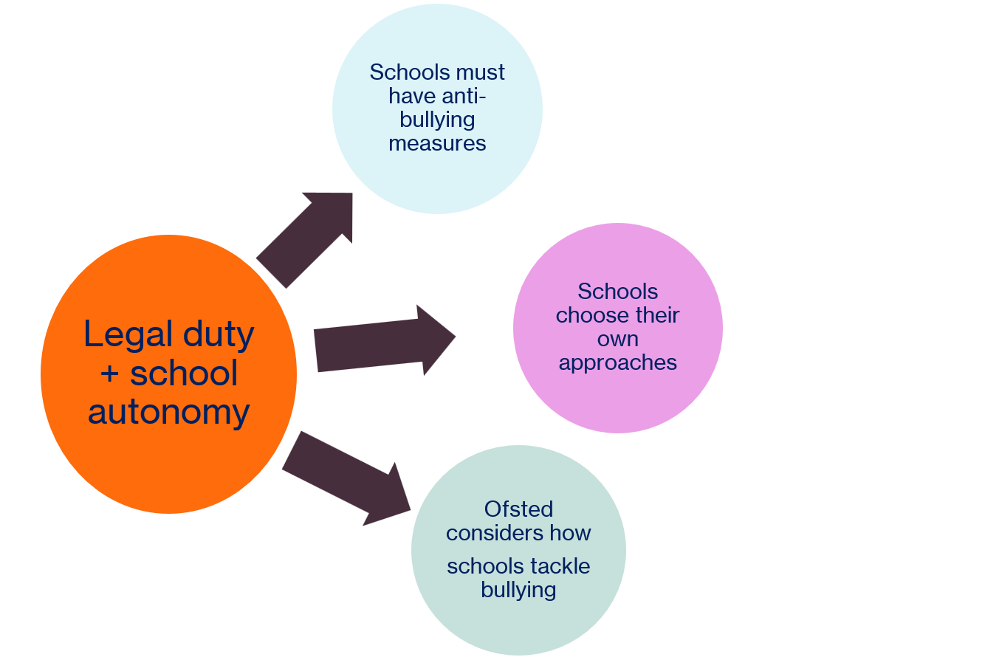
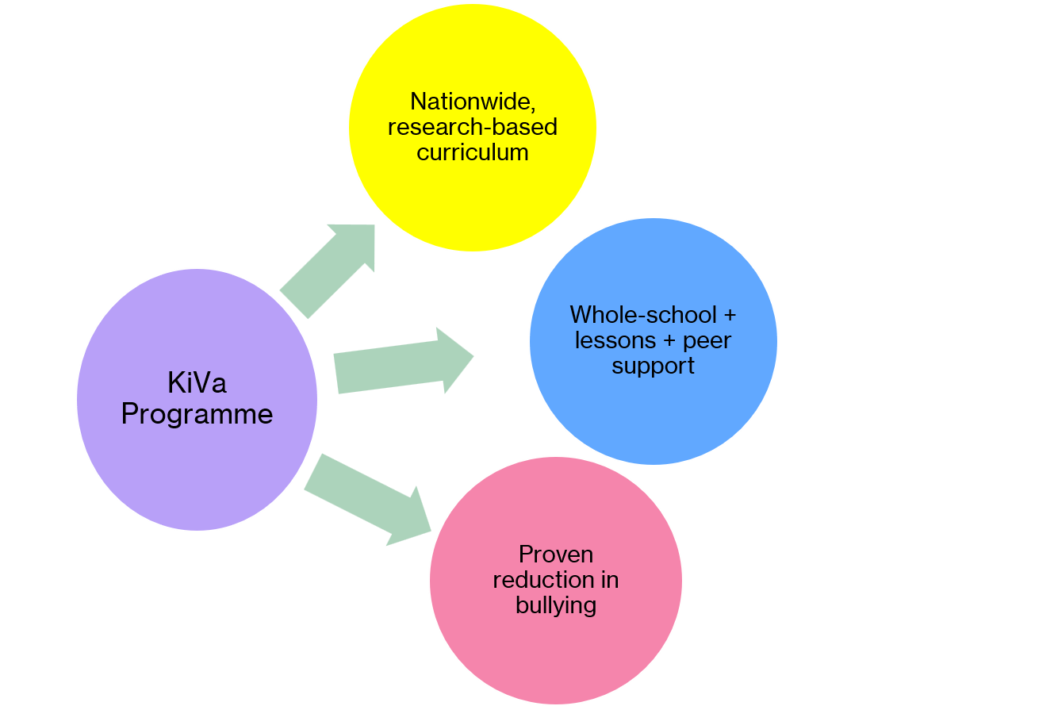
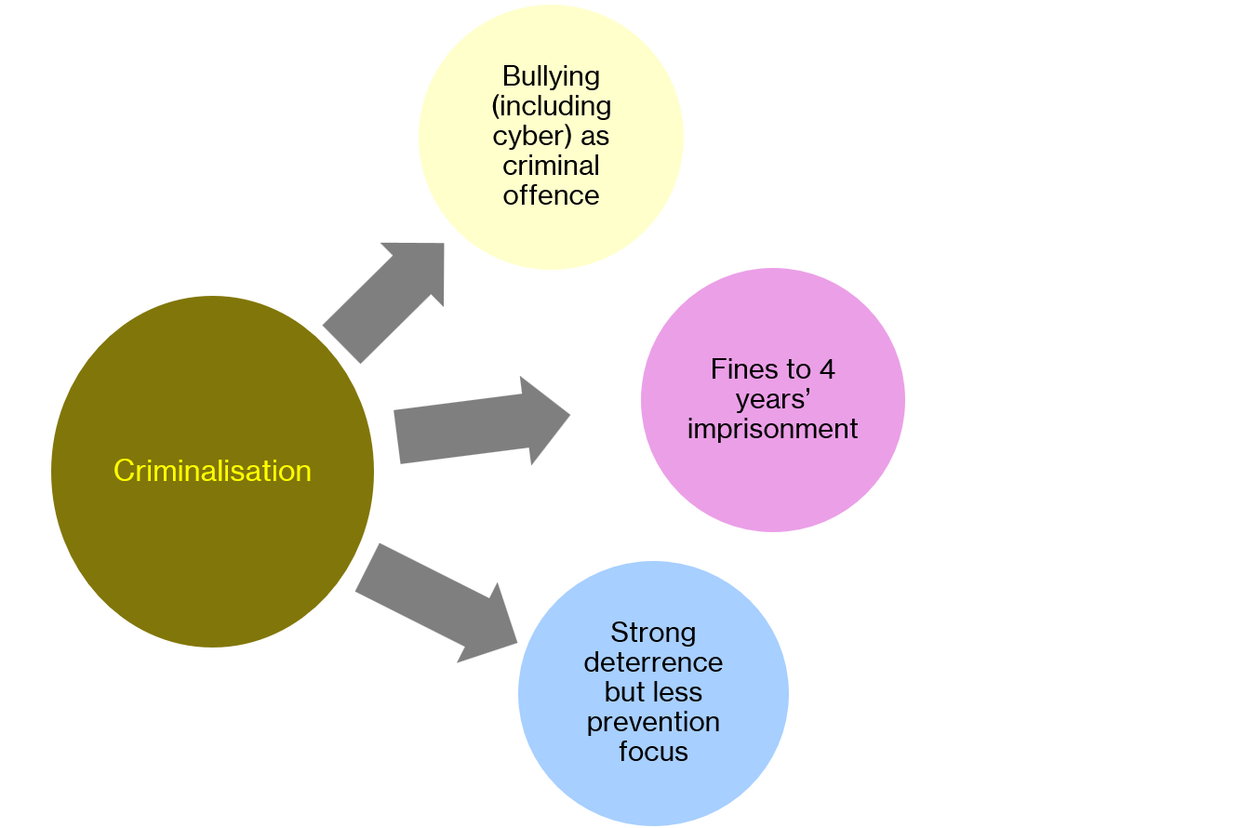
How Countries Respond: Policy Comparison
Finland
Brazil
UK: England
UNESCO (2024): only 32 states (16%) had a comprehensive legal framework
to combat violence in schools.
Notes:
[Sources]
https://www.kivaprogram.net/kiva-is-effective/
https://invest.utu.fi/kiva-antibullying-programme/
https://www.planalto.gov.br/ccivil_03/_ato2023-2026/2024/lei/l14811.htm
https://www.gov.uk/government/publications/preventing-bullying
https://assets.publishing.service.gov.uk/government/uploads/system/uploads/attachment_data/file/1069688/Preventing_and_tackling_bullying_advice.pdf
https://www.unesco.org/en/articles/violence-and-bullying-schools-unesco-calls-better-protection-students
[/Sources]
KiVa launched nationally in 2009, not compulsory or universal current coverage. Controlled studies and national implementation evaluations support reduced bullying. Brazil distinguishes a fine for bullying from 2–4 years imprisonment plus a fine for cyberbullying, unless the conduct constitutes a more serious offence. These are criminal-code penalties; youth justice rules differ for minors. The law also includes prevention duties, so strong deterrent effects or little prevention cannot be assumed. DfE and Ofsted apply to England, not all UK jurisdictions. UNESCO's 16% refers to comprehensive frameworks addressing violence in schools, not specifically anti-bullying laws. Legal-framework icon is AI-generated, not an official emblem. Official KiVa logo, flags and DfE screenshot could not be retrieved and are omitted rather than recreated.

Slide 5
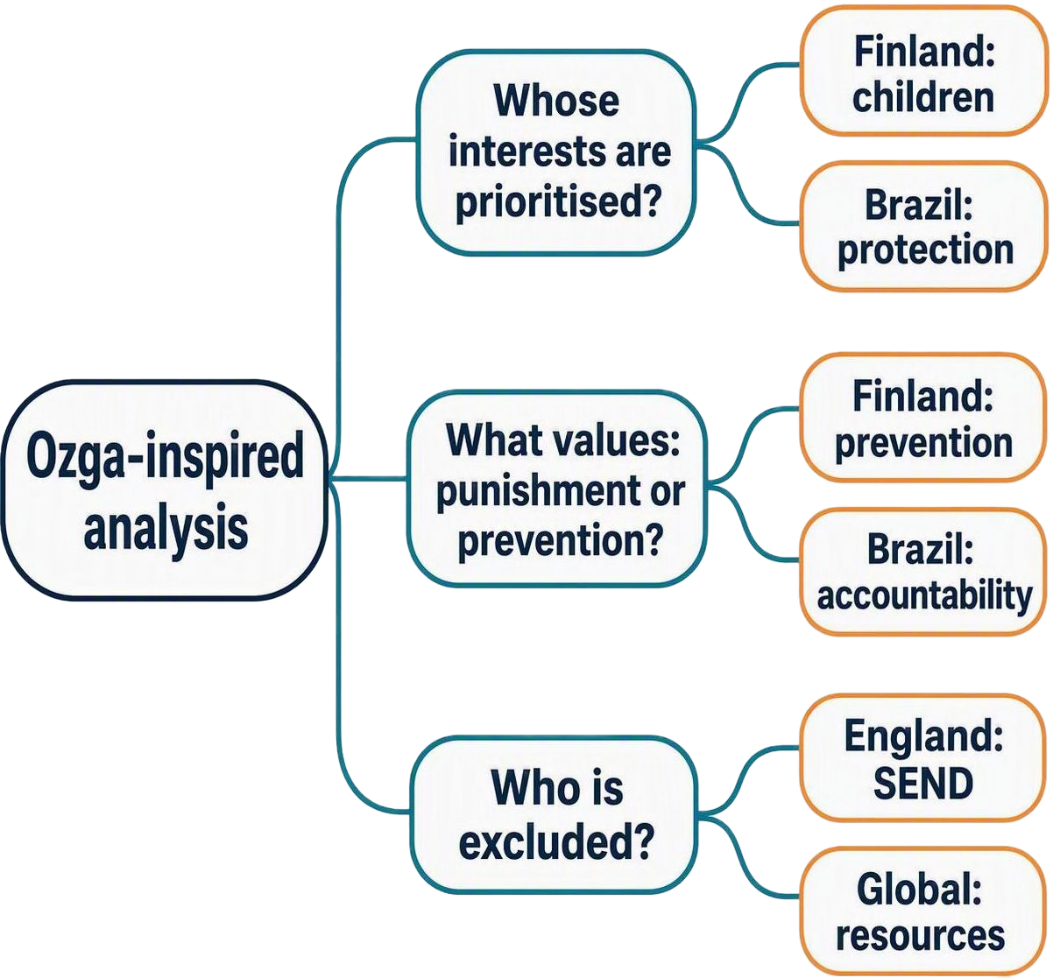
Critical Evaluation: Using Ozga Internationally
Critical questions applied comparatively
KEY FINDINGS: COMPARATIVE ANALYSIS
Finland
Evidence-led and child-centred.
Resource needs may limit replication.
Brazil
Accountability and protection.
Could criminalisation stigmatise pupils
or discourage reporting?
UK: England
Flexibility may produce uneven support.
Are pupils with SEND and marginalised
groups adequately included?
Global
Resource constraints in low-income
countries may limit implementation.
Notes:
Source attribution supplied by presenter: Ozga, J. (2021). Full title and publication details were not supplied, so these questions are presented as an Ozga-inspired application rather than verified verbatim quotations. The country findings are the presenter's comparative interpretation, not findings directly attributed to Ozga. Potential stigma, underreporting, uneven support and resource barriers are framed as risks or questions, not established causal findings. England is used for the DfE/Ofsted policy case from the preceding slide, rather than all UK jurisdictions. SEND means special educational needs and disabilities. The mind map is an AI-generated explanatory image, not an original Ozga figure. All supplied comparative points are retained in qualified language.

Slide 6
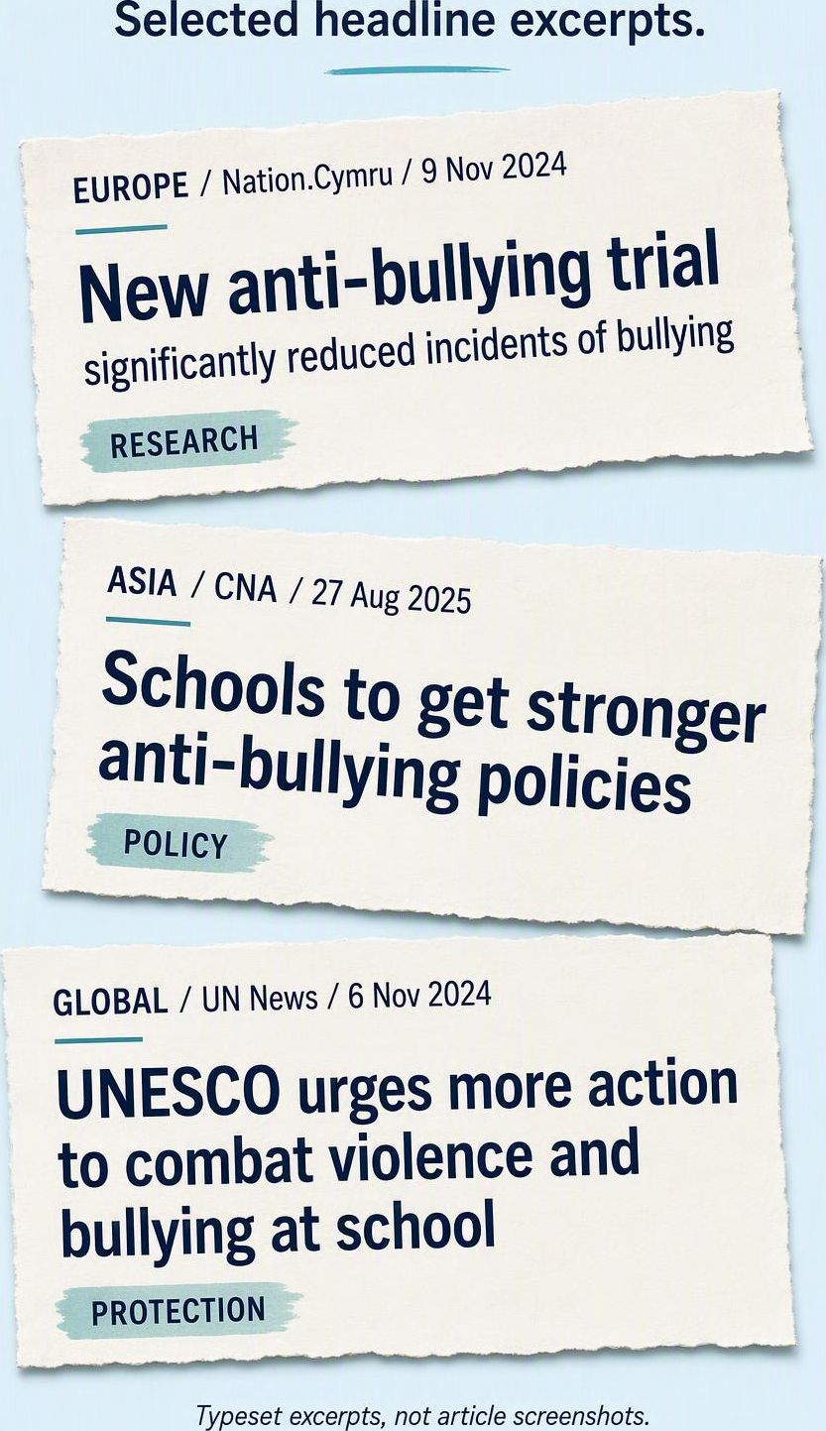
How Media Shapes Global Understanding
International coverage: a critical reading
Viral reach
Videos can travel without the cultural context
needed to understand a local incident.
Pressure for quick fixes
High-profile cases can encourage rapid action
before research evidence informs policy.
Unequal visibility
Whose stories receive global attention?
Global South perspectives may receive less space.
Opportunity: awareness and shared reform
Risk: copying policies without cultural adaptation
or treating Western models as universal
Notes:
[Sources]
Nation.Cymru, 9 November 2024, "New anti-bullying trial ‘significantly reduced incidents of bullying’": https://nation.cymru/news/new-anti-bullying-trial-significantly-reduced-incidents-of-bullying/
CNA, 27 August 2025, "Schools to get stronger anti-bullying policies, review of discipline framework: Desmond Lee": https://www.channelnewsasia.com/singapore/bullying-schools-discipline-moe-desmond-lee-5317211
UN News, 6 November 2024, "UNESCO urges more action to combat violence and bullying at school": https://news.un.org/en/story/2024/11/1156591
[/Sources]
The collage is an AI-typeset graphic using verified headline excerpts, not original article screenshots. Headlines are shortened and source-labelled. RESEARCH, POLICY and PROTECTION are interpretive framing labels. The examples represent European and Asian reporting plus global UN reporting, not a systematic sample of continents. A suitable BBC headline was not verified, so none is attributed to BBC. The supplied claims about context loss, rapid fixes, attention inequalities and unadapted policy transfer are critical analytical concerns; these three articles do not prove those media effects or demonstrate that Western models always dominate. CNA reports a review that began before the cited recent incidents, so the slide does not assert that this reform bypassed research.

Slide 7
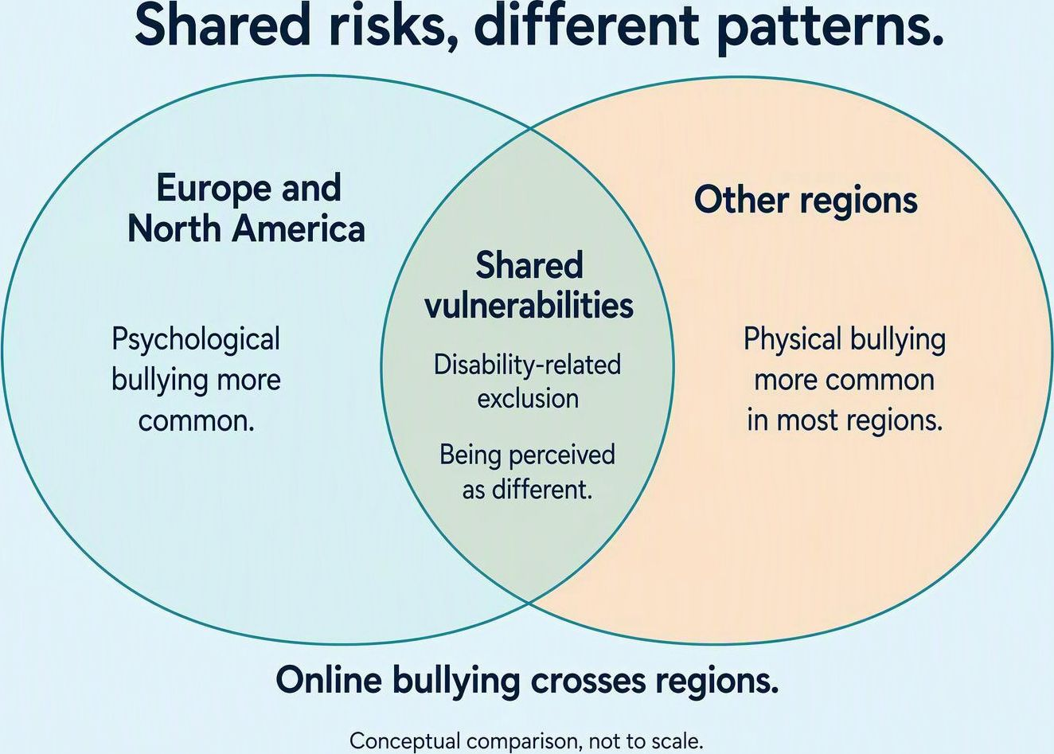
Research Questions & Evidence: Children
KEY QUESTIONS
1. Do laws reduce bullying
across cultural contexts?
2. Are whole-school approaches
effective in every setting?
3. How can countries protect
marginalised children?
EVIDENCE AND IMPLICATIONS
Disability and SEND
Elevated risk, but estimates vary by study and setting.
Cyberbullying
Risk varies with gender and local context.
Protection
Combine inclusive practice with national standards.
Programme effects
About 19–20% less perpetration in school-based programmes; effects vary.
Regional patterns overlap; they are not exclusive risk categories.
Notes:
[Sources]
UNESCO, Bullying rates higher for children with disabilities (7 September 2021, updated 20 April 2023): https://www.unesco.org/en/articles/bullying-rates-higher-children-disabilities
UNESCO, Behind the numbers: ending school violence and bullying (2019): https://www.unesco.org/en/articles/behind-numbers-ending-school-violence-and-bullying
UN News, New UN bullying report calls for safe, inclusive schools for all children (22 January 2019): https://news.un.org/en/story/2019/01/1031052
Gaffney, H., Ttofi, M.M., & Farrington, D.P. (2021). What works in anti-bullying programs? Analysis of effective intervention components. Journal of School Psychology, 85, 37–56. doi:10.1016/j.jsp.2020.12.002. https://pubmed.ncbi.nlm.nih.gov/33715780/
[/Sources]
The requested UN Secretary-General Report 2023 was not identified and is not cited as verified. A universal 2x SEND risk and 25% reduction attributed to that report were not verified. UNESCO's reviewed studies find disabled learners as or more likely to experience bullying, not one consistent global risk ratio. SEND is a broader category than disability. The 19–20% estimate is a relative reduction in perpetration for school-based anti-bullying programmes from prior meta-analysis summarised in the 2021 paper, not a guaranteed reduction from all whole-school interventions. Whole-school components were associated with larger perpetration effects. Inclusive school practice and national standards are an implication, not a quantified ranking as strongest protection. Gender and marginalisation patterns need local assessment; no universal female cyberbullying risk is asserted. The AI-generated Venn is a conceptual comparison of common vulnerabilities and predominant regional forms, not measured set overlap or region-exclusive problems. The three research questions remain open.

Slide 8
Research Questions & Evidence: Schools & Systems
WHAT SUPPORTS IMPLEMENTATION?
UNESCO WHOLE-EDUCATION APPROACH
Nine connected components, summarised
National policy and local action
Align school policies with national frameworks
and adapt implementation to context.
1. Leadership and legal / policy frameworks
2. Training and support for school staff
Reporting and accountability
3. Curriculum, learning and teaching
4. Safe physical and psychological spaces
Clear reporting duties support accountability.
Pair safe reporting with referral and monitoring.
5. Reporting, support and referral
6. School community and parent involvement
Resources and delivery
7. Learner empowerment and participation
Schools need trained staff and support services.
Limited capacity can leave guidance unfulfilled.
8. Cross-sector collaboration and partnerships
9. Monitoring and evaluation
Conclusion
No single model fits every context. Comprehensive, inclusive approaches
need resources and action beyond legislation.
Notes:
[Sources]
UNESCO (2024). Safe to learn and thrive: Ending violence in and through education. DOI: 10.54675/LUPY3293. https://www.unesco.org/en/articles/safe-learn-and-thrive-ending-violence-and-through-education and https://unesdoc.unesco.org/ark:/48223/pf0000391797
UNESCO and France (2020). International Conference on School Bullying: Recommendations by the Scientific Committee on preventing and addressing school bullying and cyberbullying. ED/PSD/HAE/2020/06 Rev. https://unesdoc.unesco.org/ark:/48223/pf0000374794
James O’Higgins Norman, UNESCO Chair on Tackling Bullying & Cyberbullying, Dublin City University. Whole Education Approach to Tackling Bullying. Presentation, nine-component summary. https://s3-ap-northeast-2.amazonaws.com/gced-public/resources/220003eng_CS1.3_James%20O%27Higgins%20Norman.pdf
Cornu et al. (2023, online 2022). An Introduction to a Whole-Education Approach to School Bullying: Recommendations from UNESCO Scientific Committee on School Violence and Bullying Including Cyberbullying. International Journal of Bullying Prevention 5:317–318. DOI: 10.1007/s42380-021-00093-8.
[/Sources]
The nine components represent UNESCO Scientific Committee recommendations, not an experimentally ranked list. The requested six headings compress these components and omit explicit staff training, learner participation and school-community involvement. The editable text summary uses the full nine-component structure, with shortened wording, rather than an official diagram.
The implementation column and conclusion synthesise the recommendations. They do not establish that a particular combination of autonomy and national standards produces the strongest outcomes, or that reporting mandates are absent in most nations. Those comparative claims are not established by the cited evidence. Reporting data require careful interpretation because changes can reflect awareness and willingness to report. Resource limitations are a potential implementation constraint, not a claim that all low-income countries fail to act. No single perfect model is an analytical conclusion about contextual adaptation, not a measured ranking. The 2024 source advocates sustained, holistic prevention and response embedded in education systems.

Slide 9

Conclusion
Aim achieved: examined global scale, compared national policies,
critically evaluated approaches and reviewed cross-national evidence.
KEY FINDINGS
A global issue
Around 1 in 3 learners report bullying in the past month.
Action beyond legislation
Prevention programmes can reduce bullying. Inclusion matters.
Gaps in legal protection
Only 16% of states had comprehensive school-violence
frameworks in 2024.
Limits to policy transfer
Resources and cultural fit shape implementation.
Media and global learning
Global progress needs shared standards,
local adaptation and resources,
with children’s voices at its centre.
Coverage can raise awareness and oversimplify context.
Illustration of shared responsibility, not official UN artwork
Notes:
[Sources]
UNESCO (2019). Behind the numbers: Ending school violence and bullying. https://www.unesco.org/en/articles/behind-numbers-ending-school-violence-and-bullying
UNESCO (2024). Violence and bullying in schools: UNESCO calls for better protection of students. https://www.unesco.org/en/articles/violence-and-bullying-schools-unesco-calls-better-protection-students
UNESCO (2024). Safe to learn and thrive: Ending violence in and through education. https://unesdoc.unesco.org/ark:/48223/pf0000391797
UNESCO Scientific Committee (2020). Recommendations on preventing and addressing school bullying and cyberbullying. https://unesdoc.unesco.org/ark:/48223/pf0000374794
Gaffney, H., Ttofi, M.M., & Farrington, D.P. (2021). What works in anti-bullying programs? Journal of School Psychology, 85, 37–56. https://pubmed.ncbi.nlm.nih.gov/33715780/
[/Sources]
Conclusion synthesises the preceding slides. The 1-in-3 statistic concerns learners reporting bullying in the previous month, not all children or lifetime experience. UNESCO's 16% (32 states) concerns comprehensive frameworks to combat violence in schools as reported in 2024, not only anti-bullying laws and not a current count. Prevention programmes can reduce bullying on average, with variation across settings. Inclusion, adequate resourcing, local adaptation and learner participation reflect whole-education guidance. The resource and media-transfer points are comparative analysis and plausible implementation risks, not measured universal causal findings. The final thought is the presenter's normative synthesis. The generated solidarity illustration is original conceptual artwork and is not a UN emblem or official UN asset.

Slide 10
References
Brazil (2024) Lei nº 14.811, de 12 de janeiro de 2024. Brasília: Presidência da República.
UNESCO (2019; disability review, 2021, updated 2023); Gaffney, Ttofi & Farrington (2021). SEND: special educational needs and disabilities.
Available at: Planalto, Law 14.811/2024
(Accessed: 9 October 2026).
Nation.Cymru (9 Nov 2024); CNA (27 Aug 2025); UN News (6 Nov 2024). Media effects: critical analysis, not measured by this sample.
OECD (2025) PISA and school wellbeing. Paris: OECD.
Ozga, J. (2021) ‘Critical policy analysis in education’, in Sage Handbook of Education Policy. London: Sage. [Editors and pages needed.]
UNESCO (2024) Safe to learn and thrive: ending violence in and through education. Paris: UNESCO.
Thank you for listening.
Available at: https://doi.org/10.54675/LUPY3293
(Accessed: 9 October 2026).
United Nations (2023) Protecting children from bullying: Report of the Secretary-General. New York: UN. [Report number needed.]
UNESCO (2019, 2024), UNESCO Scientific Committee (2020), Gaffney et al. (2021). Synthesis of slides 3–8.
UNESCO (2024); University of Turku / KiVa; Brazil Law 14.811/2024; DfE guidance (2017). ¹Unless a more serious offence applies.
Notes:
[Sources]
Brazil (2024) Lei nº 14.811, de 12 de janeiro de 2024. Brasília: Presidência da República. Available at: https://www.planalto.gov.br/ccivil_03/_ato2023-2026/2024/lei/l14811.htm (Accessed: 9 October 2026).
UNESCO (2024) Safe to learn and thrive: ending violence in and through education. Paris: UNESCO. Available at: https://doi.org/10.54675/LUPY3293 (Accessed: 9 October 2026).
University of Wales Trinity Saint David (2024) Referencing handbook: Harvard. Version 1.4. Available at: https://digitalservices.uwtsd.ac.uk/wp-content/uploads/2025/05/Harvard-en_v.1.4-V4.pdf (Accessed: 9 October 2026).
UWTSD referencing support page: https://digitalservices.uwtsd.ac.uk/library/academic-and-infoskills/referencing-handbooks/
[/Sources]
The Brazil law number is corrected from 14.812 to 14.811. The three entries under Details to confirm retain the presenter's supplied bibliographic information, clearly marked unverified. They are not validated publications or a substitute for complete records. The exact UN 2023 report, Ozga 2021 handbook chapter and OECD 2025 title were not identified in searches. Do not use those entries as checked references until original sources or catalogue records establish the title, year, and where applicable editors, page span and report number. The existing slide 5 already marks the Ozga attribution as presenter-supplied. The Harvard handbook landing page and bibliographic record were found, but the PDF and requested icon could not be retrieved. A text hyperlink to the authentic handbook substitutes for the icon. Full compliance with the UWTSD handbook has not been certified. Other references remain in the corresponding slides' notes.

