Slide 1
BMOE7014
Research Methods in Health, Outdoor Education and Physical Literacy
Dr Nalda Wainwright

Slide 2
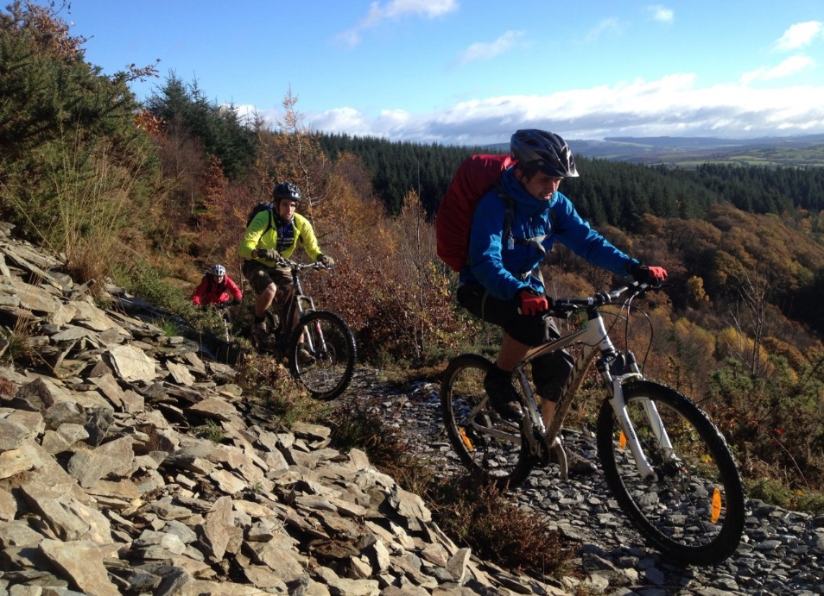
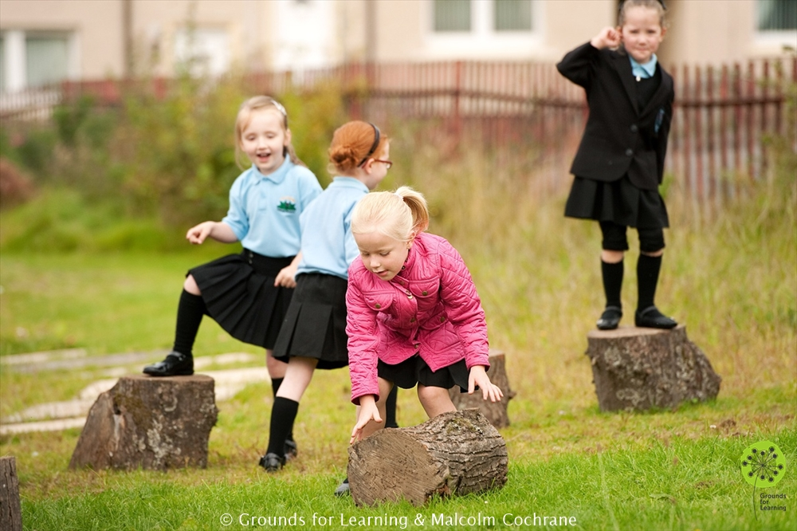

Intro to Module
Overview of module
Weekend overview
What is research?
The research process
Alignment
Finding a topic.

Slide 3
Purpose and structure of the module
Introduce / revisit research
Enhance understanding and criticality of the literature in your field
Prepare for dissertation
Write a research proposal and ethics (Assessment 1)
Complete data collection and analysis.
Present the research (Assessment 2 – e poster)
Reflect on the process (Assessment 3 – reflective paper)

Slide 4
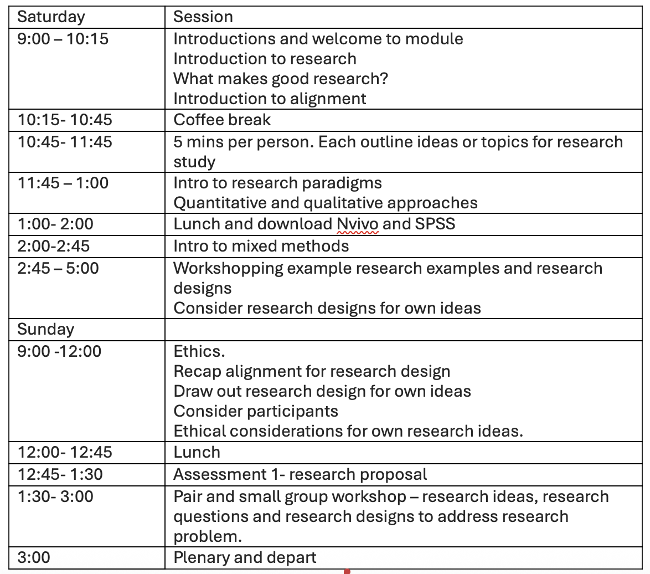
Weekend overview

Slide 5
Why do you think we do research?
Basic research seeks to develop universal principles and to produce findings that are of value to society.
Can you think of examples where we have seen research impact on society?
Big examples….
Smaller examples….
Notes:
Discussion about medical vaccines…covid etc.
Smaller examples…talk about SKIP-Cymru and SKIP

Slide 6
Concepts:
Research questions and good research
Research paradigms & your research project
  Positivism; Post-positivism; Critical theory, Interpretivism
  Ontology, epistemology, methodology
Methodology
  Quantitative; Qualitative methodology
Alignment of research design
Ethics

Slide 7
How do we get to the research question ?
My background experiences (related to sport, physical activity, health, coaching,
physical education
, etc.)
My social identities (social class, gender, race, sexual orientation, ability, etc.)
Research Interests
What the literature says
Research Problem
Research question
Context factors (e.g., school/ work/ participants; schedule, etc.)
Broader popular culture, interests.

Slide 8
Alignment
Research has its own vocabulary you will be reading about these…
Ontology
Epistemology
Paradigm (philosophical perspectives)
Methodology
Methods
Theoretical perspectives
we all have our own assumptions about the world. In research we must be aware of these and aim to be open minded. (battleship story)
https://youtu.be/3vsfnPehSHM?si=XxxaNqkSrSuynvFw

Slide 9
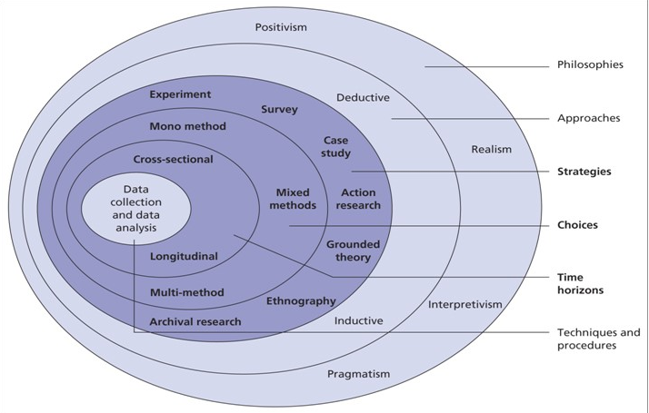
The research onion (Saunders et al. 2015)
It all starts with
philosophy
Paradigm:
Set of beliefs based on assumptions about ontology, epistemology and methodology.
Guba & Lincoln, 1994

Slide 10

Ontology: What is the nature of reality?
What is true? What exists? What is real?
Relativism
Realism

Slide 11
Ontology: The nature of reality and truth
REALISM
Which option describes you best?
RELATIVISM
1. Regarding reality
There is a reality that exists and can be understood with appropriate methods
There are multiple realities that exist and are only understood through people’s experiences (constructions)
There are multiple realities constructed by people but they are situated within boundaries of context (time/ space; culture)
2. Think about something such as a flower
There is a reality of a flower that exists regardless of me ‘seeing’ or experiencing it.
The reality of a flower is created through my experience of it.
3. Regarding Truth:
Through reason the Truth can be determined
There isn’t one Truth only truth claims or truths

Slide 12
Epistemology: The study of knowledge
What is knowledge?
What counts as knowledge?
How is knowledge acquired?
How do we know what we know?

Slide 13
Epistemology: The nature of knowledge
which describes you best?
1. Regarding creation of knowledge – (How is knowledge created?):
There is an objective reality of objects that can be discovered through examination
Knowledge about objects is always subjective in that meaning only exists by an individual constructing it through experience with the object.
Knowledge is not Neutral
By Whom, For Whom, For What?
What do I want to know?
How can I know it?
Why do I want to know it?
What counts as knowledge? Why or why not?

Slide 14

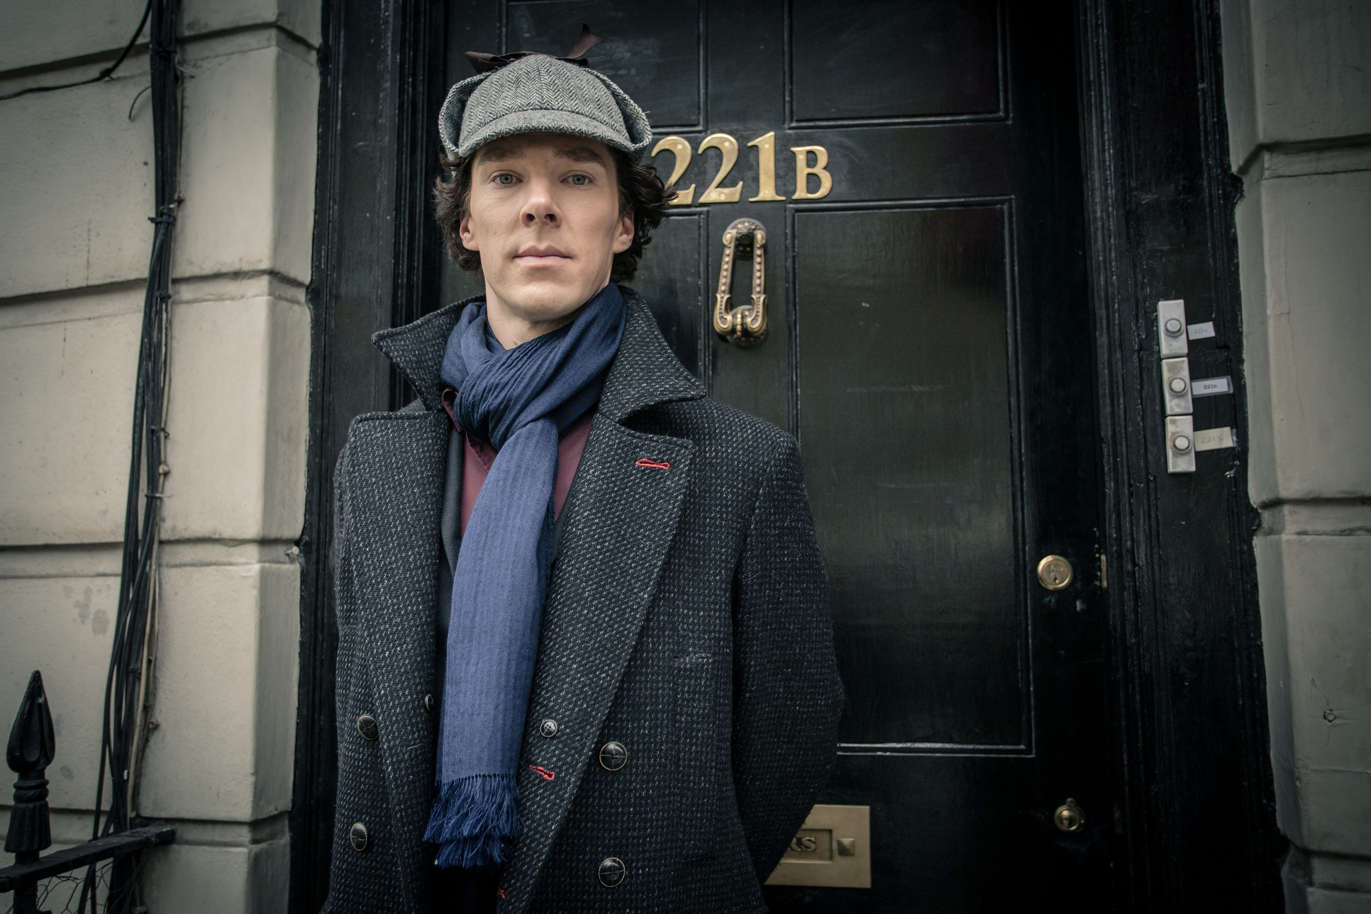
Deductive vs. Inductive Approach to Knowing
Think Sherlock Holmes
Deductive
-Clues are already there
-Just have to piece them together (like a puzzle)
E.g. Research -Have variables look at how they fit together (quantitative methodology)
Inductive
-Don’t have/ know the clues or the story
-Must find clues and piece them together from what is around you
-Some things useful, some not
E.g., Research – Gather data and look for clues from it to piece together into themes (qualitative methodology)

Slide 15
Ontology (re: reality)
Epistemology (re: knowledge)
Objective reality; can be known (a Truth)
Subjective reality; Multiple ‘truths’ & knowledge situated & constructed
Objective reality; difficult to know; multiple truths
Reality situated in social context
Positivism (Discipline based theories)
Post-Positivism
Critical Theory
Interpretive
Quantitative Methodologies (numerical data) (e.g., experiment; field experiment)
Quantitative & Qualitative Methodologies
Qualitative Methodologies (e.g., ethnography, case study, phenomenology)
Methods: measure, observation, survey
Methods: Questionnaires, interviews, participant observation, journal, content analysis

Slide 16
A Research Taxonomy
Epistemology –
The Nature of Knowledge
The philosophical
theory of
knowledge
Ontology –
The nature of reality
the branch of metaphysics
that studies of the nature of existence
or being of a Field
Methodology –
Foundations, practices,
procedures,
and rules of a field
of knowledge.
QUANTITATIVE
Scientific Method
Objective
Positivist
Quantifiable facts
E.G - Pharmaceutical research
Sports Science (much of)
Sports psychology (some of)
Seeks generalisable findings
Uses statistical method
QUALITATIVE
Varied methods
Relativist
Constructivist (often)
observable data
E.G - Ethnological enquiry into “other” peoples
Outdoor Education (much of)
Can include CRITICAL theory
Seeks depth and detail, not generalisability
Uses human inquiry
METHODS

Slide 17
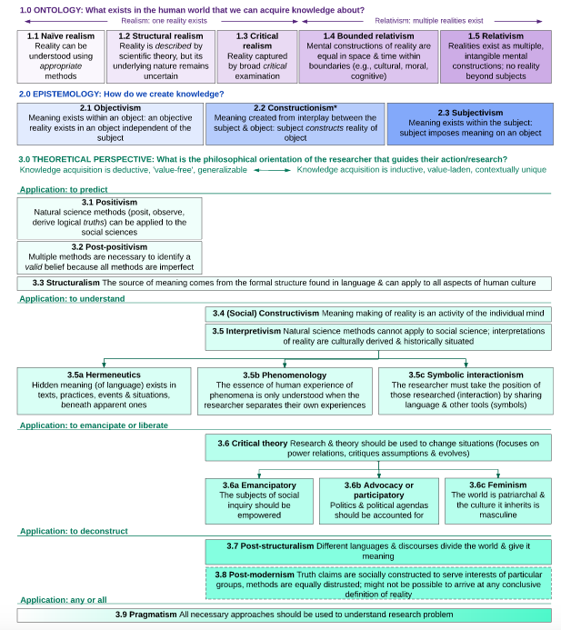
Notes:
Moon and Blackman 2014

Slide 18
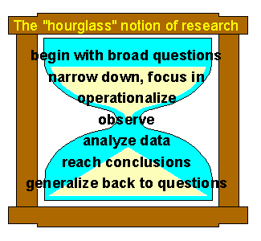
The structure and process of research
Your research must show alignment.
The question must be generated from the literature and problems in the field
The methodology needs to be appropriate for answering the question
Trochim, 2021
https://conjointly.com/kb/structure-of-research/

Slide 19
Your research proposal – more tomorrow
Working title
Aims
Objectives
Review of the literature and rationale
Research questions/hypothesis
Methodology
Work schedule
References
Ethics Form
Work schedule
Needs to have time for the whole research process, analysis of data, presenting research project and findings as an e poster and reflecting on the process for assessment 2 and 3.

Slide 20
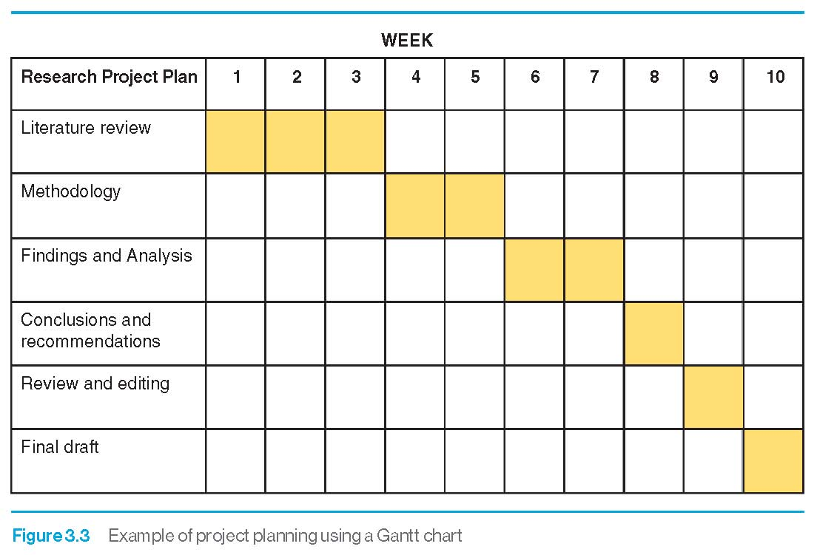
Research proposal ideas- Topics to avoid
Too big- must be manageable in timeframe
Too trivial.
Lacking in resource materials.
Too technical.
Dependent on the completion of other projects.
Not possible due to restrictions.
Unethical.

Slide 21
Examples of student and staff research
Gender in Ultimate – A mixed methods investigation of female players opportunities in a season of Ultimate (mixed)
Impact of motor development programme on children’s physical development - TGMD-2 (quant)
Disconnection to social media on residential experience (qual)
Environmental project and sense of place (qual)
Teacher experiences of new way of delivering the curriculum (qual)
Non-Sport curriculum and pupil motivation (action research)
Parental perspectives on pre school physical activity (Qual)
The impact of SKIP intervention on children’s motor competence and perceived motor competence (Quant)
Families experiences of MiniMovers APP and the impact on preschoolers physical competence (mixed)

Slide 22
Where do your ideas come from?
Remember ….
Your experiences
Social context
Current ideas
THE LITERATURE. – previous research

Slide 23
The importance of the literature
  There are two literatures that have to be covered – the subject matter itself and the research methods literature.
  Distinguishes what has been done in the field from what needs to be done.
  Places the topic or problem in the broader scholarly literature.
  Places the research in the historical context of the field.
  Acquires and enhances the subject vocabulary.
  Articulates important variables and phenomena relevant to the topic.
  Synthesises and gains a new perspective on the literature.
  Identifies the main methodological and research techniques that have been used in the field, and their advantages and disadvantages.
  Relates ideas and theories in the field to research methodologies.

Slide 24
Keeping a literature log – summaries and critiques
Keep a search log – information on what has been searched, when, how and with what results.
Use the full reference as the title
Outline the main subject focus and the keywords that describe it.
Summaries key points
Critique its relevance to your topic and how relates to other work
Note key pages / quotes
Create bibliography as you go.

Slide 25
The literature review - moodle support
Panopto from Dr Kate Williams on week one
Library post grad info skills
Link to library on how to set up Refworks
Video from Anna Stevenson

Slide 26

Questions …..

Slide 27
COFFEE….then your research areas of interest
AFTER THE BREAK
5 minutes to share you initial ideas about an area of interest for research….
This can be a starting point do not worry if you are not yet clear about what the research problem and question is ….
We will use these ideas over the weekend in the workshops to help you begin to shape your ideas

