Slide 1
Electrical
and Electronic Principles
(ACDA4006)
Lecture - 14

Slide 2
Content
Transistor

Slide 3
Transistors -Introduction
The transistor was invented by three scientists (John Bardeen, Walter Brattain and William Shockley) at the Bell Laboratories in 1947.
It rapidly replaced the vacuum tube as an electronic signal regulator.
A transistor regulates current or voltage flow and acts as a switch or gate for electronic signals.

Slide 4
Transistors -Introduction
A transistor is a semiconductor device used to amplify or switch electronic signals and electrical power.
It is composed of semiconductor material usually with at least three terminals for connection to an external circuit.
A voltage or current applied to one pair of the transistor's terminals controls the current through another pair of terminals.

Slide 5
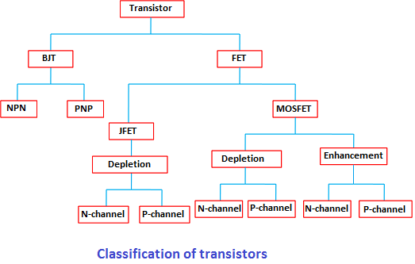
Transistors -Types

Slide 6
Transistors -Types
Transistor
  BJT (Bipolar Junction Transistor)
    NPN
    PNP
  FET (Field Effect Transistor)
    JFET (Junction Field Effect Transistor)
      Depletion
        N-Channel JFET
        P-Channel JFET
    MOSFET (Metal Oxide Semiconductor Field Effect Transistor)
      Depletion (Channel exist
        N-Channel MOSFET
        P-Channel MOSFET
      Enhancement
        N-Channel MOSFET
        P-Channel MOSFET

Slide 7
Transistors -Types
Bipolar junction transistor (BJT)
  Current conduction is due to both type of charge carriers (minority and majority carriers)
  Output current is controlled by input current. So it is called as Current controlled device.

Slide 8
Transistors -Types
Types of BJT
N-P-N type
  When a transistor is formed by sandwiching a single P-region between two N- region in called as NPN transistor.
P-N-P type
  When a transistor is formed by sandwiching a single N-region between two P- region in called as PNP transistor.

Slide 9
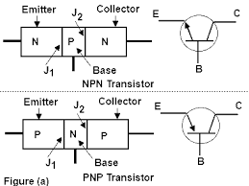
Transistors -Structure

Slide 10
Transistors -Structure
Base
The middle region of the transistor is called the base of the transistor. This region is very thin and lightly doped.
Emitter
This region is heavily doped. But the doping level in emitter is slightly greater than that of collector. The size of the region is slightly less than collector.
Collector
This region is slightly more than that of emitter. The doping level is slightly lesser than that of emitter

Slide 11
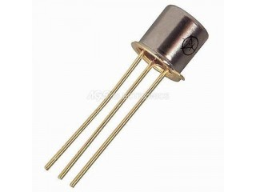
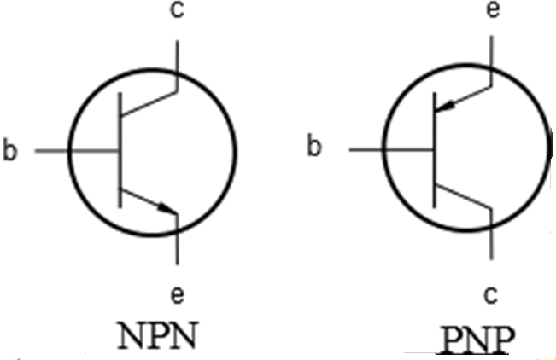
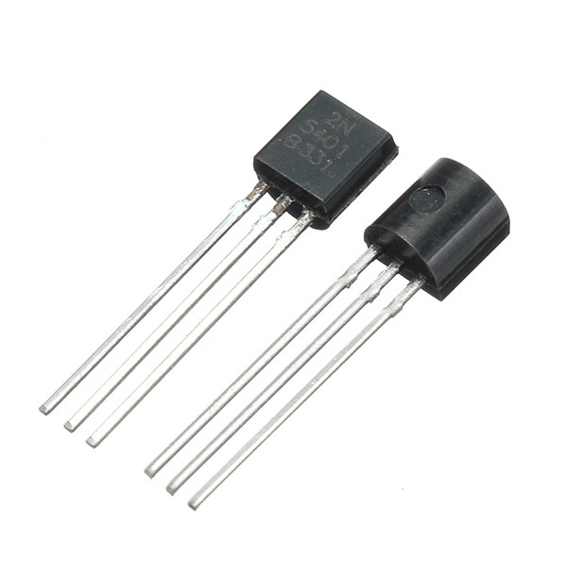
Transistors -symbol

Slide 12
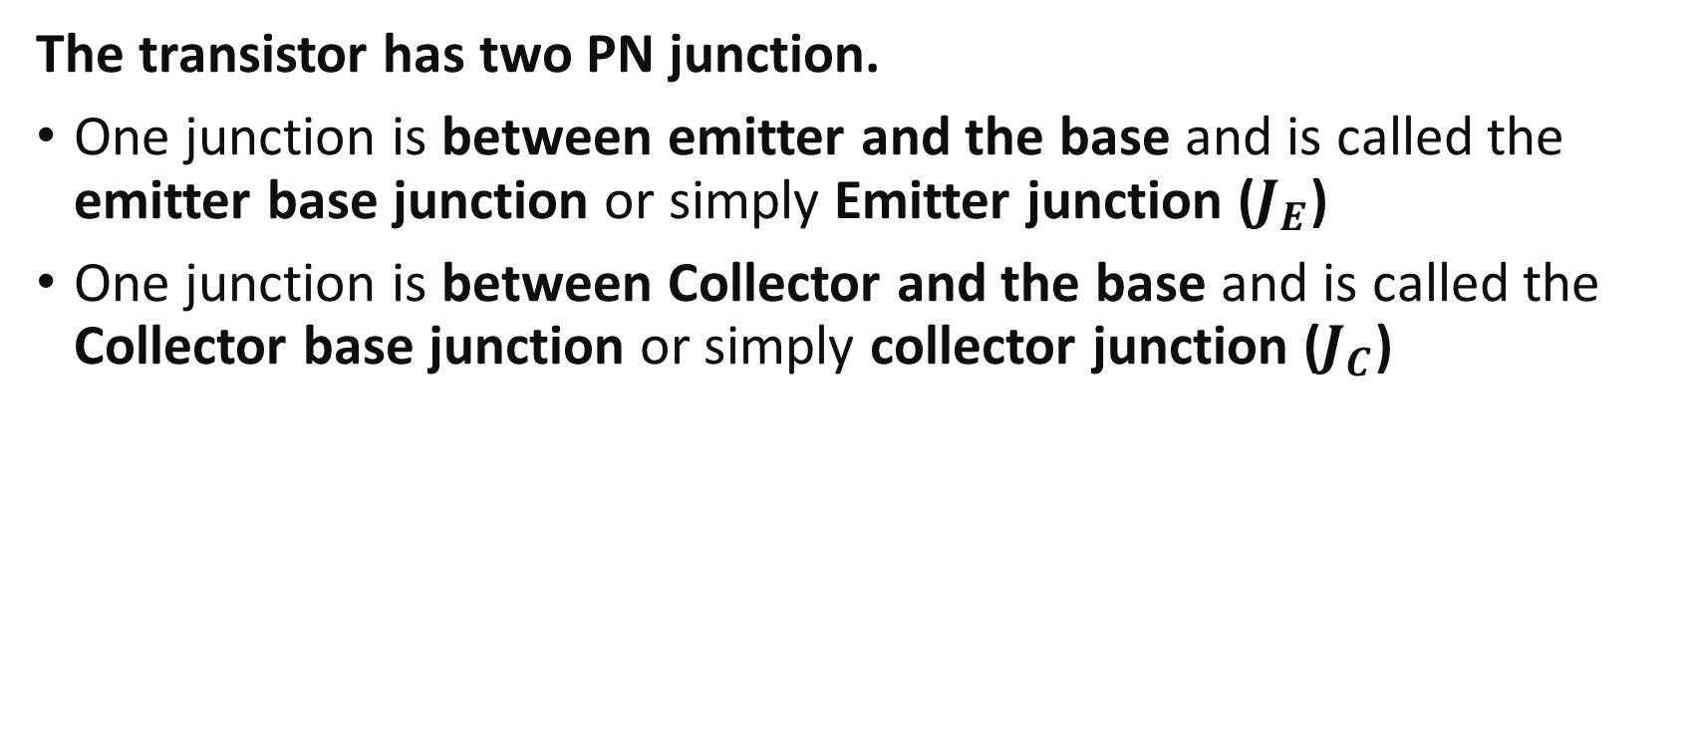
Transistors -Junction
The transistor has two PN junction.
One junction is between emitter and the base and is called the emitter base junction or simply Emitter junction ($J_{E}$)
One junction is between Collector and the base and is called the Collector base junction or simply collector junction ($J_{C}$)

Slide 13
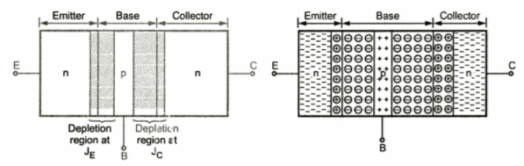
Transistors operation – Unbiased transistor

Slide 14
Transistors operation – Unbiased transistor
Unbiased transistor means a transistor with no external voltage, applied. So, No current will be flowing from any of the transistor terminals.
During diffusion process, depletion region penetrates more deeply into the lightly doped side.
Depletion region at emitter junction penetrates less in the heavily doped emitter and extends more in the base region.
Depletion region at collector junction penetrates less in the heavily doped collector and extends more in the base region.

Slide 15
Transistors operation – Unbiased transistor
As collector is slightly less doped than the emitter, the depletion layer width at the collector junction is slightly more than the depletion layer width at the emitter junction.
Like diode, a barrier voltage exists within the transistor.

Slide 16
Transistor
Application:
A transistor as an amplifier can be used to amplify current. (This is because a small change in base current causes a large change in collector current. Example is a microphone.)
Transistor as switch (In a transistor, no current can flow in the collector circuit unless a current flows in the base circuit. This property allows a transistor to be used as switch.)

Slide 17
Reference
[1] P. Horowitz and W. Hill, The Art of Electronics, 3rd ed. Cambridge, U.K.: Cambridge University Press, 2015.
[2] C. Simpson, Principles of Electronics, 4th ed. London, U.K.: Routledge, 1999.
[3] K. F. Brennan, Understanding Modern Transistors and Diodes. Cambridge, U.K.: Cambridge University Press, 2002.

Slide 18
Thank You

