Slide 1



UWTSD
A critical evaluation of the „CRM” has on an organisations’ performance.
Module: Understanding and engaging in the customer experience
Prepared by Natalia Michalak

Slide 2
Topics on
our Agenda
UWTSD
Natalia Michalak
What we are going to discuss and analyze
Quality
01
QMS
02
3 Benefits
03
Critical evaluation
04
SWOT
05
Conclusion
06

Slide 3


QUALITY
Natalia Michalak
UWTSD
„Quality in a service or product is not what you put into it. It is what customer get out of it. „
Peter Drucker

Slide 4
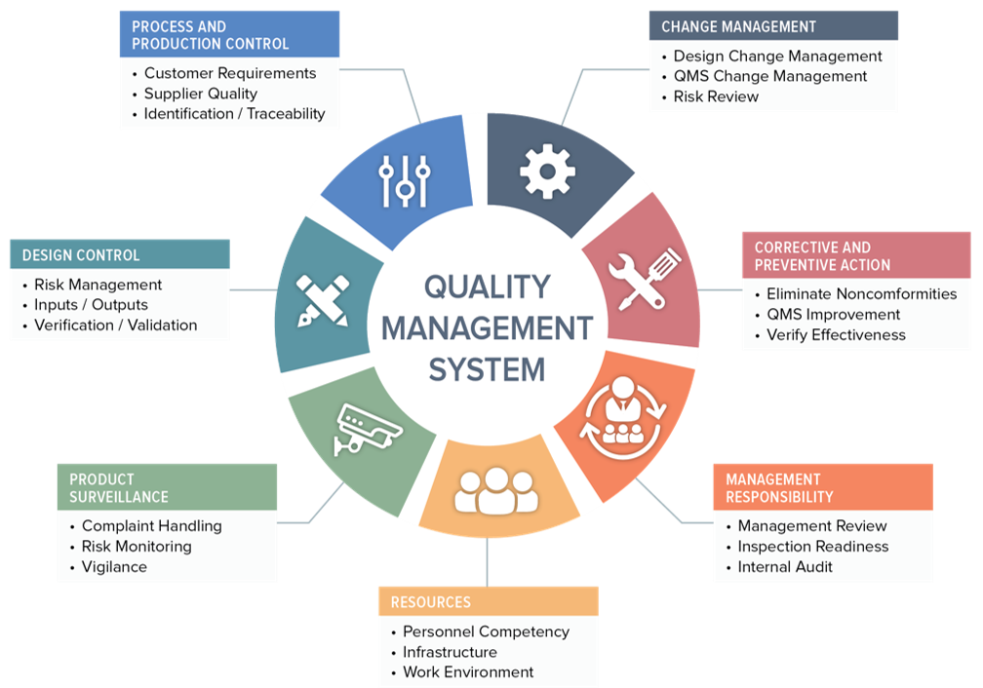
QMS
Company Name
Quality
Managment
System

Slide 5


Quality Management System
The Umbrella of Quality
Through understanding customers and their needs, product and market trends Tesco’s expert team of developers work hard to bring great quality, innovative and value for money products to the market; their dedicated team of food researchers and chefs constantly review food trends and bring new food ideas to life to meet those customer needs.
3 BENEFITS OF TESCO
Quality Control
They have well-established and comprehensive food safety management systems throughout Tesco and every day we monitor and check the quality and safety of our food. They have a routine testing programme through which Tesco products are regularly tested by independent expert laboratories to make sure that they are safe, legal and meet our exacting quality specifications.
Quality Accurance
Tesco has SUPPORT and DEVELOPMENT TEAM to understanding customers, their needs and wider market trends, our expert team of developers work hard to bring great quality, innovative and good value products to the market.

Slide 6
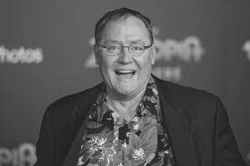
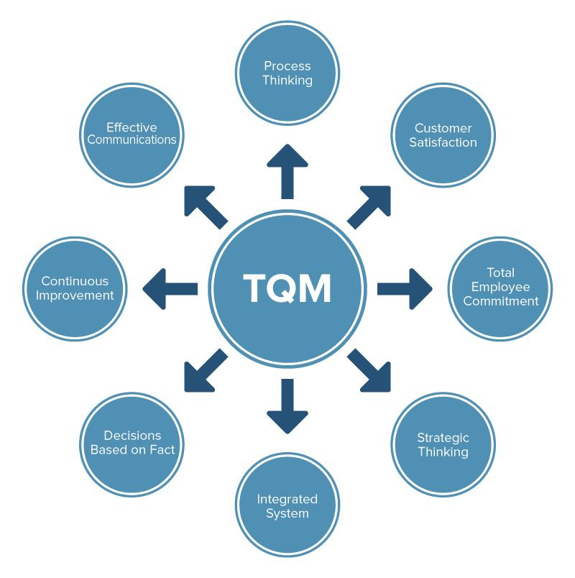
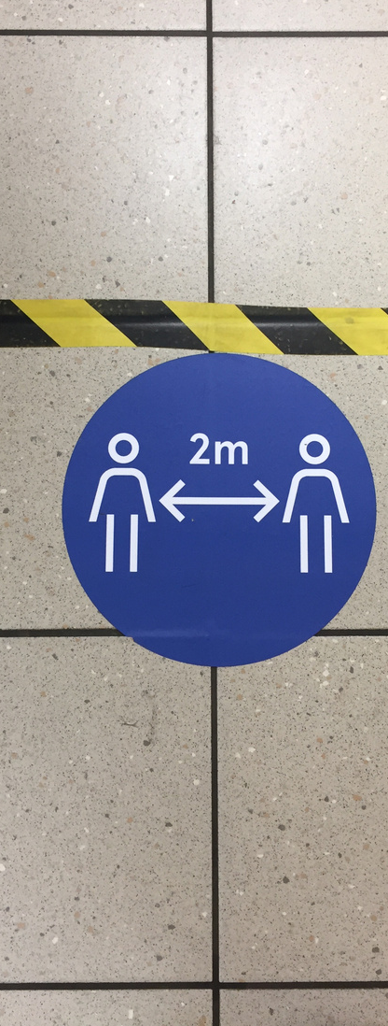
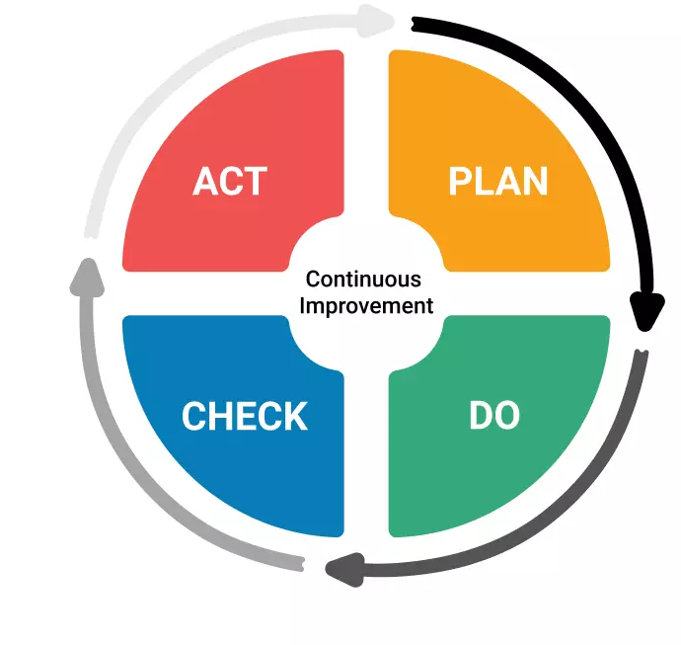
Two Models
„Quality is the Best Business plan”
John Lesseter
01
02
TQM
PDCA

Slide 7
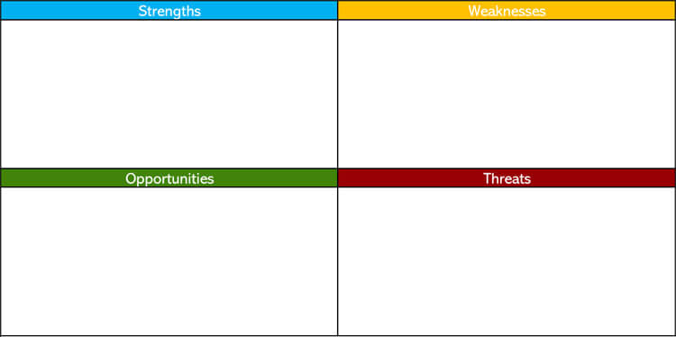
SWOT
Natalia Michalak
UWTSD
--Monitoring Managment Cycle: Keep updaing data from employees, good development and motivational system like flexiable schedule, apraisals, bonuses
-Sustaiblity polices and practices- keep upgrading new solutions, eco choices, influence eco-changes like no plastic bags, charities, partnerships with schools
-Loyalty ladder- click and collect, newssettler, clubcard, deliveries to home, bargains, vouchers
-
-Higher prices compare to the competitors
—Bad reputention from investigation in using toxic chemicals, slaving and neglect it occupations on the Tesco’s farm; unfair bonuses for chief Executive Dave Louise
- Lower rank compare to the competitors-customer choice depends from the living status and age
-Sale of shares in Poland and Asia
-Not enough number of employees or more agency one than contractors
-New Restrictions in pandemic
-Litemd number of customer wants to join to newsletter
-War impact on the windrawprocus, problems with deliveries , increasing prices
-Bad media reputations
-Lower ranking score compare to competitions
-More sales of shares in different countries
-4 main opportunities by Ken Murphy is: delivery food to everyone, safety for everybody, Support for all colleagues, support for all groups
- Zero Net Plan by 2050 - reduced all CO2 emission in company by 2050
--Keeping on the track with suisibility polices and practices
-Gain new newsletter customers and club card

Slide 8
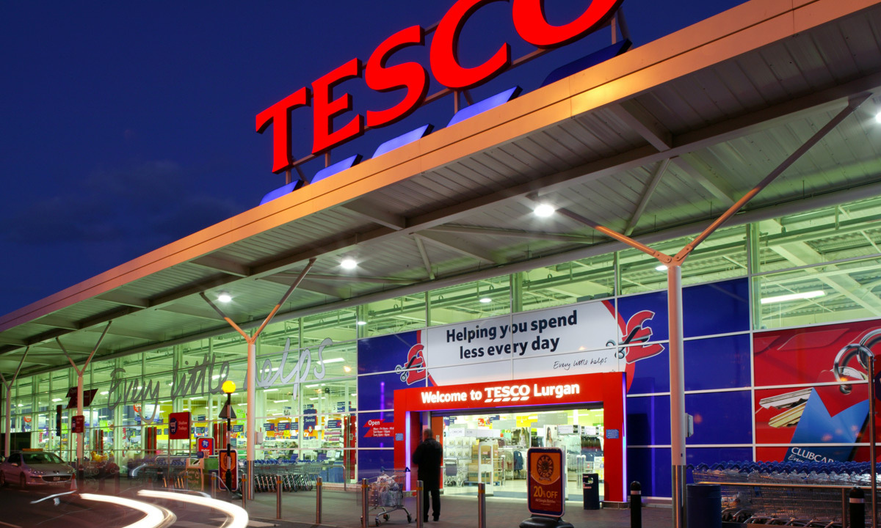
Conclusion:
01
Enhance email marketing including Clubcards
02
Track goals with CRM quality data
03
Motivate, develope and good manager engagement with employees
04
Be first with sustainability policy and procedures
Natalia Michalak
UWTSD

Slide 9

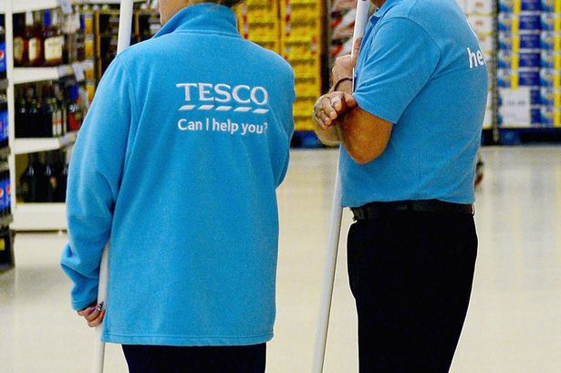
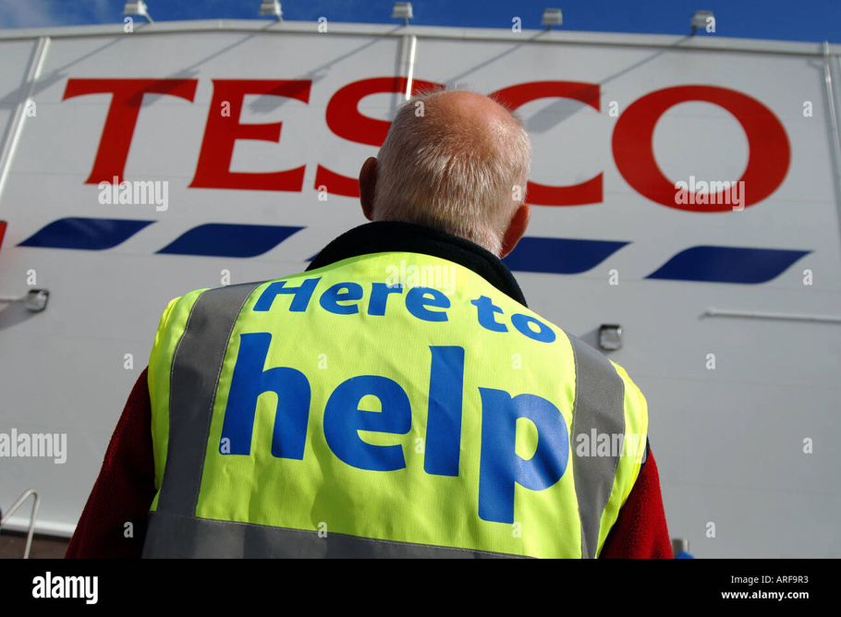
Natalia Michalak
UWTSD
Thank you!
Feel free to approach me if you have any questions.

Slide 10






























Resource Page
1.Oriel STAT A MATRIX Blog. 2022. What is a Medical Device Quality Management System (QMS)?. [ONLINE] Available at: https://www.orielstat.com/blog/medical-device-qms-overview. [Accessed 17 March 2022].
2.Azamba. 2022. The 6 Pillars of CRM Data Quality - Azamba. [ONLINE] Available at: https://www.azamba.com/2019/08/27/the-6-pillars-of-crm-data-quality/. [Accessed 17
March 2022].
3.Tesco PLC. 2022. Product safety & quality - Tesco PLC. [ONLINE] Available at: https://www.tescoplc.com/sustainability/documents/policies/product-safety-quality/. [Accessed 17 March 2022].
4.Cloud Integrate. 2022. Top Tips to Improve Salesforce Data Quality - Cloud Integrate. [ONLINE] Available at: https://cloud-integrate.com/top-tips-to-improve-salesforce-data-quality/. [Accessed 17 March 2022].
5.www.tescoplc.com. 2022. No page title. [ONLINE] Available at: https://www.tescoplc.com/media/757589/tesco_annual_report_2021.pdf. [Accessed 17 March 2022].

Slide 11
Resource Page
6.Smartsheet. 2022. All About Total Quality Management (TQM) | Smartsheet. [ONLINE] Available at: https://www.smartsheet.com/total-quality-management. [Accessed 17 March 2022].
7.Economics Help. 2022. Costs and Benefit of Tescos - Economics Help. [ONLINE] Available at: https://www.economicshelp.org/blog/96/retail/costs-and-benefit-of-tescos/. [Accessed 17 March 2022].
8.the Guardian. 2022. Tesco suppliers say retailer worst at following grocery code of practice | Tesco | The Guardian. [ONLINE] Available at: https://www.theguardian.com/business/2015/jun/22/tesco-suppliers-say-retailer-worst-at-following-grocery-code-of-practice. [Accessed 17 March 2022].
9.Tesco CEO Dave Lewis tells court of "surprise" & "shock" over accounting scandal - Retail Gazette. 2022. Tesco CEO Dave Lewis tells court of "surprise" & "shock" over accounting scandal - Retail Gazette. [ONLINE] Available at: https://www.retailgazette.co.uk/blog/2017/11/tesco-ceo-dave-lewis-tells-court-surprise-shock-accounting-scandal/. [Accessed 17 March 2022].
10.Ethical Consumer. 2022. Tesco ethical issues | Ethical Consumer. [ONLINE] Available at: https://www.ethicalconsumer.org/company-profile/tesco-plc. [Accessed 17 March 2022].

