Slide 1
Problem Solving and Innovation
Dinicuta Cristian
(SWOT Analysis: The Body Shop)

Slide 2
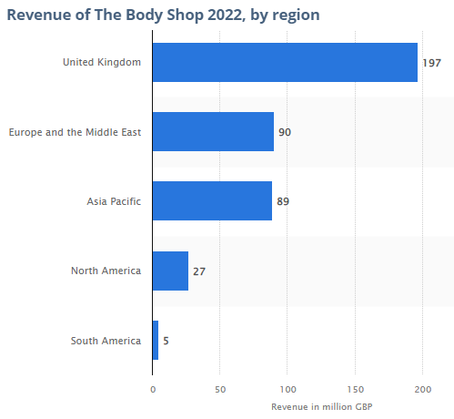
Strengths: The Body Shop
Strong global brand recognition
Strong retail network with more than 3000 outlets in 66 different countries
Strong online presence with high website traffic and social media followership
Unique and vast product portfolio with all natural and ethical offerings
Massive product variety for satisfying natural personal care product lovers
Source: Statista, 2023
Notes:
Strengths
Global brand image and recognition is one of the biggest strengths for the Body Shop due to product supply in 66 different nations across the globe. The Body Shop also has strong international retail network and market capitalisation depending on e-commerce platform and more than 3000 company owned and franchised outlets (Meddings and Linsell, 2024). Online presence is also a significant strength of the Body Shop to get average 3.15 million e-commerce website visits per month (as per March 2023) and more than 2million Instagram followers (Born and Collins, 2023). Ethical trading approach with all natural and cruelty free beauty and personal care products strengthens sustainable and responsible brand image of the Body Shop. Product portfolio is also a key strength of the Body Shop to have one of the largest varieties of natural personal care and beauty products in the world (Wearden, 2024).

Slide 3
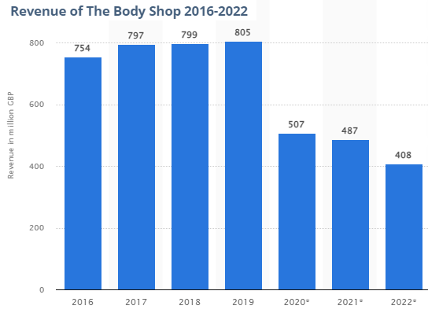
Weaknesses: The Body Shop
Overpriced nature of the products
Drastic decline in recent year financial performance
Lack of responsiveness to changing competitive scenario
Overdependence on franchised retail network
Gradual dilution of ethical business approach due to ownership of chemical cosmetic brands.
Source: Statista, 2023
Notes:
Weaknesses
High pricing of products is a key weakness of the Body Shop to make its products unaffordable to a large proportion of buyers and subsequently affect its price competency. Poor financial performance management in recent years and drastic decline in worldwide revenue output between 2019 and 2022 is also a significant weakness of the Body Shop (Meddings and Linsell, 2024). Inability to cope with growing competition and slow product innovation rate of the Body Shop is also a weakness to affect its global market competency and share. High level of dependency on franchised store network and subsequent inconsistency of in-store consumer experience in wider global business territory is also a weakness to affect brand reputation of the Body Shop (Taaffe-Maguire, 2024). Gradual dilution of ethical business stance is also a weakness of the Body Shop as also promoted subsidiary brands like L’Oreal with wide range of chemical cosmetics and personal care products (Born and Collins, 2023).

Slide 4
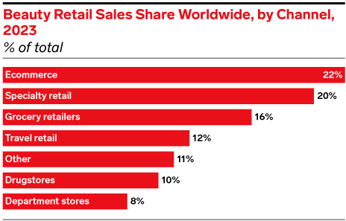
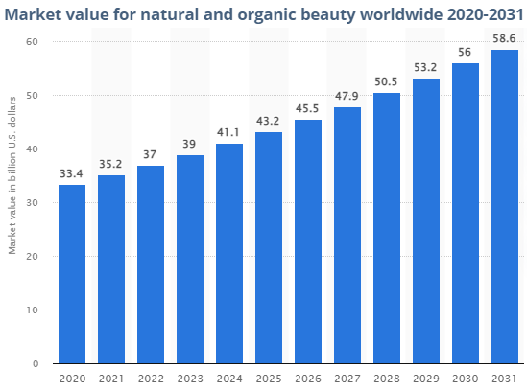
Opportunities: The Body Shop
Source: (Taaffe-Maguire, 2024)
Source: Statista, 2023
Sale growth opportunity with e-commerce retail
Demand growth projections for natural personal care and beauty products across the globe
Market growth and expansion opportunity in emerging economic markets across Asia and Africa.
Notes:
Opportunities
Growing global trend for online beauty and personal care product shopping (22% sales revenue generated by e-commerce channels) is a key opportunity for the Body Shop to reduce dependency on franchise store network and increase sales performance (Taaffe-Maguire, 2024). Global market value for natural beauty and personal care products has been projected to increase from £29.2 billion in 2022 to £46.3 billion and it could be a great opportunity for increasing future demand condition for all natural product range of the Body Shop (Wearden, 2024). Growing product demand in emerging economic markets in Asia and Africa could provide the Body Shop with further market growth and expansion opportunity.

Slide 5
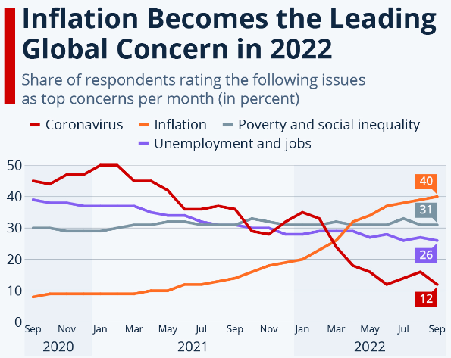
Threats: The Body Shop
Sales decline risk with recent digital transformation and store closure vision
Growing competition due to increasing adaptation of natural product range by conventional personal care brands
Low consumer buying interest of high cost products due to ongoing economic downturn.
Source: Statista, 2023
Notes:
Threats
In February 2024, the Body Shop announced visions for closure of nearly 200 UK stores for digital business transformational vision but could be threat to deeply impact sales performance of the business as it gains highest proportion of revenue from the domestic market region (Meddings and Linsell, 2024). Growing competition is also a potential threat for affecting global market position of the Body Shop as many mainstream beauty and personal care brands are adopting natural product range (Taaffe-Maguire, 2024). Post-pandemic economic downturn in the UK and other global market regions could also be a threat for buying interest of customers towards high cost product range of the Body Shop (Born and Collins, 2023).

