Slide 1

Student Name: CRISTIAN DUMITRU
Student ID: 2438147
Lecturer’s Name: Mucahit Ozden
Module Code: LCLM 4004
Module Name: Problem Solving and Decision-Making
Component 1: Green Haven Florists

Slide 2

Provide an Overview of your presentation
The presentation highlights the issue of Green Haven Florists and how the problems are affecting the company.
This will also highlight the 5W2H model, PESTLE analysis and cause and effect analysis to find the root cause of the issue.
Notes:
This presentation focuses on describing the issues of the Green Haven Flosrist company and applied 5W2H model to highlight the issues properly. Thus, it will also applied PESTLE analysis and the cause-and-effect model to find the proper issues of the business.

Slide 3
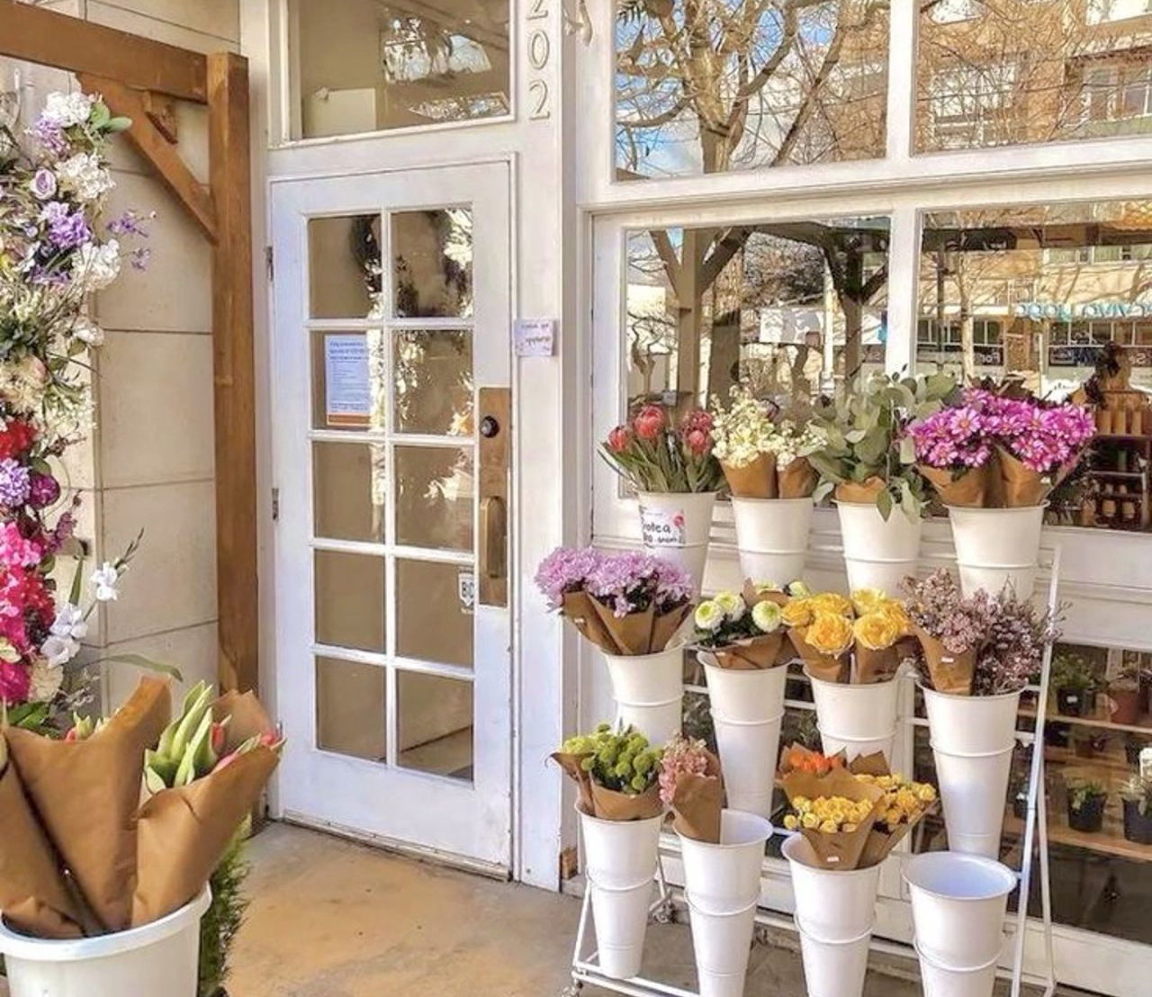
1. Overview of Green Haven Florists
The Green Haven Florist company was established in 2016, which was located in Norwich, UK.
It will also discuss the PESTLE analysis, Cause and effect analysis and assess the 5W2H summary, which is significant.
Notes:
The Green Haven Florist company was established as an independent flower shop which is located in Norwich, UK. This company was founded in 2016 by two founders. This company has gained a quick reputation for bespoke floral arrangement.
The 5W2H summary, it focuses on a question framework which helps to identify the problems and issues in-depth and creates a deep understanding of the topic.
The PESTLE analysis of Green Haven Florists will highlight some of the crucial information of external factors, such as rising costs of operations, changes in customer preferences, high risks of wastage and other problems.
Next, it will focus on the cause-and-effect theory, in which weak marketing and declining sales are creating challenges for the company to sustain its growth.

Slide 4
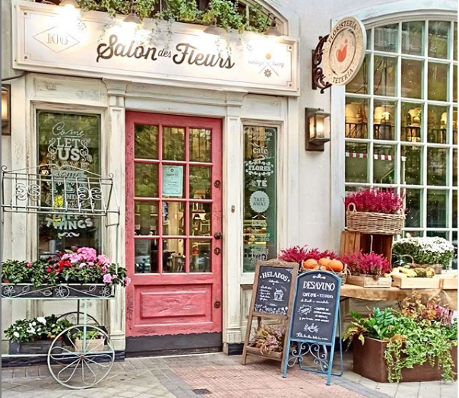
Provide an overview of Green Havan Florists
The Green Haven Florist company is a well-known flower shop which was founded in 2016, and the headquarters of this company is located in Norwich.
This company has gained a quick reputation at market through bespoke floral arrangements, and now they are facing lots of issues.
Notes:
The Green Haven Florists company was established into 2016 as an independent flower shop which was mainly located in Norwich, UK. This company was founded by two partners named Priya Patel and Liam. After a while, this shop has gained a quick reputation for its bespoke floral arrangements and its eco-friendly packaging. However, they are suffering from some of the crucial issues at market to survive.

Slide 5

Provide an insight into the problems Green Haven Florists are facing
The internal issues for the company are foot traffic loss, mixed customer feedback and rising costs of operations, which are problematic.
The competition is the external problem for Green Haven Florists' shop at the market, which generates issues.
Notes:
From the case study, it was found that the root cause of the Green Haven Florists is 30% decline in their in-store sales. The sales of online orders have increased into this shops; however, it does not compensate for the loss of foot traffic for businesses. The reason behind its decline was rising costs, mixed customer sentiments and new competitors. The customer feedback and foot traffic decline are internal issues, and competitors are external issues for the company. The Green Haven has very low control over these issues.

Slide 6
Apply a 5W2H model and discuss the information provided in your table
What? | Where? | When? | Who? | Why? | How? | How much?
What effect is it having? | Where is the problem occurring? | When was the problem first noticed? | Who is impacted by the problem? | Why is the problem happening? | How serious is the problem? | How much money is being lost?
Decline of customers engagement | Operational aspects of the shop | After the decline in sales | Owner of this shop | Due to rising costs | Very serious | 30% of sales decline
Lack of trust | Customers service | After getting mixed sentiments | Customers | Low quality and waste | Very serious | 30% of sales decline
Low morale | Competition | Identifying new competitors. | Owner | New entrants of competitors | Very serious | 10% decline
Into this 5W2H model, it has identified some of the root cause issues of the Green Haven Florist company at the marketplace (Pacaiova, 2015).
This has also identified its impacts and how this will create difficulties for shops with what, where, when, who, why, how and how much questions (Pacaiova, 2015).
Notes:
The 5W2H model is crucial to identify the impact of issues in a shop, such as rising costs, new entrants and mixed customer sentiments. This has also assessed how the company is impacting over their further operations and growth (Pacaiova, 2015).

Slide 7

Provide a critique of the PESTEL Framework
The PESTLE analysis is one of the crucial frameworks that helps to assess the external factors (Perera, 2017).
The benefits of using this framework are step-by-step understanding, and criticism is lack of analytical perspective (Perera, 2017).
Notes:
The PESTLE analysis is one of the foremost frameworks that helps to assess the external factors and identify how they have impacted the operations of the business and its growth. The benefits of using this framework are structural understanding, and criticism is very little analytical (Perera, 2017).

Slide 8
Application and discuss the information provided in your PESTEL Framework
In political aspects, they do not have to suffer; the rising costs are negatively affecting them. From a social aspect, shifting interests of customers are creating challenges (Akman, 2020).
In technological term the company do not have a modernised system, and risks of wastage are creating difficulties for them (Akman, 2020).
Political Factors | Economic Factors | Social Factors | Technological Factors | Legal Factors | Environmental Factors
No impact | 30% decline Rising cost | Changing customers’ sentiments Lack of trust | Old websites model system | Managing wastage | Risk to managing wastage
Notes:
From a political point of view, Green Haven does not have to face any kind of issues, however into economic perspective, they are facing the rising costs of fresh flowers. In social aspects, the customers are now shifting their interest to buy from online sources. In terms of technological aspects, the company has not modernised websites system. From legal aspects, they do not face any problem, but environmentally, they have to face a high risk of wastage (Akman, 2020).

Slide 9
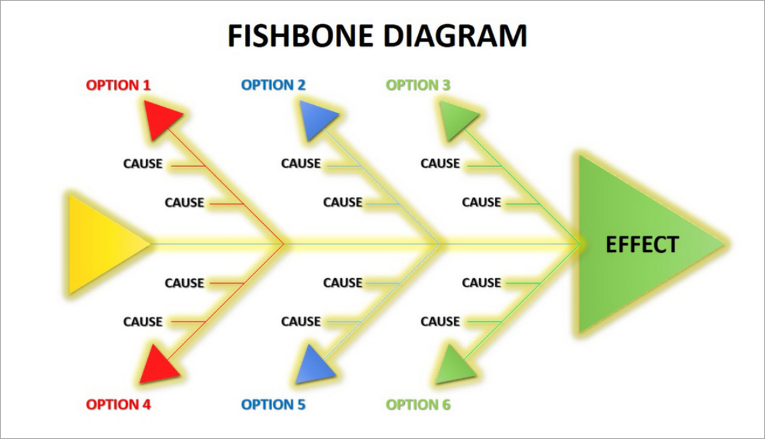
Provide a critique of the Cause-and-Effect model
The cause-and-effect model is known as the fishbone diagram, which mainly identifies the issues and their root cause (Ilie and Ciocoiu, 2010).
The fishbone diagram’s benefit is a structured way to find issues, and criticism is a casualty while observing issues (Ilie and Ciocoiu, 2010).
Notes:
The cause-and-effect model is also known as the fishbone diagram, which defines the issues and their root cause to cure the problem effectively. It use step by step to identify the issues and benefits of this model in a structured way to find the core issue. The criticism can be a casualty while observing issues (Ilie and Ciocoiu, 2010).

Slide 10
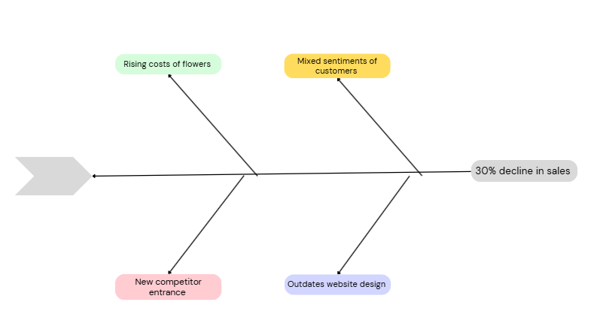
Application and discuss the information provided in your Cause-and-Effect diagram
The Fishbone or cause and effect diagram has helped to identify the issues of Green Haven Florist.
This has highlighted that the core issue is 30% decline in sales due to rising costs, changing customer sentiment and competitors.
Notes:
Through the application of the Fishbone diagram, it has become very clear how the issue of 30% sales decline has happened and its reason such as the rising costs ogf flower, changing customer sentiments and reducing foot traffic. Outdated website design and new entrants of competitors are the main issues (Coccia, 2020).

Slide 11

Provide a summary of your Key Findings
The first key findings have analysed the application of the 5W2H model to get an in-depth impact analysis of Green Haven
The second finding is the core issue, such as 30% decline in sales of Green Haven Florists in their operations.
The third finding is the impact of PESTLE or external factors on the shop
The fourth finding states about the Fishbone diagram, which assessed the issue step by step.
Notes:
The findings have helped to identify how 5W2H, PESTLE analysis and fishbone diagram have helped to find the core issues and those factors which were responsible for creating difficulties for the Green Have Florist shop.

Slide 12
Reference List:
Akman, M.K., (2020). Defence management and PESTLE analysis. Ante Portas-Security Studies, 1(14), pp.93-102. Link https://anteportas.pl/wp-content/uploads/2020/10/AP.XIV_.pdf#page=93
Coccia, M., (2020). Fishbone diagram for technological analysis and foresight. International Journal of Foresight and Innovation Policy, 14(2-4), pp.225-247. Link https://www.inderscienceonline.com/doi/abs/10.1504/IJFIP.2020.111221
Ilie, G. and Ciocoiu, C.N., (2010). Application of fishbone diagram to determine the risk of an event with multiple causes. Management research and practice, 2(1), pp.1-20. Link https://www.researchgate.net/profile/Carmen-Ciocoiu/publication/46567642_Application_Of_Fishbone_Diagram_To_Determine_The_Risk_Of_An_Event_With_Multiple_Causes/links/572afd7408aef5d48d30d6dd/Application-Of-Fishbone-Diagram-To-Determine-The-Risk-Of-An-Event-With-Multiple-Causes.pdf?_sg%5B0%5D=started_experiment_milestone&origin=journalDetail
Pacaiova, H., (2015). Analysis and identification of nonconforming products by 5W2H method. Center for Quality, pp.33-42. Link http://www.cqm.rs/2015/cd1/pdf/papers/focus_1/006.pdf
Perera, R., (2017). The PESTLE analysis (Vol. 1). Avissawella, Sri Lanka: Nerdynaut. Link https://okknf.smcebi.edu.pl/bmx670mvie62/12-christopher-bradtke-phd-1/the-pestle-analysis-9781986623346.pdf

Slide 13
Thank you for listening

Slide 14


