Slide 1
Sustainable Presentation
Module: Sustainable Global Tourism & Events
Module Code: BMTP5023
Lecturers Name: Deborah Jenkins
Student Name: Jayden Bond
Student ID: 2305531

Slide 2
Sustainable Policies & Regulations - Jayden
When examining sustainability, it is important to examine how policy and regulations can have effects on the industry and the agendas of companies.
For a company to operate within sustainability principles and address environmental issues, they must always consider the regulations set by the nation or regions governmental jurisdiction they are operating under.
Differing nations and even regions within a nation can have stricter or more lax policies that can influence the enforcement of sustainability.
Examples of this would be;
France banning disposable plastics to limit waste, thus companies need to change their approach to disposable use. (Domenitz & Sokolow, 2023)
The Swedish Environmental Code uses legislation to promote the sustainable development initiative. (Naturvardsverket, 2025)
The UK Environment Act has introduced legislation and discussion on a national scale to enforce sustainable change. (ClientEarth, 2022)

Slide 3
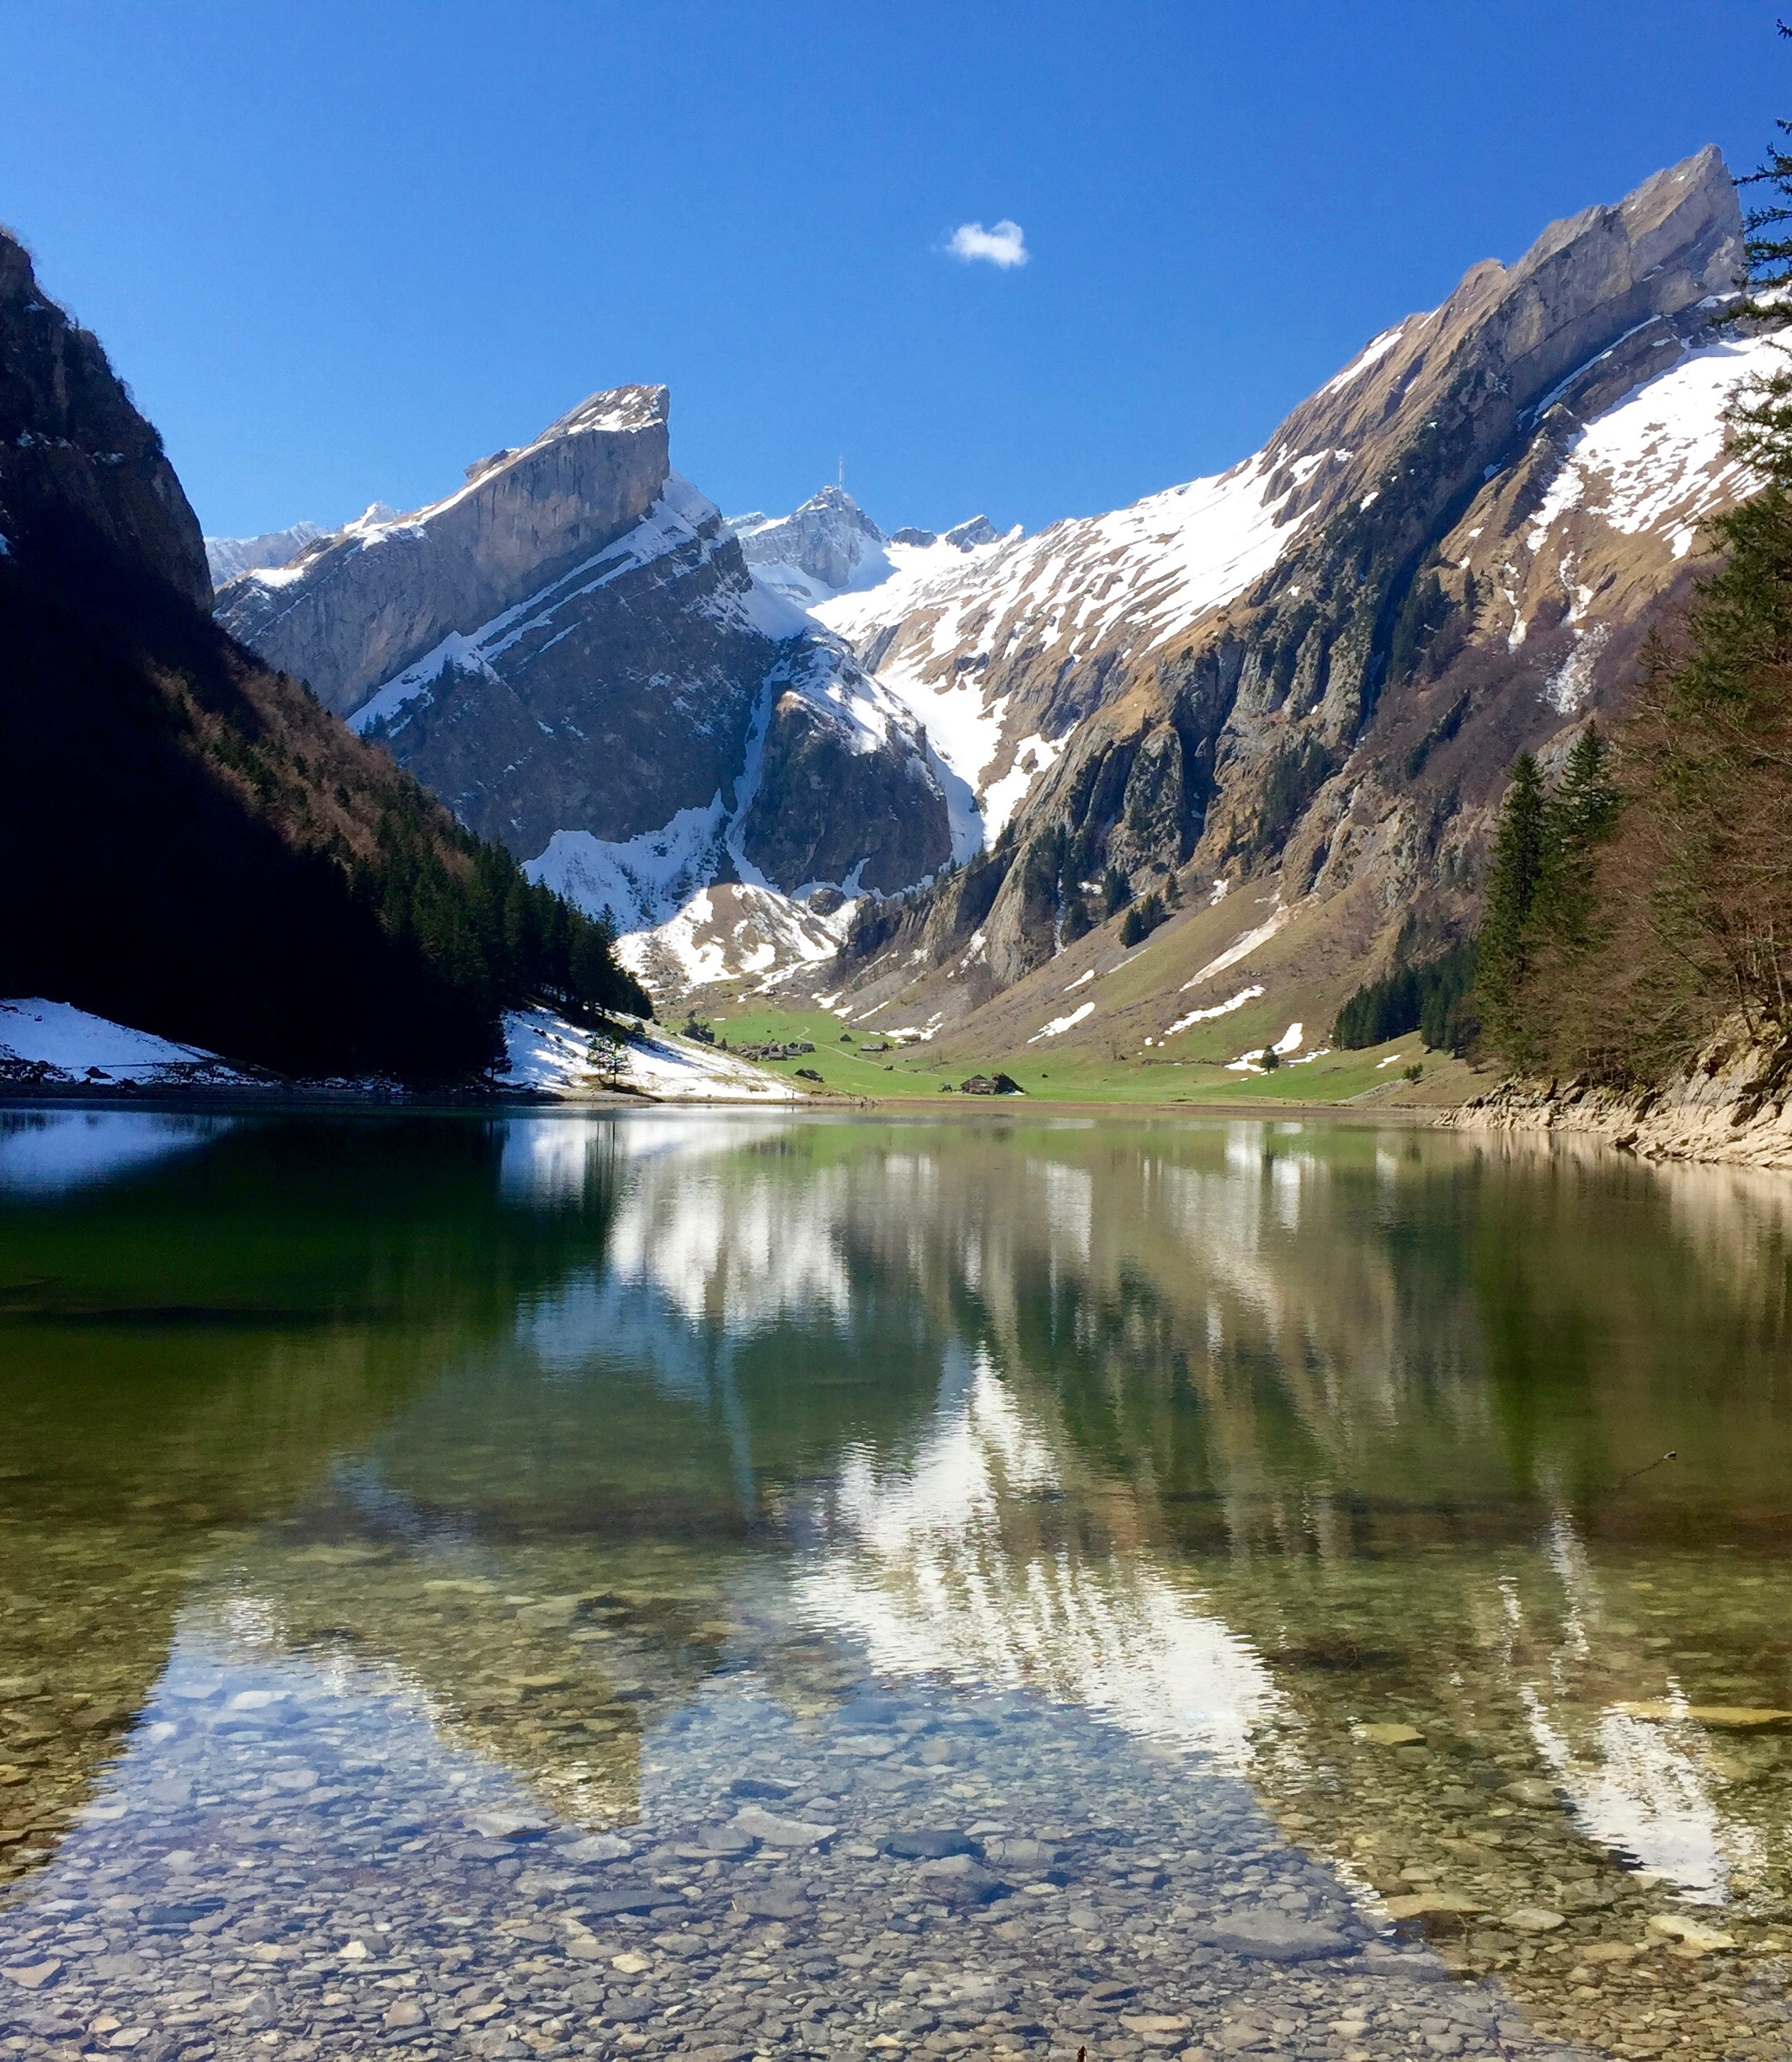
Regional Sustainability
As is the case with other countries, within Switzerland the focus on sustainability is present not only in corporate agendas but also in governmental practice. Such as;
The city of Zurich has become known as one of the world's leading destinations in sustainable conventions, having won the Smart City Award 2024 and the EarthCheck Silver certification. (Zuerich, 2025)
The Centre for Development and Environment is the Swiss centre for sustainable development as part of the University of Bern. They are mainstreaming sustainable research and collaborating with global partners (CDE, 2025)
The Swisstainable Program is an initiative led by the government of Switzerland aimed at labelling businesses and organisations with the 'Swisstainable' label from level 1 to 3 to reflect their degree of sustainable engagement. This can be used to increase consumer recognition for sustainability and urge change. (GreenPolicyPlatform, 2025)
As can be seen the country itself has been focusing on sustainable policy and is not restricted to the corporate world itself. This emphasis on sustainability shines a light for the consumers and puts emphasis on companies like Alpine Haven to adapt and change.

Slide 4

Global Sustainability
As a nation Switzerland has been an active voice in the sustainable development process and policy making to ensure a continual progression for a more environmentally conscious populace and an improving world. This can be seen in their contributions to global initiatives like;
Switzerland was a key contributor to the change in global perspective and policy on sustainability. The nation was one of the main advocates for the creation of the Sustainable Development Goals, including the implementation of the Voluntary National Reviews system (United Nations, 2025).
Switzerland has implemented the Agenda 2030 of the SDGs within the federal, cantonal and even communal levels to consider all obligations and established divisions of tasks to more effectively address sustainability. As well as highlighting detailed reports for the UN every 4 years since its participation. (Agenda 2030, 2025)
Switzerland is also part of the United Nations Sustainable Development Solutions Network, the SDSN, that aims to help mobilise its members and leverage their strengths to help realise the SDGs and promote awareness and collaboration. (UNSDSN, 2025)
As can be show by these contributions globally the nation has several environmental policies, regulations and initiatives that contribute to its national and international processes, which companies like Alpine Haven would need to factor and consider.

Slide 5

Operational Procedures
& Policy
With the nation of Switzerland enforcing national and global initiatives and policy, as well as regional regulations within the cantons it is important that Alpine Haven adapt and adhere to these procedures and practices. These practices and procedures can be implemented throughout the company, whether it is;
Adapting operational procedure to obtain a Swisstainable Award to show emphasis with environmental adherence
Transition of resort energy to renewable sources like solar panels and wind turbines to power facilities, whilst adopting energy efficient systems like advanced insulation and LED lighting to ensure effective power usage
Creating systems to recycle water used for facilities or in snowmaking and further preserve and protect natural water bodies and use them responsibly in resort operations
Monitor and protect the Alpine ecosystems and implement programs and methods to minimise ecological disruptions. Furthermore, establishing wildlife corridors or restricted areas around the resort to allow for safe migration of the local wildlife
Prioritisation of sourcing food, services and materials from local farms and businesses to support the local economy while engaging with the community through educational visits, charitable donations and work opportunities
By providing information on sustainable practices within marketing materials and to guests during their stay, encouraging environmental awareness as well as regularly training and reviewing staff on sustainable policy and procedures within their training
This adherence to sustainable initiatives should also be encouraged through regular monitoring and reviewal to ensure compliance with the national and international regulations and initiatives, as well as to promote transparency and maintain accountability. (Project 44, 2024)

Slide 6
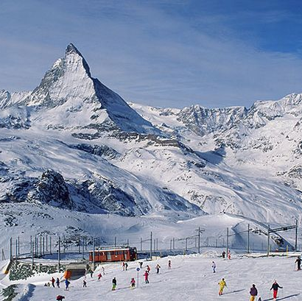
How Procedure Can Build Legacy?
As has been shown the importance of environmental policy is key on a global scale. In the past policy has been important to influence the future, as could be shown in the Montreal Convention of 1987.
This convention led to protocols that regulated the production and consumption of nearly 100 chemicals that affected the ozone layer and is considered one of the first global treaties that dealt with the environment and showed just how possible global cooperation and future treaties could be. (UNFCCC, 2022)
By implementing policies and changing perceptions on the environment nations like Switzerland can alter the processes of business and organisations globally to ensure sustainable development and environmental wellbeing. (Dimitriadou, 2023)
With how aware ski resorts like Alpine Haven and Switzerland as a nation are of the environmental impacts, these procedures combined with the active awareness and engagement with stakeholders can ensure the long-term future viability of businesses like Alpine Haven is maintained and that legacy is made. (Saxena, 2024).

Slide 7
Reference List - Jayden
Domenitz, J. and Sokolow, L. (2023) How France’s anti-waste law targets plastic waste at its source, Frontier Group. Available at: https://frontiergroup.org/articles/how-frances-anti-waste-law-targets-plastic-waste-at-its-source/ (Accessed: 30 March 2025).
The Swedish Environmental code (2025) NaturvÃ¥rdsverket. Available at: https://www.naturvardsverket.se/en/laws-and-regulations/the-swedish-environmental-code/ (Accessed: 30 March 2025).
Sustainable convention city || sustainable events in Zurich (2025) The Official Zurich City Guide. Available at: https://www.zuerich.com/en/business/why-zurich/sustainability?gad_source=1&gbraid=0AAAAADGK862dHOTP3MIjHUV1PirnCjSDw&gclid=EAIaIQobChMIp_zf8dW0jAMVFphQBh0Z4wkMEAAYASAAEgI4bfD_BwE (Accessed: 30 March 2025).
(2025) Centre for Development and Environment (CDE). Available at: https://www.cde.unibe.ch/ (Accessed: 30 March 2025).
Switzerland - launch and implement the Sustainability Program ‘swisstainable’ (2025) Switzerland - Launch and Implement the Sustainability Program ‘Swisstainable’ | Green Policy Platform. Available at: https://www.greenpolicyplatform.org/big-e/switzerland-launch-and-implement-sustainability-program-swisstainable (Accessed: 30 March 2025).
Switzerland .:. sustainable development knowledge platform (2025) United Nations. Available at: https://sustainabledevelopment.un.org/memberstates/switzerland (Accessed: 30 March 2025).
(2025) Agenda 2030. Available at: https://www.agenda-2030.eda.admin.ch/en (Accessed: 30 March 2025).
Switzerland (2025) SDSN Switzerland - Sustainable Development Solutions Network. Available at: https://www.unsdsn.org/our-networks/switzerland/#:~:text=Key%20focus%20areas%20include%20raising,economies%2C%20the%20transformation%20of%20the (Accessed: 30 March 2025).
Sustainability Reporting and metrics: Enhancing transparency, accountability, and effectiveness (2024) Project44. Available at: https://www.project44.com/blog/sustainability-reporting-and-metrics-enhancing-transparency-accountability-and-effectiveness/ (Accessed: 30 March 2025).
Fifty Years of Environmental Action (2022) UNFCCC. Available at: https://unfccc.int/news/fifty-years-of-environmental-action#:~:text=These%20include%20the%20International%20Convention,Rio%20Conventions%20(climate%2C%20biodiversity%2C (Accessed: 30 March 2025).
Saxena, S. (2024) Building a sustainable legacy: Journey Towards Environmental Responsibility, BW Marketing World. Available at: https://www.bwmarketingworld.com/article/building-a-sustainable-legacy-journey-towards-environmental-responsibility-524610 (Accessed: 30 March 2025).

