Slide 1

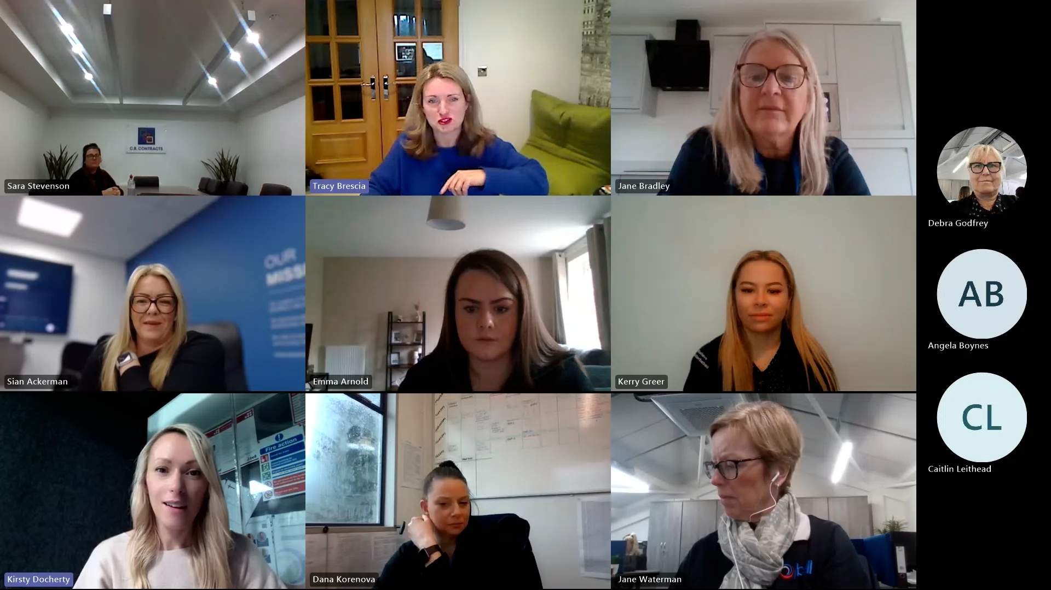
Step by step instructions on how to set up Microsoft teams
(1) First you need a computer or laptop with internet connection (2) go to https://www.microsoft.com/microsoft-teams on your computer, and click "download for desktop"
Choose your operating system (windows or mac),install the file and sign in using your Microsoft 365, on mobile devices, open the app store (iphone) or google play store (Android), search for "Microsoft Teams," and tap "install." Once installed, open the app and log in with your Microsoft credentials. (3) download outlook visit https:// www.microsoft.com/microsoft-outlook and select "download outlook for desktop" Follow the installation steps and sign in with your email account. On mobile, find Outlook in your device's app store and install it. Sign in using the same account you use for Teams to ensure both apps are connected.
Once both apps are set up, you can easily schedule a Teams meeting through Outlook. Open outlook, go to calendar, and click "New Teams Meeting." Enter the meeting title, date and time, and attendee's emails. Outlook automatically generated a Teams meeting link. Add any notes or agenda, then click "send."
Participants will receive the invite with a Join Teams Meeting link. When it's time, they can click the link from Outlook or Teams to join. This integration between Outlook or Teams makes scheduling and managing virtual meetings quick, professional, and efficient.
Open Microsoft Teams or go to Outlook calendar
https://www.bing.com/ck/a?!&&p=118118094956cdd6a9789b5916beee664ec4bcbaab538198e805534551f0b416JmltdHM9MTc2MDgzMjAwMA&ptn=3&ver=2&hsh=4&fclid=17047fdf-16e4-6217-1e8e-6ba9170463fc&psq=microsoft+teams&u=a1aHR0cHM6Ly90ZWFtcy5taWNyb3NvZnQuY29tL3YyLz9sbT1kZWVwbGluayZjdWx0dXJlPWVuLWdiJmNvdW50cnk9Z2I
Create Microsoft Teams meeting
Click calendar
Enter meeting title, attendees, dates & time and details or agenda
Press send
Select new Teams meeting

