Slide 1

Student Name: Shazia Begum
Student Number:2117727
Module Name: Addressing The Problems Of Staff Shortage In Proper Care UK
Module Code:BMSW4004
Lectures Name:Zahra-Mohammadnazari

Slide 2
Introduction
The issues with staff shortages in Proper Care UK will be discussed in the presentation that follows.
Proper Care UK is an adult care provider that is having major staff shortage problems due to issues such as Brexit.
One of the biggest staffing concerns Proper Care UK is presently facing is a shortage in nursing. Along with difficulties in medicine, particularly in specific specialties.
These pressures extend outside of the NHS with major staffing shortages in general practice.
Different methods of analysis have been used in this investigation such as PESTLE, FISHBONE, and PMI.

Slide 3
INTRODUCTION
PESTLE which is a framework that analyses external environment influences on organisation will be used to identify the problems. Proper Care are facing. The PESTLE model is a tool for analysing and determining the aspects of a project environment according toDe Val (2021).
A research-informed cause and effect analysis using a Fishbone Diagram will also be presented in this presentation. Desai (2015) states the fishbone diagrams assist in identifying areas that require attention so that resources can be focused on root causes and specific organisational department responsibilities.

Slide 4

NATURE of the problem
The main problem faced by Proper Care is a shortage of staff this issue is causing problems for both staff and patients.( Corvo, 2021) during COVID-19, a substantial issue of such workers migrating internationally as well as the estimated shortfall of around 15 million health and social care professionals, including over 6 million nurses.

Slide 5
Who is affected by the staff shortage
This in turn is causing problems to the organisations.
Staff is then affected by this as their workload is getting heavier.
Management also feels a burden as the overworked staff does not normally make up a happy team.
(2010)Employers need workers who are productive and efficient, and it stands to reason that those who are content will likely perform better than those who are not.
Patients and staff are affected as the waiting list continues to grow.

Slide 6
Impact of staff shortage
Staff shortages cause a decline in patient care.
The reputation of the company can be tarnished if they are not meeting its goals.
Greater workload for existing staff.

Slide 7
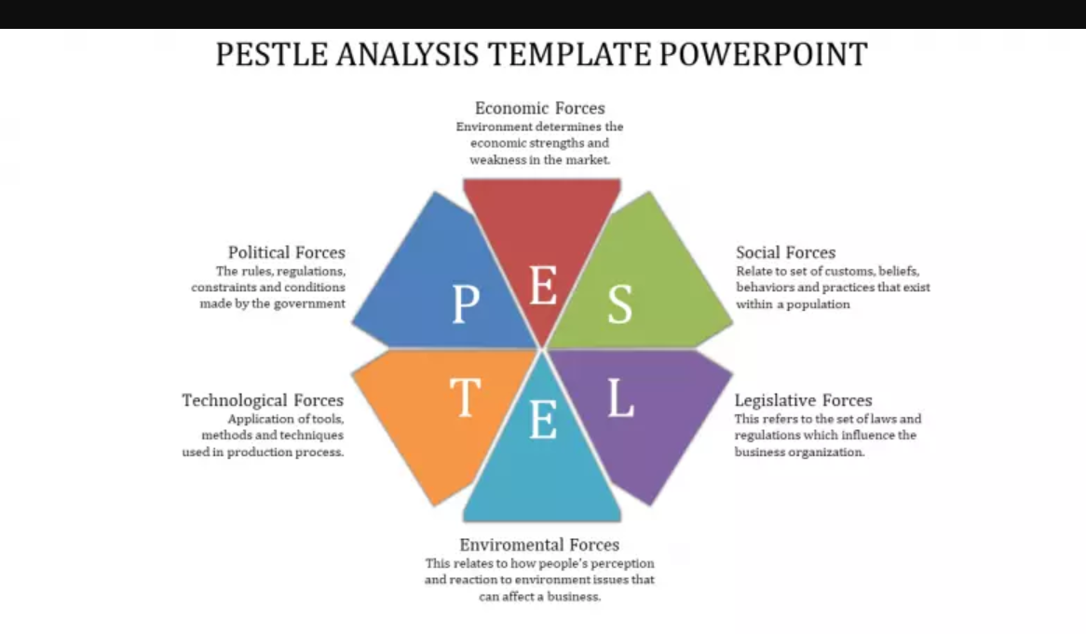
pestle
Slidegg (No Date)
PESTLE analysis is considered a common research tool to analyse and classify political (P), economic (E), social (S), technological (T), legal (L) and environmental (E) issues.( Vardopoulos, . et al. 2021)

Slide 8
pestle
Using the PESTLE analysis to manage the current situation and its associated factors to see how a wider range of problems has an impact on Proper Care.
Proper Care in this case PESTLE can be used to identify factors which cause issues within the organisation
P=Government policy Trade Restrictions
E=
S
T
E
L
p | e | s | t | l | e
Political Factors These are issues such as employment law, tax , introduction to new laws And new policies for organisations. | Economic Factors National and international issues. It is important to stay connected with costs. | Social Factors Population growth. Age. Cultural barriers. | Technological Factors Technological change. Technological awareness. According to (Hicks 2000) Effective problem-solving in technology can take some time and effort however to get to your company goal it is essential. | Legal Factors Discrimination law. Employment law. Health and Safety law. | Environmental Factors Weather. Climate change. Environmental policies.

Slide 9
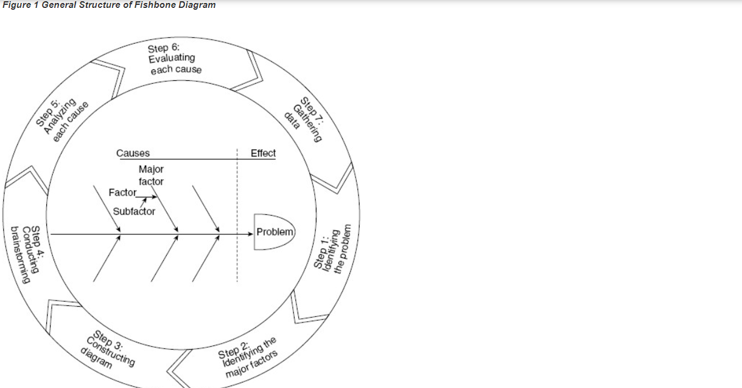
fishbone
Adult Care has a number of minor concerns that can be resolved using the fishbone method because it will allow the business to pinpoint where its weaknesses are.
According to (Sage 2015) to clarify how several aspects can be recognised and connected to an investigation problem, Kaoru Ishikawa created it in 1943 at the University of Tokyo.
The smaller issues that Proper Care is facing once identified through the fishbone technique will help the company come up with a solution to its staff shortage issues..
Figure 1 General Structure of Fishbone Diagram
(Sage 2015)

Slide 10
fishbone
The fishbone strategy can be used as the main problem Proper Care is facing is a shortage of staff.
The smaller problems which amount to the bigger issue are problems in medication, particularly in some areas.
Also, the area to where medicines are reaching is an issue
Brexit is also adding to staffing issues.
The primary issue can be identified using the fishbone cause and effect analysis, as can the minor issues that are contributing to the main issue.
Environmental
Personal Circumstances
Wage
Brexit
Work culture.
Location
Parking.
Staff Shortage
Change off carer after COVID 19 pandemic.
Medication
Lack of equipment.
People
Equipment

Slide 11
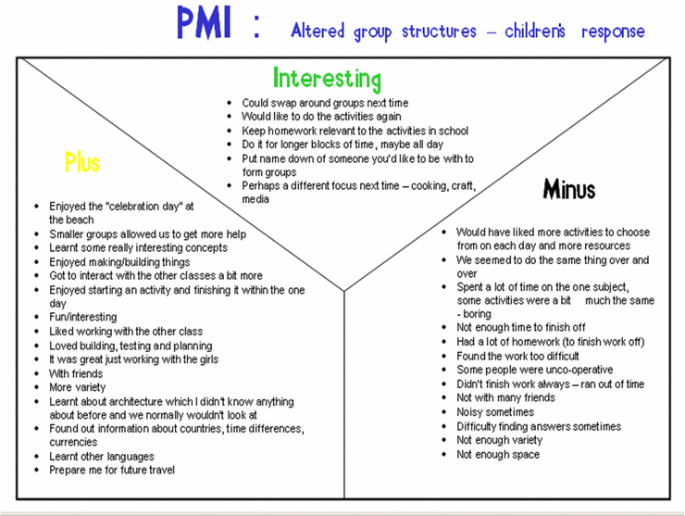
pmi
PMI is a useful tool for weighing a decision's benefits, drawbacks, and implications. PMI is a useful strategy to utilise once you have decided on a plan of action to ensure that it is worthwhile.
(Gillard 2012)

Slide 12
SOLUTIONS FOR STAFF SHORTAGE USING PMI
Proper Care should offer incentives to existing staff as they want to retain them
Star of the week to offer positive praise to current staff.
The company should recruit worldwide as there are so many vacancies.
Advertise more on the internet and social media for job roles to be filled. (Farsi,2021) One of the most popular web-based activities is using social media, which had an estimated 2.9 billion members as of 2019 and is expected to reach 3.4 billion by 2023.
It has been recommended that Proper Care, should use the internet to advertise more jobs as this method is a popular choice amongst individuals looking for employment.

Slide 13
Pmi
Advertise more on the internet and social media for job roles to be filled.
Staff Shortage
PLUS | MINUS | INTERESTING/IMPLICATION
World wide advertising +5 Easy to apply +5 Can have multiple applicants +5 | CRB checks Criminal checks -5 Age barrier -3 Internet access -2 | Diverse work unit +5 Less paper waste +4 Multiple applicants +5
Total=15 | Total=10 | Total=14

Slide 14
Discussion
PMI charts can help identify what recommendation is best for the organisation.
The main problem has been addressed which is a shortage of staff.
It is recommended Proper Care apply method 3 as this is the best approach for the company's current problem.
Recommendation 1 is to introduce star of the week. Recommendation 2 is to recruit worldwide. Recommendation 3 is to advertise on the internet for jobs.
This method can help build an effective and diverse work team.
According to (Hicks 2000) Effective problem solving can take some time and effort however to get to your company goal it is essential.
Proper Care should be thinking about using methods like PESTLE and Fishbone to identify the problems they have in their company.

Slide 15

CONCLUSION
To conclude, in order for Proper Care to be a successful workforce, the company should follow the advice from the PMI chart, which is to advertise online because it is a simple way and can be accessed globally.

Slide 16
Reference PAGE
–.
De Val, J., Sohal, G., Sarwar, A., Ahmed, H., Singh, I. and Coleman, J.J., (2021). Investigating the challenges and opportunities for medicines management in an NHS field hospital during the COVID-19 pandemic. European Journal of Hospital Pharmacy, 28(1), pp.10-15.
Desai, K.J., Desai, M.S. and Ojode, L. (2015) ‘Supply chain risk management framework: a fishbone analysis approach’, S.A.M. advanced management journal (1984), 80(3), p. 34–.
‘Fishbone Diagram’ (2015). In The SAGE Encyclopedia of Quality and the Service Economy. Thousand Oaks: SAGE Publications.
Hicks, T. (2000) Seven steps outlined for effective problem-solving. The Business journal (Phoenix, Ariz.).
Slideegg (no Date) Attractive Pestle Analysis Template Available at https://www.slideegg.com/pestle-analysis-template-powerpoint-1/ [Accessed 21 June 2022].
Perks and pride to retain the talent (2010) . Why a happy workforce is good for everyone.. Human Resource Management International Digest, 18(3), pp. 13-15.
Corvo, E. and De Caro, W. (2021). ‘Mobility and migration of health care workers’, European journal of public health, 31(Supplement_3).
Farsi, D.,( 2021). Social Media and Health Care, Part I: Literature Review of Social Media Use by Health Care Providers. Journal of Medical Internet Research, 23(4),.
Gillard, M. (2012). PMI - Plus Minus Interesting. Innovation-creativity.com. Available at http://www.innovation-creativity.com/pmi.html [Accessed 7 July 2022].
Vardopoulos, I. et al. (2021) ‘An Integrated SWOT-PESTLE-AHP Model Assessing Sustainability in Adaptive Reuse Projects’, Applied sciences, 11(15), p. 7134–.

