Slide 1

CBT and New Cognitive Approaches: 27th February
Mindfulness Based Approaches

Slide 2

Mindfulness Activity

Slide 3

Resources
BABCP Podcast
MIND – Link
Mindfulness based approaches: A guide for psychologists
Davis, D., DeBlaere, C., Hook, J. N., & Owen, J. (2020). Mindfulness-based practices in therapy: A cultural humility approach. American Psychological Association. https://doi-org.ezproxy.uwtsd.ac.uk/10.1037/0000156-000
University of Oxford Mindfulness Based Centre

Slide 4

Mindfulness Based Approaches
Mindfulness Based Stress Reduction (MBSR)
Mindfulness Based Cognitive Therapy (MBCT)
Dialectical Behaviour Therapy (DBT)
Compassion Focus Therapy (CFT)
Acceptance and Commitment Therapy
Other Psychotherapeutic Practices

Slide 5

Mindfulness is linked to Eastern spiritual traditions but can be used separately from these without fear of converting someone to a faith path or being disrespectful to spiritual traditions.
Mindfulness has been defined as the awareness that emerges when we pay attention to experience on purpose, in the present moment, and nonjudgmentally (Kabat-Zinn, 1994).
Notes:
• the development of mindful awareness by a combination of systematic and informal practice;
• an attitudinal framework characterized by kindness, curiosity, and a willingness to be present with the unfolding of experience;
•

Slide 6

BPS….
Psychologists introducing mindfulness-based approaches need to be open to unusual and unexpected effects, and these must be approached in a mindful way to help people through them. Afterwards, reflection without judgement through supervision is recommended to discover what can be learned from the experience

Slide 7
Beneficial for….
Mindfulness-based approaches have been demonstrated to be potentially beneficial for children and adolescents, people with intellectual disabilities and older adults, as well as adults.
Mindfulness-based approaches have demonstrated benefits for people with long-term conditions (e.g. chronic pain and cancer) but care needs to be taken to adapt the approach to encompass physical health needs

Slide 8
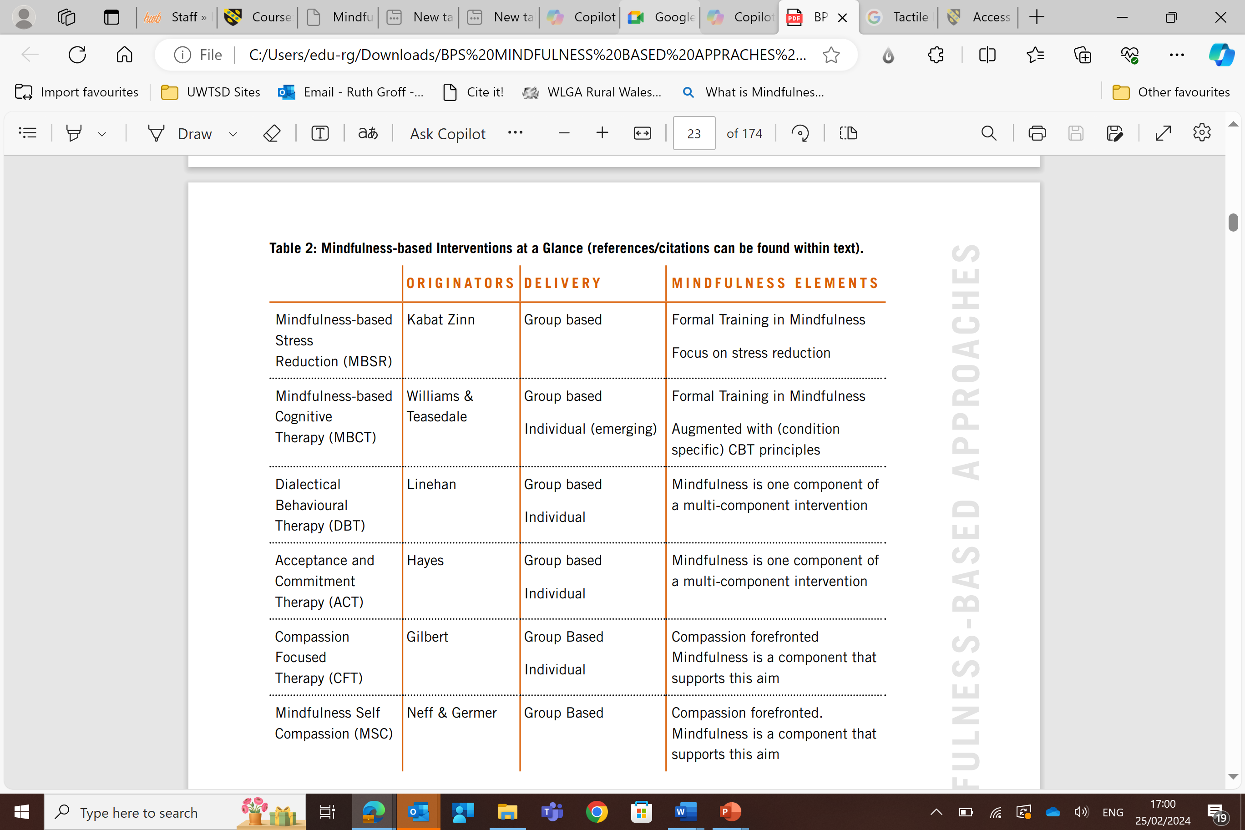

Slide 9
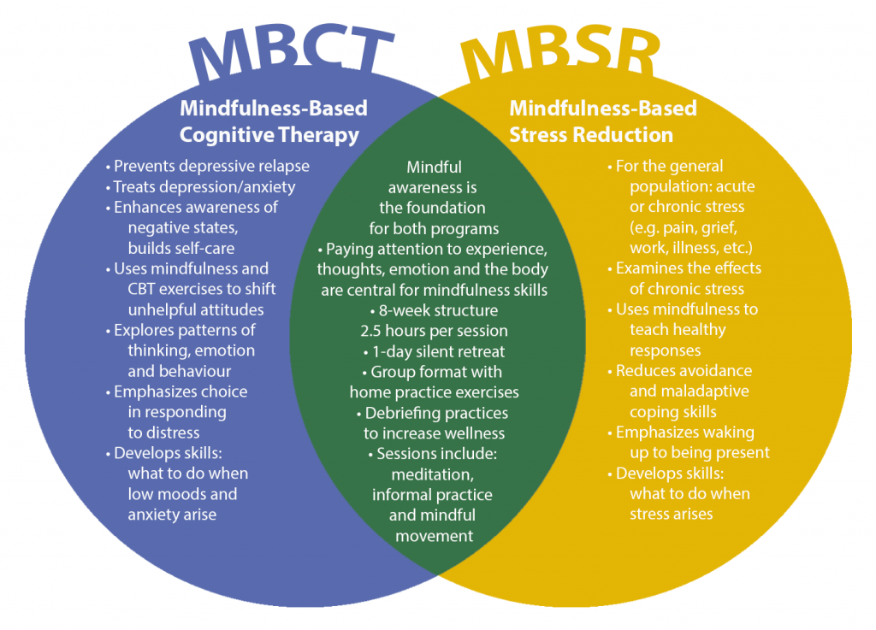
Centre for Mindfulness Studies
https://www.mindfulnessstudies.com/understanding-mbps/

Slide 10
In Brief…(BPS)
MBSR and MBCT are standardised group mindfulness training protocols taught over eight weeks that specifically teach and train mindfulness as the primary active ingredient in the therapeutic process.
DBT and ACT utilise mindfulness skills and tools included within a broader spectrum of multifaceted therapeutic approach. In these models, mindfulness skills augment other elements trained concurrently. Both individual and group work are offered as part of these interventions.
Programmes forefronting the development of compassion have elements of mindfulness that are related to and augment compassion training, but are not necessarily the main component.
• Delivering any of these interventions requires additional personal as well as professional development training and supervision

Slide 11
Core Elements of MBSR
Body-scan exercises (suggested 45 minutes duration daily lying down scanning attention through the body).
Mental exercises focusing one’s attention on the breath.
Physical exercises with focus on being aware of bodily sensations. 4
Practise in being fully aware during everyday activities

Slide 12
CORE ELEMENTS (EIGHT SESSIONS) OF MBCT (from Mindfulness-based Cognitive Therapy for Depression: A New Approach to Preventing Relapse, Segal et al., 2018)
1. Automatic Pilot
2. Dealing with Barriers
3. Mindfulness of the Breath
4. Staying Present
5. Allowing/Letting Be
6. Thoughts are Not Facts
7. How can I best take care of myself?
8. Using what has been learnt to deal with future m

Slide 13

Practical Applications – Group Work
NHS and NICE Guidance? G1
Evidence Based? Research G2
Application and Interventions G3

Slide 14

Feedback
What has been helpful?
What has not worked?
What are some suggestions?

