Slide 1
2407917
I have not used AI.
ECEY5009 word count:1818
Health, well-being and lifestyles
Introduction
The poster examines the theoretical foundations underlying these concepts specifically in relation to early years and childhood development, explores key research findings relevant to young children, reviews legislation and policy guidance affecting early years settings and primary schools, and discusses curriculum integration within early childhood education and primary education frameworks. It will also explore the multifaceted nature of health and wellbeing in early childhood, examining how theoretical perspectives inform practice and policy in supporting young children's holistic development. The concepts of health, wellbeing, and lifestyles take on particular significance during early years and childhood, as these developmental periods establish foundational patterns that influence lifelong outcomes (Shonkoff and Phillips, 2000). Contemporary understanding recognises that health and wellbeing in young children are not merely individual characteristics but emerge through complex interactions between biological development, family relationships, early educational experiences, and broader environmental contexts (Shonkoff and Phillips, 2000).Rresearch consistently demonstrates that experiences during the first five years of life have profound and lasting effects on physical, emotional, social, and cognitive development (Shonkoff & Phillips, 2000).
Concepts
Health in early childhood encompasses far more than the absence of disease or illness. The World Health Organization's definition of health as "a state of complete physical, mental and social wellbeing" (WHO, 1946) provides a foundation for understanding health as a holistic concept. In the early years context, this translates to supporting children's physical growth and development, nurturing their emotional and mental health, and fostering positive social relationships and connections.
Health
Health in early childhood encompasses far more than the absence of disease or illness. The World Health Organization's definition of health as "a state of complete physical, mental and social wellbeing" (WHO, 1946) provides a foundation for understanding health as a holistic concept. In the early years context, this translates to supporting children's physical growth and development, nurturing their emotional and mental health, and fostering positive social relationships and connections. Physical health in early childhood involves multiple interconnected components.

Slide 2
Proper nutrition forms the foundation, with early feeding experiences establishing taste preferences, eating patterns, and metabolic programming that can influence health throughout the lifespan (Birch & Doub, 2014). Adequate sleep is equally crucial, with research demonstrating that sleep quality and duration directly impact cognitive development, emotional regulation, immune function, and physical growth (Mindell & Owens, 2015). Regular physical activity supports not only cardiovascular health and motor development but also brain development, with movement experiences creating neural pathways that support learning and cognitive function (Diamond, 2000). Preventive healthcare measures, including routine immunizations, developmental screenings, and regular health assessments, represent another critical component of physical health in early years (Public Health England, 2016). These interventions aim to identify and address potential health concerns before they become significant problems, supporting optimal development during this critical period. Mental and emotional health in early childhood encompasses the development of emotional regulation skills, resilience, and positive mental health foundations. Young children's mental health is characterized by their ability to experience, regulate, and express emotions appropriately, develop and maintain close relationships, and explore their environment with confidence (Zero to Three, 2016). Early experiences of trauma, stress, or adversity can significantly impact developing brain architecture, potentially leading to long term mental health challenges (National Scientific Council on the Developing Child, 2014).
Well-being
Wellbeing represents a broader concept that encompasses quality of life, life satisfaction, and the presence of positive characteristics such as happiness, contentment, and resilience (Statham & Chase, 2010). Unlike health, which can be measured through observable indicators, wellbeing is more subjective and encompasses children's own perceptions of their experiences and quality of life.
Psychological wellbeing in early childhood involves the development of positive self-concept, emotional security, and a sense of agency and competence (Laevers, 2000). Children with high psychological wellbeing demonstrate curiosity, enthusiasm for learning, and confidence in their abilities. They show resilience in the face of challenges and maintain generally positive emotional states.
Social well being encompasses children's sense of belonging, acceptance, and connection within their families, early years settings, and communities. Children with strong social wellbeing feel valued and supported by others, demonstrate prosocial behaviours, and successfully navigate social situations (Mashford-Scott et al., 2012). This dimension of wellbeing is particularly important as children transition between different social contexts and relationships.
Spiritual wellbeing, while often overlooked in early childhood discourse, represents children's sense of wonder, meaning, and connection to something greater than themselves (Hyde, 2008). This may manifest through appreciation of nature, engagement with cultural or religious traditions, or experiences of awe and transcendence. Spiritual wellbeing contributes to children's overall sense of purpose and connection.

Slide 3
Physical wellbeing extends beyond mere physical health to encompass children's comfort with their bodies, enjoyment of physical activity, and sense of physical competence (Maude, 2010). Children with strong physical wellbeing feel capable and confident in their physical abilities and demonstrate positive relationships with their bodies.
Lifestyles
Lifestyles in the early years context refer to the patterns of behavior, habits, and environmental factors that influence health and wellbeing (McLeod & Giles, 2018). Unlike adult lifestyle choices, which are largely autonomous, children's lifestyles are predominantly shaped by their families, cultural contexts, socioeconomic circumstances, and the policies and practices of their early years settings.
Physical activity lifestyles include both structured and unstructured movement experiences, outdoor play opportunities, screen time patterns, and sedentary behaviors (Timmons et al., 2012). The amount and quality of physical activity children experience impacts not only their physical development but also their cognitive function, emotional regulation, and social skills development. Modern lifestyles increasingly involve extended periods of sedentary behavior and reduced outdoor play, creating new challenges for supporting healthy physical activity patterns.
Dietary lifestyles encompass not only the types of foods children consume but also eating patterns, food preparation methods, mealtime routines, and food cultural practices (Savage et al., 2007). Early dietary experiences establish taste preferences, eating behaviors, and relationships with food that often persist into adulthood. The timing of meals, family mealtime interactions, and food security all contribute to children's dietary lifestyle patterns.
Sleep lifestyles encompass bedtime routines, sleep environments, sleep duration and quality, and family attitudes toward sleep (Mindell et al., 2010). Cultural variations in sleep practices, family sleeping arrangements, and bedtime routines all contribute to children's sleep lifestyle patterns. The increasing presence of electronic devices and artificial lighting in home environments has created new considerations for healthy sleep lifestyles.
Social and emotional lifestyles refer to patterns of social interaction, emotional expression, stress management, and relationship formation within families and communities (Denham et al, 2012). These include communication patterns, conflict resolution approaches, celebration and ritual practices, and community engagement levels. Environmental lifestyles include exposure to natural environments, air and water quality, housing conditions, neighbourhood safety, and access to community resources (Evans, 2006). These factors, while often beyond individual family control, significantly impact children's health and development outcomes.

Slide 4
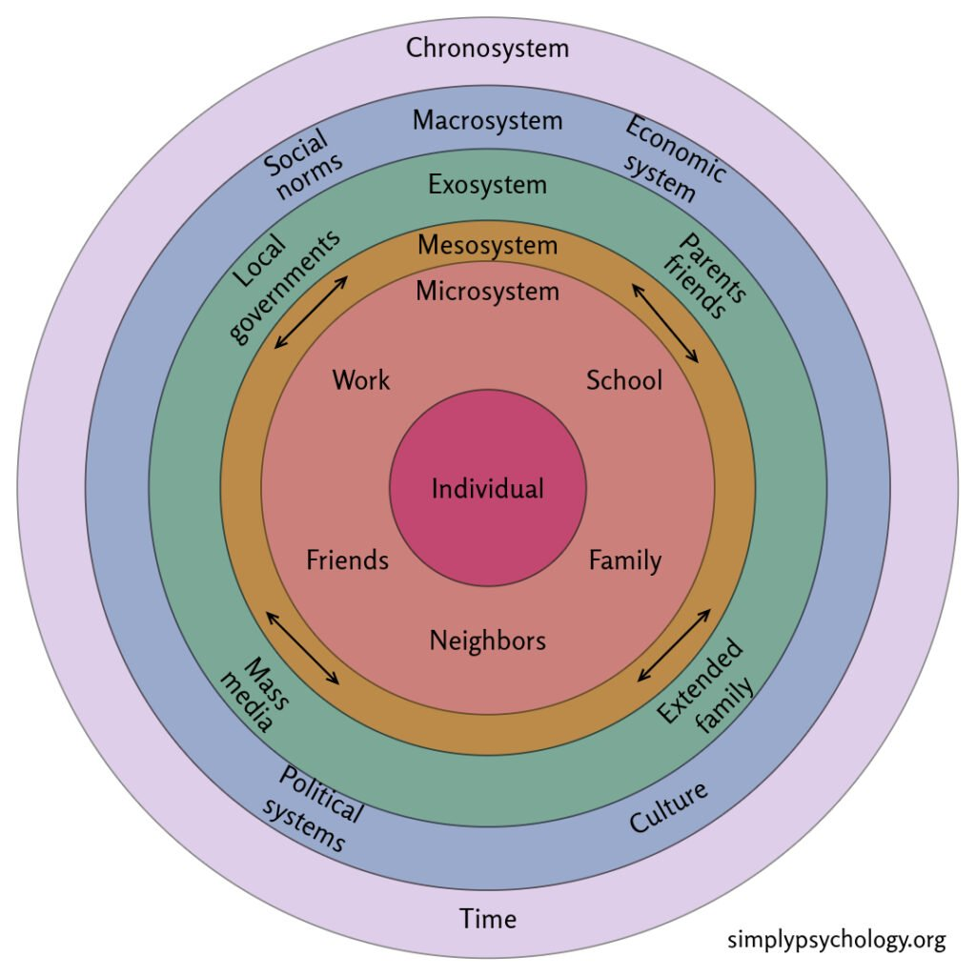
Bronfenbrenner's Ecological Systems Theory
Urie Bronfenbrenner's ecological systems theory provides a comprehensive framework for understanding how multiple environmental systems influence child development, health, and wellbeing (Bronfenbrenner, 1979). The theory identifies five interconnected systems that impact children's development: the microsystem (immediate environment including family and early years settings), mesosystem (connections between microsystems), exosystem (indirect influences such as parental workplace policies), macrosystem (cultural values and beliefs), and chronosystem (changes over time).
This theoretical perspective emphasizes that children's health and wellbeing are influenced by factors operating at multiple levels simultaneously. For instance, a child's nutritional health is affected by family food choices (microsystem), the relationship between home and early years setting food policies (mesosystem), community food security (exosystem), cultural attitudes toward nutrition (macrosystem), and changing nutritional guidelines over time (chronosystem).
The ecological approach has significant implications for early years practice, suggesting that effective interventions must address multiple system levels rather than focusing solely on individual child factors (Bronfenbrenner & Morris, 2006). This perspective supports comprehensive approaches to promoting health and wellbeing that involve families, communities, and policy makers working collaboratively.
(Guy-Evans, 2025)
Albert Bandura's social cognitive theory highlights the importance of observational learning, self efficacy, and reciprocal determinism in shaping behaviour and development (Bandura, 1986). This theory is particularly relevant for understanding how lifestyle patterns and health behaviors are established during early childhood.
Children learn health-related behaviors through observing and imitating significant adults in their lives. The development of self efficacy beliefs about their ability to engage in healthy behaviours influences their motivation to adopt and maintain positive lifestyle choices (Bandura, 1997). The concept of reciprocal determinism suggests that personal factors, environmental influences, and behaviour continuously interact to shape health outcomes.
Social cognitive theory supports the implementation of modelling, scaffolding, and environmental modification strategies in early years settings to promote healthy lifestyle choices and positive wellbeing outcomes (Wood et al, 2016).

Slide 5
Attachment Theory
John Bowlby's attachment theory and Mary Ainsworth's subsequent research on attachment patterns provide crucial insights into the relationship between early relationships and lifelong health and wellbeing (Ainsworth, 1978). Secure attachment relationships formed in early childhood serve as a foundation for emotional regulation, stress management, and social competence throughout life.
Research demonstrates that children with secure attachment relationships are more likely to develop positive self-esteem, effective coping strategies, and resilient responses to challenges (Sroufe et al., 2005). These characteristics contribute significantly to both mental health and physical health outcomes. Conversely, insecure attachment patterns may contribute to increased stress responses, which can negatively impact immune function, emotional regulation, and social relationships. The implications of attachment theory for early years practice are profound. Creating environments that support the development of secure attachments through responsive caregiving, consistent routines, and nurturing relationships becomes a fundamental strategy for promoting health and wellbeing (Geddes, 2006).
Applications to early years
The EYFS framework provides statutory guidance for early years providers in England, establishing standards for learning, development, and care for children from birth to five years (Department for Education, 2021). The framework identifies personal, social, and emotional development and physical development as prime areas of learning, recognizing their fundamental importance for children's overall development.
The EYFS emphasizes the importance of supporting children's health and wellbeing through providing nutritious meals, opportunities for physical activity, emotional support, and safe, nurturing environments. The framework also recognizes the crucial role of partnerships with families in promoting children's health and wellbeing. The framework focuses on the child holistically rather than just one specific area, ensuring all factors surrounding a child's health, well being and lifestyle are covered.
Conclusion
The promotion of health, wellbeing, and positive lifestyles during the early years represents both a fundamental responsibility and a significant opportunity for creating lasting positive impacts on children's lives. The theoretical frameworks, research evidence, and policy guidance examined in this essay demonstrate the complex, multifaceted nature of these concepts and their profound importance for children's development. Effective promotion of health and wellbeing in early years requires comprehensive approaches that recognize the holistic nature of development, address multiple influencing factors, and involve collaboration between families, early years practitioners, and broader community systems. The integration of health and wellbeing concepts across curricula and the use of play-based, developmentally appropriate approaches provide practical strategies for implementation.

Slide 6
Reference list
Ainsworth, M. D. S., Blehar, M. C., Waters, E., & Wall, S. (1978). Patterns of attachment: A psychological study of the strange situation. Lawrence Erlbaum.
Bandura, A. (1986). Social foundations of thought and action: A social cognitive theory. Prentice-Hall.
Birch, L. L., & Doub, A. E. (2014). Learning to eat: Birth to age 2 y. The American Journal of Clinical Nutrition, 99(3), 723S-728S.
Bronfenbrenner, U. (1979). The ecology of human development. Harvard University Press.
Bronfenbrenner, U., & Morris, P. A. (2006). The bioecological model of human development. In R. M. Lerner & W. Damon (Eds.), Handbook of child psychology: Theoretical models of human development (pp. 793-828). John Wiley & Sons.
Denham, S. A., Bassett, H. H., & Zinsser, K. (2012). Early childhood teachers as socializers of young children's emotional competence. Early Childhood Education Journal, 40(3), 137-143.
Department for Education. (2021). Statutory framework for the early years foundation stage. DfE.
Diamond, A. (2000). Close interrelation of motor development and cognitive development and of the cerebellum and prefrontal cortex. Child Development, 71(1), 44-56.
Evans, G. W. (2006). Child development and the physical environment. Annual Review of Psychology, 57(1), 423-451.
Geddes, H. (2006). Attachment in the classroom: The links between children's early experience, emotional well-being and performance in school. Worth Publishing.
Guy-Evans, O. (2025). Bronfenbrenner’s Ecological Systems Theory. [online] Simply Psychology. Available at: https://www.simplypsychology.org/Bronfenbrenner.html.
Hyde, B. (2008). Children and spirituality: Searching for meaning and connectedness. Jessica Kingsley Publishers.
Laevers, F. (2000). Forward to basics! Deep-level-learning and the experiential approach. Early Years, 20(2), 20-29.
Mashford-Scott, A., Church, A., & Tayler, C. (2012). Seeking children's perspectives on their wellbeing in early childhood settings. International Journal of Early Childhood, 44(3),
Maude, P. (2010). Physical literacy and the young child. In M. Whitehead (Ed.), Physical literacy: Throughout the lifecourse (pp. 100-115). Routledge. 231-247.

Slide 7
McLeod, S., & Giles, R. M. (2018). Supporting young children's learning and development through play. Information Age Publishing.
Mindell, J. A., Sadeh, A., Wiegand, B., How, T. H., & Goh, D. Y. (2010). Cross-cultural differences in infant and toddler sleep. Sleep Medicine, 11(3), 274-280.
Mindell, J. A., & Owens, J. A. (2015). A clinical guide to pediatric sleep: Diagnosis and management of sleep problems. Lippincott Williams & Wilkins.
National Scientific Council on the Developing Child. (2014). Excessive stress disrupts the architecture of the developing brain: Working paper 3. Harvard University.
Public Health England. (2016). Making every contact count (MECC): Consensus statement. PHE
Savage, J. S., Fisher, J. O., & Birch, L. L. (2007). Parental influence on eating behavior: conception to adolescence. The Journal of Law, Medicine & Ethics, 35(1), 22-34.
Statham, J., & Chase, E. (2010). Childhood wellbeing: A brief overview. Loughborough University.
Sroufe, L. A., Egeland, B., Carlson, E. A., & Collins, W. A. (2005). The development of the person: The Minnesota study of risk and adaptation from birth to adulthood. Guilford Press.
Shonkoff, J. P., & Phillips, D. A. (Eds.). (2000). From neurons to neighborhoods: The science of early childhood development. National Academy Press.
Timmons, B. W., Leblanc, A. G., Carson, V., Connor Gorber, S., Dillman, C., Janssen, I., Kho, M. E., Spence, J. C., Stearns, J. A., & Tremblay, M. S. (2012). Systematic review of physical activity and health in the early years (aged 0-4 years). Applied Physiology, Nutrition, and Metabolism, 37(4), 773-792.
WHO. (1946). Constitution of the World Health Organization. WHO.
Wood, E., Chesworth, L., & Centre for Studies on Inclusive Education. (2016). Personalisation and early years education. Sage Publications.
Zero to Three. (2016). DC:0-5: Diagnostic classification of mental health and developmental disorders of infancy and early childhood. Zero to Three Press.

