Slide 1
Module: Developing and Managing Individuals and Teams
Module Code: LCLM5002
Assignment 1: Individual Presentation
Student Name: Festus Ssebunya
Student ID: 2442547
Submission Date: 13th July 2026
Lecturer: Amer Kareem

Slide 2
Table of Contents:
Page
Introduction……………………………………………………………………… ………. 3
Recruitment process (Overview)……………………………………………………...... 4
Job analysis
Job description
Person specification
Advertisement platform
Types of interviews…………………………………. ……………………………………5 -7
Justification of appropriate questioning techniques ……………………………………8
Comparison and contrast between face-to-face and virtual interviews …………...…9
Conclusion and key recommendations ………………………………………………….10
References………………………………………………………………………………… 11

Slide 3
Introduction.
Company: Argos, formerly, Green Shield savings (stamp loyalty scheme).
Founder: Richard Tomkins in 1973.
Transformation Idea: Increase profit by selling shop catalogue items for cash instead of stamps.
High street launch with 17 stores with 1,000s of employees.
1979: Business sold to tobacco giant BAT (£32m).
After listing on LSE in 1990, in 1998 sold to catalogue retailer, GUS.
2006: Demerged by Home Retail group.
2016: J Sainsbury’s PLC acquired Home Retail group to present.
USP: Offer wide range of goods at competitive prices compared to rivals.
(Management Today 2010)
(Argos 2021)
Changing customer shopping trends and expectations necessitates digital transformation, hence Change manager recruitment.

Slide 4
Change manager recruitment process.
Change manager. Takes charge of change management initiatives, guiding their implementation in an organisation. (Atlassian n.d).
Job Analysis. Is a systematic process that identifies the responsibilities and competencies associated with a specific job.
It helps create an accurate job description and specification for recruiting a suitable person. (Kivak 2020).
Job description.
Guide stakeholders through business transformation.
Provide support and resources to stakeholders.
Monitor and address change-related issues and impact.
Identify and mitigate potential risks.
Ensure effective communication among stakeholder.
Person specification.
Essential- Bachelor’s degree.
Advantageous- LBTC course certification.
3-year professional retail change manager experience.
Retail-related soft skills.
Advertisement platforms.
Internal recruitment Memo.
LinkedIn.
Microsoft Advertising. (Indeed 2026)

Slide 5
Types of interviews- Selection process.
Interview: A conversation between a potential employer and a applicant. (Indeed 2026).
Structured Interview.
Decide what information to be gathered from applicants.
Arrange questions in best and most logical order.
Fixed set of questions- No deviation.
Use clear scoring.
Advantages
Better hiring decisions due to reduced biasness.
Easily compare applicants’ responses to questions.
Makes process more transparent to interviewees.
Makes process more efficient- less time to prepare interviews and score applicants.
Disadvantages
Not easy determining applicant’s honesty
Expensive- skilling up interviewers and data analysists to perform unbiasedly.
(GOV.UK 2026)
(Online Learning College 2022)

Slide 6
Types of interviews- Selection process. Continued………
Semi-structured Interview.
Have characteristics of both structured and unstructured interviews.
Question structure pre-planned.
More flexible than structured interview.
Open-ended questions asked.
Advantages
Open-ended questions- more data.
Better insight into applicants abilities and feelings.
Disadvantages.
Time-consuming- data collection and analysation.

Slide 7
Types of interviews- Selection process. Continued………
Unstructured Interview.
Question format not predetermined.
Questions differ between applicants.
Allows more flexibility- Interviewer and interviewee.
Questions- Open-ended.
Advantages.
Allows qualitative data collection due to amount gathered.
Gives deeper insight into applicant’s overall abilities and understanding.
Encourages thoughtful answers.
Disadvantages.
Time-consuming- data gathering and evaluation.
Unrestructured nature may introduce biasness.
Hard to compare data between applicants.

Slide 8
Justification of appropriate questioning technique.
Closed question technique.
Advantages.
Quickly offer clarity, direction and structure.
Easily provide factual data.
Provide useful quantitative data.
Disadvantages.
Limit deep insight into applicant’s knowledge and feelings.
Open question technique.
Advantages.
Offer deep insight into applicants feelings.
Give opportunity to discover applicant’s soft skills.
Disadvantages.
Time-consuming
Data hard to analyse.
Situational question technique.
Advantage
Give deep insight into applicant’s soft skills and personality. (Indeed 2025)

Slide 9
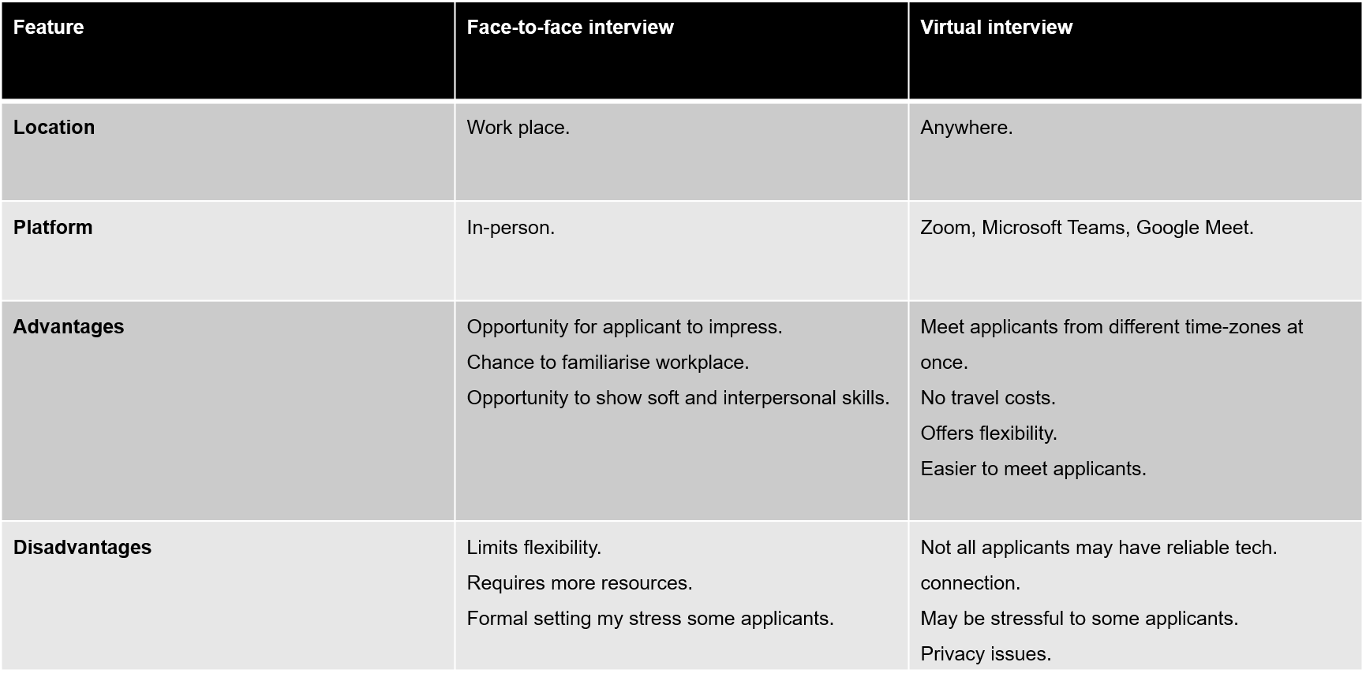
Comparison and contrast between face-to-face and virtual interviews

Slide 10
Conclusion.
Given that recruitment is a process, deciding on what best interview type or question techniques to use may highly depend many factors. For example, level of position, time and resources available.
However, organisation transformation is an important initiative, therefore, recruiting the right change manager to lead the transition may not be rushed, hence the need to collect all necessary data in order to make informed decision. On that basis, a semi-structured interview type and a hybrid face-to-face and virtual interviews would be recommended because of their associated benefits.

Slide 11
References:
Argos (2021) About us [Online] Available at: https://www.argos.co.uk/m/static/StaticDisplay/include-Name/customer_services_aboutus_waste_m.htm (Accessed 6 July 2026).
Atlassian (n.d) [Online] Available at: https://www.atlassian.com/itsm/change-management/roles-and-responsibilities (Accessed 11 July 2026).
GOV.UK (2026) Use fair and structured interview techniques [Online] Available at: https://www.gov.uk/government/publications/use-fair-and-structured-interview-techniques/use-fair-and-structured-interview-techniques (Accessed 12 July 2026).
Indeed (2025) The differences between open-ended questions vs closed [Online] Available at: https://uk.indeed.com/career-advice/career-development/open-ended-question-vs-closed
(Accessed 13 July 2026)
Indeed (2026) Change Manager Job Description: Top Duties and Qualifications [Online] Available at: https://uk.indeed.com/hire/job-description/change-manager-job-description (Accessed 11 July 2026).
Indeed (2026) What Is An Interview: Types Of Interviews And Formats [Online] Available at: https://in.indeed.com/career-advice/interviewing/what-is-interview (Accessed 2026).
Kivak, R. (2020) Job analysis [Online] Available at: https://www.ebsco.com/research-starters/business-and-management/job-analysis (Accessed 11 July 2026).
Leighton, P. and Proctor, G.(2009) Effective Recruitment: A Practical Guide to Staying Within the Law (Thorogood Reports) [Online] Available at: https://books.google.co.uk/books?hl=en&lr=&id=EipTS9ofTv4C&oi=fnd&pg=PR3&dq=Effective+recruitment+process+UK&ots=craAR9QE6m&sig=IhxCgtPfKPYt-VqAh8W-YuAM9bo&redir_esc=y#v=onepage&q=Effective%20recruitment%20process%20UK&f=false (Accessed 6 July 2026).
Management Today, Company Vitae: Argos [Online] Available at: https://www.managementtoday.co.uk/company-vitae-argos/article/1042685 (Accessed 6 July 2026).
Online Learning College (2022) Types of interviews [Online] Available at: https://online-learning-college.com/knowledge-hub/gcses/gcse-psychology-help/types-of-interviews/#h-strengths-of-closed-ended-questions-nbsp-include (Accessed 12 July 2026).

