Slide 1

Community Care
& development
Health and Social Care
Jessica Brito (2008475)

Slide 2

Hate Crime Rate in Newham
Notes:
Protection services have realised that hate crime has instantly increase in the year of 2016 after BREXIT Jhas been imposed. This was the year where legal immigrants have decided to leave United kingdom due to harsh laws of immigrations status and schemes imposed at the time

Slide 3

demographics of Newham Borough
Newham is a borough situated in the inner part of east London which is also boarded to the south of the famous river Thames
According to "Varbes" 2023, the estimated rate of population residing in Newham to be 357,000 people .
Newham is considered one of the top 10 most dangerous boroughs in London, according to Crime Rate UK
"In the year between mid-2020 and mid-2021, the population in Newham fell by an estimated 4,640 people, and in the ten years prior to mid-2021, the population grew by 34,331." According to Varbes 2023
According to the Strategy plan for Newham 2022-2025 72% of the residents are black, Asian and ethnically from diverse communities

Slide 4
Hate Crime within nEWHAM BOROUGH
Thousands of people are physically and sometimes brutally attacked each year in hate crimes. (BBC News 2018)
Normally hate crime motivated from people who have views on how a community should be, there are many factors such that can trigger and motivate hate crime such as sexual orientation, race or ethnicity, religion or belief (including non-belief) and transgender identity
In Newham borough, racist and religious hate crime are most reported

Slide 5
STATISTICS OF HATE CRIME IN NEWHAM BOROUGH
According to Newham council 2022, " In 2021 Newham ranked 6th in London for overall hate crime offences and was above the MPS Average for the last 12 months. This is an increase on the previous ranks of 10th in 2020 and 11th in 2019."
Newham is one of the boroughs, where their offences are at their highest for consecutive 3 years.

Slide 6

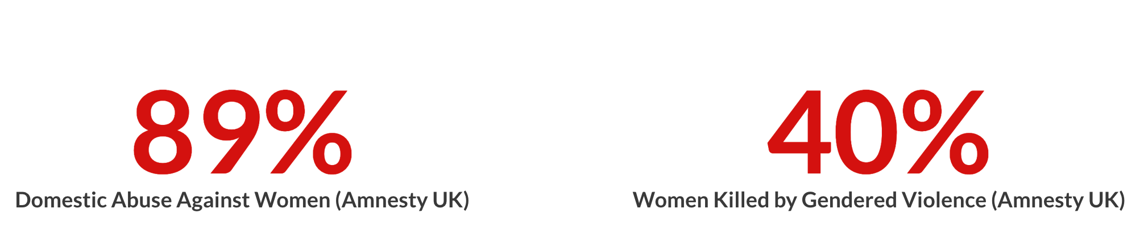
Reasons and causes of the crime
Just gender based hate crime violence and misogyny alone it affects more female disproportionately as it is driven by misogyny, the belief that women are a lesser gender than men and should always remain at a lower status than men.
There's always a bias motivation behind hate crime

Slide 7
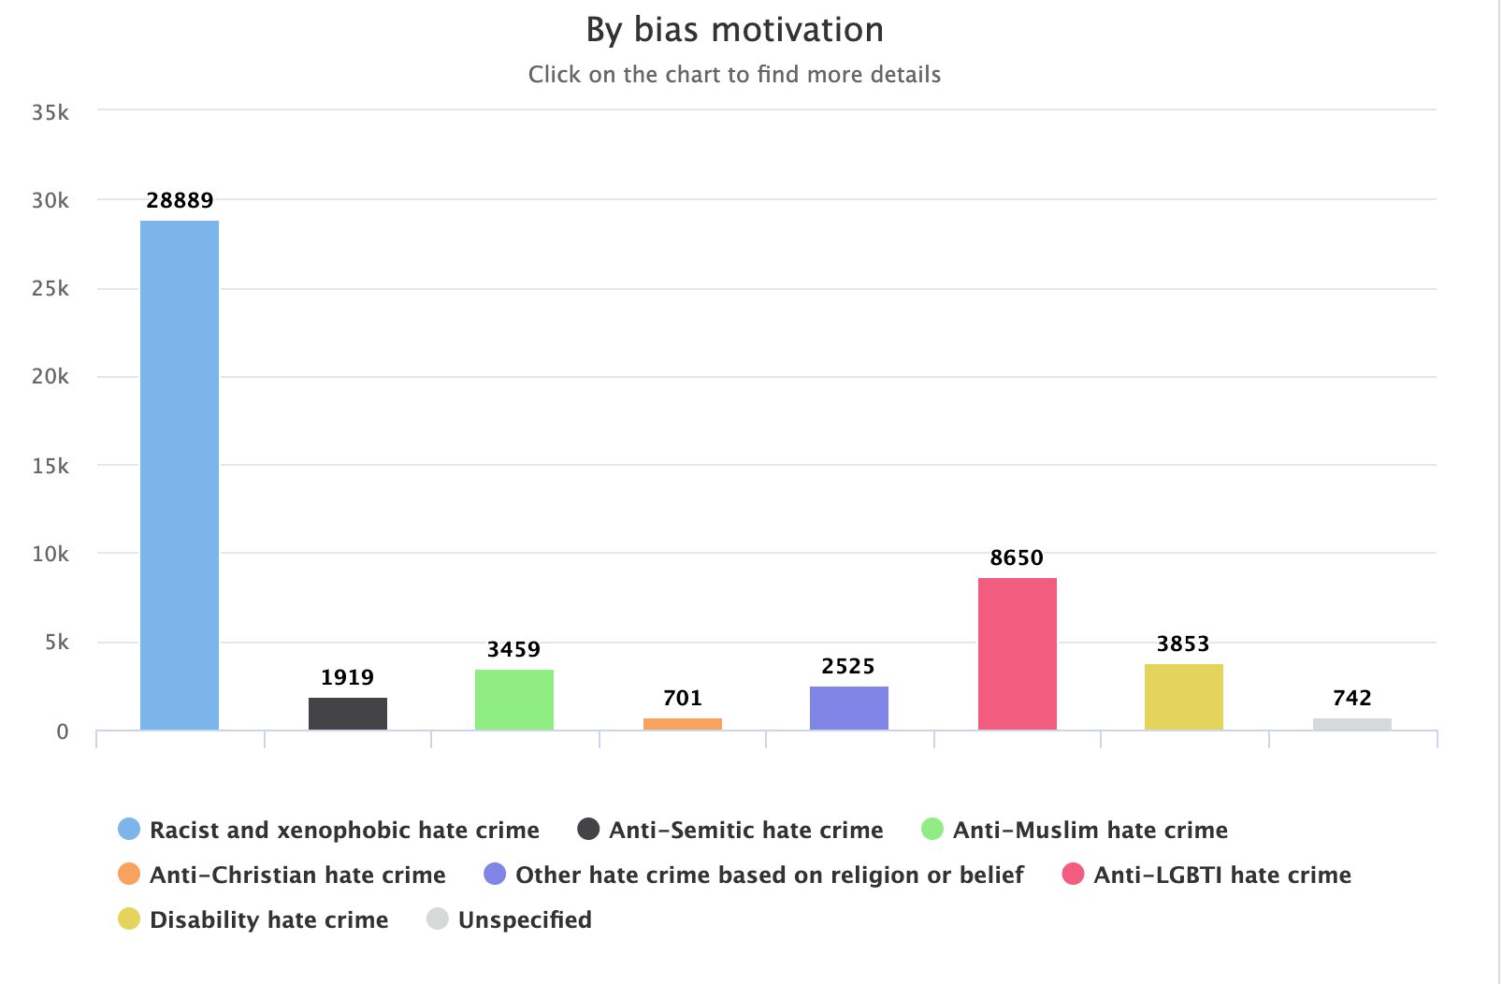
Bias motivation

Slide 8

Policies in place
Crime and Disorder Act 1998 and section 66 of the Sentencing Act 2020) is applied on a hate crime this including :
Racial hostility
Religious hostility
Sexual orientation related
And any other aggravated factor related to the subsection of the Act

Slide 9
Strategies tackle hate crime within newham borough
The strategic plan to tackle hate crime within Newham borough has been imposed to be accomplished by 2025
Mayor of london imposed stratetgies to tackle hate crime in Newham and some of them were:
Better support to victims and people affected by crime: support that can be received by MPS
Reducing and preventing violence, this includes making the area feel safer, by tackling the harms that are motivated by drugs
"Protecting people from being exploited or harmed – reducing the number of young people and adults who are criminally exploited or harmed; keeping young people in the justice system supported and safe; and keeping people safe online."
Action Against Hate’, The UK Government’s Plan for tackling Hate Crime, July 2016, p34

Slide 10

Means of communication to tackle hate crime
According to the strategy plans in place, there is a variety of means of communication in place, which are the use of:
Local authorities visits to school: This consists on assemblies with students in order to educate them
Educational projects within Hate Crime Awareness Week (8-16 October) at educational establishments( One example of a project would be "Stand Up! Education Against Discrimination", by Zaynab Albadry,
Media campaign promotions: https://www.youtube.com/watch?v=FujQEwdd8Co

Slide 11

Recommendations
It is important that laws are imposed in order to protect innocent individuals .
It would be beneficial if police or safety services could impose more police patrol around the communities that are affected within the borough above mentioned

Slide 12
References :
BBC News "How hate crime affects a whole community, 2018", available on: https://www.bbc.co.uk/news/uk-42622767 last acessed 26th July 2023
CPS- Hate Crime 2022, available on: https://www.cps.gov.uk/crime-info/hate-crime last acessed 26th July 2023
Crime " Crime and Safety in Newham" 2022, available on https://crimerate.co.uk/london/newham#:~:text=Crime%20and%20Safety%20in%20Newham&text=Newham%20is%20among%20the%20top,of%2095%20per%201%2C000%20residents. last acessed 26th July 2023
Educating against Hate "Addressing Hate Crime in the Classroom" 2023: https://www.educateagainsthate.com/blog/posts/addressing-hate-crime-in-the-classroom/ last acessed 26th July 2023
Home office "Hate crime England and Wales" available on https://www.gov.uk/government/statistics/hate-crime-england-and-wales-2021-to-2022/hate-crime-england-and-wales-2021-to-2022 , last accesed 27th july 2023
Newham hate crime strategy 2022-2025- available on: https://www.newham.gov.uk/downloads/file/5157/newham-hate-crime-strategy-online-final#:~:text=This%20outlined%20plans%20to%20boost,and%20the%20Crown%20Prosecution%20Service. last acessed 26th July 2023
Metropolitan police "What is. Hate crime" available on https://www.met.police.uk/advice/advice-and-information/hco/hate-crime/what-is-hate-crime/ last acessed 25th July 2023

