Slide 1
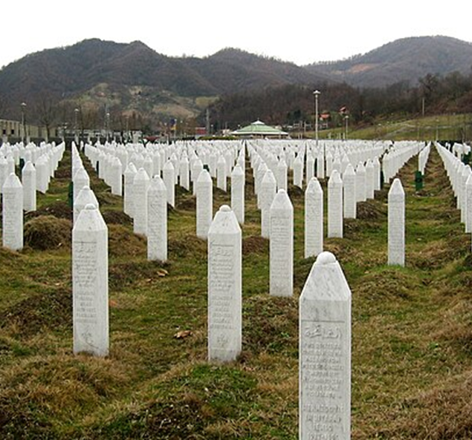
HPHI4903 Pathways to EVIL: Genocide – History, Theory and Denial
Session 2: What is genocide?
Dr Rhian Elinor Keyse

Slide 2
CONTENT NOTE
Topics covered will include violence (including sexual and racist violence), murder, sexual assault, racism, homophobia and transphobia.
Let’s treat each other carefully
There will be breaks, but you’re welcome to step outside if you need to take care of yourself, and rejoin when you feel able.
Local and national support resources are available – these are linked here:
  Wellbeing Support | University of Wales Trinity Saint David (uwtsd.ac.uk)
  Domestic abuse | GOV.WALES
  New Pathways Rape crisis and sexual abuse support services.

Slide 3
This session
Defining genocide
The 1948 Genocide Convention
Is the term ‘genocide’ adequate?
Why is genocide difficult to prove?
Stanton’s (1996) 10 stages of genocide

Slide 4
What is genocide?

Slide 5
What is genocide?
‘The word is new, the concept is ancient’ (Kuper, 1981).
Jones (2000) draws on examples from antiquity, the early modern period, and later.
Winston Churchill 1941 speech: ‘A crime without a name’ (cited in Vasel 2019).

Slide 6
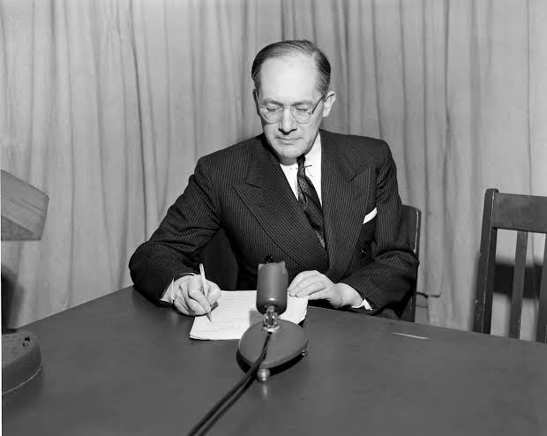
Coining ‘Genocide’
Raphael Lemkin – Polish-Jewish lawyer and refugee.
Influenced by learning about Armenian genocide during WWI.
Initially raised the issue in 1930s as ‘barbarity’– but state sovereignty was considered more important than protection of citizens from state violence.
Lost 49 members of his family in the Holocaust, and himself fled Poland as a refugee to Lithuania, then Sweden, then to the USA.
Axis Rule in Occupied Europe (1944) – ‘new conceptions require new terms’ (applied the term ‘genocide’ to campaigns of genocide in Poland and elsewhere in Nazi-occupied Europe
Persuaded UN to adopt Convention.

Slide 7
Coining ‘Genocide’
Greek and Latin roots
GENOS (Greek: race, tribe)
CIDE (Latin: killing).

Slide 8
Coining ‘Genocide’
‘Genocide is directed against the national group as an entity, and the actions involved are directed against individuals, not in their individual capacity, but as members of the national group’ (Lemkin, 1944, p.79).

Slide 9
Coining ‘Genocide’
Lemkin’s (1944) conception includes:
Disintegration of political and social institutions of culture, language, national feelings, religion, economic existence, of national groups
Destruction of personal security, liberty, health, dignity, and lives of individuals belonging to group

Slide 10
Coining ‘genocide’
Lemkin (1944) identifies 2 phases:
Destruction of national pattern of oppressed group
Imposition of national pattern of oppressor.
Key question for Lemkin – whether such acts proceeded as policy. If they did, then genocidal, even if it doesn’t result in physical destruction of whole group (or any of group)

Slide 11
DEBATING LEMKIN
Is mass killing necessary for genocide?
Lemkin’s focus on national and ethnic groups also contested – especially given 1940s/50s destruction of political groups under Stalin

Slide 12
Genocide and the International community
Political salience – within a year, ‘genocide’ included in the indictments of the Nuremberg tribunals (but not the judgments).
1948 Convention on the Prevention and Punishment of the Crime of Genocide adopted 9 December 1948

Slide 13
Genocide Convention 1948
How does it define genocide?
How should states respond to genocide according to the convention?
What are the limitations of the definition?

Slide 14
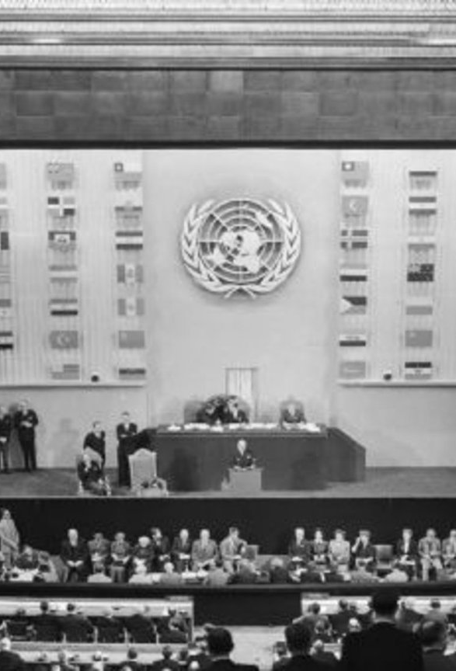
Genocide convention 1948
Defines genocide – whether committed in peace or wartime – as a crime under international law

Slide 15
Genocide convention 1948
Article 2: “Genocide means any of the following acts committed with intent to destroy, in whole or in part, a national, ethnical, racial or religious group, as such:
Killing members of the group;
Causing serious bodily or mental harm to members of the group;
Deliberately inflicting on the group conditions of life calculated to bring about its physical destruction in whole or in part;
Imposing measures intended to prevent births within the group;
Forcibly transferring children of the group to another group.

Slide 16
Genocide convention 1948
Cites different acts which can be interpreted as genocide
Did not define ‘national, ethnical, racial or religious’ groups – subsequent legal interpretation by courts.
International Criminal Tribunal for Rwanda: ‘any stable and permanent group’ to be protected.
Doesn’t require the extermination of whole or even part of group (though in practice genocide without mass killing less likely to be prosecuted).

Slide 17
Genocide convention 1948
Does not define key aspects e.g. national, ethnical, racial, or religious groups.
What is meant by ‘serious bodily harm’?
In practice interpreted as in 1961 trial of Adolf Eichmann as enslavement, deportation, starvation, persecution, detention in ghettoes and camps in conditions designed to cause suffering.
ICTR has added interpretation to include bodily and mental torture, inhuman treatment, persecution, acts of rape.

Slide 18
Genocide convention 1948
‘As such’ raises question of motive.
Initial draft of convention was broader – defined targets as ‘groups of human beings’
Exclusion of political groups – common perception that this was due to Soviet pressure, but archival evidence does not evidence this (Schabas, 2009).

Slide 19
Genocide convention 1948
Contracting parties undertake to prevent and punish genocide, may call upon UN to take action.
Actual obligations are vague.
Issue of proving intent.

Slide 20
Why is genocide difficult to prove?
What it takes to prove genocide – video | International court of justice | The Guardian

Slide 21
Contesting ‘genocide’
Some scholars (e.g. Destexhe, 1995) believe genocide is too widely applied.
Others believe the definition should be made broader and be more responsive.
Some argue for new terms (Scheffer, Gerlach)

Slide 22
Scholarly definitions: Exercise
How do the definitions in front of you differ?
Are they broad or narrowly defined?
What do they say about victims and perpetrators?
What do they say about the nature of genocide?

Slide 23
Other International crimes: War crimes
No single document in international law codifies all war crimes.
Sources can be found in the Hague and Geneva Conventions, and the Rome Statute of the International Criminal Court.
War crimes take place in context of armed conflict, either international or non-international, and definitions of ‘war crime’ differ depending on whether the conflict is international or non-international.
Rome Statute (1988) of the International Criminal Court – sets out 4 categories of war crimes, depending on the type of war.

Slide 24
War crimes (International conflicts) – Rome Statute 1998
Grave breaches of the 1949 Geneva Conventions, such as:
  Willful killing, torture or inhuman treatment, or willfully causing great suffering or serious injury to body or health against the sick, wounded and shipwrecked persons not taking part in hostilities, prisoners of war and other detainees, civilians and civilian objects.
  Extensive destruction and appropriation of property, not justified by military necessity and carried out unlawfully and wantonly.

Slide 25
War crimes (International conflicts) – Rome Statute 1998
Other serious violations of the laws and customs, such as:
  Intentionally directing attacks against the civilian population as such or against individual civilians not taking direct part in hostilities;
  Intentionally directing attacks against civilian objects, that is, objects which are not military objectives;
  Attacking or bombarding, by whatever means, towns, villages, dwellings or buildings which are undefended and which are not military objectives;
  Employing poison or poisoned weapons.

Slide 26
War Crimes (non-international conflicts) – Rome Statute 1998
  Serious violations of Article 3 common to the 1949 Geneva Conventions, such as:
    Violence to life and person, in particular murder of all kinds, mutilation, cruel treatment and torture of persons taking no active part in the hostilities, including members of armed forces who have laid down their arms and those placed hors de combat by sickness, wounds, detention, or any other cause against the sick, wounded and shipwrecked persons not taking part in hostilities, prisoners of war and other detainees, civilians and civilian objects.

Slide 27
War Crimes (non-international conflicts) – Rome Statute 1998
Other serious violations of the laws and customs, such as:
  Intentionally directing attacks against the civilian population as such or against individual civilians not taking direct part in hostilities;
  Intentionally directing attacks against buildings dedicated to religion, education, art, science or charitable purposes, historic monuments, hospitals and places where the sick and wounded are collected, provided they are not military objectives.

Slide 28
War Crimes
Contrast with genocide and crimes against humanity – war crimes can be committed against diverse victims, both combatants and non-combatants.
International conflict – war crimes victims can include wounded/sick members of armed forces, prisoners of war, civilians.
Non-international conflict – war crimes victims can be persons taking no active part in hostilities, including members of armed forces who have laid down arms and wounded/sick members of armed forces, prisoners of war.
In both types of conflict, protection also afforded to medical and religious personnel, humanitarian workers, and civil defence staff.
(Global Centre for the Responsibility to Protect, 2018).

Slide 29
CRIMES AGAINST HUMANITY (Rome Statute, 1998)
Acts committed as part of a widespread or systematic attack directed against any civilian population, such as:
Murder
Extermination
Deportation or forcible transfer of population
Torture
Rape, sexual slavery, enforced prostitution, forced pregnancy, enforced sterilisation, or any other form of sexual violence of comparable gravity.
The crime of apartheid
Other inhumane acts of a similar character intentionally causing great suffering, or serious injury to body or to mental or physical health.
(Global Centre for the Responsibility to Protect, 2018)

Slide 30
Ethnic Cleansing
Not recognised as an independent crime under international law
Emerged in context of conflict in former Yugoslavia 1990s
Has been referenced in UN Security Council and General Assembly resolutions, and acknowledged in judgements of the International Criminal Tribunal for the Former Yugoslavia.
UN Commission of Experts examining violations of international humanitarian law in former Yugoslavia defined ethnic cleansing as: “rendering an area ethnically homogeneous by using force or intimidation to remove persons of given groups from the area” and as “a purposeful policy designed by one ethnic or religious group to remove by violent and terror-inspiring means the civilian population of another ethnic or religious group from certain geographic areas.”

Slide 31
Ethnic Cleansing
The Commission stated that coercive practices used to remove civilian population can include:
MurderDisplacement and deportation of civilian population
Torture Deliberate military attacks/threats of attacks on civilians/civilian areas
Arbitrary arrest and detention Use of civilians as human shields
Extrajudicial executions Destruction of property
Rape and sexual assaults Robbery of personal property
Severe physical injury to civilians Forcible removal
Attacks on hospitals, medical personnel and locations with Red Cross/Crescent emblem

Slide 32
TEN STAGES OF GENOCIDE (Stanton, 1996)
‘Genocide is a process that develops in ten stages that are predictable, but not inexorable’.
At each stage, preventive measures can stop it.
Later stages must be preceded by earlier stages, though earlier stages continue to operate throughout the process.

Slide 33
Stage 1: Classification
Division of society into ‘us’ and ‘them’ – by ethnicity, race, religion, nationality.
If societies are too segregated, genocide more likely.

Slide 34
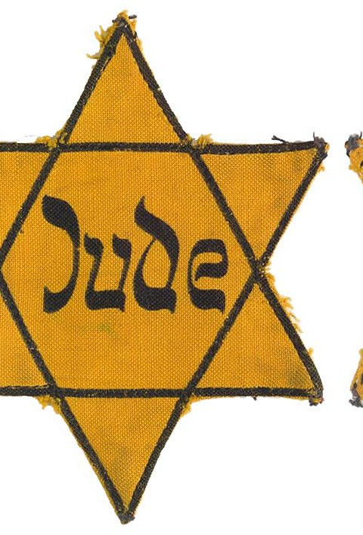
STAGE 2: Symbolization
Giving names or other symbols to the classifications of ethnicity, race, religion, nationality.
Naming people
Distinguishing them by colours or dress
Classification and symbolization are ‘universally human’, don’t necessarily result in genocide unless they lead to the stage of dehumanisation.
Yellow star for Jews, blue scarf for people from Eastern Zone in Democratic Kampuchea, Rwanda ID cards

Slide 35
STAGE 3: Discrimination
Dominant group uses law, custom, political power to deny right of other groups
Denial of full civil rights or citizenship
1935 Nuremberg Laws in Nazi Germany – stripped Jews of German citizenship and prohibited their employment in universities and government.

Slide 36
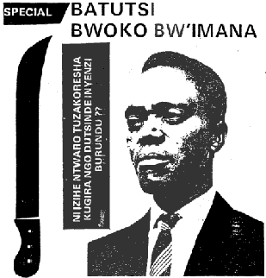
Stage 4: Dehumanization
Treatment of a group as second-class citizens
Comparisons with animals, parasites, insects, diseases
When a group of people is thought of as ‘less than human’, it is easier to murder them
Hate propaganda e.g. Rwanda
Picture on right is November 1991 issue of Kangura. Text to the right of the machete, translated from Kinyarwanda, reads:
“Which weapons are we going to use to beat the cockroaches for good?”

Slide 37
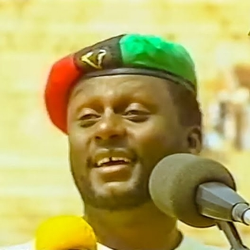
STAGE 5: ORGANIZATION
Genocide is always organised, usually by the state, though sometimes informally or by terrorist groups.
Special army units are often trained and armed, and plans made for genocidal killings

Slide 38
Stage 6: Polarization
Extremists drive groups apart
Hate groups broadcast propaganda that reinforces prejudice and hate
Laws may forbid intermarriage or social interaction
Extremist terrorism targets moderates and intimidates them.
Assassination of moderate leaders

Slide 39
Stage 7: Preparation
National or perpetrator group leaders plan the ‘Final Solution’ to the targeted group ‘question’.
Often use euphemisms e.g. referring to ‘ethnic cleansing’, ‘purification’, ‘counter-terrorism’.
Build armies, buy weapons, train troops and militias.
Indoctrinate population with fear of the victim group.

Slide 40
Stage 8: Persecution
Victims identified and separated out
Death lists drawn up
Forcing people to wear identifying symbols
Property often confiscated
Sometimes segregated into ghettoes, deported into concentration camps, confined to famine-struck regions and starved.
Massacres begin.

Slide 41
Stage 9: Extermination
Extermination begins.
When government-sponsored, often carried out by armed forces, sometimes working with private armies.
Sometimes genocide results in revenge killings.

Slide 42
Stage 10: DEnial
‘Always follows genocide’.
Is ‘among the surest indicators of further genocidal massacres’.
Digging up mass graves, destruction of victims’ remains, cover up evidence, intimidate witnesses
Blaming victims
Blocking investigation

Slide 43
NEXT WEEK
We’ll be looking at the first of our case studies - the German genocide against the Herero and Nama people of Namibia in the early C20th.
Please read the set reading for the class – on Moodle
Complete the ‘asynchronous task for assignment preparation’.
One testimony from the “Blue Book”

Slide 44
References
Frank Chalk and Kurt Jonassohn, The History and Sociology of Genocide: Analyses and Case Studies (New Haven, 1990)
Israel Charny, ‘Toward a generic definition of genocide’ in G. J. Andreopoulos, ed., Genocide: Conceptual and Historical Dimensions (Philadelphia, 1994).
Alain Destexhe, Rwanda and Genocide in the Twentieth Century (London, 1995)
Peter Drost, The Crime of State, vol. 2 (Leiden, 1959).
Helen Fein, Genocide: A Sociological Perspective (London, 1988).
Irving Louis Horowitz, Genocide: State Power and Mass Murder (London, 1976).

Slide 45
References
Henry Huttenbach, ‘Locating the Holocaust on the Genocide Spectrum: Towards a Methodology of Definition and Categorization’, Holocaust and Genocide Studies 3:3 (1988), pp. 289-303.
Steven T. Katz, The Holocaust in Historical Context, Vol. 1 (New York, 1994).
Leo Kuper, Genocide: Its Political Use in the Twentieth Century (New Haven, 1981).
Raphael Lemkin, Axis Rule in Occupied Europe: Laws of Occupation, Analysis of Government, Proposals for Redress (Washington, DC, 1944).
William Schabas, Genocide in International Law: The Crime of Crimes (Cambridge, 2009).
Gregory Stanton, Genocide Watch- Ten Stages of Genocide (1996)
Johann Justus Vasel, ‘In the beginning, there was no word…’, European Journal of International Law 29:4 (2019), 1054-1056.
Isidor Wallimann and Michael N. Dobkowski, Genocide and the Modern Age: Etiology and Case Studies of Mass Death (Syracuse, NY, 1987).

