Slide 1

Student Name = Mahendra Vadhel
Student ID = 2430466
Module Code = LCHS7009
Module Title = Population Health and Digital Health Promotion
Lecturer's Name = Dr Besty Jose
Assignment Title = Component 02 Poster

Slide 2
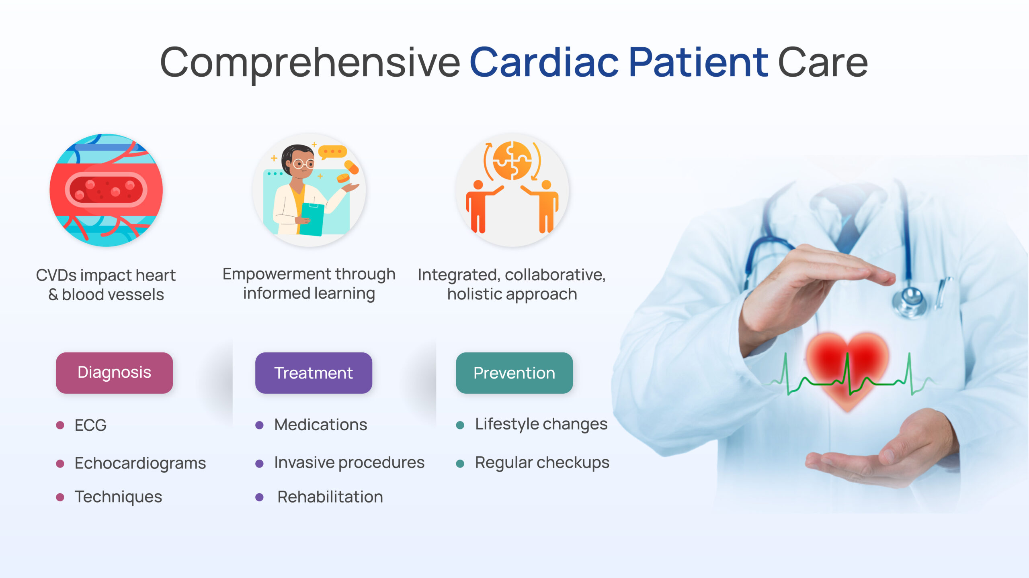

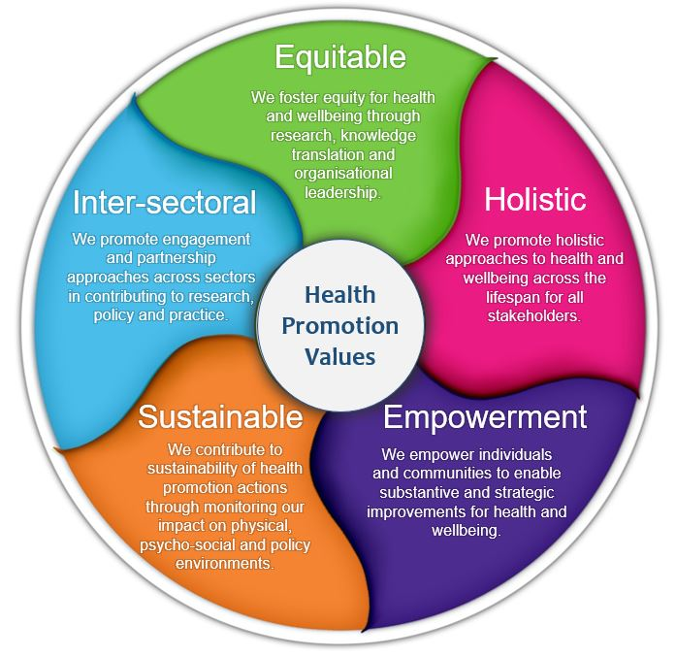
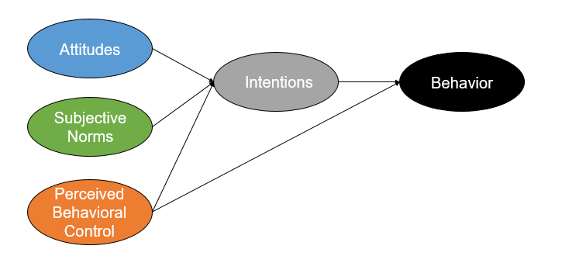
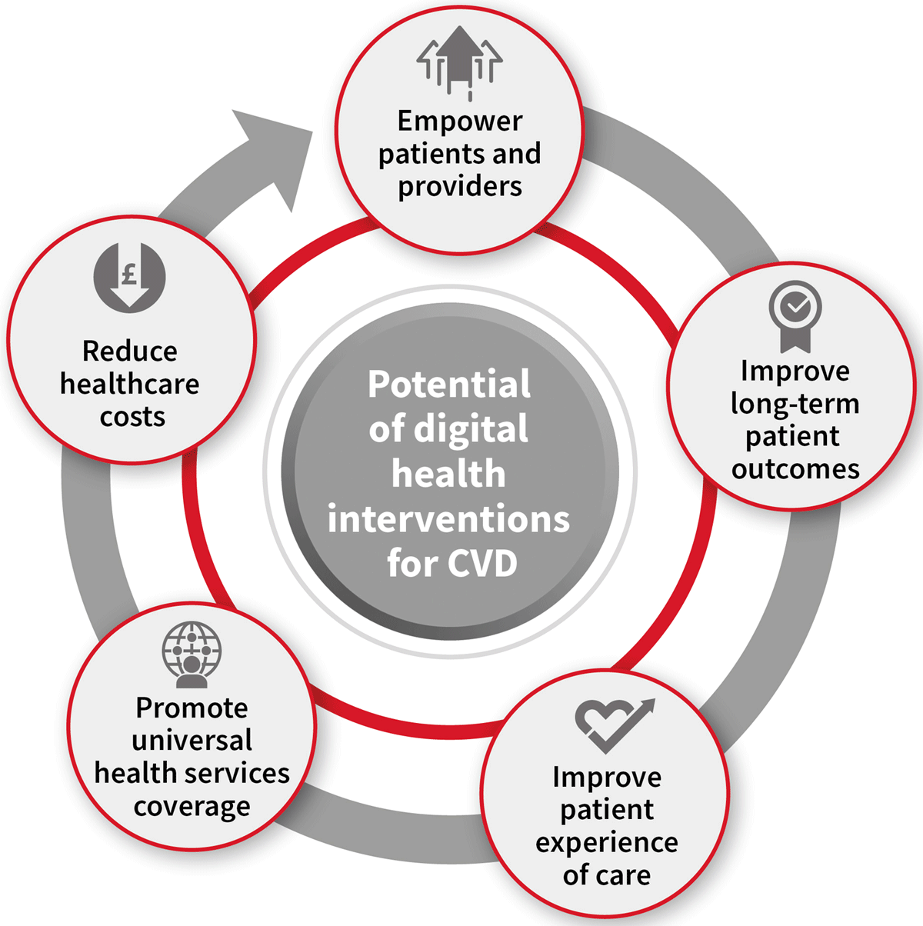
Improving Cardiovascular Care in the NHS Through Digital Innovation
2. Health Promotion Values and Principles
A collection of fundamental beliefs and principles that are the foundation on which the health promotion works to strengthen the people and the communities to assume control of their health condition, and to enhance their overall standard of living. The core principles of health promotion include the fact that it is the duty of all people to credit his or her health and the fact that health is a fundamental human right (Ahmed et al., 2022). Based on the fact that well-being is associated with other variables, including education, income, housing and access to healthcare, it aims at treating illness and other social, environmental and economic determinants of health at large. To ensure that health becomes one of the central aspects of all initiatives that the Charter recommends, the necessity of collaboration between governments, communities and organizations is particularly important. There are 4 principles of health promotion namely; sustainability, equity, empowerment and participation. Empowerment includes providing individuals with information and skills as well as the confidence necessary to make sound health choices (Adeghe et al., 2024). By involving themselves, individuals will be ensured to be actively engaged in defining their health requirements and developing solutions, which are community based and using a culture of relevance. Sustainability is concerned with the long run health maximization through inclusive, environmentally friendly and pragmatic approaches. Finally, the significant principles of health promotion are social justice, empowerment and prevention.
3. Behavioural Change Theory
Behavioural change theory provides a model under which people decode how they can transform their behaviours, attitudes and habits to improve their health and wellness. It can often be utilized in healthcare and community health initiatives with an aim of ensuring the healthy lifestyle decisions, such as becoming more active, quitting smoking, or eating healthier (Hernandez and Rodriguez, 2023). These theories have made real the complexity of behaviour change process that does not only entail the awareness or information about behaviour; psychology; social and environmental factors also affect behaviour. The behavioural change theory also has many implications to the health promotion field. Once health practitioners are aware of the motivation of people and the difficulties they face, they are able to make more expert and effective interventions. The promotion of cardiovascular health or smoking cessation like promotion to increase the self-efficacy, social support as well as create the conditions that allow the long-term change (Palumbo et al., 2022). These are theories that are actively utilized in the digital products that deal with health, e.g. wearable devices and smartphone applications, to promote goal setting, self-monitoring and feedback that all improve the user engagement (Mokri et al., 2025). The Health Belief Model (HBM) is fundamentally rooted in the knowledge that people tend to seek healthy behaviour in the event they believe an activity to be effective as well as in situations when they feel more competent to do an exercise and also when they have a fear of being sick. The TPB lays a lot of healthy stress on the influence the attitudes and perceived control over behaviour, and subjective norms have on change intentions. TTM, in its turn, also considers the fact that change is not immediate, but progressive, and provides steps of change, such as precontemplation to maintenance.
Cardiac Paitent Care
(Source: Feigin et al., 2022)
1. Background
Cardiovascular disease as CVD is the main cause of mortality and morbidity, as well as a continually increasing burden on the National Health Service (NHS) in the UK. No need to treat cardiovascular disease effectively, preventionally, and in a patient-centred manner has been better today than in history due to the aging population, greater risks of obesity, and avoidable risk factors (Tan et al., 2024). The traditional model of care is too burdensome due to the increased load of patients and the necessity to attend to patients timely and having disconnected systems of information. Therefore, it has transformed digital innovation to the core of cardiovascular care change at the National Health Service. The digital platforms, in specific, help in supporting the organization of care, enhance the communication between the medical staff, and the patients in the active formation of their own health (Williams et al., 2023). Despite these constructive advances, issues of funding, digital literacy, data protection and integration of the system remain. The NHS, however, presents the revolutionary prospective of the enhancement of patient outcomes, the decrease in the number of hospital admissions and the optimal utilization of resources with the strategic use of the digital innovation in cardiovascular care (Feigin et al., 2022). Some examples of digital technologies, which have been used to provide new opportunities to improve the long-term management of disease, individualize treatment, and improve early detection, are AIs, telemedicine, nEHRs, and remote monitoring devices.
Principles
(Ahmed et al., 2022)
Health Promotion Values
(Adeghe et al., 2024)
4. Expected Outcomes
The desired result of enhancing cardiovascular care in the NHS via digital innovation is a more effective, patient-based, and preventative healthcare system that can considerably help in minimising the burden of cardiovascular diseases (Zwack et al., 2023). Digital technology attributes that can positively influence the work of the NHS are artificial intelligence, telemedicine, and remote monitoring devices, and electronic health records in helping the body to diagnose earlier, provide individuals with individual treatment regimes, and extend their care (Hughes et al., 2023). Such developments are expected to result in better control of chronic cardiovascular system diseases in the long run, a decrease in the number of hospital visits, and an increase in timeliness. One would anticipate that a systemic view of the NHS would have more cost-effectiveness and operational efficiency. As predictive analytics can identify patients at risk, and avoid the problems that are preventable, it can aid in more effective resource management (Vardas et al., 2022). Moreover, as the digital technologies will enhance the promotion of health, and behaviour modification, they will also promote such efforts by spreading awareness about the cardiovascular disease risk factors and encouraging more people to adopt healthier lifestyles. Virtual consultations and remote health monitoring will increase the access of patients especially those that have minimal access to their locality or those in secluded areas to care. With the help of digital tools, people will be able to track their progress, proactively coordinate their health and adhere to treatment regimens more actively and regularly.
Behaviour Change Theory
(Hernandez and Rodriguez, 2023)
6. Conclusion
Since cardiovascular diseases remain one of the UK's major killers, the application of digital solutions is now a necessity, and not an option. Technologies which have already shown promise in encouraging early diagnosis, individual treatment, and continuous patient monitoring include artificial intelligence, telemedicine, remote monitoring, and electronic health records. These developments support the goal of the NHS Long Term Plan, which is to utilise technology to build a healthcare system that is more patient-centred, proactive and preventative.
Expected Outcomes
(Zwack et al., 2023)

Slide 3
References
Adeghe, E.P., Okolo, C.A. and Ojeyinka, O.T., 2024. A review of wearable technology in healthcare: Monitoring patient health and enhancing outcomes. OARJ of Multidisciplinary Studies, 7(01), pp.142-148. https://www.researchgate.net/profile/Ehizogie-Adeghe-2/publication/380068620_A_review_of_wearable_technology_in_healthcare_Monitoring_patient_health_and_enhancing_outcomes/links/66294d5906ea3d0b740103d7/A-review-of-wearable-technology-in-healthcare-Monitoring-patient-health-and-enhancing-outcomes.pdf
Ahmed, F.Z., Sammut-Powell, C., Kwok, C.S., Tay, T., Motwani, M., Martin, G.P. and Taylor, J.K., 2022. Remote monitoring data from cardiac implantable electronic devices predicts all-cause mortality. EP Europace, 24(2), pp.245-255. https://academic.oup.com/europace/article-pdf/24/2/245/42370406/euab160.pdf
Feigin, V.L., Owolabi, M., Hankey, G.J., Pandian, J. and Martins, S.C., 2022. Digital health in primordial and primary stroke prevention: a systematic review. Stroke, 53(3), pp.1008-1019. https://www.ahajournals.org/doi/pdf/10.1161/STROKEAHA.121.036400
Hernandez, M.F. and Rodriguez, F., 2023. Health techequity: opportunities for digital health innovations to improve equity and diversity in cardiovascular care. Current Cardiovascular Risk Reports, 17(1), pp.1-20. https://pmc.ncbi.nlm.nih.gov/articles/PMC9703416/pdf/12170_2022_Article_711.pdf
Hughes, A., Shandhi, M.M.H., Master, H., Dunn, J. and Brittain, E., 2023. Wearable devices in cardiovascular medicine. Circulation research, 132(5), pp.652-670. https://www.ahajournals.org/doi/pdf/10.1161/CIRCRESAHA.122.322389
Mokri, H., van Baal, P. and Rutten-van Mölken, M., 2025. The impact of different perspectives on the cost-effectiveness of remote patient monitoring for patients with heart failure in different European countries. The European Journal of Health Economics, 26(1), pp.71-85. https://link.springer.com/content/pdf/10.1007/s10198-024-01690-2.pdf
Palumbo, R., Nicola, C. and Adinolfi, P., 2022. Addressing health literacy in the digital domain: insights from a literature review. Kybernetes, 51(13), pp.82-97. https://www.emerald.com/insight/content/doi/10.1108/K-07-2021-0547/full/pdf
Tan, S.Y., Sumner, J., Wang, Y. and Wenjun Yip, A., 2024. A systematic review of the impacts of remote patient monitoring (RPM) interventions on safety, adherence, quality-of-life and cost-related outcomes. NPJ Digital Medicine, 7(1), p.192. https://www.nature.com/articles/s41746-024-01182-w.pdf
Vardas, P.E., Asselbergs, F.W., van Smeden, M. and Friedman, P., 2022. The year in cardiovascular medicine 2021: digital health and innovation. European heart journal, 43(4), pp.271-279. https://discovery.ucl.ac.uk/id/eprint/10160732/2/Asselbergs_The%20Year%20In%20Cardiovascular%20Medicine%202021_Final.pdf
Williams, G.J., Al-Baraikan, A., Rademakers, F.E., Ciravegna, F., van de Vosse, F.N., Lawrie, A., Rothman, A., Ashley, E.A., Wilkins, M.R., Lawford, P.V. and Omholt, S.W., 2023. Wearable technology and the cardiovascular system: the future of patient assessment. The Lancet Digital Health, 5(7), pp.e467-e476. https://www.thelancet.com/pdfs/journals/landig/PIIS2589-7500(23)00087-0.pdf
Zwack, C.C., Haghani, M., Hollings, M., Zhang, L., Gauci, S., Gallagher, R. and Redfern, J., 2023. The evolution of digital health technologies in cardiovascular disease research. NPJ digital medicine, 6(1), p.1. https://www.nature.com/articles/s41746-022-00734-2.pdf

