Slide 1
Modern Slavery Awareness
Kim Ann Williamson MBE
Ben Bruten
Slavery Still Exist – Do you Know the signs?

Slide 2
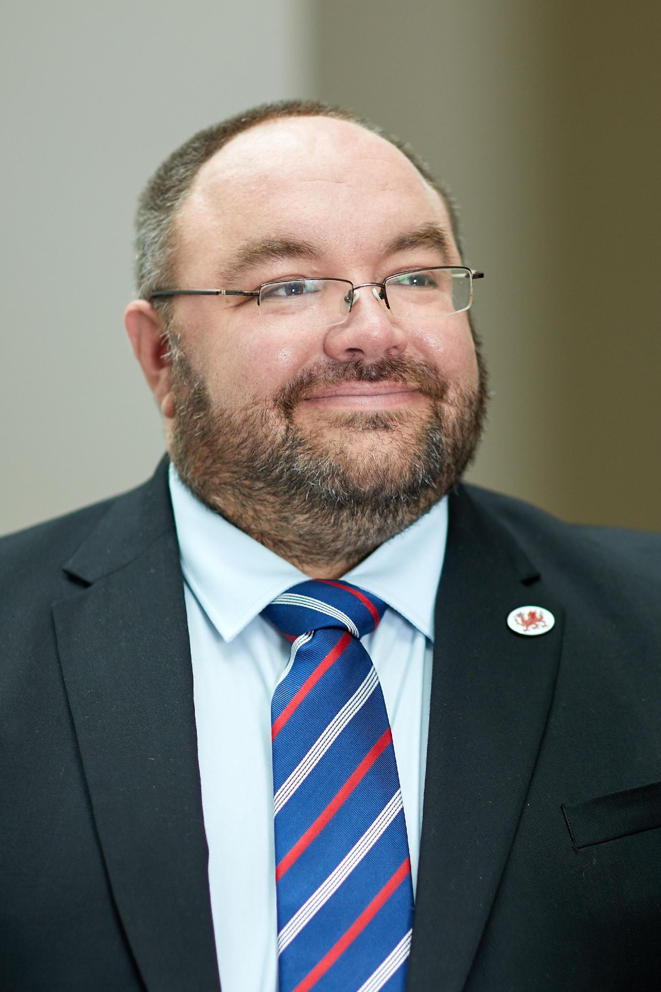

Our Role

Slide 3
HOUSEKEEPING
  Fire Safety
Toilets
Mobile Phones
Timings and breaks
Smoking

Slide 4
AIM
Raise awareness of the signs of modern slavery and human trafficking. Whilst understanding the criminal justice challenges involved.

Slide 5
OBJECTIVES:
By the end of the session delegates will be able to:
Recognise the different types of Modern Slavery and Human Trafficking
Understand the legislative framework around modern slavery
Identify a potential victim of exploitation
Understand the role of local and national agencies in modern slavery
Understand how modern slavery affects individuals
Understand your responsibilities as a member of your own local community and within university campus

Slide 6
UK GOVERNMENT
MODERN SLAVERY STRATEGY
Refers to the four Ps:
Pursue – is prosecute & disrupt individual & groups responsible for slavery
Prevent – people from engaging in slavery
Protect – strengthen safeguards against slavery by protecting people from exploitation & increasing awareness of & resilience against this crime
Prepare – reduce the harm caused by slavery through improved victim identification & enhanced support.

Slide 7

WHAT DO YOU KNOW ABOUT
MODERN SLAVERY?
Notes:
Human trafficking is the fastest growing form of slavery today and is prohibited under international law, as well as under the criminal laws of the United Kingdom and other countries.
The home office estimated in 2013 there were between 10,000 & 13,000 victims of modern slavery in UK

Slide 8
Activity – Problem Profile – 10mins group consideration and 10mins group presentation.
Provide some characteristic of a potential victim of Modern Slavery or Human Trafficking
Consider – what you might keep your eyes out for, what the tell tales signs might be
Think about – where they might work or be located.
Picture – what exploiters might do to hide the abuse or how they might recruit a victim.
Consider picking an exploitation type or just consider how a victim might present.

Slide 9
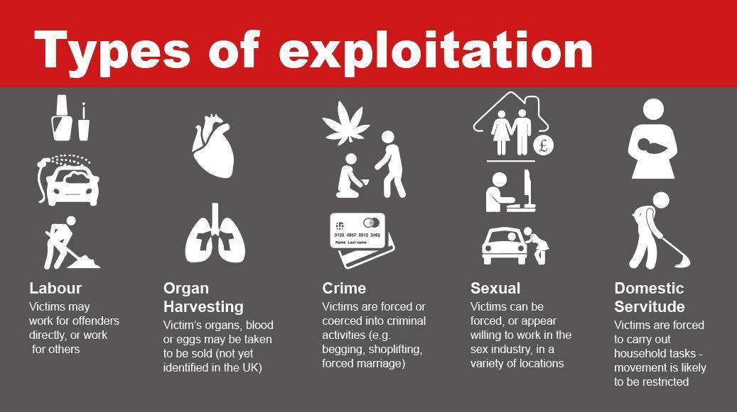

Slide 10
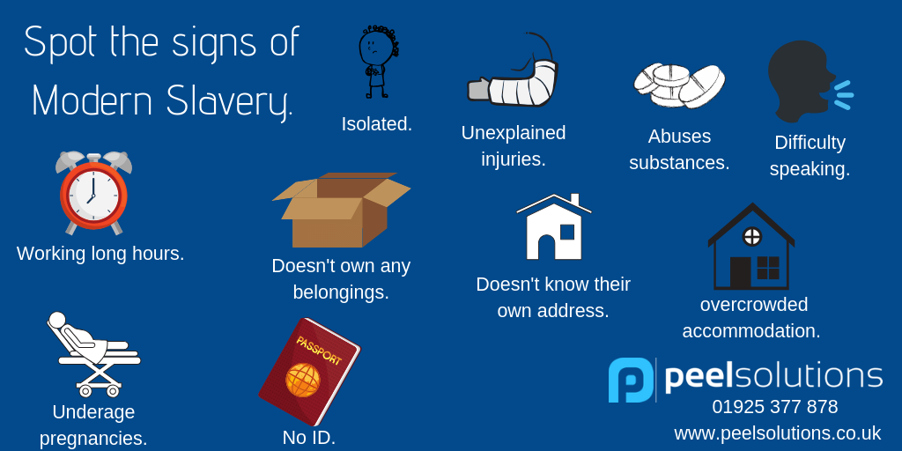
Spot the Signs …..

Slide 11
The LAW

Slide 12
DEFINITION
Originates from The Palermo Protocols;
To Prevent, Suppress and Punish Trafficking in Persons, especially Women and Children;
The Protocol against the Smuggling of Migrants by Land, Sea and Air;
The Protocol against the Illicit Manufacturing and Trafficking in Firearms, Their Parts and Components and Ammunition.

Slide 13
HUMAN TRAFFICKING
(Palermo Protocol)
THE ACT
(What is done)
THE MEANS
(How it is done)
THE PURPOSE
(Why it is done)
Recruit,
Transport,
Transfer,
Harbour or Receipt of Persons
Threat or use of force or other forms of coercion
Abduction
Fraud / Deception
Abuse of power or of a position of vulnerability
Giving or receiving of payments or benefits to achieve the consent of a person having control over another person
*The MEANS is not pertinent for under 18 year olds
Sexual exploitation; forced labour or services
Slavery or practices similar to slavery
Servitude, or
the removal of organs.

Slide 14
TRAFFICKING IN PERSONS
IS DEFINED AS:
The recruitment, transportation, transfer, harbouring or receipt of persons, by means of the threat or use of force or other forms of coercion, of abduction, of fraud, of deception, of the abuse of power or of a position of vulnerability or of the giving or receiving of payments or benefits to achieve the consent of a person having control over another person, for the purpose of exploitation.
Exploitation shall include, at a minimum, the exploitation of the prostitution of others or other forms of sexual exploitation, forced labour or services, slavery or practices similar to slavery, servitude or the removal of organs.

Slide 15



UN Sustainable Development Goals

Slide 16
What is Duty to Notify?
From 1 November 2015, specified public authorities have a duty to notify the Secretary of State of any individual encountered in England and Wales who they believe is a suspected victim of slavery or human trafficking.
The ‘duty to notify’ provision is set out in Section 52 of the Modern Slavery Act 2015 This duty is intended to gather statistics and help build a more comprehensive picture of the nature and scale of modern slavery.

Slide 17
LEGAL FRAMEWORK
Modern Slavery Act 2015
Social Services and Well-being (Wales) Act 2014
Violence against Women, Domestic Abuse and Sexual Violence (Wales) Act 2015
Employment Right Act 2025

Slide 18
WHO ARE FIRST RESPONDERS?
In Wales, the statutory first responders are:
local authorities,
the police force,
UK Visas and Immigration and Border Force
The Gangmasters Labour Abuse Authority (The Fair Work Agency).
NGO First Responders in Wales:
BAWSO
New Pathways.
Other first responders in the UK include Salvation Army, the NSPCC, and Barnardos.

Slide 19

I am a Victim !!!!

Slide 20
Section 45 Modern Slavery Act 2015
45 Defence for slavery or trafficking victims who commit an offence
(1)A person is not guilty of an offence if—
(a)the person is aged 18 or over when the person does the act which constitutes the offence,
(b)the person does that act because the person is compelled to do it,
(c)the compulsion is attributable to slavery or to relevant exploitation, and
(d)a reasonable person in the same situation as the person and having the person’s relevant characteristics would have no realistic alternative to doing that act.

Slide 21
Section 45 cont.
(4)A person is not guilty of an offence if—
(a)the person is under the age of 18 when the person does the act which constitutes the offence,
(b)the person does that act as a direct consequence of the person being, or having been, a victim of slavery or a victim of relevant exploitation, and
(c)a reasonable person in the same situation as the person and having the person’s relevant characteristics would do that act.

Slide 22
NATIONAL REFERRAL MECHANISM
The National Referral Mechanism ( NRM ) is a framework for identifying and referring potential victims of modern slavery and ensuring they receive the appropriate support
The creation of the Single Competent Authority (SCA) was announced in Autumn 2017 as part of the National Referral Mechanism (NRM) Reform Programme. The SCA was launched in April 2019, replacing the previous competent authorities for the NRM.
Notes:
Richard to sort this slide
The National Referral Mechanism is a process set up by the Government to identify and support victims of trafficking in the UK. It was born out of the Government's obligation to identify victims under the Council of Europe Convention on Action against Human Trafficking, which came into force on 1 February 2008.
Show copies of a child & adult blank NRM to each group.
A positive conclusive grounds decision is beneficial to the victim’s case.

Slide 23
Key Statistics (1)
1. Labour exploitation - The single largest category (around 36–45% of referrals depending on dataset).
2. Criminal exploitation - Particularly dominant among UK national children (e.g. county lines drug activity).
3. Sexual exploitation is typically the third most reported category.
👉 In practice, these three categories consistently account for the majority of NRM referrals year-on-year.

Slide 24
Key Statistics (2)
🌍 Top 3 nationalities (NRM – latest data, 2025)
Based on the most recent published figures:
1. UK nationals (British) -Largest single group (~22%).
2. Eritrean nationals- Second most common (~13%).
3. Vietnamese nationals -Third most common (~9%).
There is also year-to-year variation:
Earlier datasets (e.g. 2024) show UK, Albanian, Vietnamese as top three.
Quarterly data can temporarily show different rankings (e.g. Eritrean, Sudanese, Albanian).

Slide 25
Vulnerability

Slide 26
ACTIVITY
In your groups:
What might make children and adults vulnerable to being pulled into slavery?
How are they recruited?
Where/ how might you find victims of slavery being exploited in the UK?

Slide 27
WHY ARE THEY VULNERABLE?
Violence (inc harmful traditional practices)
Lack of
opportunity
Conflict or natural disaster
Family debt
Poverty
Vulnerability
Factors
Demand for cheap labour
Gender and
Equality Issues
Slavery endemic in area
Substance dependency

Slide 28
RECRUITMENT
Employment
Expensive lifestyle
Support family back home
A Home
Better lifestyle
Vulnerability
Factors
Perceived safety
Improved social position in own country
Love
Education

Slide 29
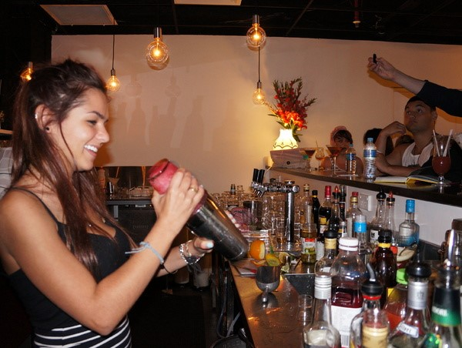
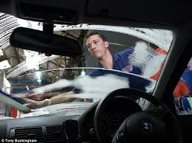
Working in Bars
Restaurants
Care providers/ establishments
Shop work and pack houses
Having your nails done
Having your car washed
In Hotels
On building sites
Leaflet drops
Slavery is everywhere!

Slide 30
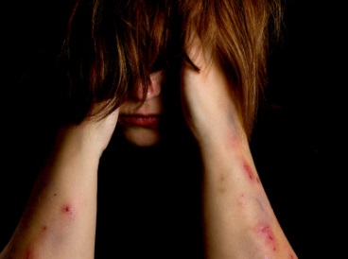
What should I be looking for?
Look at their appearance (unkempt dirty tired)
Any unexplained injuries
Not wearing clothes suitable for work or weather
No communication (Always has someone that speaks for them)
Always taken to and from work
No eye contact
Taken to and from work
Receiving cash for work
No payslips / contracts

Slide 31
Case Study – Hidden Harms. Hand Car Washes 10mins group consideration and 10mins group presentation
What types of exploitation might occur in a hand car wash
What vulnerabilities are likely to be present in a potential victim working in a hand car wash environment
Discuss how you might identify a victim or the exploiter
Discuss how you might consider sectoral change in the hand car wash sector to end exploitation
Present your thinking on key themes and discussion areas.

Slide 32

Context and Scale of the Hand Car Wash Sector
Market Value and Economic Role
  The hand car wash sector is valued between £1.1 billion and £1.5 billion, constituting a significant part of the UK’s £2.28 billion car wash market.
Regulatory and Compliance Challenges
  About 90% of the sector operates informally, evading government and tax authority oversight, leading to lost tax revenue and compliance issues.
Labour Risks and Competition
  Informality increases risks of worker exploitation and unfair competition, undermining labour standards and compliant businesses.
Geographic and Market Distribution
  Hand car wash operations are mostly located in urban areas with steady customer demand and discretionary spending.
Notes:
---
This slide references information from the following file: https://outlook.office365.com/owa/?ItemID=AQMkAGM1YjJlOGYwLThkYzItNDI3NS1iZjFjLWQ0YThmODE2YjhhZQBGAAADjxpwvi13M0ubOUuEZZ0OogcAdpacTE7ROkeSwBTFHvjz%2bQAAAgEMAAAAdpacTE7ROkeSwBTFHvjz%2bQAEILzC3QAAAA%3d%3d&exvsurl=1&viewmodel=ReadMessageItem
The hand car wash sector represents a substantial portion of the UK’s wider car wash market and is characterised by high visibility yet low formal regulation. With a total estimated value ranging between £1.1 billion and £1.5 billion, this segment contributes significantly to an overall market valuation of approximately £2.28 billion. Such figures highlight the sector’s commercial relevance within the UK economy, particularly due to the dominance of hand-operated services over automatic or conveyor-based alternatives. Despite this economic weight, the sector exhibits profound structural opacity, with around 90 percent believed to be hidden from government oversight, HMRC, and law enforcement frameworks. This lack of transparency results in both compliance challenges and lost fiscal opportunities, particularly given the estimated £350–£475 million in annual direct taxation potential linked to PAYE, National Insurance, VAT, business rates, and corporation tax. The widespread informality also heightens risks of worker exploitation, unfair competition for compliant businesses, and reduced regulatory leverage to enforce labour standards. Geographic distribution patterns indicate the prevalence of operations within major urban areas and built‑up environments where customer demand remains steady and discretionary spending supports service volume. Collectively, these insights underscore the intrinsic need for better data, oversight mechanisms, and collaborative regulatory approaches to address existing gaps. Although the sector generates substantial revenue and local economic activity, its current state reflects a fragmented environment that requires targeted oversight to modernise compliance, increase transparency, and protect both workers and legitimate businesses.

Slide 33
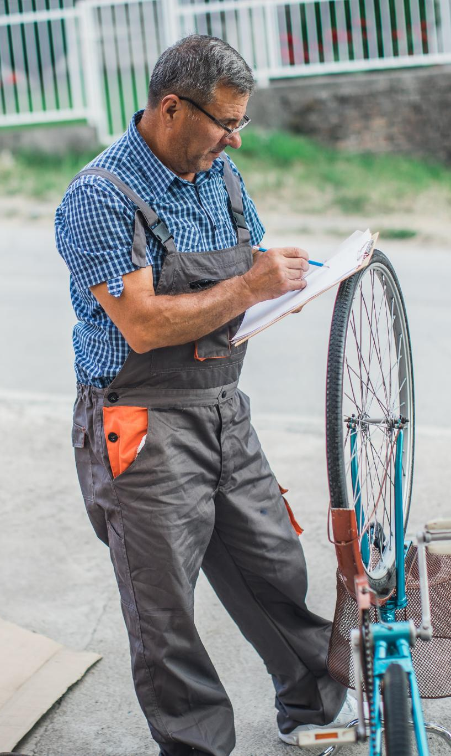
Illegal Working: Threats, Drivers, and Impacts
Regulatory Loopholes
  Right-to-work checks focus on formal jobs, leaving informal and gig work vulnerable to illegal employment practices.
Economic Drivers
  Consumer demand for low-cost services and labour shortages encourage businesses to use underpaid or undocumented workers.
Exploitation Risks
  Illegal working increases exploitation risks, weakens labour protections, and reduces employer accountability in the sector.
Enforcement Framework
  The Prevent–Pursue–Protect–Prepare framework aims to deter and disrupt illegal working but faces legislative and resource challenges.
Notes:
---
This slide references information from the following file: https://outlook.office365.com/owa/?ItemID=AQMkAGM1YjJlOGYwLThkYzItNDI3NS1iZjFjLWQ0YThmODE2YjhhZQBGAAADjxpwvi13M0ubOUuEZZ0OogcAdpacTE7ROkeSwBTFHvjz%2bQAAAgEMAAAAdpacTE7ROkeSwBTFHvjz%2bQAEILzC3QAAAA%3d%3d&exvsurl=1&viewmodel=ReadMessageItem
Illegal working within the hand car wash sector emerges from a combination of regulatory blind spots, labour market pressures, and behavioural incentives that reinforce non‑compliance. A major structural challenge lies in the limited scope of existing right‑to‑work checks, which effectively cover only formal employment conditions. This leaves a significant loophole for informal arrangements, including gig work and self‑employment structures, to conceal unlawful practices. At the same time, consumer preference for lower‑cost services fuels demand for operations that may rely on underpaid or undocumented labour to offer competitive pricing. Labour shortages across various industries intensify this vulnerability as businesses, particularly those operating on thin margins, may resort to exploiting migrant workers to sustain output. Employer behaviours range from deliberate avoidance of legal obligations to unintentional breaches caused by misunderstanding or insufficient guidance. Workers engaged in illegal employment frequently include individuals who entered the UK legally but overstay or work in breach of their visa conditions, facilitated by social networks that help them avoid detection. Illegal working is widespread nationally and is particularly concentrated in major conurbations where informal economies can flourish. These combined factors contribute to heightened risks of exploitation, weakened labour protections, and reduced employer accountability. In response, enforcement agencies apply a Prevent–Pursue–Protect–Prepare framework designed to deter, disrupt, safeguard, and adapt interventions. However, gaps in legislation, reporting mechanisms, and resource capacity continue to undermine the overall effectiveness of these strategies.

Slide 34

Enforcement Gaps and System Reform Opportunities
Challenges in Enforcement
  Informal work structures and cash payments limit regulatory oversight in the hand car wash sector.
Need for Multi-Agency Collaboration
  Cross-government cooperation is essential to combat linked crimes like modern slavery and tax evasion.
Advanced Data Systems
  Risk-scoring models using payroll and registration data enable targeted, evidence-based enforcement strategies.
Systemic Reform Opportunities
  Modern interoperability systems can extend enforcement beyond hand car washes to address hidden economies.
Notes:
---
This slide references information from the following file: https://outlook.office365.com/owa/?ItemID=AQMkAGM1YjJlOGYwLThkYzItNDI3NS1iZjFjLWQ0YThmODE2YjhhZQBGAAADjxpwvi13M0ubOUuEZZ0OogcAdpacTE7ROkeSwBTFHvjz%2bQAAAgEMAAAAdpacTE7ROkeSwBTFHvjz%2bQAEILzC3QAAAA%3d%3d&exvsurl=1&viewmodel=ReadMessageItem
Enforcement gaps within the sector reflect significant limitations in legislative, operational, and data‑driven capabilities. Many existing powers were designed for more formalised employment contexts and therefore struggle to address the informal structures that characterise the hand car wash industry. Challenges such as cash‑in‑hand payments, subcontracting chains, and limited visibility of business ownership impede consistent regulatory oversight. Addressing these issues requires enhanced cross‑government collaboration, as illegal working is often linked to broader criminal ecosystems involving modern slavery, document fraud, tax evasion, debt bondage, and labour exploitation. Multi‑agency coordination is therefore critical, enabling organisations to pool intelligence, share enforcement responsibilities, and deliver cohesive interventions. Reforms would also benefit from more advanced data systems, including risk‑scoring models that incorporate VAT and PAYE signals, business registration information, payroll indicators, and open‑source intelligence. Studies have shown that only a small proportion of hand car wash entities appear on Companies House records, but among those that do, the presence of payroll data indicates greater operational formality. This creates opportunities for segmentation that supports targeted enforcement. Furthermore, modernised interoperability systems would allow agencies to scale findings beyond the hand car wash sector to address other hidden economy activities. The development of these capabilities would enable more strategic, evidence‑based regulation that balances compliance enforcement with fair competition and worker protection. Implementing such reforms would represent a significant step toward reducing the scale of unlawful activity and improving transparency across the sector.

Slide 35
WHAT ARE THE BARRIERS?

Slide 36
DISCLOSURE BARRIERS
Many victims do not speak English
Traffickers may “coach” victims to answer questions with a cover story and do not leave their side
Victims fear of reprisals for themselves or family
Fear of being sent back to their country of origin
Immigration status
Involvement in criminal activity
Juju
Self-blame
Stigma
‘Stockholm Syndrome’
Women exploited in domestic servitude may have a sense of responsibility to the children they care for.
Do not identify themselves as a victim
Notes:
Are unable to communicate with service providers, police, or others who might be able to help them.

Slide 37
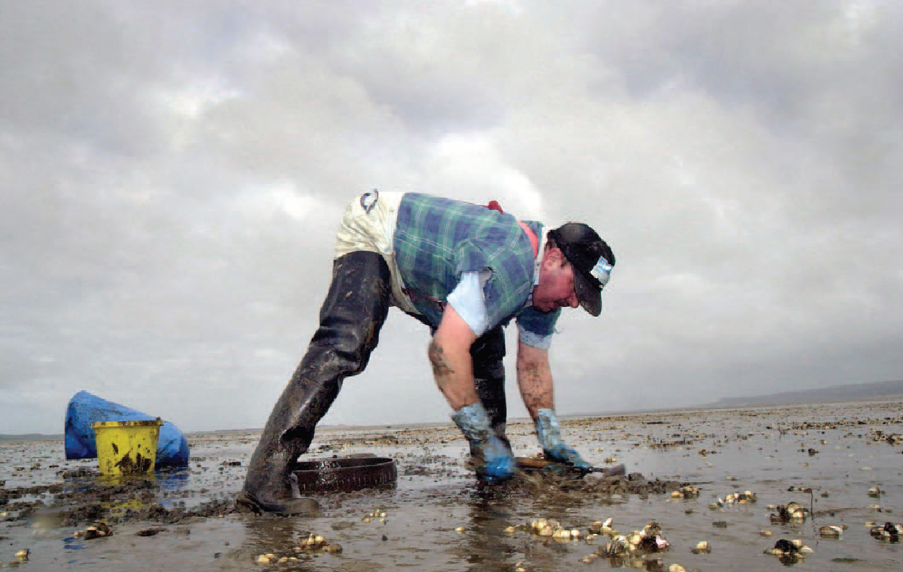
EMOTIONAL BARRIERS
Fear
Guilt
Anger
Suspicion
Hopelessness
Betrayal
Notes:
Fear: of retribution by trafficker, of being criminally prosecuted and punished, and of being thought of as a prostitute
Guilt: for allowing oneself to be deceived, for violating the law and/or religious beliefs, for failing to raise the money needed by the family
Anger: with themselves for getting into this type of a situation, with those who didn’t defend them and with society in general
Suspicion: of one’s own ability to defend oneself against those that betrayed him/her.
Hopelessness: About one’s future, that their situation will not improve. This is a strong indicator of longer-term depression.
Betrayal: by a person they trusted, by society for not intervening to protect them.

Slide 38
Fair Work Agency
March 2026

Slide 39
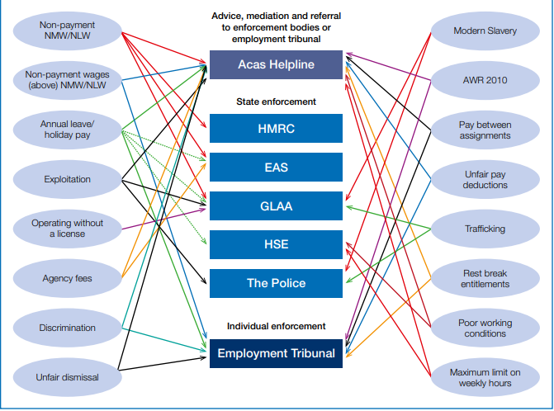
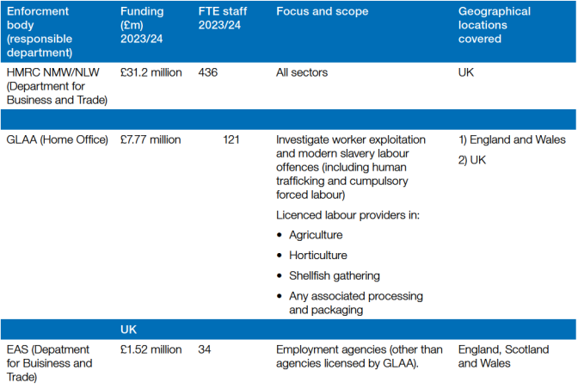
Employment Rights Enforcement – a complex landscape…
Overseen by the Director of Labour Market Enforcement
“Naming and shaming” by DBT

Slide 40
Fair Work Agency – a bigger remit
The Fair Work Agency will bring together the existing state enforcement landscape….
Agency workers regulation (EAS)
…and will expand state enforcement to new rights
Holiday Pay
Statutory Sick Pay
Gangmaster’s licensing (GLAA)
Serious labour exploitation (GLAA)
National Minimum Wage (HMRC)
Parts of the Fraud Act
Employment Tribunal penalty enforcement (EAS)
Delegated to power to expand further
Strategy and research (DLME)
Some Zero Hours Contracts measures (subject to consultation)
Fair Pay Agreements
The Fair Work Agency will be advised by a tripartite board on the LPC/Acas model and will produce annual reports on its activities and a three-year strategy. The body will have a single set of powers to investigate employers for non-compliance and take enforcement action.

Slide 41
Fair Work Agency – stronger, single set of powers
Investigatory powers
Civil proceedings
Cost recovery
Prosecutions
GLAA licensing powers
Labour Market Enforcement Undertakings and Orders
EAS agency regulatory powers
Civil penalty regime (based on NMW)
Blue = unchanged
Purple = reformed
Green = new

Slide 42
Engagement
Advisory Board
  Social partnership: equal representation from businesses, trade unions, and independent experts e.g. civil society.
  Must be consulted on the enforcement strategy and annual report. In practice, Board members will have a broader role shaping the direction of the Agency
  Currently being recruited, aiming for board members to be appointed ahead of April
Fair Work
Assembly
  Broader group with representation from the social partnership.
  To pool intelligence and inform the direction of the FWA.
  To meet several times a year, and to be chaired by the FWA Chair

Slide 43
Next steps and phasing
Phase 1 – April 2026
Future phases
Switch on FWA enforcement of additional rights once detail worked through:
Holiday Pay
Bring responsibility for existing state-enforced rights under FWA umbrella - EAS, NMW, GLAA remits.
Consider further rights to bring in scope
Governance – FWA Board, Foundation Strategy, reporting and oversight arrangements.
Statutory Sick Pay
Fair Pay Agreements (FPAs)
Enforcement officers will have access to existing powers and reformed powers (i.e. blue and purple powers on previous slide).
Switch on additional new enforcement powers (green powers on previous slide).
Ministers have been clear that the current state enforcement system is fragmented and in need of reform. Their ambition is for the Fair Work Agency (FWA) to both support good business and take tough action against rogue businesses to make the system work more efficiently for both. The Foundation Strategy is the key moment to set out how the FWA will do this.

Slide 44
University Life

Slide 45

Call for Action……
What could YOU now do differently?
What will be your pledge ?

Slide 46









What can you do?

Slide 47
Food for thought…..
Slavery Free Campus
University Guide
Awareness
Notes:
https://www.nottingham.ac.uk/research/beacons-of-excellence/rights-lab/resources/reports-and-briefings/2021/july/the-slavery-free-campus.pdf

Slide 48

Notes:
Mention the app

Slide 49
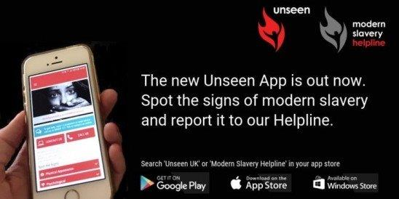

Slide 50
FINALLY WHAT NEXT….
Identify 3 things you are going to do that will raise awareness of this heinous crime
Notes:
Give a copy of Competency Framework

Slide 51
Questions and Answers

Slide 52
“Thank you – Diolch yn fawr”
“We are Modern Slavery victims only chance of Freedom ”
Kim Ann Williamson MBE 2017
Contact details:
Professor Kim Ann Williamson MBE - Ben Bruten – DBT – Department for Business and Trade
E-mail: KimAnn.Williamson@gmail.com /ben.bruten@businessandtrade.gov.uk

