Slide 1

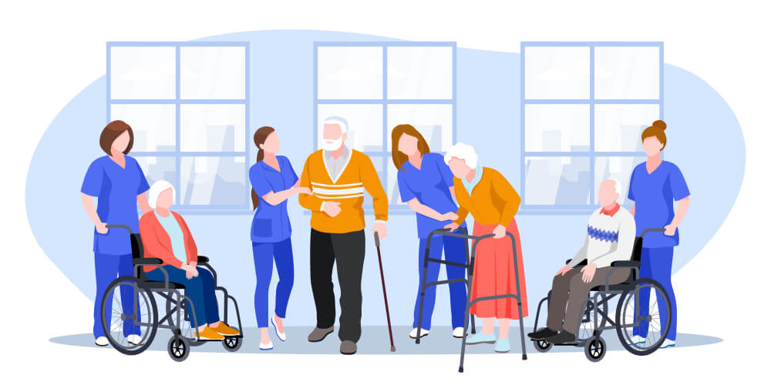
Student Number:1813848
Name:jay-j mckean
Module code:LCHS4009_BIRm
Module Name:Professional Development within Health and Social Care
Lecturer name:Hajramustaism

Slide 2

The importance of communication in Health and Social care
Introduction
Hello My name is Jay-j Mckean my student number is ...today I will talk about why communication skills are essential in health and social care and how applying these skills improves patiant outcomes and professional practice.

Slide 3

Communication in Health and Social Care
In health and social care, communication is crucial because it allows person-centered, safe, and efficient care. It facilitates professionals' understanding of people's needs, accurate information sharing, trust building, and patient participation in care decisions. In addition to promoting inclusiveness by accommodating a variety of communication of needs, effective communication also fosters teamwork, lowers the possibility of mistakes, and satisfies legal and professional obligations. In general, effective communication enhances service users' outcomes and care quality. (Sharkiya, 2023).
Communication is crucial aspect of basic healthcare it affects diagnosis, treatment choices, patient comprehension, and healthcare results (Barnes and Woods, 2024).

Slide 4

Types of communication
Verbal Communication
  The sharing of information through spoken language is known as verbal communication. To guarantee that service users comprehend crucial information regarding their care, health and social care providers must communicate effectively using suitable language and tone. Effective verbal communication lowers the possibility of mistakes, fosters comprehension, and encourages well-informed decision-making (NHS England, 2023).
Nonverbal Communication
  Body language, posture, gestures, eye contact, and facial expressions are examples of nonverbal communication. In addition to demonstrating empathy, respect, and dedication, these indicators can support spoken words. Building a trustworthy relationship with service users is facilitated by positive nonverbal communication, especially when talking (Houchens et al., 2024).

Slide 5

justify the relevance of communication skills to professional practice within health and social care
To provide safe, efficient, and person-centred care, communication is crucial in the health and social care participation of individuals in care decisions. In addition to promoting inclusion by accommodating a variety of communication needs, effective communication also fosters teamwork, lowers the possibility of mistakes, and satisfies professional and legal obligations. In general, effective communication raises the standard of care and results for clients (Öhlén and Friberg, 2023).

Slide 6
example 0f how communication can be used in a chosen job role
Job Role Example: Nurse
Before a patient is released from the hospital, a nurse employs communication skills to convey prescription instructions. The nurse speaks clearly, assesses the patient's knowledge, pays attention to any worries, and responds to enquiries. This aids the patient in understanding the proper timing and method of taking their prescription.
Impact on patient
Effective communication has a positive impact on patient care by increasing patient comprehension, promoting treatment plan adherence, lowering the possibility of drug errors, and improving health outcomes. Effective provider-patient communication has been linked to better patient experiences and health outcomes, especially for vulnerable patients, according to research.

Slide 7
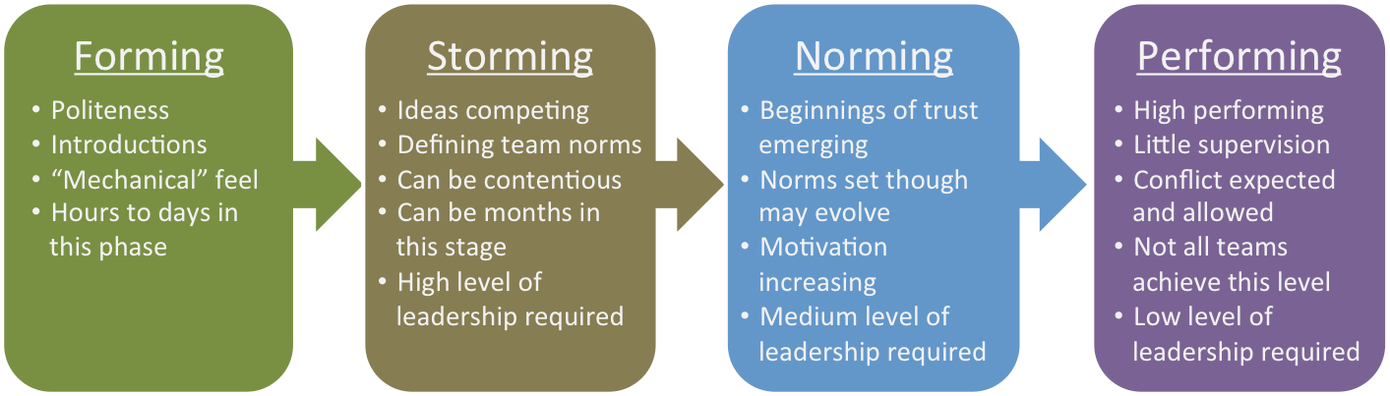
relevant model relevant to communication Skills
Tuckman's Model- of Team Development shows how communication facilitates the formation, storming, norming, and performing phases of a team's development. Effective communication in interdisciplinary nursing teams fosters teamwork, lowers errors, and improves patient care (Cornett and Kuziemsky, 2018).

Slide 8
References
Barnes, R.K. and Woods, C.J. (2024) ‘Communication in Primary Healthcare: A State-of-the-Art Literature Review of Conversation-Analytic Research’, Research on Language and Social Interaction, 57(1), pp. 7–37. Available at: https://doi.org/10.1080/08351813.2024.2305038.
Cornett, J.A. and Kuziemsky, C. (2018) ‘Team based communication and the healthcare communication space’, Journal of Health Organization and Management, 32(6), pp. 825–840. Available at: https://doi.org/10.1108/JHOM-07-2017-0189.
Sharkiya, S.H. (2023) ‘Quality communication can improve patient-centred health outcomes among older patients: a rapid review’, BMC Health Services Research, 23, 886. Available at: https://doi.org/10.1186/s12913-023-09869-8.
Links, M., Martin, P. and Morgan, M. (2023) ‘A Systems-Thinking and Person-Centred Approach to Healthcare Communication’, Australian Journal of Clinical Education, 12(1), pp. 115–129. Available at: https://doi.org/10.53300/001c.89083.

Slide 9
References
NHS England, (2023) Good communication with patients waiting for care: core principles. Available at: https://www.england.nhs.uk/long-read/good-communication-with-patients-waiting-for-care-core-principles/.
Öhlén, J. and Friberg, F. (2023) Person-centred conversations in nursing and health: A theoretical analysis based on perspectives on communication. Nursing Philosophy, 24(3), e12432. Available at: https://doi.org/10.1111/nup.12432.

