Slide 1
ACCA7032 – Enterprise Network Security
Donna Kennett (606962)

Slide 2
Securing an Enterprise Network with Check Point

Slide 3
Executive Summary
Successfully secured a multi-zone enterprise network.
Demonstrated layered security using Check Point best practices.
Gained hand-on experience with routing, VPN and firewall policy design.
Ready for live demonstration and Q&A.

Slide 4
Project Goals
Secure a Virtual Enterprise Network.
Deploy a Check Point Management Server (A-SMS) for centralised policy control.
Enforce firewall rules to restrict unauthorised traffic.
Route traffic through A-GW for inspection and logging.
Implement advanced security features.

Slide 5
Tools & Technologies
Tool/Technology | Purpose | Used For
Check Point GAIA OS | Firewall & SMS configuration | Setting up A-GW & A-SMS appliances
SmartConsole | Centralised policy management | Designing, deploying and monitoring firewall rules
Windows RRAS | VPN setup & routing | Created demand-dial interfaces between L-CD & S-DC
VirtualBox | Network simulation | Hosting & connecting virtual machines across subnets
Command-line tools | Diagnostics & routing | Manging static routes, testing connectivity & troubleshooting.

Slide 6
Outcomes
Centralised firewall with documented rule base and NAT logic.
Verified network connectivity between ClientS1 and A-GUI.
Logged and filtered traffic in Smart Console.
Implemented indentity-based access control and content filtering.
Resolved routing through static route adjustments.

Slide 7
Part 1 - Network Creation and Design

Slide 8
Network Requirement (Overview)
Purpose of the Network
Key Components
Provide secure connectivity for users and servers
Centralised authentication and management
Enforce security policies using Check Point.
3 LAN Subnets
Root Domain Controller
Child Domain Controller
Check Point Security Gateway
Check Point Security Management Server (SMS)
SmartConsole admin workstation

Slide 9
LAN Subnets
Swansea Network
London Network
Management Network
ClientS1
S-DC Domain Controller
DHCP Server
DNS Server
NTP Server
Internet Access via Check Point Gateway
ClientL1
C-DC Child Domain Controller
VPN Client
Check Point Security Gateway (A-GW)
Check Point SMS (A-SMS)
SmartConsole (A-GUI)

Slide 10
Security & Connectivity
Requirements
All inter-LAN traffic must pass through the Check Point Gateway
Domain controllers provide DNS and authentication for LANs.
SMS must maintain secure communication with the gateway.
Admins manage policies via SmartConsole.

Slide 11
Non-Functional Requirements
Scalable IP addressing
Centralised logging and monitoring
Reliable connectivity between SMS and gateway
Clear separation of user, server and management traffic.

Slide 12
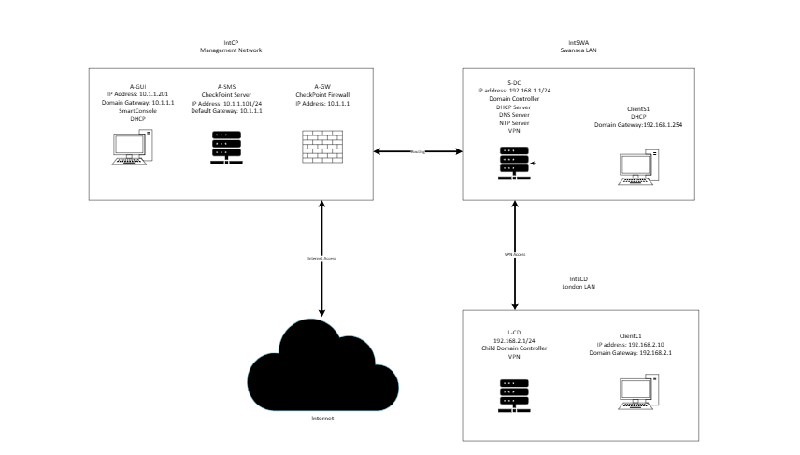
Network Architecture - Topology
This topology diagram illustrates a multi‑zone enterprise network design where all traffic is routed through a Check Point Security Gateway.

Slide 13
Appliance Setup Overview
The Check Point Security Gateway and Security Management Server (SMS) were deployed.
Initial configuration was completed using the Gaia WebUI.
Basic networking, admin access, and security settings were applied.
The appliances were prepared for policy installation.

Slide 14
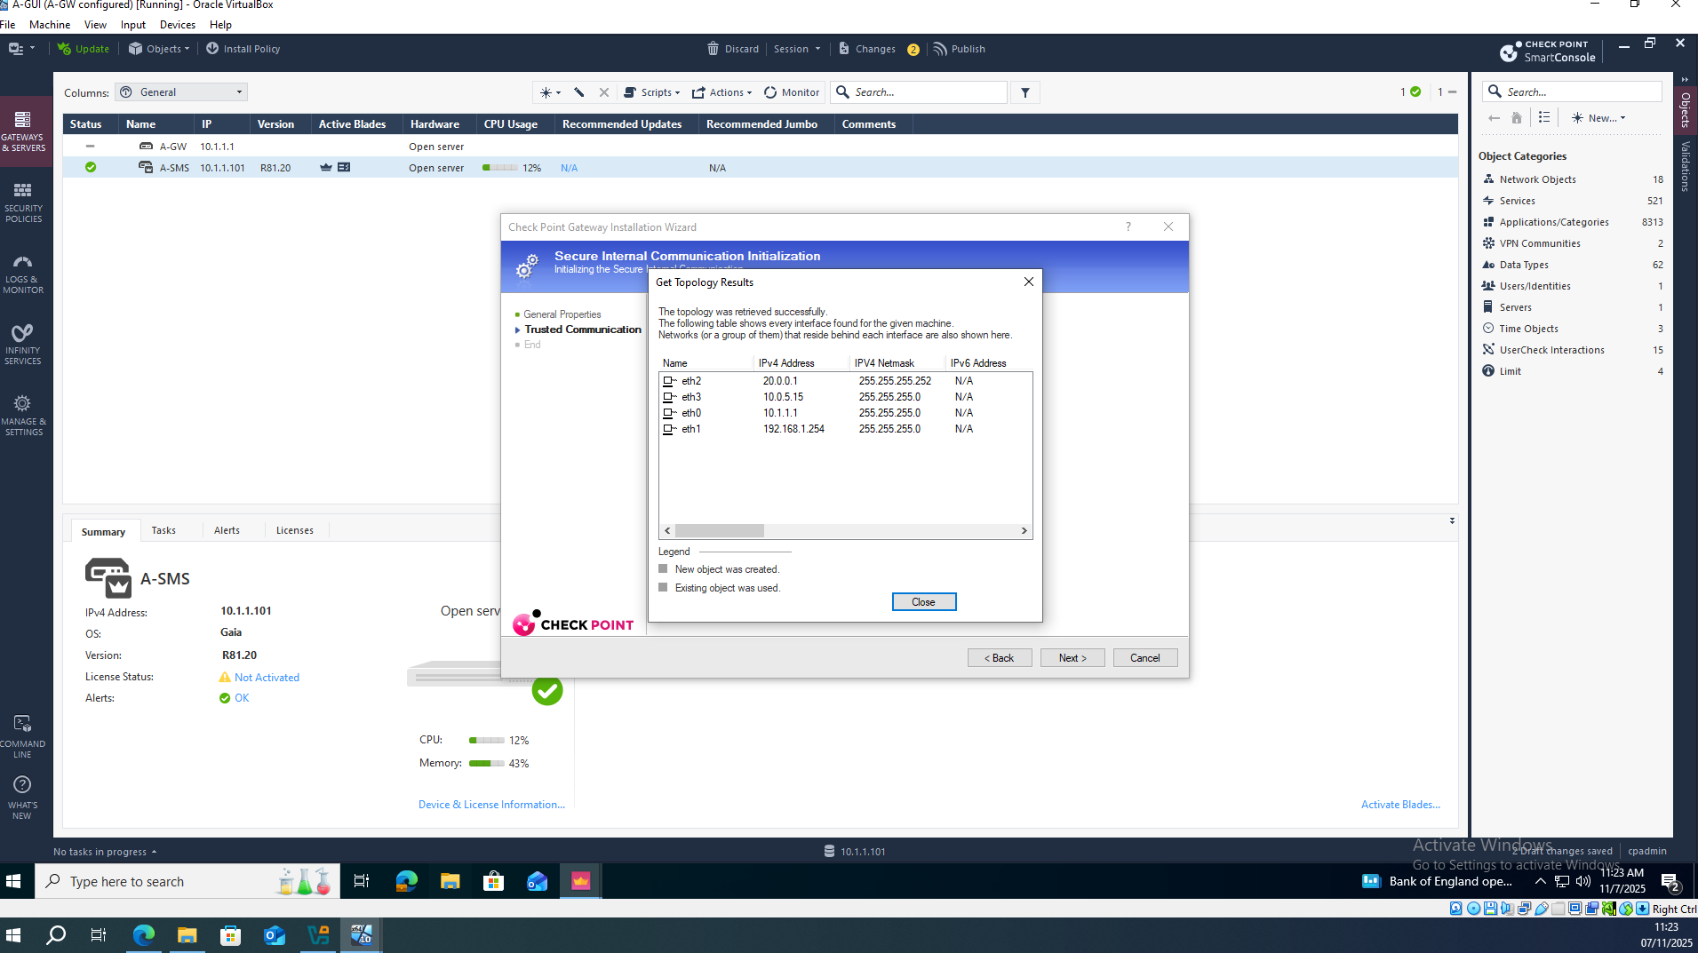
Initial Gateway Setup
Using the Gaia First-Time Wizard:
The hostname and domain were configured.
The management IP address was assigned.
The default gateway was set.
WebUI and SSH access were enabled.
Administrator credentials were created.
This screenshot shows the initial configuration of the Check Point Security Gateway using the Gaia First‑Time Wizard, including hostname assignment, interface configuration, management IP setup and enabling secure administrative access.

Slide 15
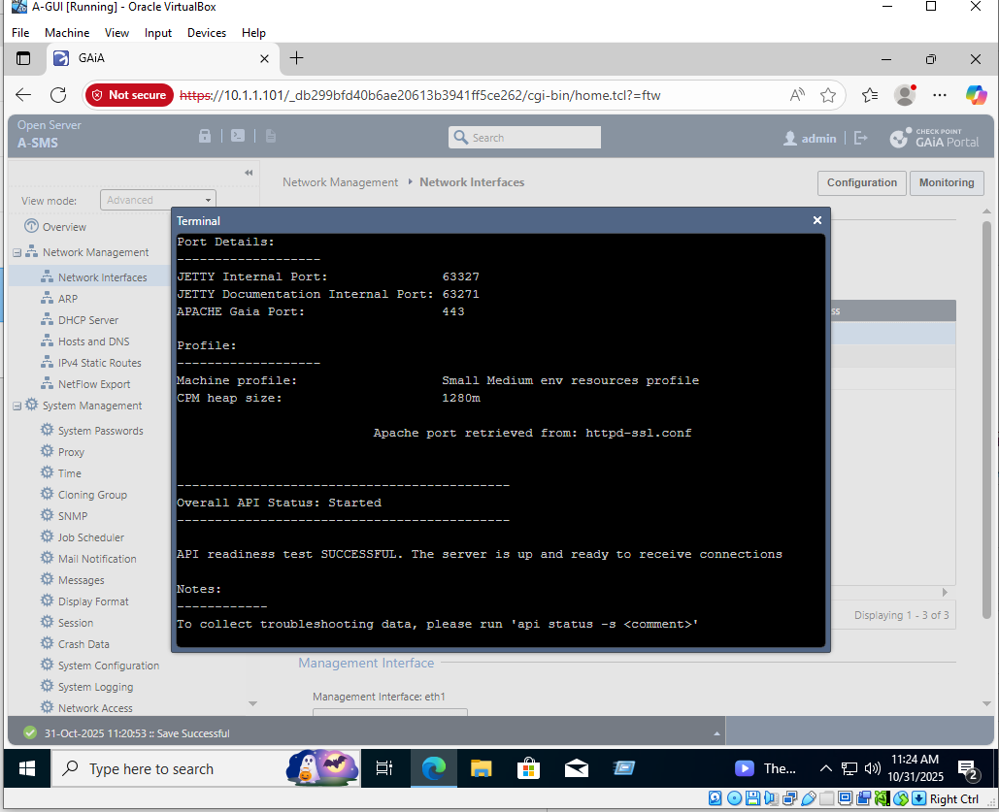
Security Management Server Setup
Using the First-Time Wizard:
The management IP and hostname were configured
The initial admin account was created
SIC (Secure Internal Communication) was enabled
Connectivity between the SMS and gateway was confirmed
The screenshot demonstrates the initial setup of the Check Point Security Management Server (SMS), where the management IP, administrator account and Secure Internal Communication (SIC) were configured to enable centralized policy control.

Slide 16
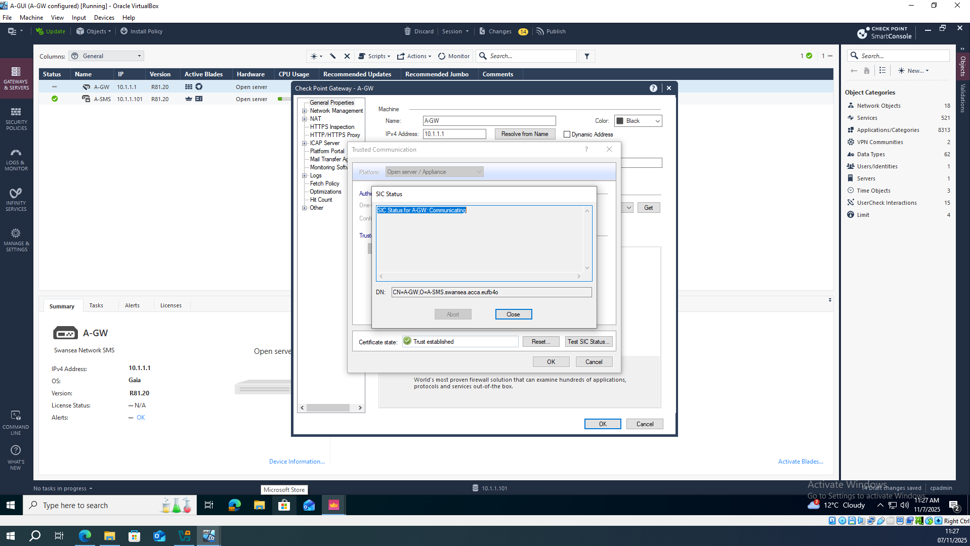
Establishing SIC Trust
A SIC activation key was generated on the gateway
The SMS connected to the gateway through SmartConsole
SIC status showed “Trust Established”
The gateway became ready for policy installation
This screenshot confirms the successful establishment of Secure Internal Communication (SIC) between the Security Gateway and the Management Server, allowing the gateway to securely receive security policies.

Slide 17
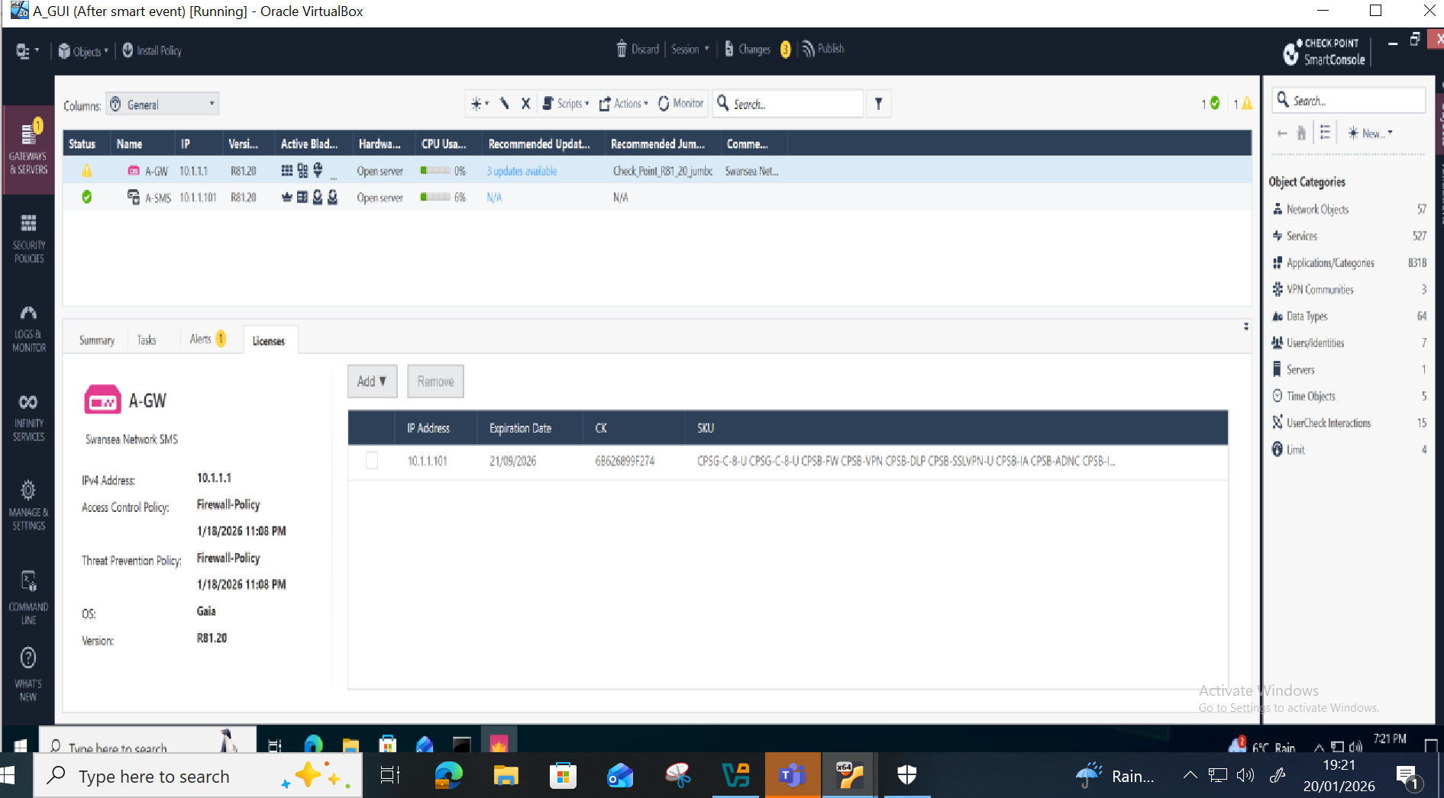
SmartConsole View
The SmartConsole interface provides centralized visibility and management of security policies, objects, logging and threat prevention across the enterprise network.

Slide 18
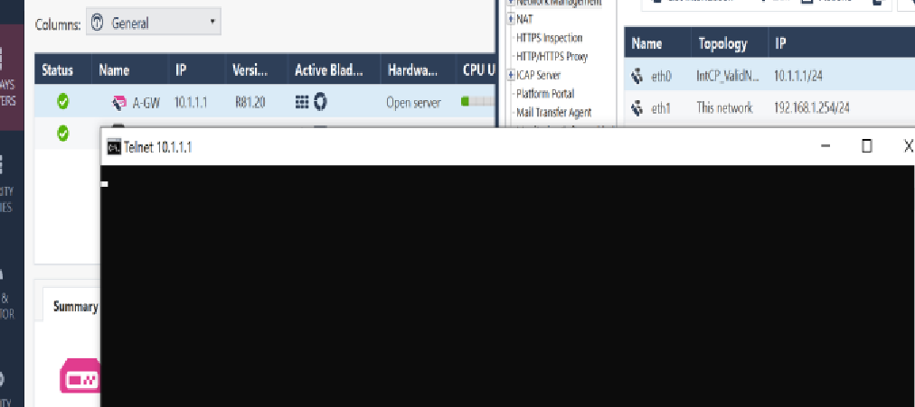
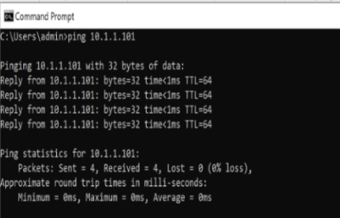
Initial Verification & Testing
Ping tests were performed between the SMS and gateway
WebUI and SmartConsole access were confirmed
Routing and interface connectivity were checked
The initial security policy was installed
Initial connectivity tests were performed to verify communication between the Management Server and Security Gateway, confirming correct routing, interface configuration and policy installation.

Slide 19
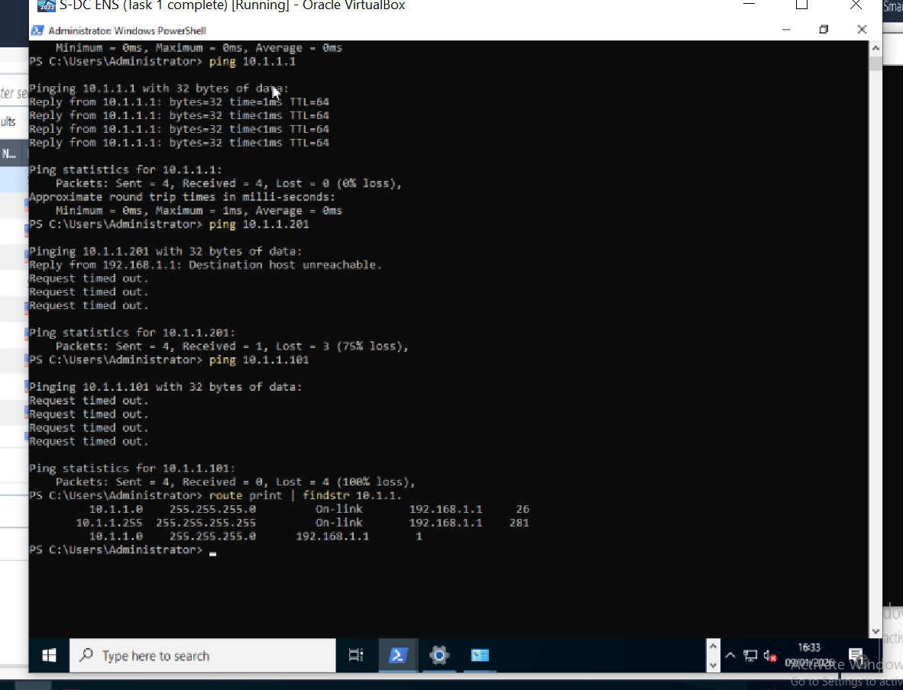
Checking connectivity Management Network
This command‑line output highlights a connectivity issue caused by the absence of a static route, preventing proper communication within the management network.

Slide 20
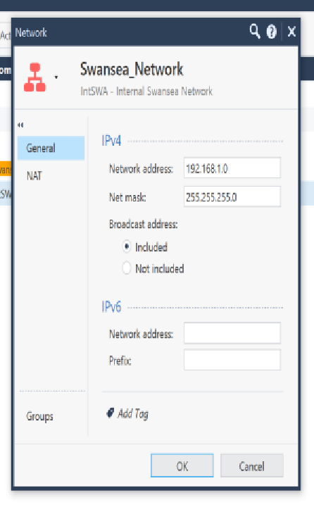
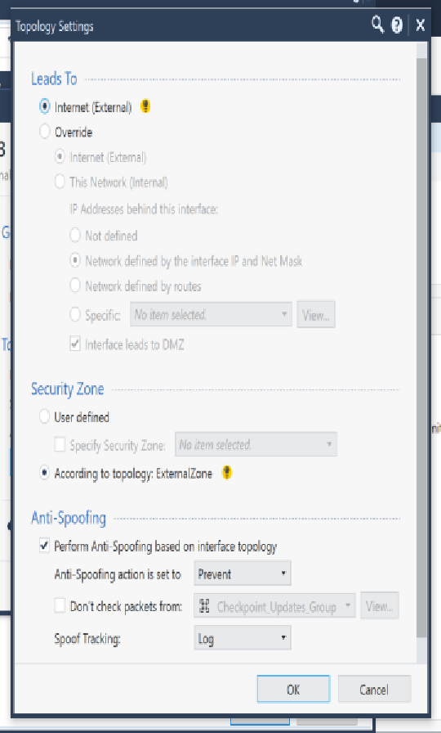
Network Objects & Topology Configuration
Network objects were created for the three LAN subnets
The gateway topology was defined
Anti‑spoofing settings were configured
Internal and external interfaces were verified
Network objects and gateway topology settings were configured to accurately represent internal subnets and interfaces, enabling correct policy enforcement and anti‑spoofing protection.

Slide 21
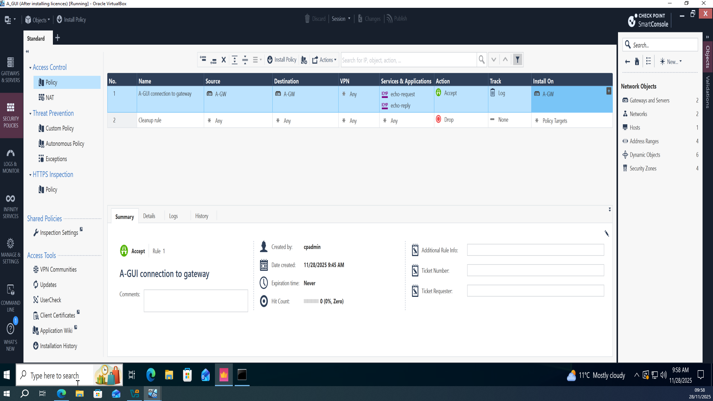
Initial Access Control Policy
Access rules were created for inter‑LAN communication
Internet access rules were added for the user LAN
A cleanup rule was applied
The policy was installed successfully on the gateway
This access control policy defines permitted inter‑LAN and internet traffic, applies a cleanup rule for unmatched traffic, and represents the foundation of network security enforcement.

Slide 22
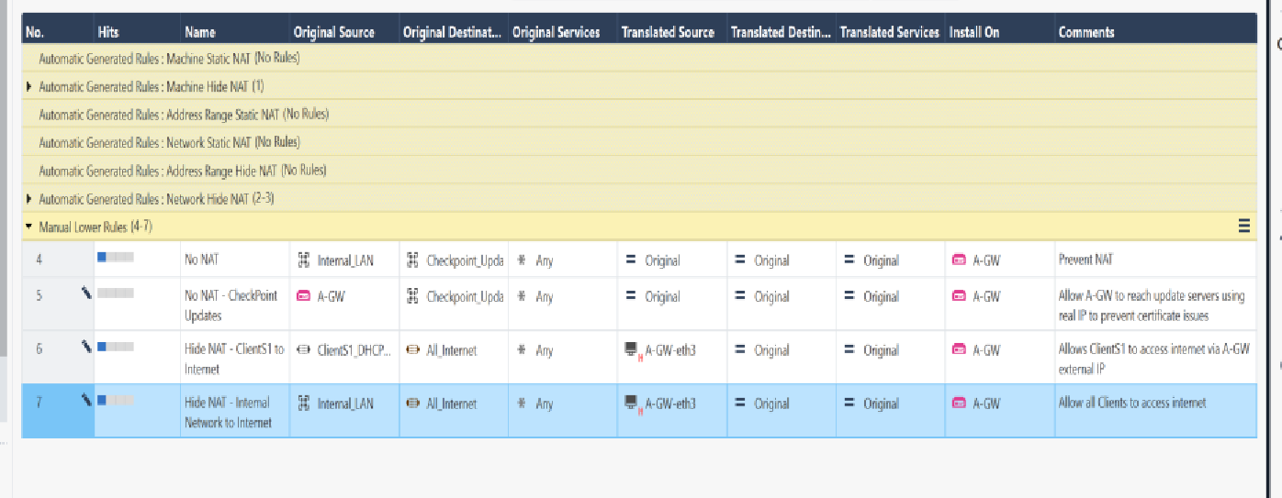
NAT Configuration
Hide NAT was configured for outbound traffic
Static NAT was not applicable.
NAT rules were verified in SmartConsole
Connectivity was tested after NAT was applied
Hide NAT was configured to allow internal hosts to access external networks while preserving private IP addressing, with rules verified through SmartConsole.

Slide 23
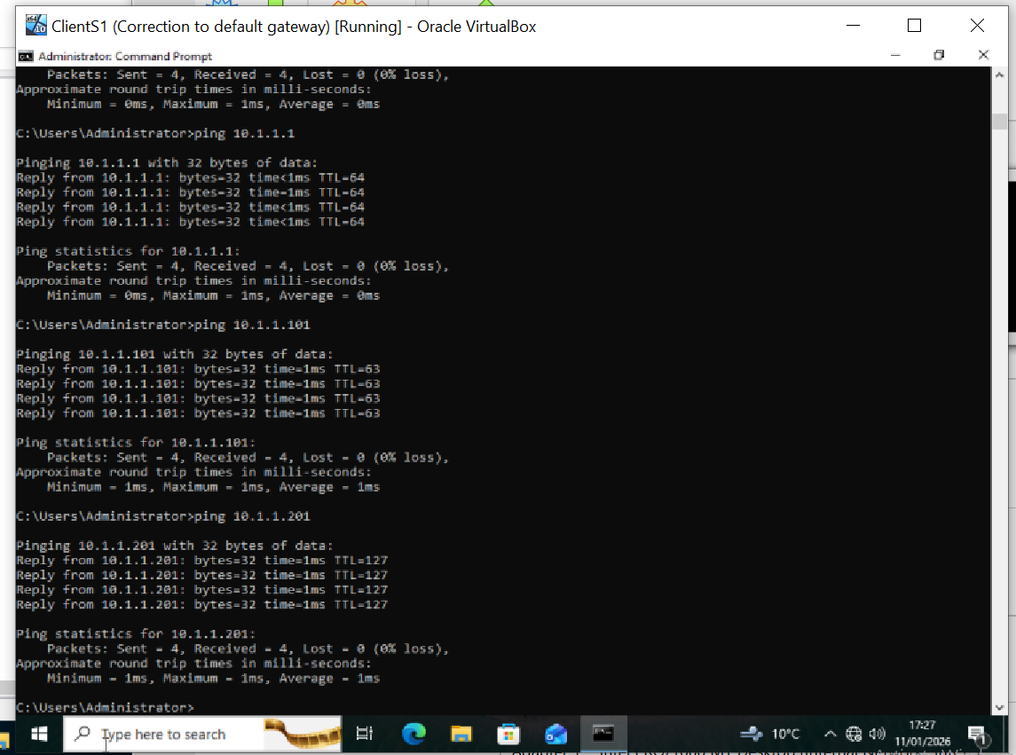
Network Connectivity Validation
Connectivity validation confirms successful communication between internal systems following policy and NAT configuration, demonstrating correct firewall behaviour.

Slide 24
Post-Configuration Security Improvements

Slide 25
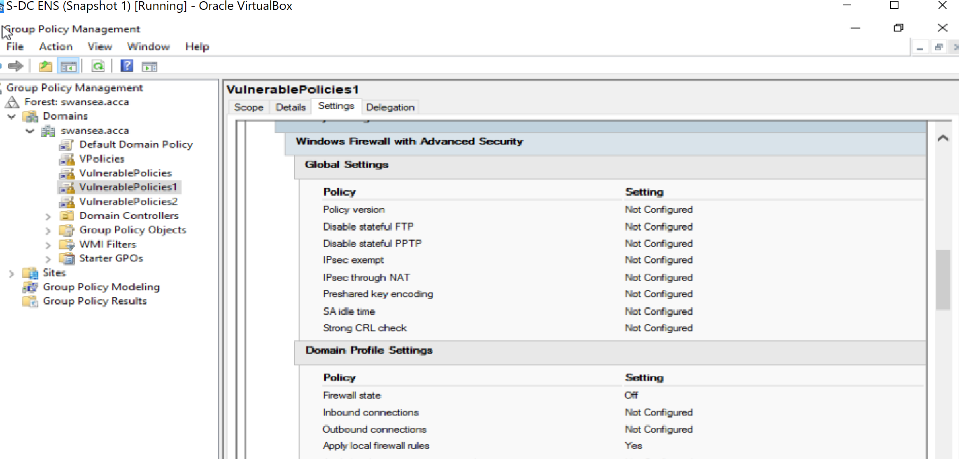
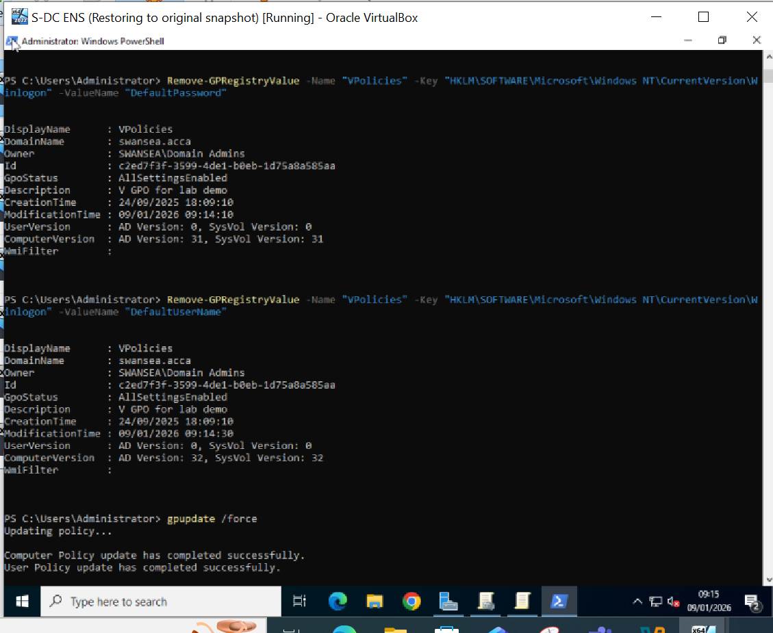
GPO Vulnerability Remediation
Vulnerable Group Policy settings were identified on the S‑DC
A policy allowed the testuser account to automatically log in
Another policy had disabled Windows Firewall across the domain
Both insecure policies were removed to restore proper security
Domain security posture was improved and validated
The screenshots show the identification and remediation of insecure Group Policy settings, including the removal of automatic logon and restoration of Windows Firewall protections.

Slide 26
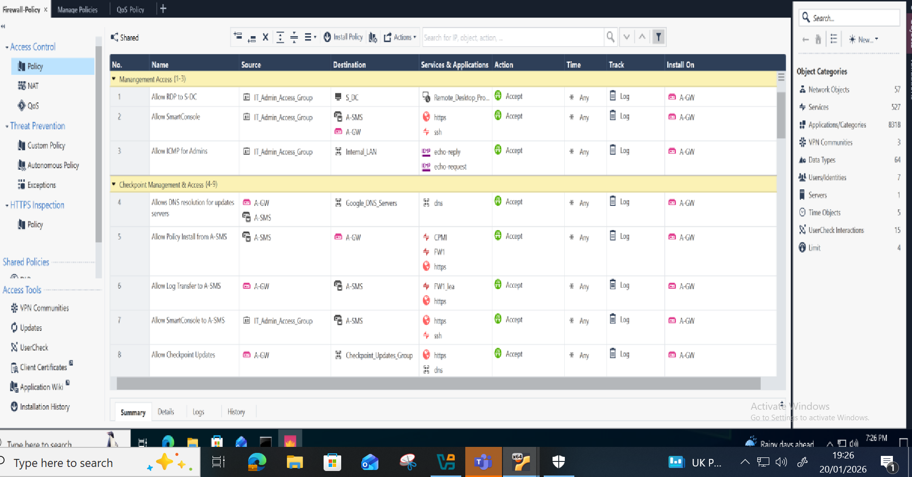
Access Control Policy Design
Layered policy was built using inline layers.
Logical objects were used to simplify services and zones.
FQDN objects enabled dynamic domain‑based access.
Rules were ordered from specific → general.
This screenshot illustrates a layered access control policy design using logical objects, inline layers and FQDN objects to improve readability, scalability and security enforcement.

Slide 27
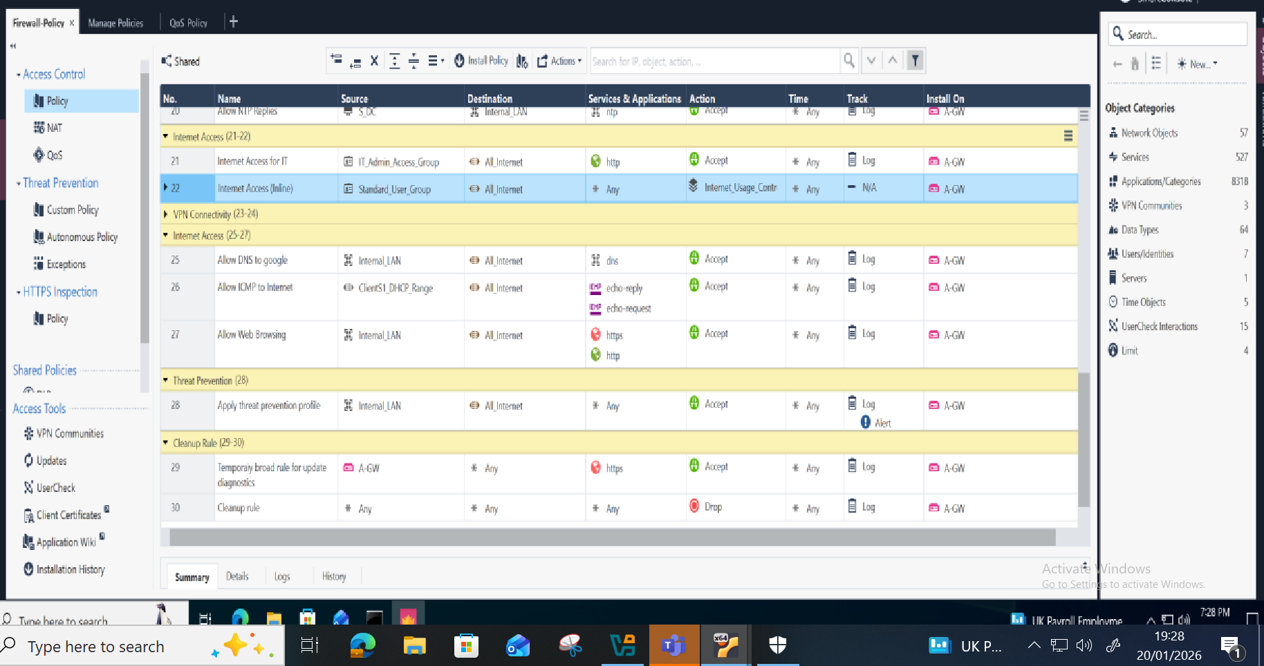
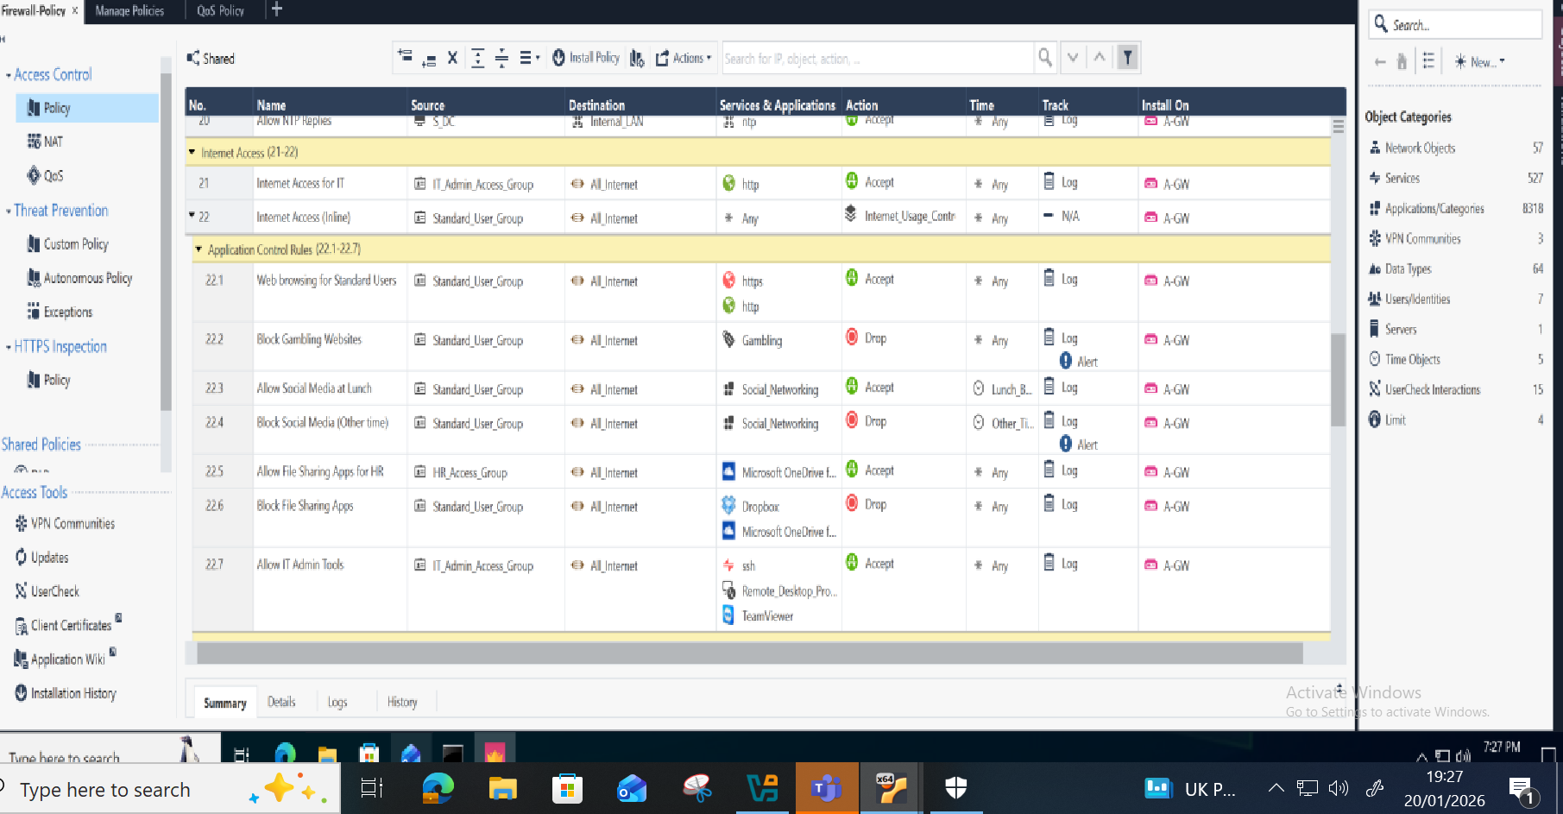
Policy Rulebase (Main View)
Inline Layer Expanded View
The main rulebase and expanded inline layer views demonstrate how policy logic is structured and evaluated within Check Point SmartConsole.

Slide 28
Advanced Security Features

Slide 29
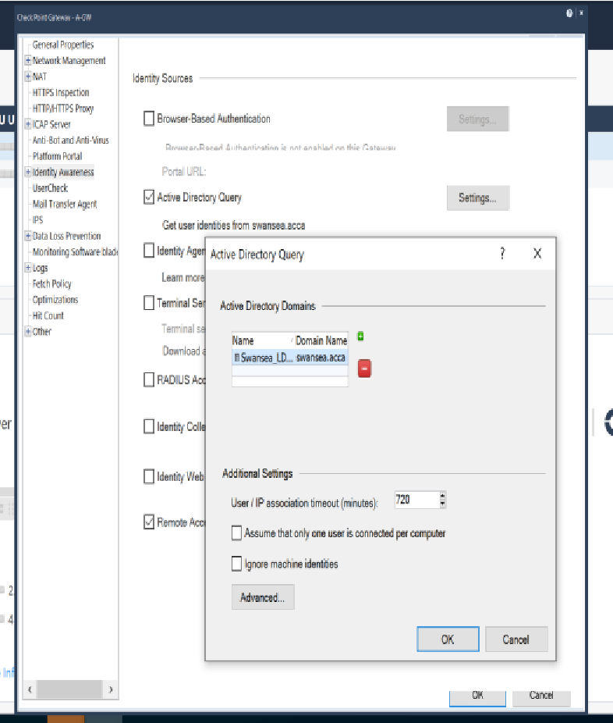
Identity-Based Access Control
Identity Awareness was integrated with Active Directory.
DNS resolution with the Domain Controller (swansa.acca) was verified.
The LDAP Server object was created using the Check Point bind DN:
(CN=checkpoint,CN=Users,DC=swansea,DC=acca).
Identity Awareness was linked to the new LDAP Account Unit.
Access Roles were created based on LDAP groups for user-based policy enforcement.
Identity Awareness was integrated with Active Directory, enabling user‑based policy enforcement through LDAP integration and access roles mapped to domain groups.

Slide 30
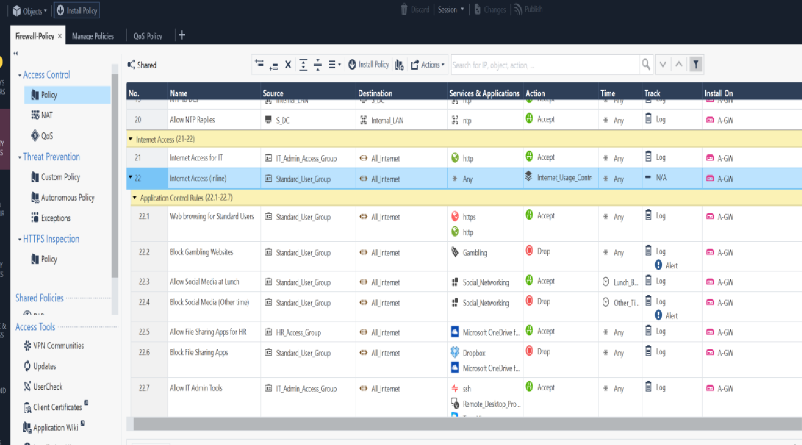
Application Control & URL Filtering
Enabled on the gateway to enforce user-based access restrictions.
Specific rules created to allow or block access to applications and membership based on category, risk level and Active Directory membership.
Identity Awareness was used to enhance visibility and control.
This screenshot shows application and URL filtering rules that restrict access based on application category, risk level and user identity.

Slide 31
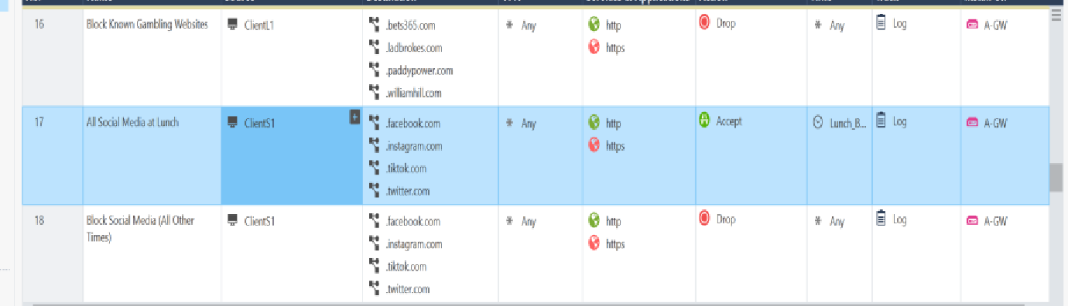
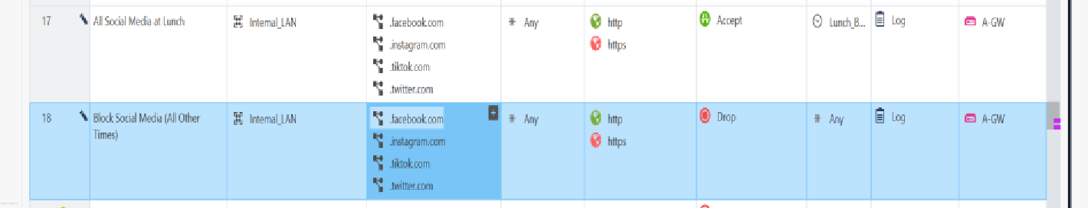
User-Based Web Access Controls
Gambling websites were blocked using Application Control & URL Filtering category‑based rules.
Social media access was restricted to lunch hours using time objects.
Identity Awareness ensured rules applied based on user login.
User‑based web access policies were implemented to block high‑risk categories such as gambling sites and restrict social media access using time‑based rules.

Slide 32
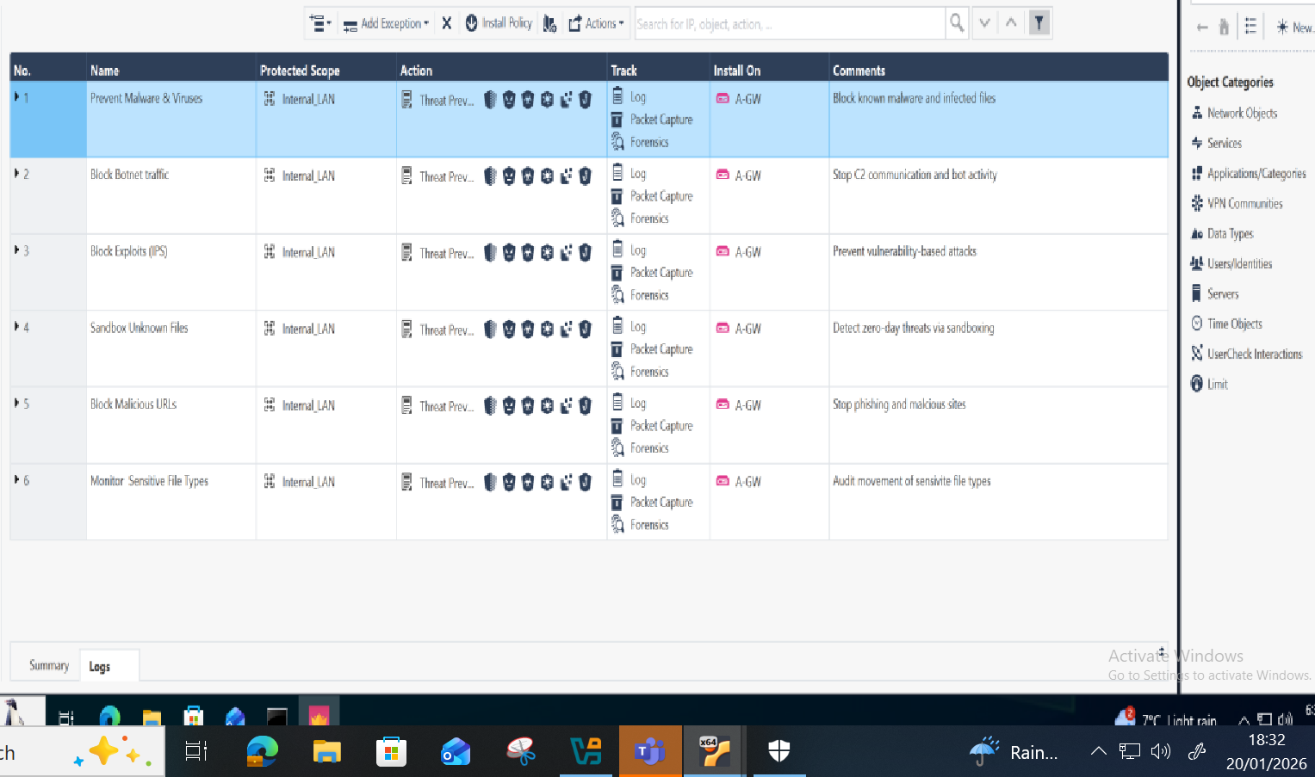
IPS & Threat Prevention
Threat Prevention blades were enabled on A‑GW to protect against known and emerging threats.
A dedicated Threat Prevention Policy was created to inspect inbound and outbound traffic.
Threat Prevention blades were enabled on the gateway to inspect network traffic in real time and protect against known vulnerabilities, exploits and intrusion attempts.

Slide 33
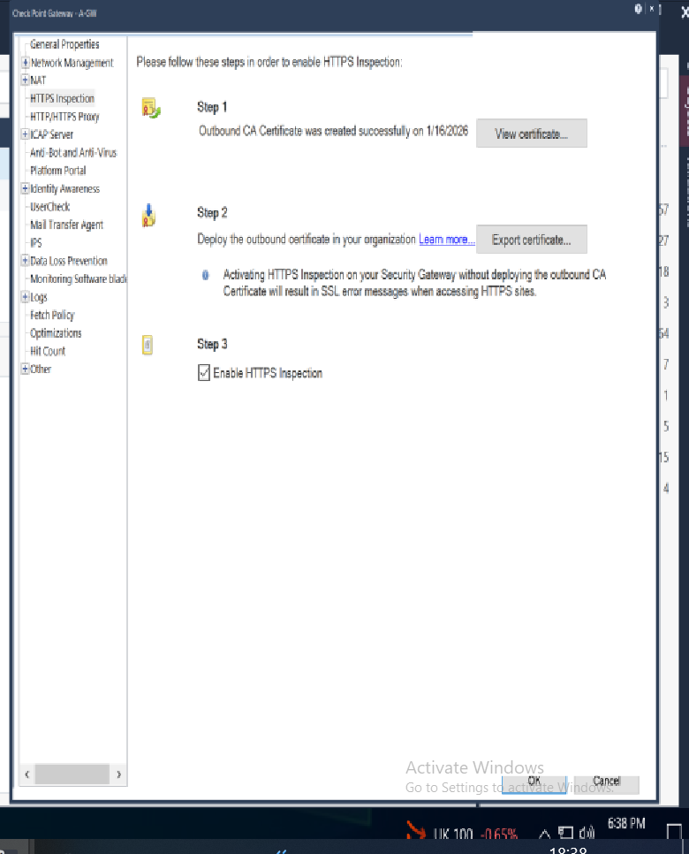
HTTPS Inspection
HTTPS Inspection was enabled to decrypt and inspect encrypted traffic.
Threat Prevention, Application Control and URL Filtering were applied to HTTPS sessions.
User‑based controls were enforced consistently through Identity Awareness.
Visibility into encrypted traffic was improved, reducing blind spots.
HTTPS Inspection was enabled to decrypt encrypted traffic, allowing security blades to apply threat prevention and application control policies consistently.

Slide 34
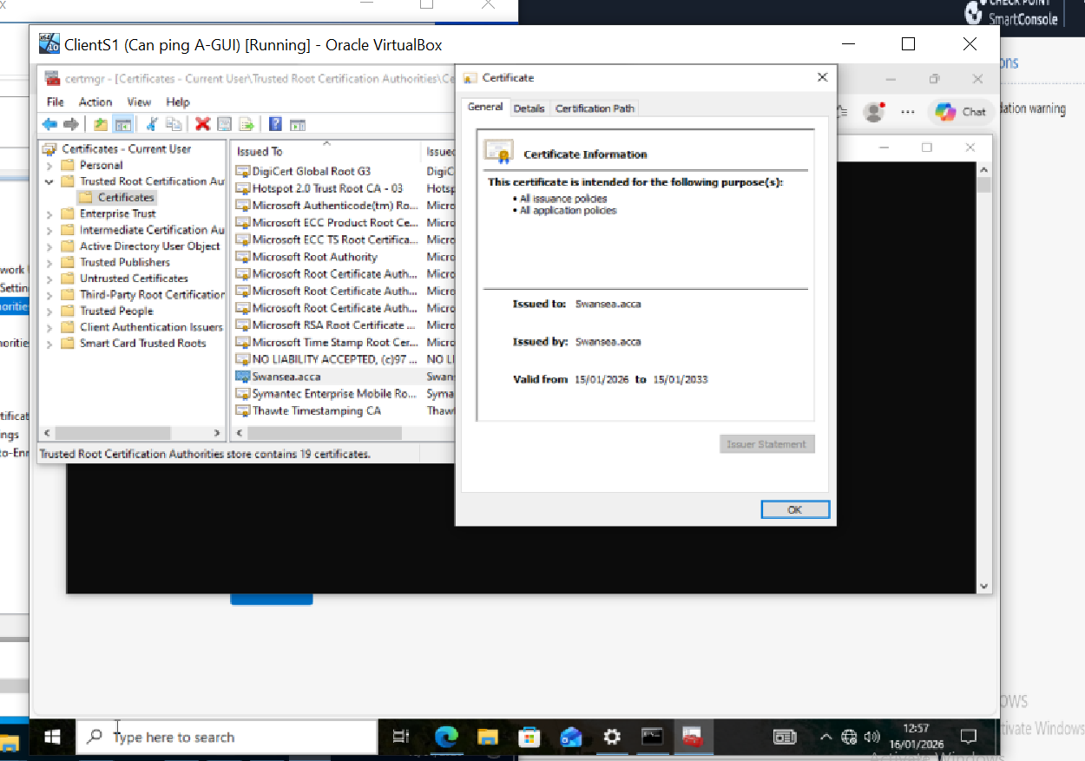
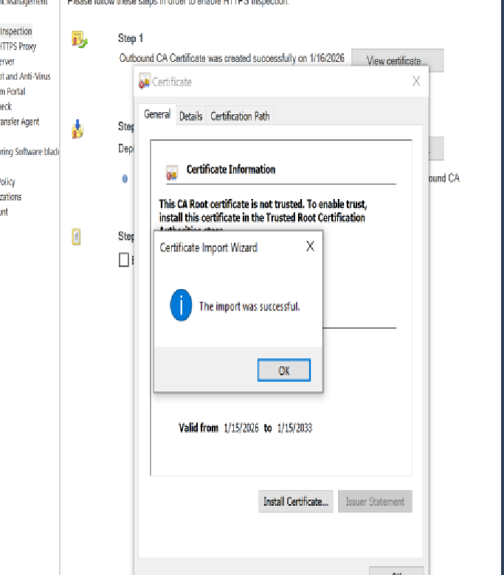
HTTPS Inspection Certificate Distribution
The screenshots show certificate deployment required for HTTPS Inspection, ensuring client trust and uninterrupted encrypted traffic inspection.

Slide 35
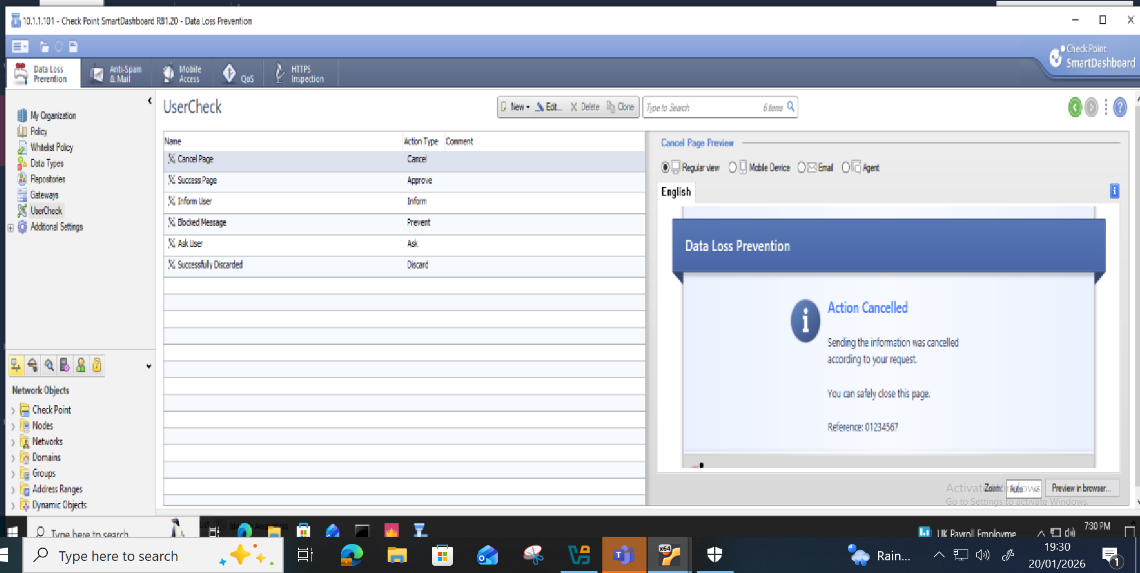
Data Loss Prevention (DLP)
DLP was implemented to monitor and control the movement of sensitive data
Built‑in and custom data types were used to detect sensitive content
UserCheck was configured to alert users and prevent policy violations
Data Loss Prevention policies were configured to detect sensitive content and alert users through UserCheck, helping to prevent unauthorized data exfiltration.

Slide 36
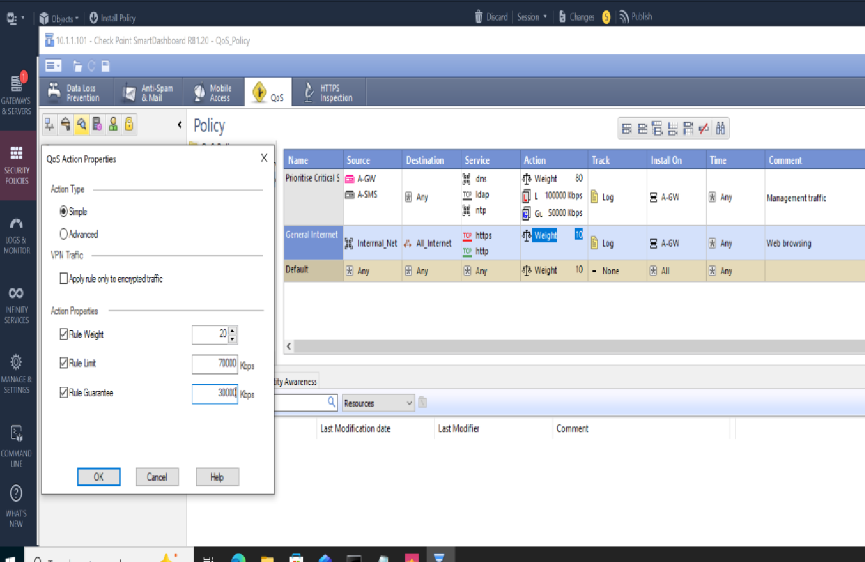
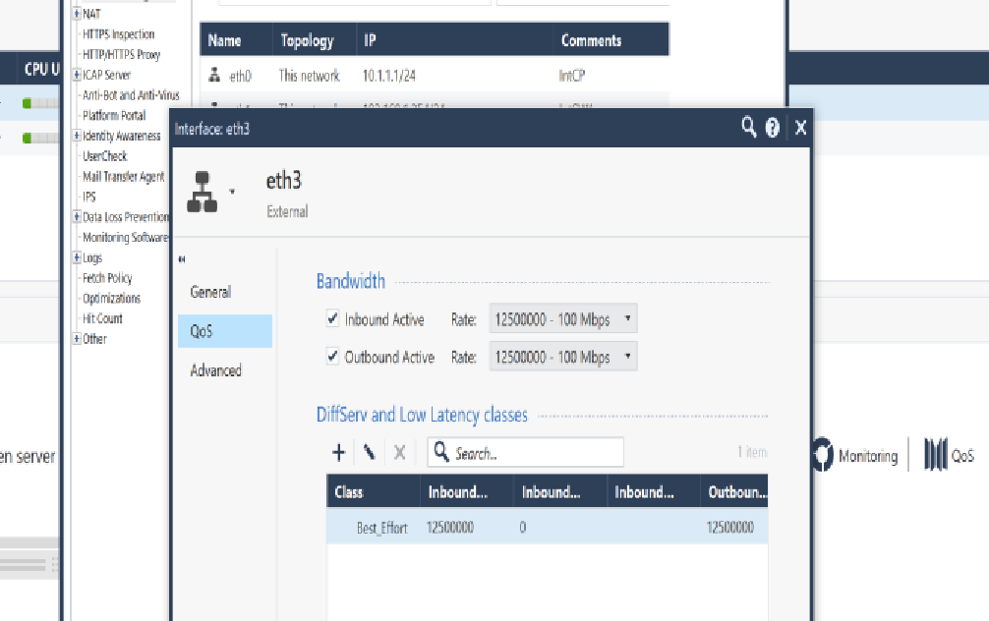
Quality of Service (QoS)
To prioritise critical traffic and mange bandwidth usage across the network the QoS blade was enabled on A-GW.
Rules were defined to guarantee bandwidth for essential services.
QoS classes were configured with guaranteed and maximum bandwidth values.
QoS policies were implemented to prioritise critical applications and guarantee bandwidth for essential services, ensuring reliable network performance.

Slide 37
Monitoring

Slide 38
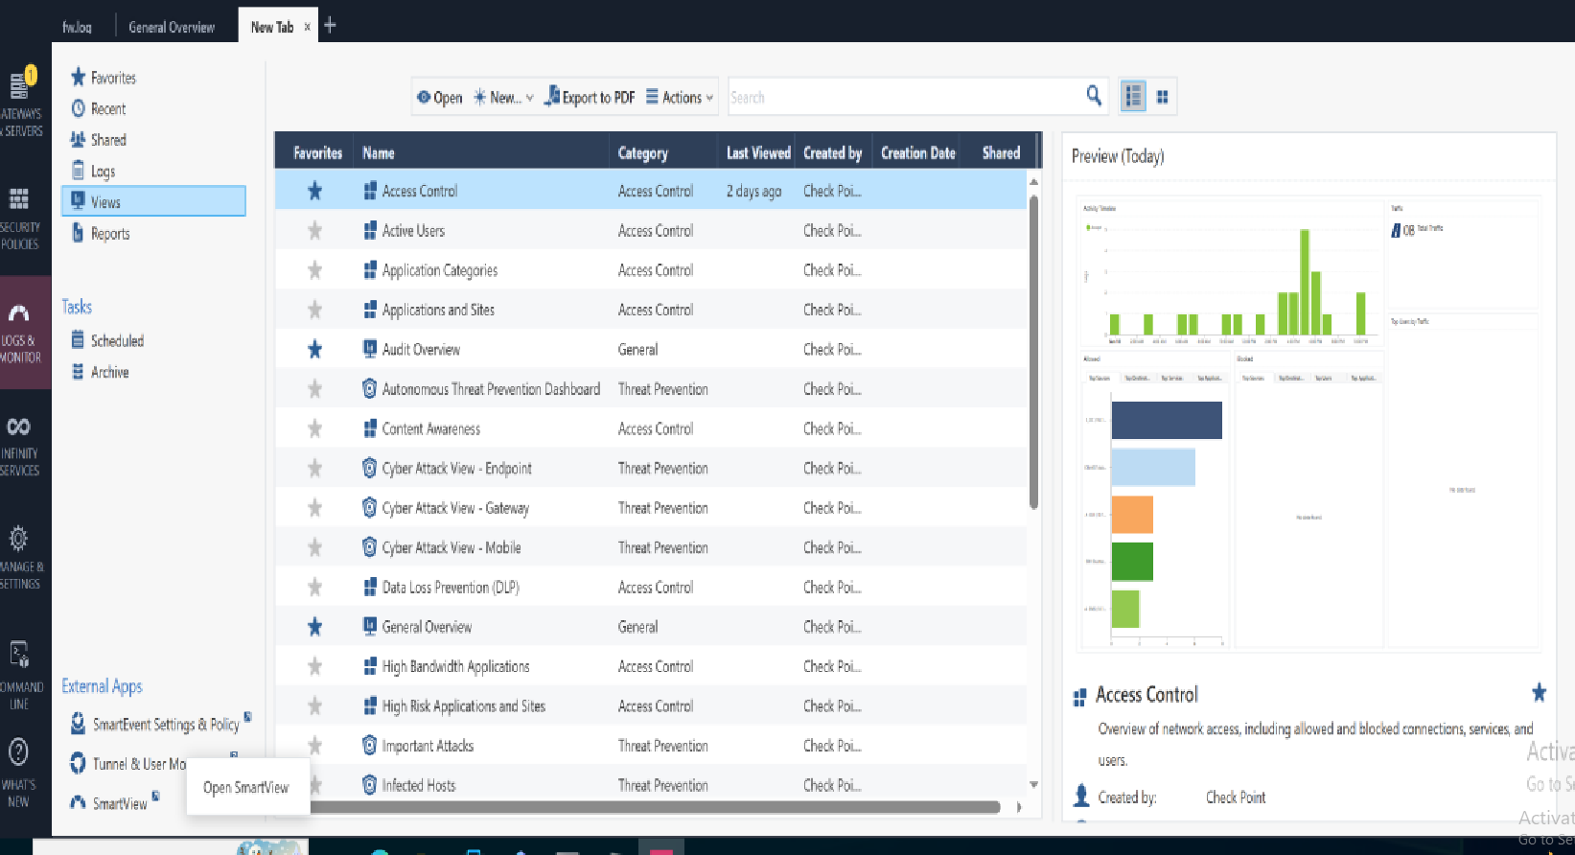
Monitoring and Visibility -SmartEvent
SmartEvent was deployed to provide centralised monitoring and correlation across all security blades
It was used to assess the effectiveness of the implemented policies
In a production environment, it would support reporting, incident investigation and user activity monitoring
SmartEvent provides centralised monitoring and correlation of security events, supporting policy effectiveness review and incident investigation.

Slide 39
Troubleshooting

Slide 40
Key Challenges
Several technical challenges were encountered during the deployment, including:
DHCP initially failed to provide a default gateway preventing client routing.
A-GW lacked internet access which blocked updates.
ClientS1 experienced time drift from the domain controller, leading to authentication issues and failed GPO updates.
Establishing VPN connection between L-CD and S-DC.

Slide 41
Resolution Strategies
Developed a step-by-step troubleshooting plan to address issues related to DNS, DHCP, time sync and internet access.
Used command-line tools to verify connectivity, services and configurations.
Reviewed SmartLog, SmartEvent and Windows Event Viewer Logs to identify issues.
Documented each issue and resolution to support auditing and future troubleshooting.

Slide 42
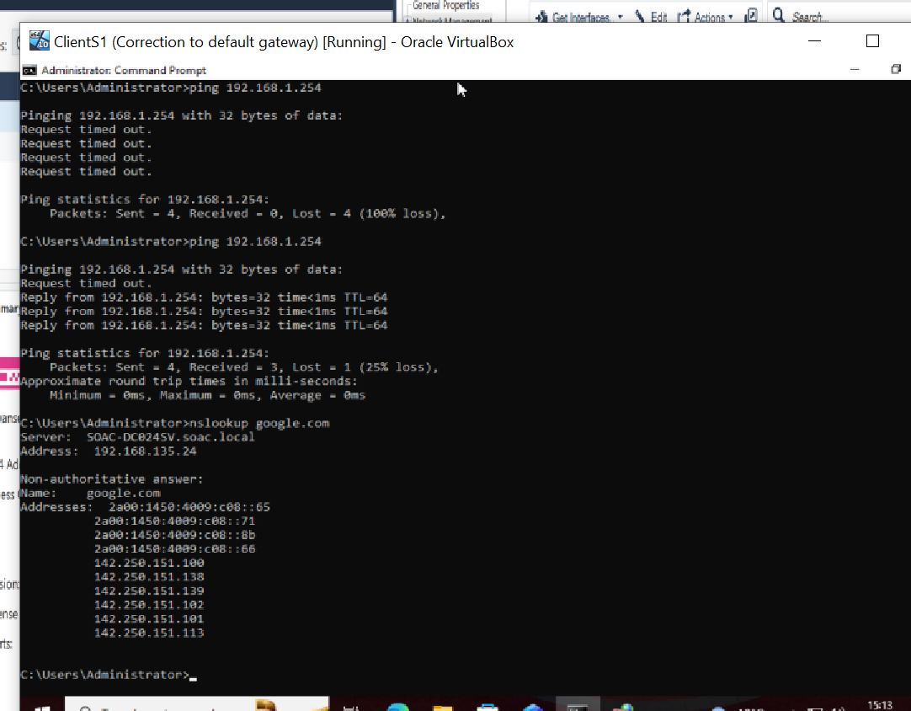
DNS Issue
This screenshot highlights a DNS resolution failure where ClientS1 was unable to resolve external domains due to misconfigured DNS settings.

Slide 43
DNS Troubleshooting Summary
Category | Details
Initial Issue | ClientS1 unable to resolve external domain names (e.g. www.google.com)
Root Causes | No DNS forwarder on S-DC NAT rule blocked outbound DNS (UDP/53) ClientS1 not using S-DC for DNS Missing A record in DNS zone
Actions take | Configured DNS forwarding to 8.8.8.8 Allowed DNS to hid NAT Verified ClienS1 DNS setting Populated DNS zone with A record
Verification | Used nslookup and ping to confirm internal and external name resolution
Outcome | DNS rolution functional for both internal and external domain.

Slide 44
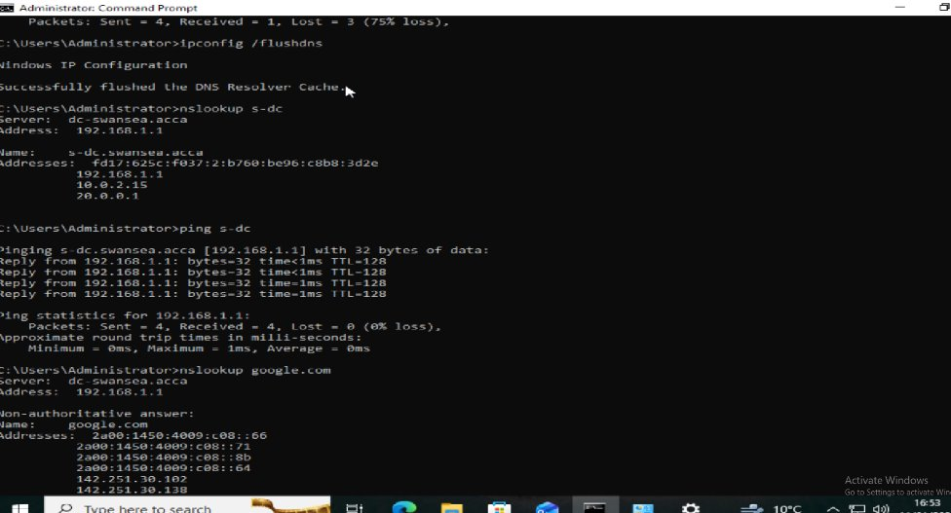
DNS Verification
Successful DNS resolution confirms that corrective actions restored both internal and external name resolution functionality.

Slide 45
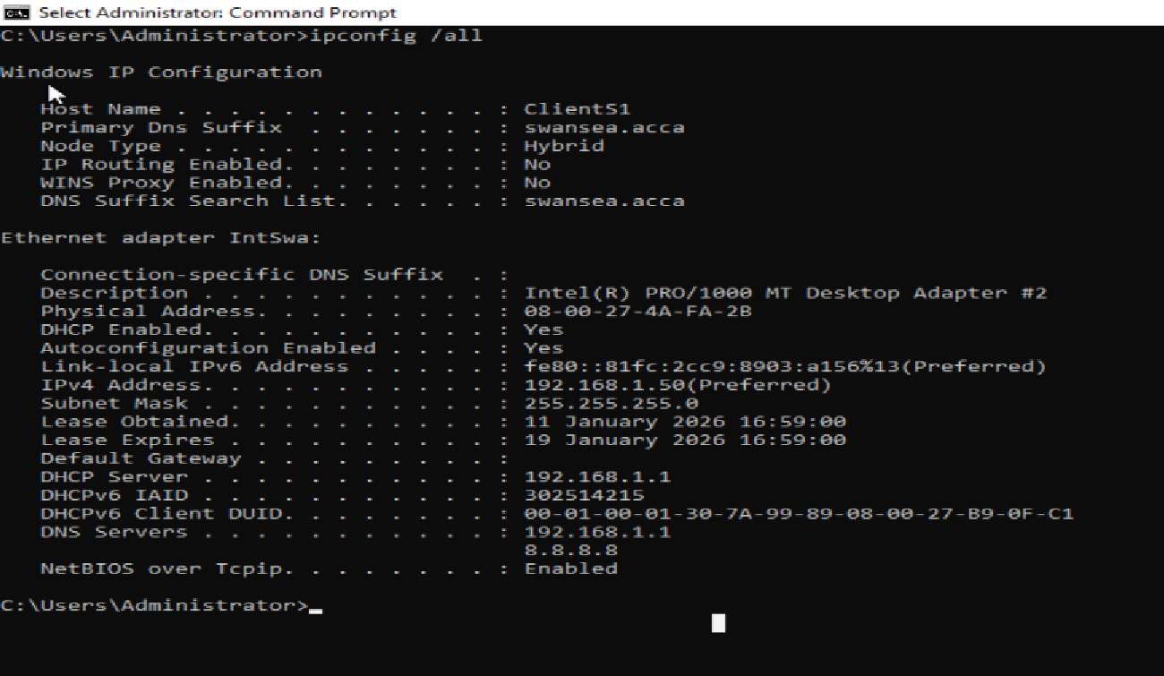
DHCP Issue
The output shows a DHCP failure where the client did not receive a default gateway, preventing outbound network connectivity.

Slide 46
DHCP Troubleshooting Summary
Category | Details
Initial Issue | ClientS1 failed to obtain default gateway automatically
Root Causes | DHCP service not running on S-DC Incorrect DHCP scope Firewall blocking DHCP traffic (UDP 67/68)
Action Taken | Started DHCP Server role on S-DC Created and activated correct DHCP scope Updated firewall rules
Verification | Used ipconfig /renew and ipconfig /all on ClientS1 to confirm lease acquisition and correct default gateway.
Outcome | ClientS1 successfully received IP, gateway .

Slide 47
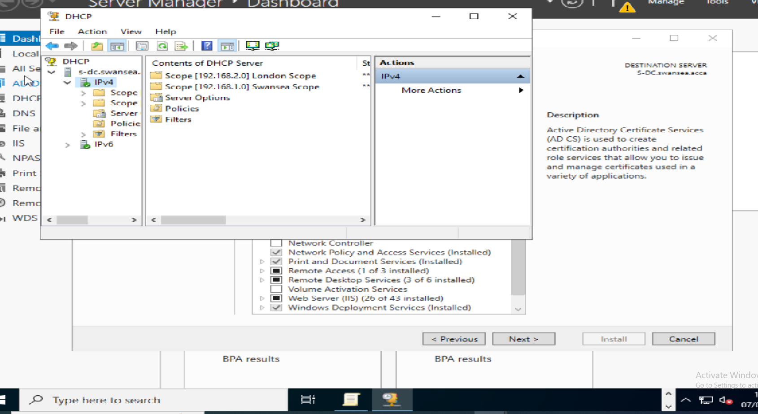
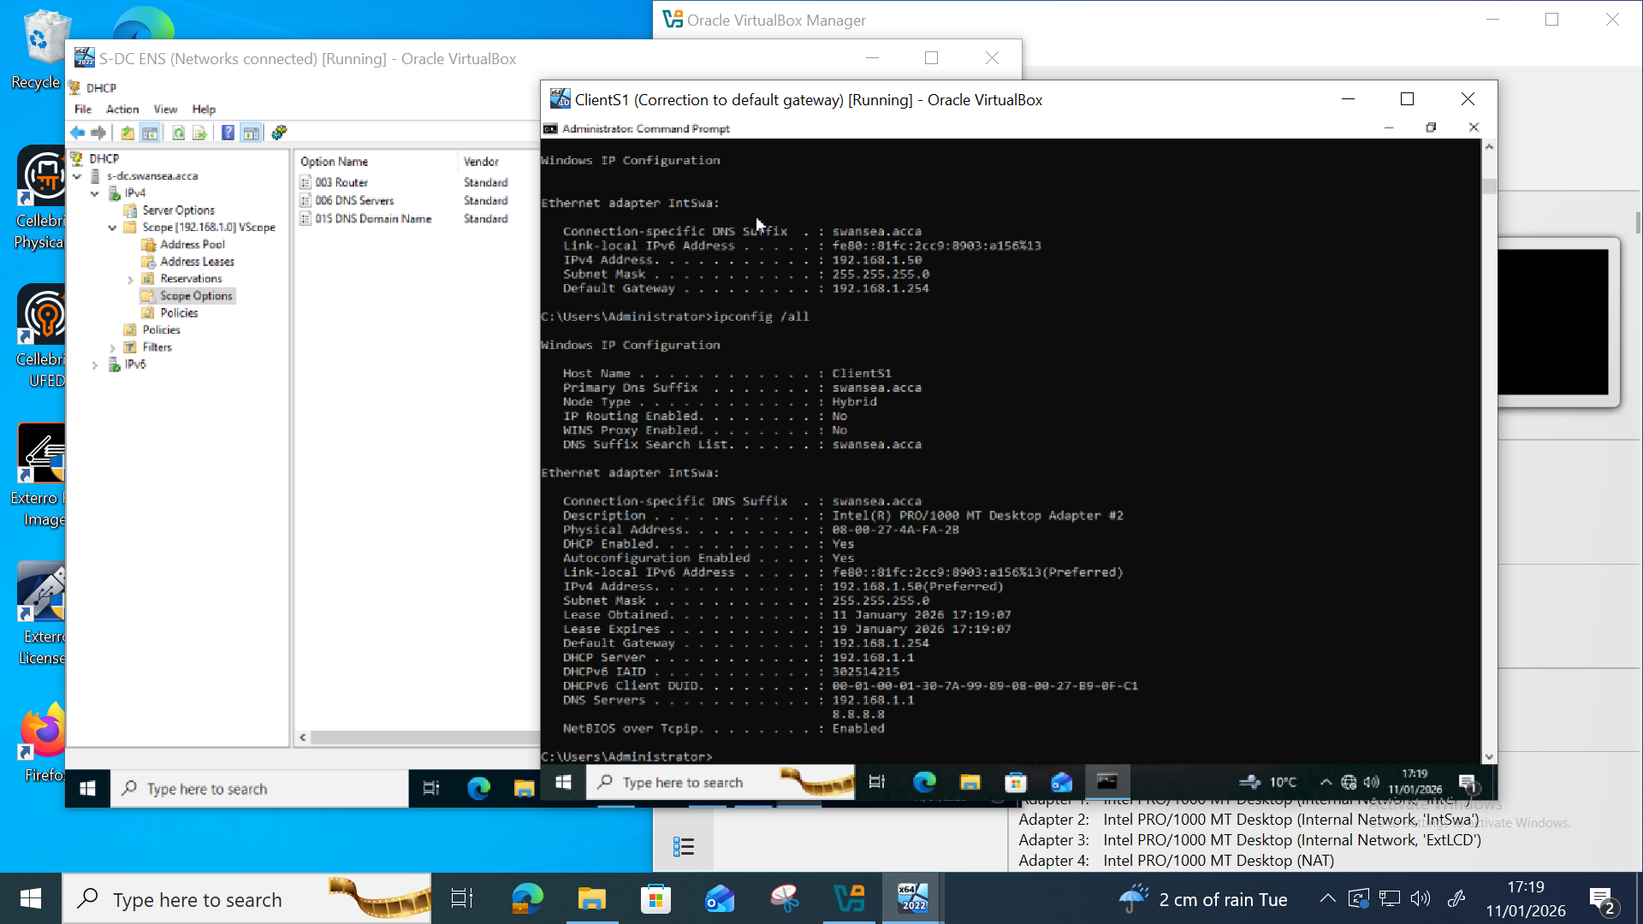
DHCP Verification
Post‑configuration verification confirms that DHCP services are functioning correctly and clients receive valid IP and gateway details.

Slide 48
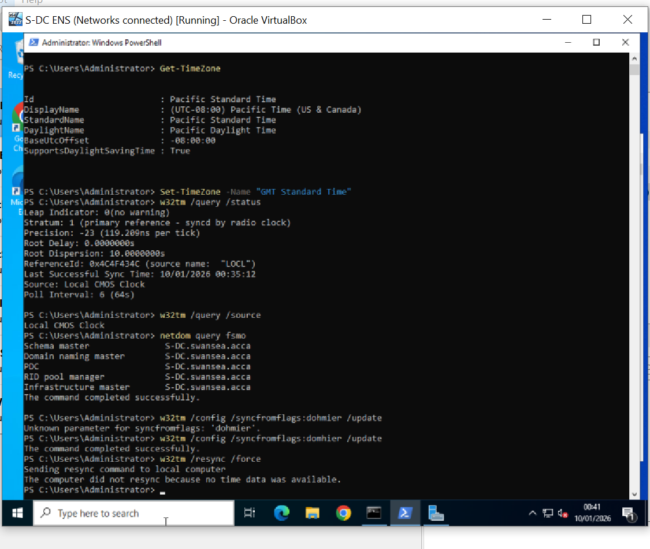
Time Sync Issue
This screenshot demonstrates time synchronisation inconsistencies that caused authentication and domain policy issues.

Slide 49
Time Sync Troubleshooting Summary
Category | Details
Initial Issue | S-DC and ClientS1 displayed mismatched system times.
Root Causes | ClientS1 was not using S-DC as the NTP time source
Actions Taken | Configured S-DC to sync with reliable external NTP server (e.g. time.windows.com) Verfied time service status using w32tm /query /status and w32tm /resync Created GPO policy
Verification | Confirmed time alignment using net time on both S-DC and ClientS1
Outcome | Time synchronised across domain members.

Slide 50
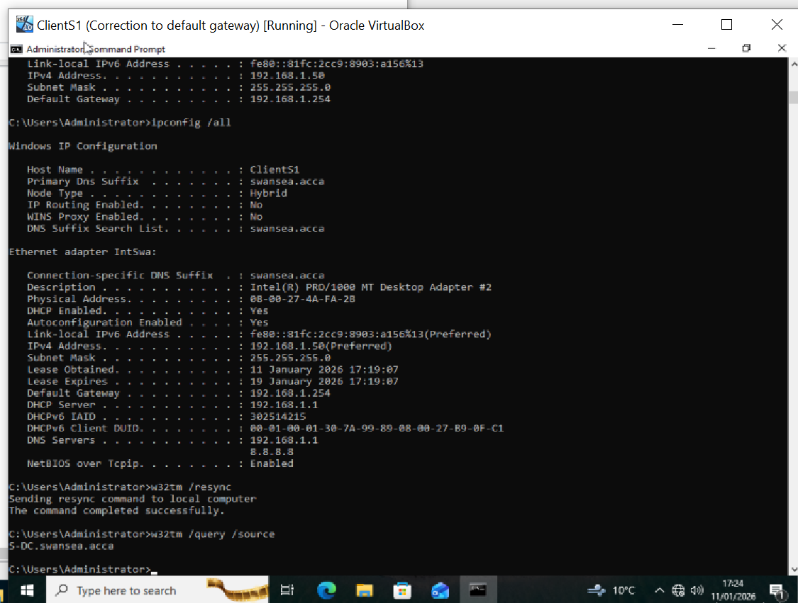
Time Sync Verification
Time synchronisation was successfully restored across domain systems, ensuring secure authentication and proper GPO application.

Slide 51
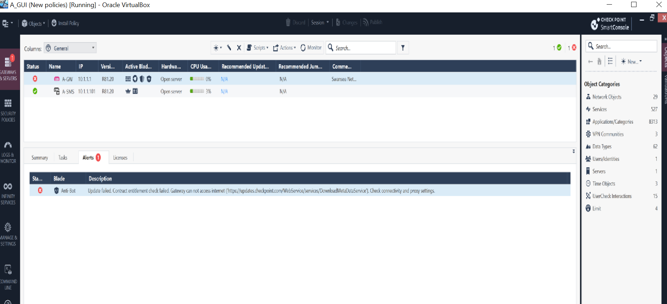
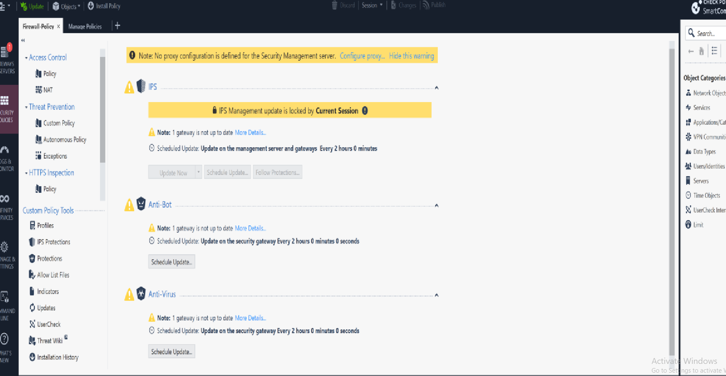
Checkpoint Update Issue 1
This screenshot shows that the Check Point Security Gateway (A‑GW) lacked internet connectivity, preventing access to Check Point update services due to incorrect routing and outbound network configuration.

Slide 52
Check Point Update Issue 1 Troubleshooting Summary
Category | Details
Initial Issue | A-GW couldn't reach Check Point cloud services (e.g. updates.checkpoint.com) for policy fetch and updates.
Root Causes | No default route on A-GW, preventing outbound traffic. Incorrect IP address on eth3 (external facing adapter) DNS resolution failed due to unreachable upstream servers. Check Point domains hidden behind Cloudflare/CDN, making static IP rules unreliable
Action Taken | Created FQDN object for *.checkpoint.com in SmartConsole Added FQDN object to outbound access rule for A-GW. Corrected IP address and configured default route (0.0.0.0/0) on A-GW pointing to NAT gateway (eth3). Checked NAT and firewall rules. Manually forced policy fetch and monitored logs and alerts.
Verification | Used telnet and Ping to confirm outbound connection. Policy fetch successful
Outcome | A-GW reached internet via default route, accessed Check Point services.

Slide 53
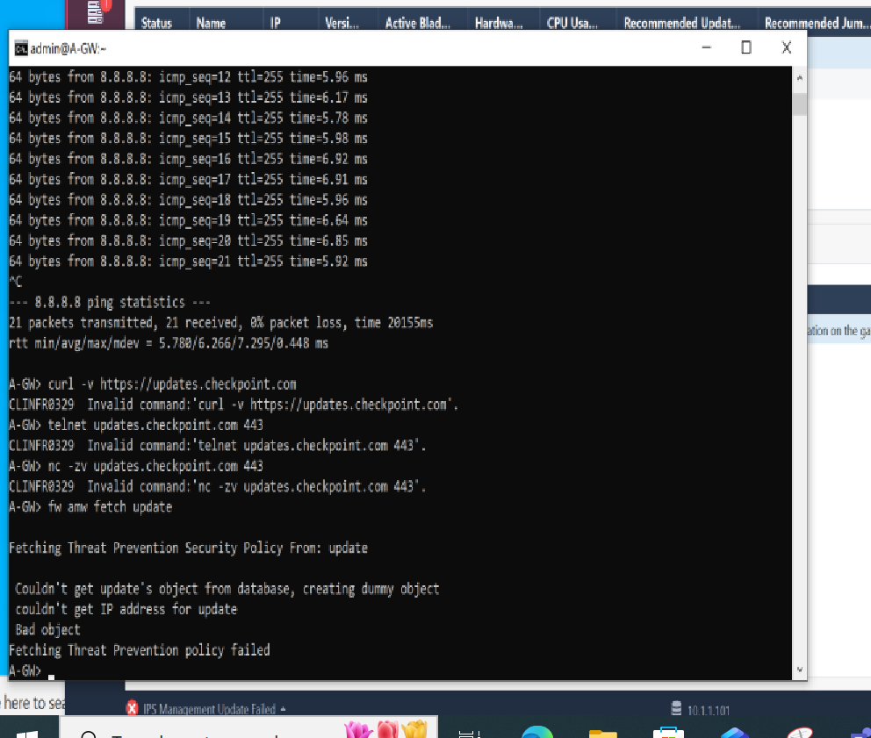
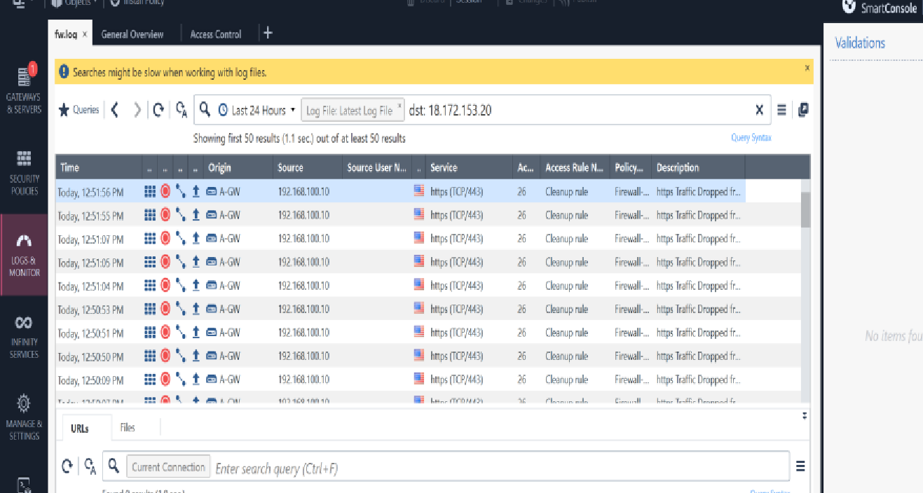
Checkpoint Updates Issue 2
Internet access was restored by correcting the external interface configuration, defining a default route, and updating outbound access rules to permit connectivity to Check Point cloud services.

Slide 54
Check Point Update Issue 2
Troubleshooting Summary
Category | Details
Initial Issue | A-GW couldn't reach Check Point cloud services (e.g. updates.checkpoint.com) for policy fetch and updates.
Root Causes | No default route on A-GW, preventing outbound traffic. Incorrect IP address on eth3 (external facing adapter) DNS resolution failed due to unreachable upstream servers. Check Point domains hidden behind Cloudflare/CDN, making static IP rules unreliable
Action Taken | Created FQDN object for *.checkpoint.com in SmartConsole Added FQDN object to outbound access rule for A-GW. Corrected IP address and configured default route (0.0.0.0/0) on A-GW pointing to NAT gateway (eth3). Checked NAT and firewall rules. Manually forced policy fetch and monitored logs and alerts.
Verification | Used telnet to confirm outbound connection. Policy fetch successful
Outcome | A-GW reached internet via default route, accessed Check Point services.

Slide 55
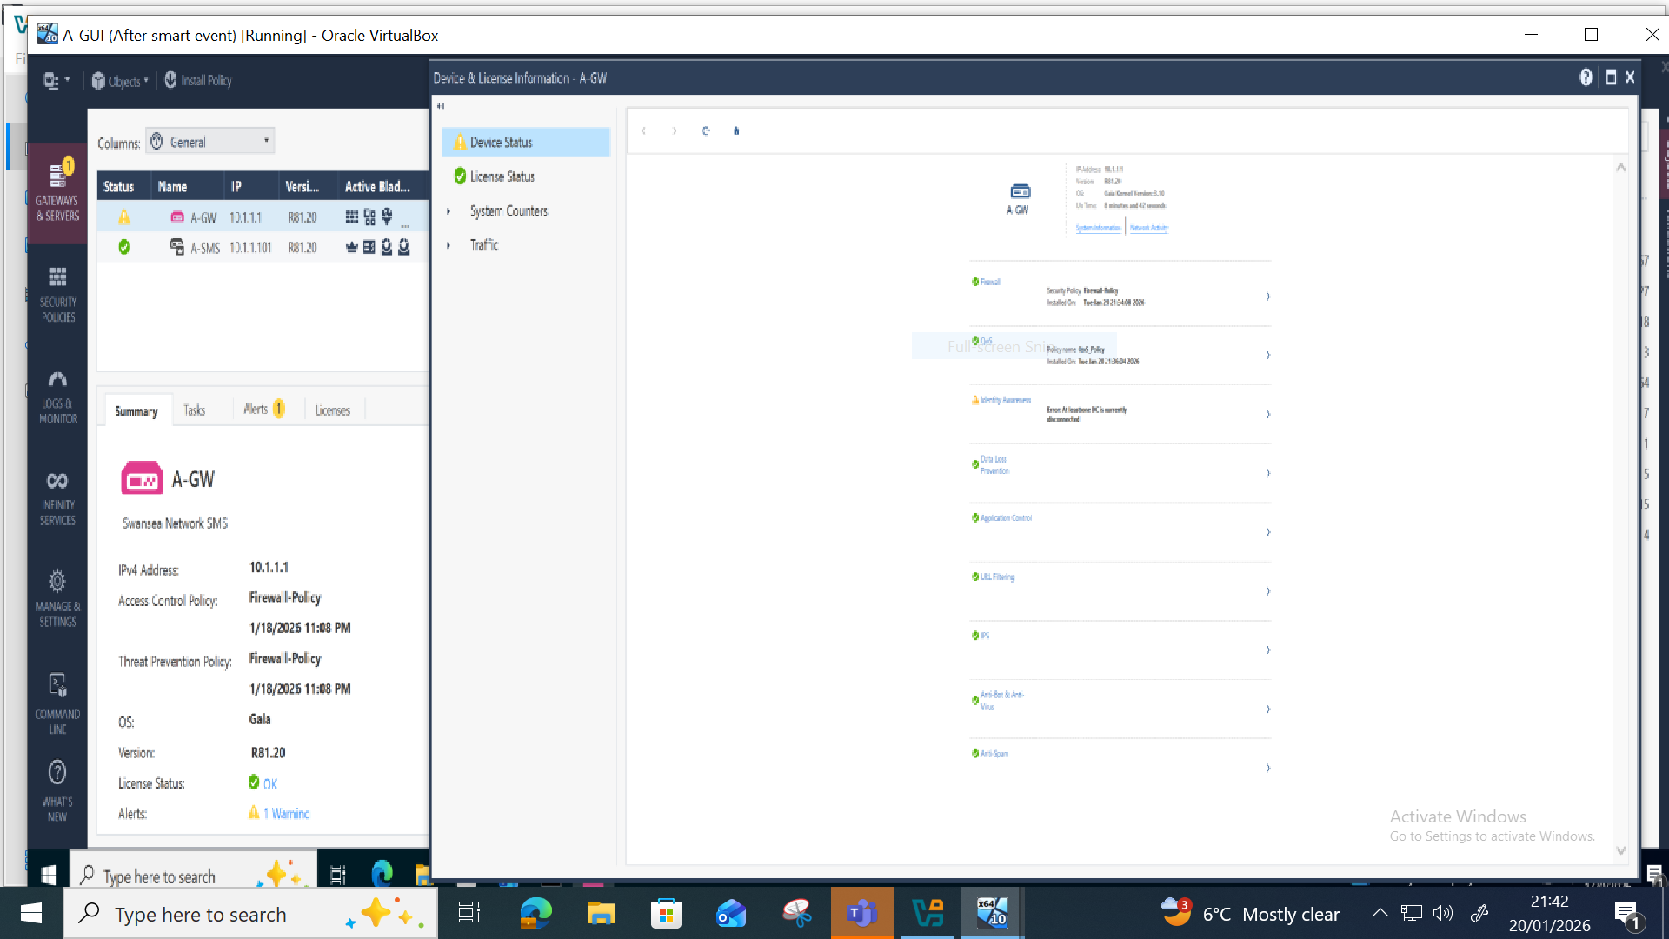
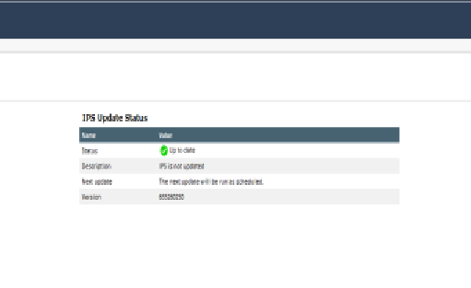
Check Point Update Verification
Successful connectivity to Check Point update services confirms that internet access for A‑GW was fully restored and policy fetching is operational.

Slide 56
Future Planning

Slide 57
Recommendations for Future Enhancements
Integrate an email security solution (Harmony Email & Collaboration or Microsoft Defender for Office 365) to protect against phishing and email‑borne threats.
Forward logs to an external SIEM to improve visibility, correlation and long‑term retention.
Automate policy validation and compliance checks using the Compliance Blade or SmartTasks.
Expand DLP with custom data types tailored to organisational needs to improve detection accuracy.

