Slide 1
Power Point Presentation
Student Name: | Gabriela Zosllei
Student Number: | 2133167
Module Code: | BMIH4003
Module Title: | Hospitality and Guest Services
Lecturer Name: | Kathryn Flynn

Slide 2
The Role & Importance of Hospitality & Guest Services within the Hotel Industry
Marriot International

Slide 3

Introduction
Taking care of the guest is the heart of the hospitality business.
Doing so means anticipating and understanding what the guest needs and how they meet and exceed those needs.
Khan et al., (2015) view guest service as the act of taking care of the guest’s needs by delivering professional, and quality service and assistance.
Notes:
Hospitality services consist of amenities that are used by every company to operate their service industry, and it is comprised of lodging, hotel, event planning, and transportation. It is popular for the reception and entertainment of visitors, and customer support is concentrated on supporting and understanding the requirements of the customers.
This presentation briefly explains the role and significance of quality service, hospitality, and guest services in the service sector that is based on Marriott International. This presentation also highlights the characteristics of the luxury brand that is provided by the hotel to its guests.

Slide 4

JW Marriott
The JW Marriott brand was established in 1984, with the opening of the first hotel in Washington, DC.
JW Marriott is the luxury hotel chain of Marriott International, offering more luxurious rooms and amenities than other Marriott brands.
Marriot International is an American international company that runs its businesses, franchises, and licenses lodging that involve hotels, residential properties, timeshare properties, etc.
Notes:
The JW Marriott brand was established in 1984 as the tribute to J.W. Marriott, the founder of Marriott corporation. It is the part of Marriott International luxury portfolio and consists of award-winning properties and beautiful resort locations around the world. Today, there are over 100 JW Marriott hotels in more than 35 countries providing its services to sophisticated, mindful travelers who come seeking experiences.

Slide 5
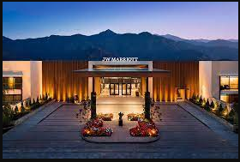
The “luxury” hotel brand “JW Marriott”
In 2016, Marriott International took over Starwood Hotels & Resorts, as Marriott International is popular for its guest services.
It is an initiative to expand its luxurious and premium brands with all-inclusive getaways all over the globe (Gong et al., 2020).
They classify their hotel brands and various kinds of hotels by utilizing their STR chain scale.
Notes:
Currently, they have merged with Marriott Rewards, Ritz-Carlton Rewards, and SPG to form Marriott Bonvoy, the world's largest loyalty program with 140 million members. It creates a very high-end Bulgari brand, and Bulgari hotels are in collaboration with the Bulgari jewellery brand. They cater wellness and relaxation to visitors at 110 properties in two nations, as they are experts in this and in organising royal marriages and honeymoon suites for couples. They provide properties that provide a beautiful view of nature, like beaches and remote settings.

Slide 6
Current travelers
All travel related services are included in the hospitality sector.
There are usually three different types of guests, namely, Business travellers, holiday makers and Family.
This presentation discusses about the Hospitality and Guest services of Marriot International.
Notes:
Both customer support and hospitals are vital for the service industry, and they need various skills and methods (Khan et al., 2015). Room service, laundry, etc. are known as "guest services," and it is those facilities that are provided by the hotel to their guests.

Slide 7
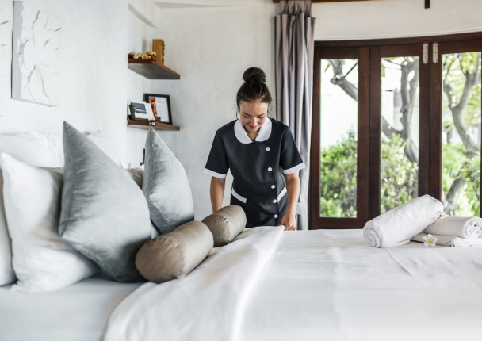
Importance of Hospitality and Guest services to Hotels
Guest service is the consistent delivery of the products and services that not only meets the expectations but also exceeds the expectation of the guests.
It is about providing delightful hotel experiences to the customers
Improve the relationship between the guests and hotels; as satisfied guests are more likely to come back and be loyal to the hotel.
It is essential for the business to ensure that their customer representative
Notes:
Customer service is important as it inspires customer loyalty and makes employees job easier. This in turn helps the businesses to grow. By providing great customer services, JW Marriott can recover customer acquisition costs, foster brand loyalty and retain talent.

Slide 8
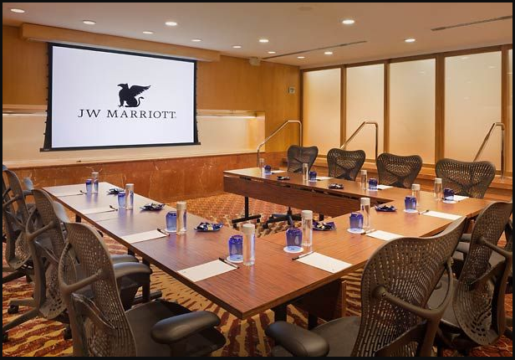
Services for Business Guests
Fast and dependable internet or WiFi services
Convenience of working
Emergency services
Accessible meeting rooms
Healthy hotel dining options
Easy fitness opportunities
Notes:
JW Marriott provides fast internet services to its guests and also provides convenience of working (Wuest et al., 2006). There are several power outlets in the room for cell phone, tablet or computer and other electronics. The Hotel also provides conference rooms and meeting spaces for business travellers.

Slide 9

Services for Millennial Guests
Millennial respond highly to the loyalty programs and personalised services due to the importance they place on individuality.
Research among millennial showed the following services needed by Millennial guests
Room service
Wifi
TV to watch movies
Flexible check-in and check-out service
Tour Package
Recreational activities
Notes:
JW Marriott offer customised tour packages including sightseeing. For the recreational activities, guests can join fitness class, cooking or swimming class arranged by the hotel. JW Marriott uses technology so that millennial guests can have access to the personalised services and communication. For example, the hotel provides mobile application service so that youngsters or any guests can book just through their phone.

Slide 10
Services for Family guests
For the hoteliers, the family market is important not just because of the potential multi-room booking but also for customer loyalty and brand awareness.
Here are some of the services that Family want from hotels;
Family Rooms
Free baby features and food warming options
Playrooms and children only zones (Gong et al., 2020).
Notes:
At JW Marriott, family guests are welcomed to spend their leisure time in a hotel together. As family travellers often have children, JW Marriott offer family rooms or double bed options rooms. The hotel also provides all the needed room essential services such as sanitizer, soap, and shampoo to its guests. They also provide emergency services and provides baby essential to the family guests.

Slide 11
Customer Preferences
In hospitality, customer preferences are expectations, dislikes, likes, inclinations and motivations that drive a customer to purchase a specific product.
In JW Marriott, customer preferences are important as 80% customers are more likely to make a purchase if personalized services are provided.
Notes:
Customer Preferences means guest histories, preferences, loyalty program activity and any other related information collected from actual or potential guests or customers of the Hotels or Other Marriott Products operated or licensed by Manager or its Affiliates through the Loyalty Programs or other means.

Slide 12
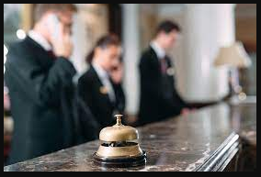
Characteristics of Good Service
Promptness
Politeness
Professionalism
Personalisation (Gong et al., 2020).
Notes:
One of the main characteristics of good customer service is promptness, which is about making promises on timely delivery (Susskind et al., 2010). In this, cancellations or delays of the services must be avoided. Politeness is also important in customer service as customers don’t want to have argument and doesn’t accept any rude behaviour from the hotel staffs. For any business, good manners among employees are important.
In customer service, there must be professionalism as all guests aim to be treated professionally, which shows that they are caring for the customers (Wuest et al., 2006). Furthermore, personalised services can also be effective in producing loyalty as guests like the idea of having services at personalised level.

Slide 13
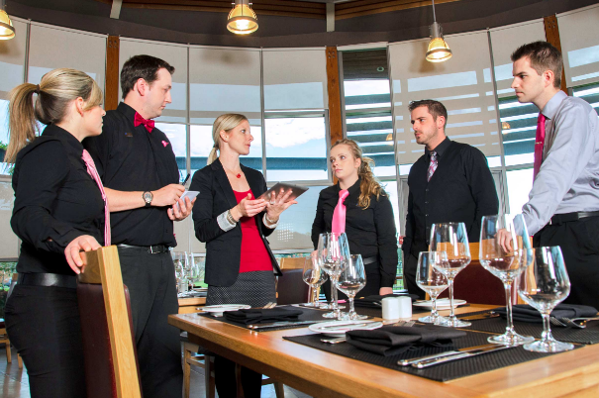
Skills hotel members should have for high quality service:
Time Management
Solving Problems
Detail oriented
Technological skills
Notes:
For JW Marriott, time management is important as in luxurious hotels, guests expect smooth and coordinated service. The staffs should be detail oriented and must be able to explain every factors or aspects regarding any of the queries (Susskind et al., 2010). Furthermore, staffs should be educated enough to solve customers’ problems. As JW Marriott is digitalised, it is important that staffs have good technological knowledge to assist customers.

Slide 14
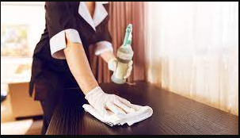
Strategies to manage Customer service in changing environment
Going contactless
Hygiene Environment
Covid-19 negative staffs
Notes:
In the current business environment, JW Marriott can come up with an application for contactless entry into the hotel. For example, most of the hotels provide room booking services online but requires ID checks at the reception. If JW Marriott can verify the check-in services online, it would be able to provide excellent service. Guests are now seeking clean and hygiene environment; thus requires Marriot International to maintain hygiene environment during all seasons.

Slide 15
Theories of customer service
Several theories are connected to the customer services that are mentioned below:
Constructivist theory
Stimulation theory of empathy
Uncertainty reduction theory
Notes:
Constructivist theory: If any business provides complicated products or services, then businesses need to streamline the on boarding and consumer support materials with this theory in mind. In simple words, companies require involvement in an active dialogue to comprehend what clients exactly know and how they can assist them in explaining the prevailing knowledge of customers. If clients are facing any difficulties, then many tools can tackle their issues that are provided by the company.
Stimulation theory of empathy: It is a very useful procedure as it aids companies in establishing strong teams for customer support so that they can influence their natural inclination to sympathize by assisting clients. This service can aid customers in establishing a feeling of being cared for. If a company provides empathetic services, then it can acquire a larger customer base.
Uncertainty reduction theory: The company’s customer support is being established to tackle the issues of the customers as well as to lessen the uncertainty and attempt to comprehend the motivations and attitudes of the customers. If the customer support team is highly trained, then it can provide outstanding services to the client, which empowers the company as well as lessens the uncertainty of the business.

Slide 16
Conclusion
The primary essence of the JW Marriott is to provide excellent customer service.
The quality of the services offered to guests determines the quality of the stay, leading to positive word of mouth promotions for the JW Marriott.
To provide the required service, it is important to learn about the sort of guests, their preferences and the purpose of the visits.

Slide 17
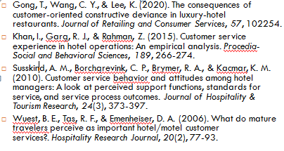
References

