Slide 1


BUSINESS PLAN
Title: KAAZ tech “all your digital needs under 1 roof”
Kushba Begum: 1713328
Amina Begum: 1711698
Md Al Amin: 1713449
Zahed Ahmed: 1714926
Group:2
Lecturer name: Dr Doreen Aya
KAAZ tech

Slide 2

Executive Summary
At KAAZ tech, we understand the complications and challenges technology can create for anyone, we are here to help with all your digital needs under 1 roof, our mission is to steadily sharpen and enhance seniors most indispensable skill for the usage and management of technology, we envision a community where all seniors and people from the older generation and all backgrounds have a greater understanding and knowledge of using the internet, even the most inexperience user is capable of creating opportunities , leading to greater things.

Slide 3
Business / Company Overview
Our aim is to provide IT solutions on all types of digital technologies, from programming to software, installation of hardware, security, all services are covered, also supply accessories, the latest gadgets and nearly new refurbished devices with a 12 month warranty.
We will also run a computer club within our premises for the older generation who lack the basic knowledge of IT skills, teaching them how to use a computer and how to use digital technologies for their own personal use, device operation specifically on computers which is paramount for todays technical world.

Slide 4
Products and Services
We will be shop based, local to our customers, we will also offer in-home services which means we can pick-up and drop off, but this service will incur a small charge.
Our educational programs will run on specified dates, at the arranged location, we will run 2 levels of teaching/learning, foundation level is free of charge and will last 6 weeks, higher level is optional and has an enrolment fee, this service is aimed for anyone who wishes to advance their IT skills. It is highly recommended for serious learners.
On the shop floor we repair and sell devices, install hardware and software, all accessories, gadgets and cables are available here as well as advice! We can guarantee our quality wont be beaten as all products come with manufactures warranty and seal of approval, we will only sell genuine original products.
We have a range of services available: home delivery, in home repair services, one to one advice from our friendly well in formed staff and a group computer club.
Most our products are pre ordered for originality and guarantee ,advise always on hand but depending on waiting list and delivery of products majority of services will require ¾ working days.

Slide 5
Target Market
Our target market is aimed to serve the older generation, who have basic or no knowledge of IT skills, who struggle with the latest technologies, software help is an essential requirement , as software is everywhere not only in computers but also in mobile phones, car navigational systems, digital cameras, smart tv’s plus many more products.
Our aim is to help the older generation to keep up with the changes of technology and it is imperative that the older generation feel confident and comfortable with digital devices, with technology prevailing and becoming more complex it is difficult for the older generation to understand the operational features and they fall behind even more.

Slide 6
Competitors
To keep costs low we will buy in wholesale, however our prices are expected to be higher than our competitors because our products are genuine branded and of high quality, just like what you would get if you went to the actual brand shop.
We have a wide selection of original products available instore however if anything specific you may need, it can be ordered from the catalogue and sent out to you in 3/4 working days

Slide 7
Marketing and Sales Plan
We will be marketing our business in many ways such as using social media like Facebook a instagram as well as printing out leaflets and business cards and distributing them to the local areas. We will also be marketing by using friends and families to spread the business of ours as well as by going door to door to target potential customers.

Slide 8
Management Team
Our team will consist of four people who will be all equal business partners. All four of us will be fully qualified and trained to run all aspects of the business. We will all take the same responsibilities when it comes to running the business as well as being mature and professional. As we are all equal partners we will obtain the same level of quality and respect for each other by being honest and communicating well with one another.

Slide 9
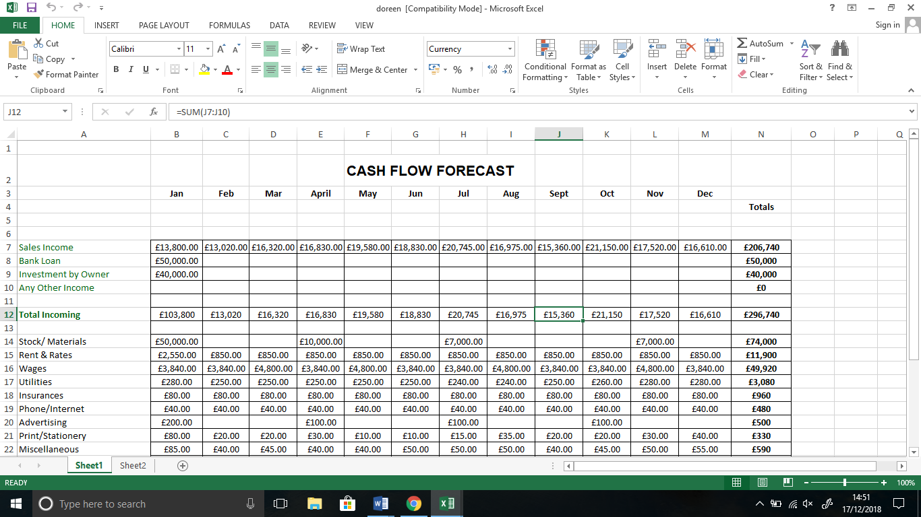
Financial plan
The table below shows our financial figures for the first year. Our loans amount as well as the money we all put in, sales income, stocks, rent rates and wages. The table also shows our annual plan.

Slide 10
SWOT Analysis
S.W.O.T stand for Strength, weaknesses, opportunity and threats. (According to investopedia.com 2016)
Our strengths are we are all young committed enthusiastic as well as all computer educated to high levels and we all have huge passion for modern day technologies.
Our weaknesses are we are going into business for the first time which means are lacking practical experience.
Our opportunities are gaining practical experience as well as helping the local communities gain ICT knowledge. We also have the opportunity to run a successful business and in time have financial stability.
Our threats are other local businesses such as other ICT repairs services, as well as lack of interest for the customers to join and buy our products. Other threats can be low quality or fake products sold on the market by other businesses.

Slide 11
PESTLE Analysis
A PESTEL analysis is a framework or tool used by marketers to analyse and monitor the macro-environmental (external marketing environment) factors that have an impact on an organisation. The result of which is used to identify threats and weaknesses which is used in a SWOT analysis. (According to the professional academy website 2016).
Political factors that are going to affect our business are keeping up with the laws are regulations of the 21st business as well as keeping up with the internet safety act.
Economic factors that affect our business are Brexit which will affect our funds as well as stop us from trading with the European countries it will stop us from buying products from them and we will pay more VAT and Tax for the products.
Social factors that affect our business are maintaining the business and our personal life keeping a balance between the two as well as respecting our business colleague’s traditions.
Technological factors that affect our business are both positive and negative to our business such as the world of technologies are advancing day by day and also the cost of technologies are rising regularly. Technologies have huge effect in all our lives which is why we believe ICT knowledge is very vital regardless of the cost.
Legal factors that affect our business are complying with the legal requirements of the country for example, making sure all workers have the right documentations and have the right to work in the country there are based in. legal factors such as meeting the right wages when it comes to paying employees as well as meeting the right age requirements. Other legal factors such as not discrimination and racism may affect our business as they have to comply with the rules and regulations of the country.
Ethical factors that affect our business are following rules and regulations adhering to the businesses rules and having a sense of responsibility. There is many similarities between ethical and legal factors affecting business.

Slide 12
Reference list
https://www.ons.gov.uk/businessindustryandtrade/itandinternetindustry/bulletins/internetusers/2018 (visited on the 28th November 2018)
https://www.oksbdc.org/why-is-technology-important-in-business/ (visited on the 28th November 2018)
www.Investopedia.com visited on the 29th November 2018)
https://pestleanalysis.com/technological-factors-affecting- (visited on the 2nd December 2018)
https://www.nibusinessinfo.co.uk/content/pestle-analysis-example (visited on the 2nd December 2018)
https://www.inc.com/guides/business-plan-financial-section.html (visited on the 09th December 2018)
https://www.trustatec.co.uk/?gclid=EAIaIQobChMIqoW67Z- (visited on the 11th December 2018)
https://www.ricemedia.co.uk/competitor-analysis/ (visited on the 15th December 2018)

