Slide 1
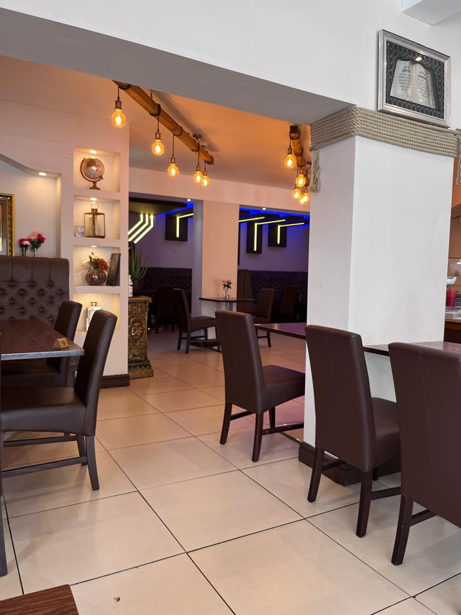
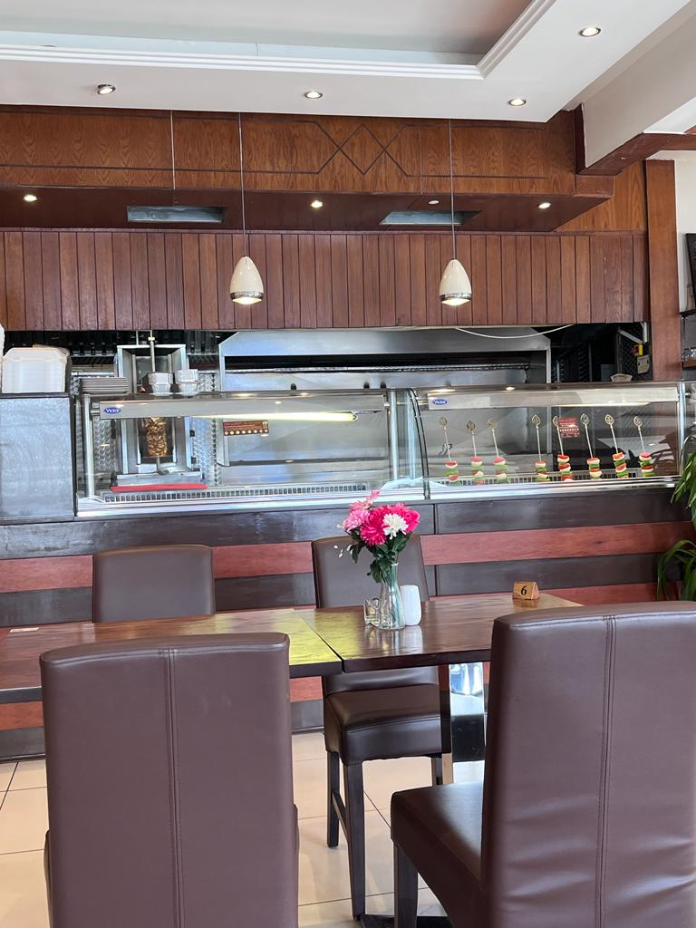
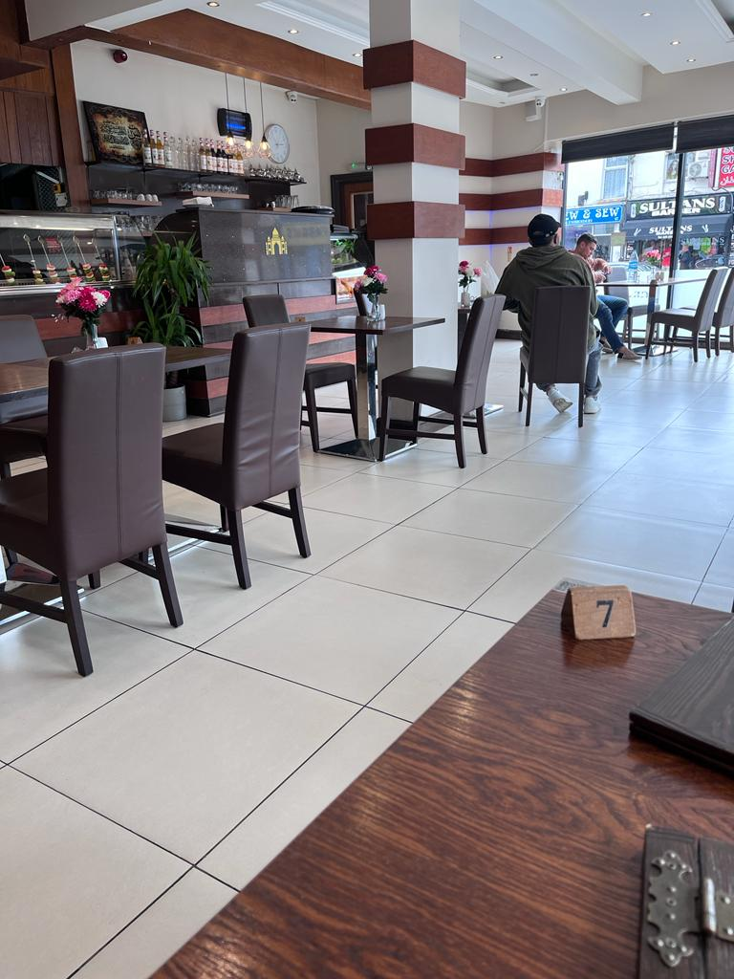
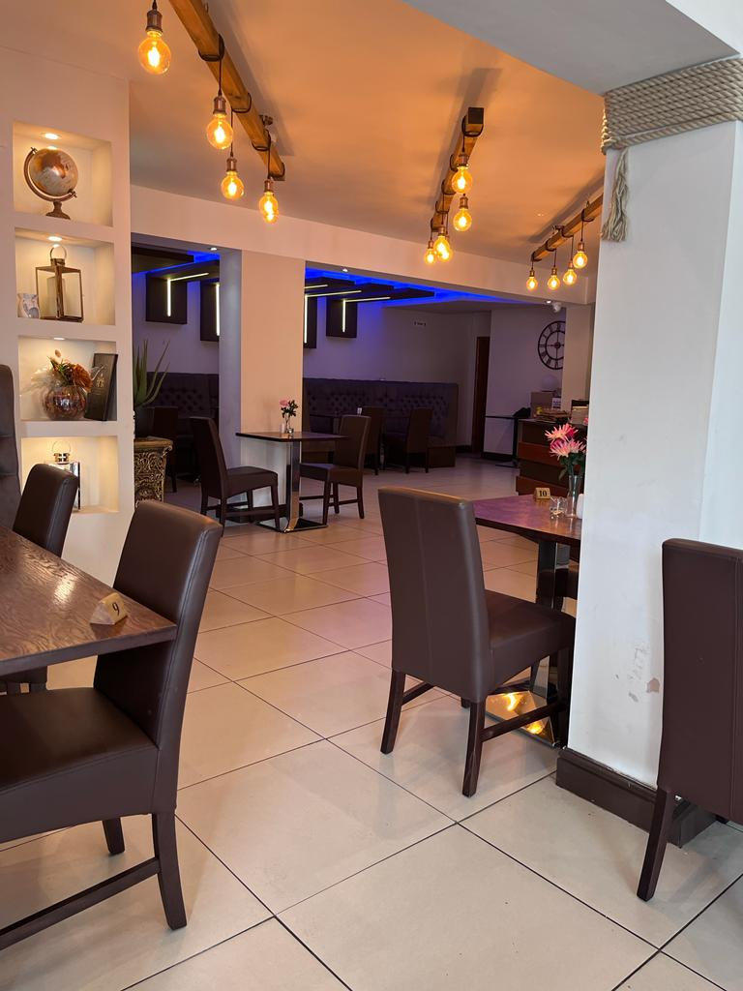
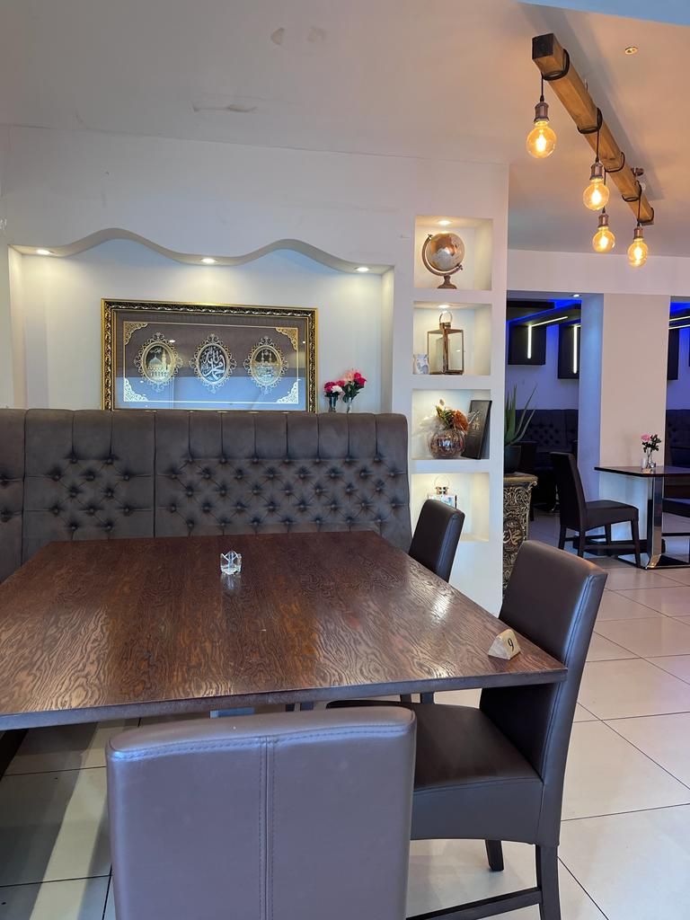
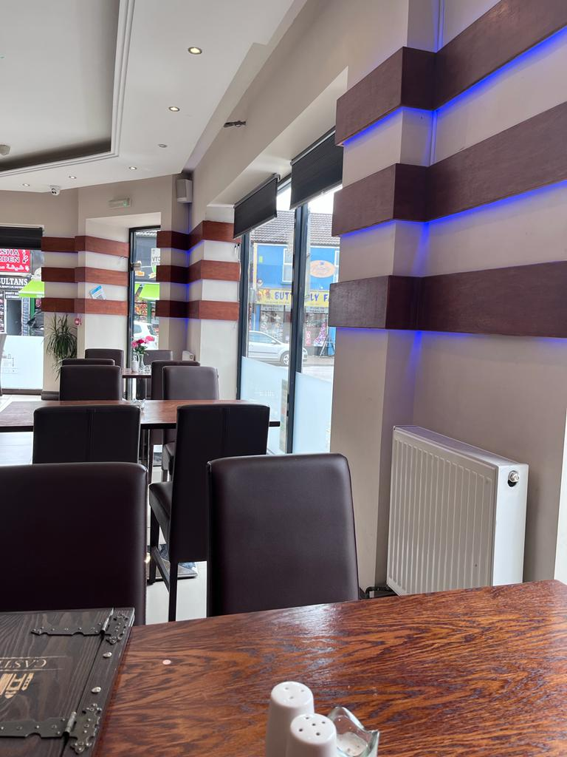
WELCOME

Slide 2

Name:
Institution:
:Role
Student name bilal mohammed
Student number 2022701
Tutor name jayne Griffith parry
BMGM40001
Module name international gastronomy manageme.

Slide 3
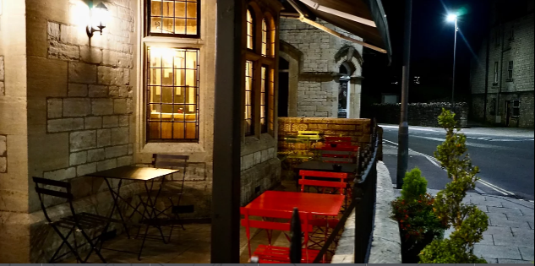


CASTELLO
5 The St, Radstock BA3 3PZ, UK
castelloradstock@gmail.com
+44 1761 568283
Castello-Radstock
Castello.radstock

Slide 4
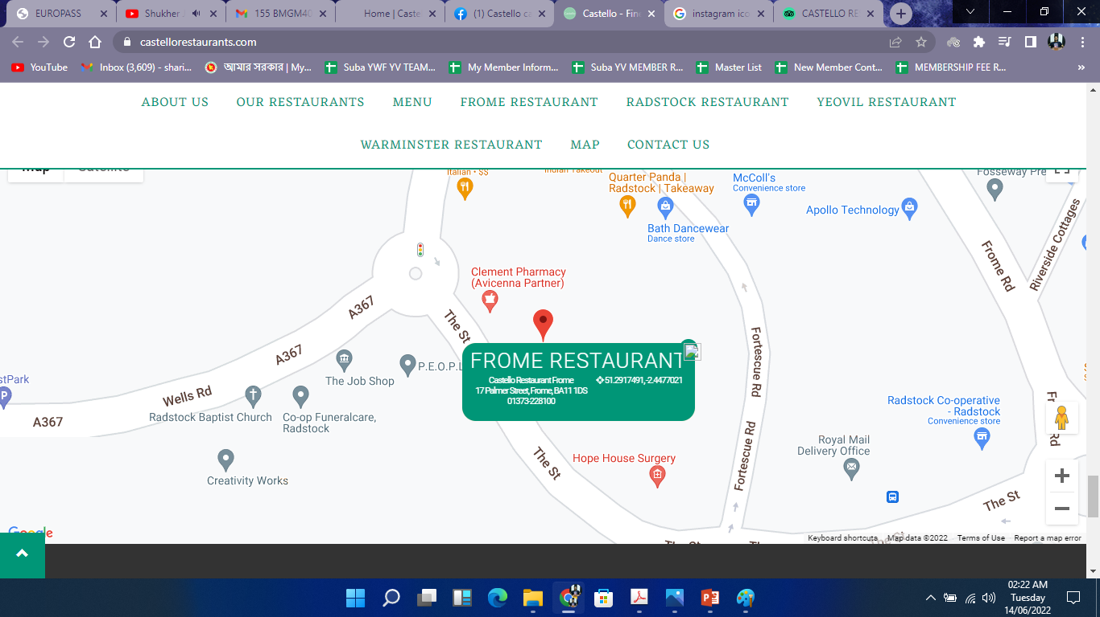
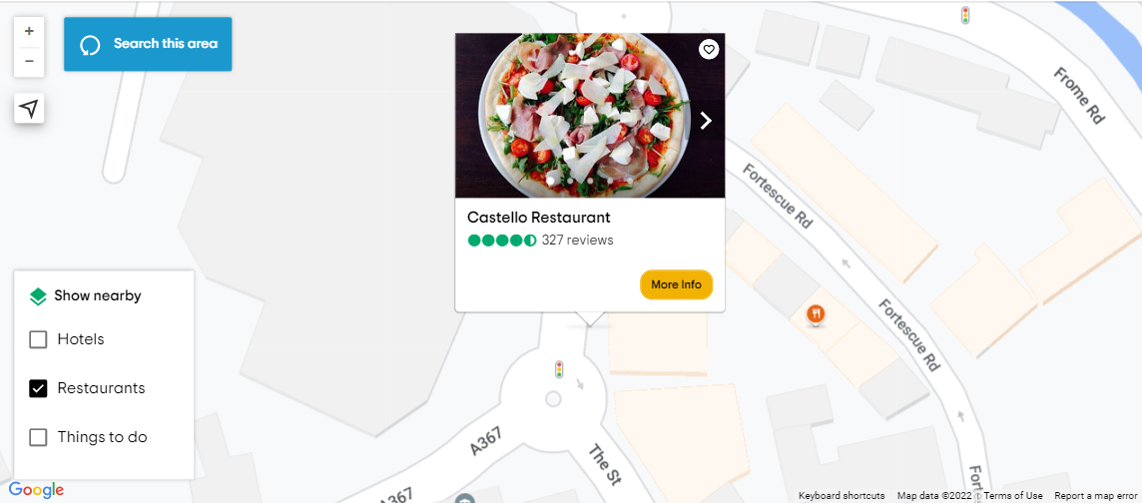
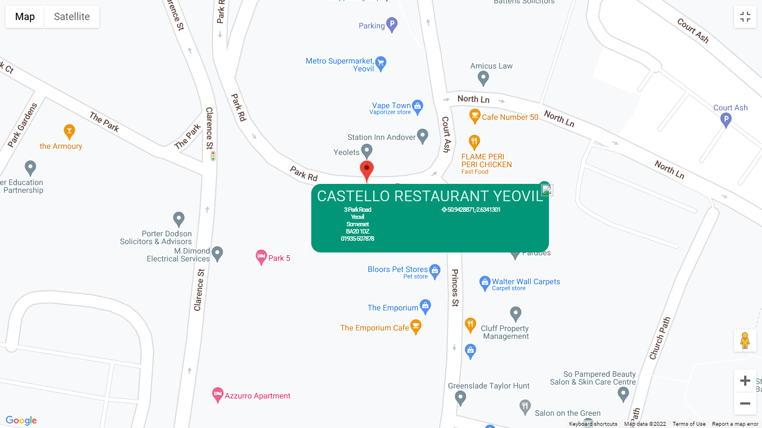
CASTELLO
BRANCHES
Castello Restaurant Frome
17 Palmer Street, Frome,
BA11 1DS
01373-228100
Castello Restaurant Radstock
5 The St, Radstock,
BA3 3PZ
01761-568283
Castello Restaurant Yeovil
3 Park Road, Yeovil,
BA20 1DZ
01935-507878

Slide 5
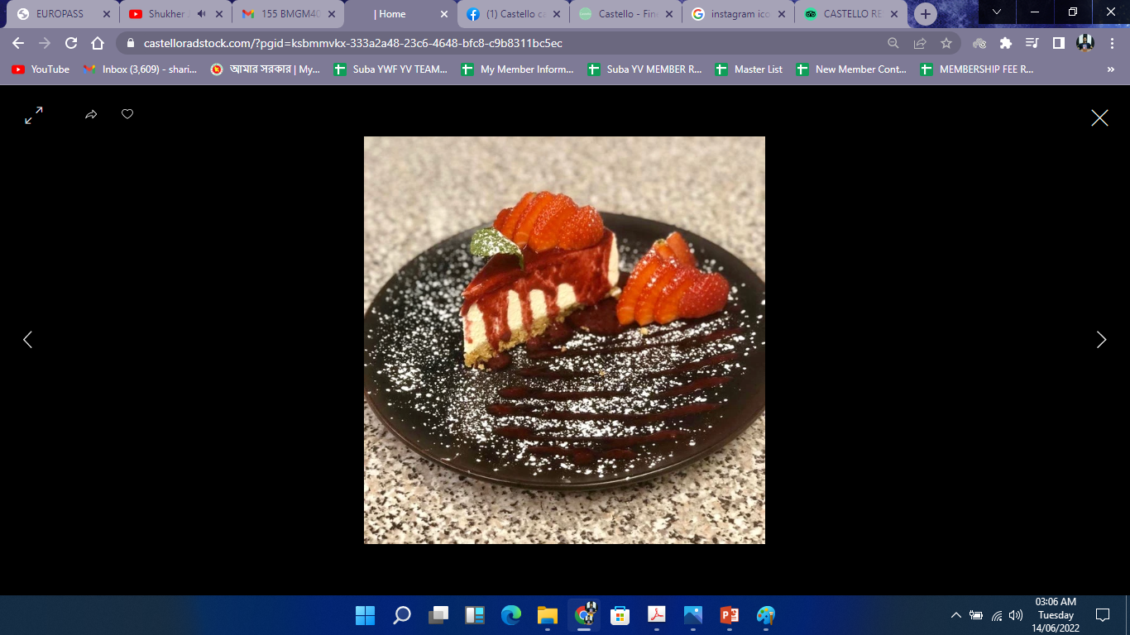
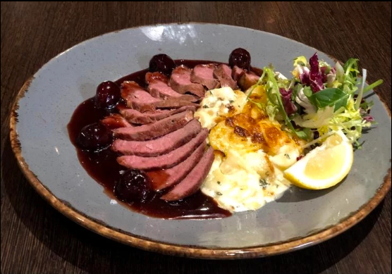
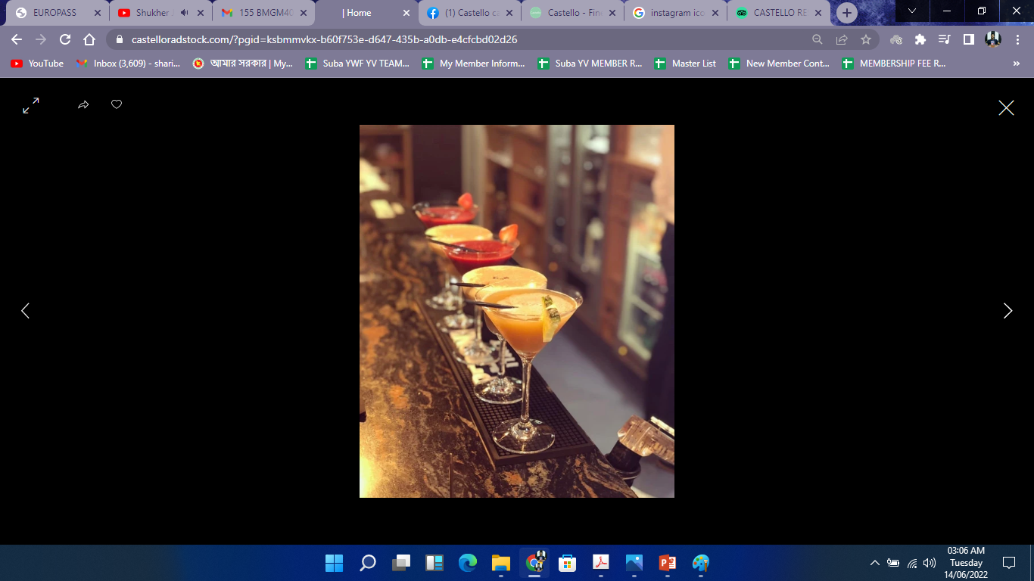
ABOUT CASTELLO
Castello was first started their restaurant business back in 2013 with the acccompanionship of three friends who had previous experience in restaurant business for 15 years. They are sound in terms of culture and tradition of the restaurant business and that made them passionate about choosing the best ingredients for serving an authentic food. Castello carries the value of Italian cuisine along with the tradition of Italian food (Castello, 2022).
Whether it’s Classic Cheesecakes or Selections of Gelato, it always offers the best of classic.
From the heart of Italy and the Mediterranean, we bring the very best and fresh ingredients that Italy has to offer to your plate.
Castello offers a unique selection of regional wines that complement the cuisine.

Slide 6
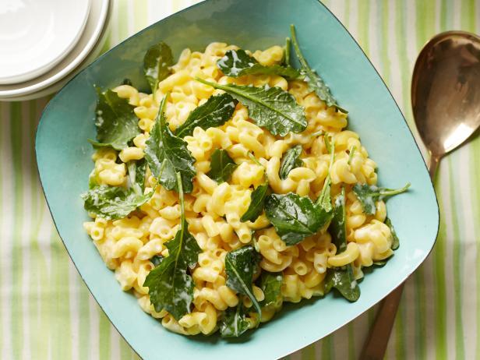
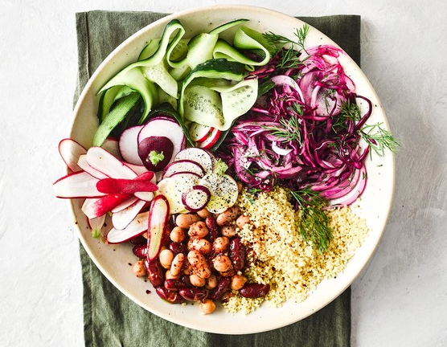

SPECIALITY
FESTIVE DISHES
It serves special dishes on special occasions.
VEGAN OPTIONS
Being healthy is the ultimate goal. It has the option of vegan foods for those who want to keep healthy.
GLUTEN-FREE DISHES
It has variety of selection of gluten-free breakfast.

Slide 7
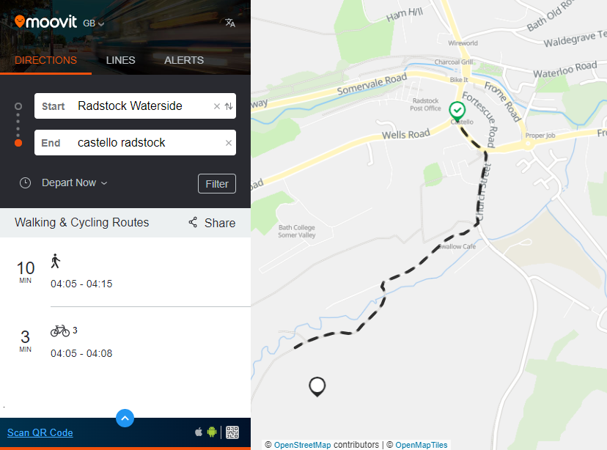
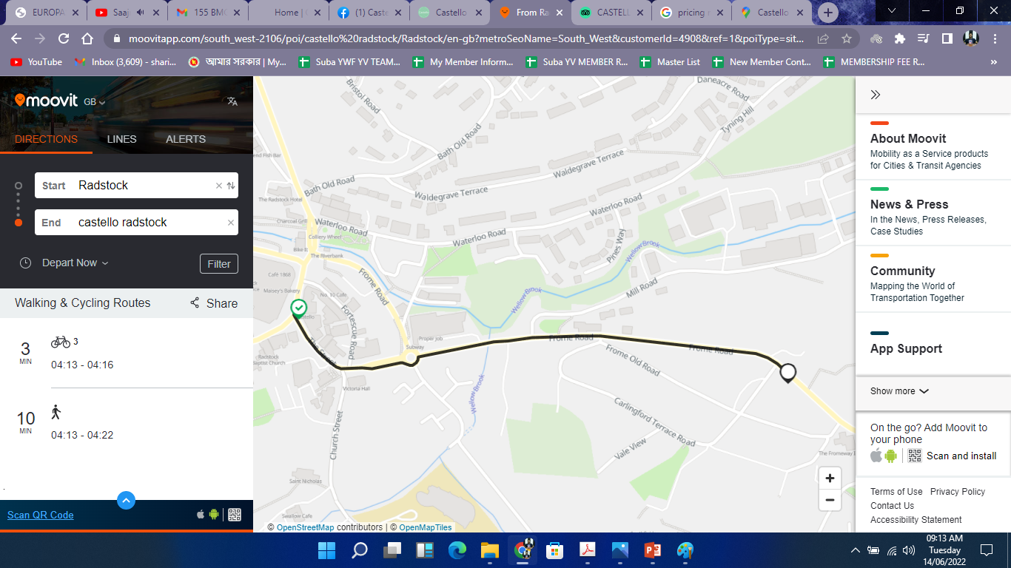
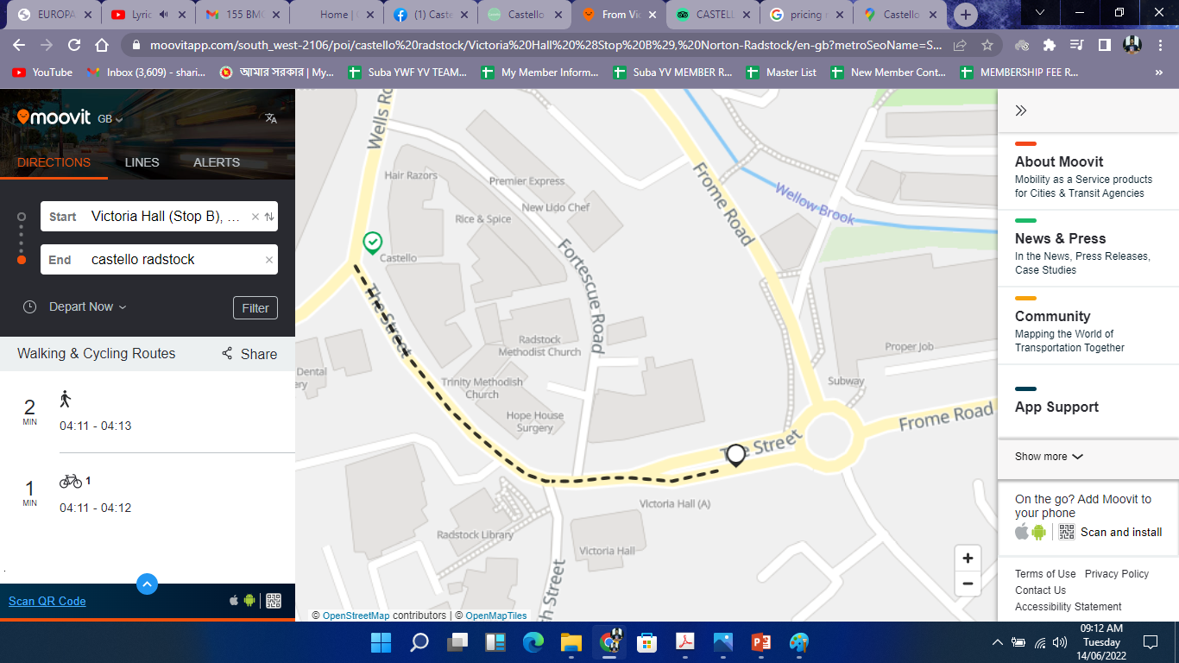
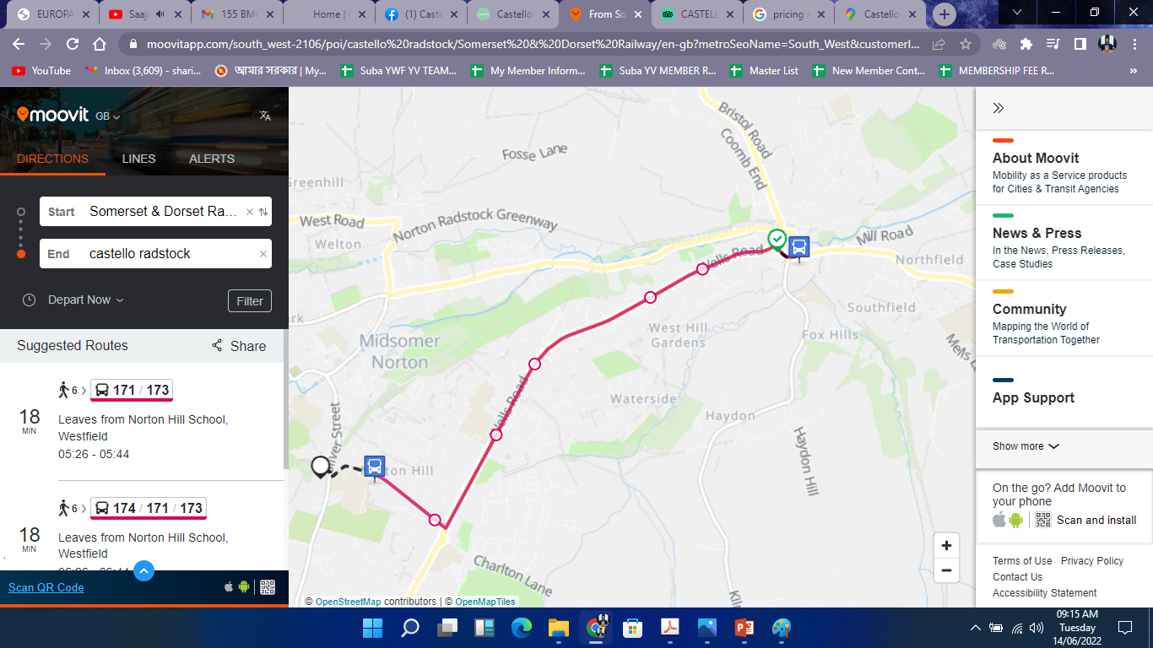
LOCATION
Castello is about 1.4 miles away from Radstock Waterside which takes 10 mins walking or 3/4 mins of cycle ride to reach there.
Castello is about 1.3 miles away from Radstock Mall which takes 10 mins of walking or 3/4 mins of cycle ride to reach there.
Castello is 453 feet away from Victoria Hall bus stand which takes 2 mins of walking to reach there.
Castello is about 1.9 miles away from Somerset & Dorset which takes 6 mins of bus ride to reach there.
Customer Reviews
“…the staff were great, and the location was convenient.”
“delighted by…. its location, the food and service.”

Slide 8

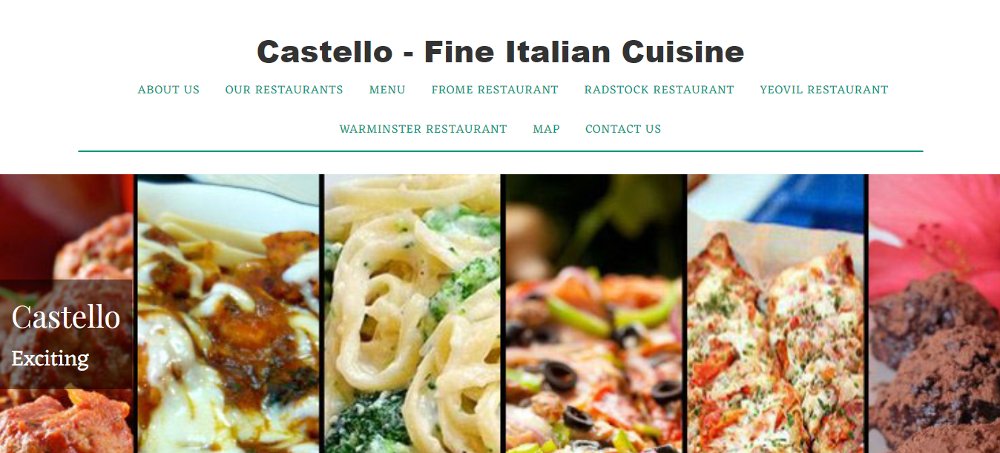
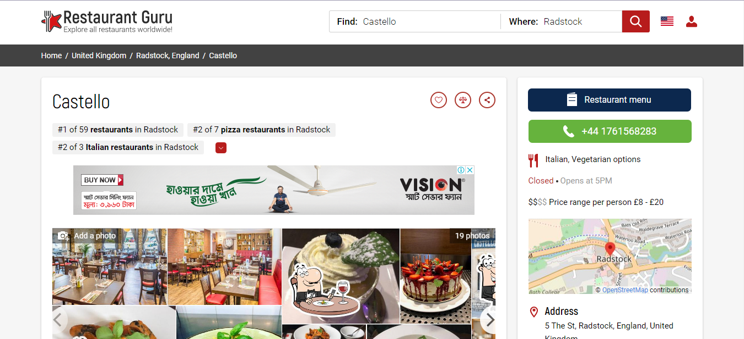
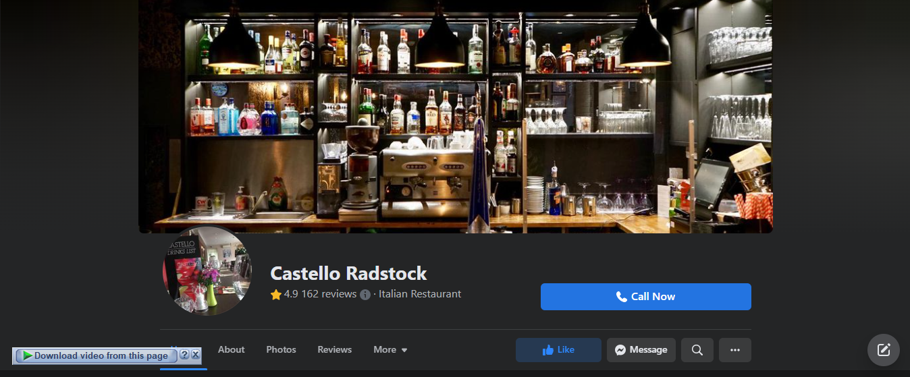
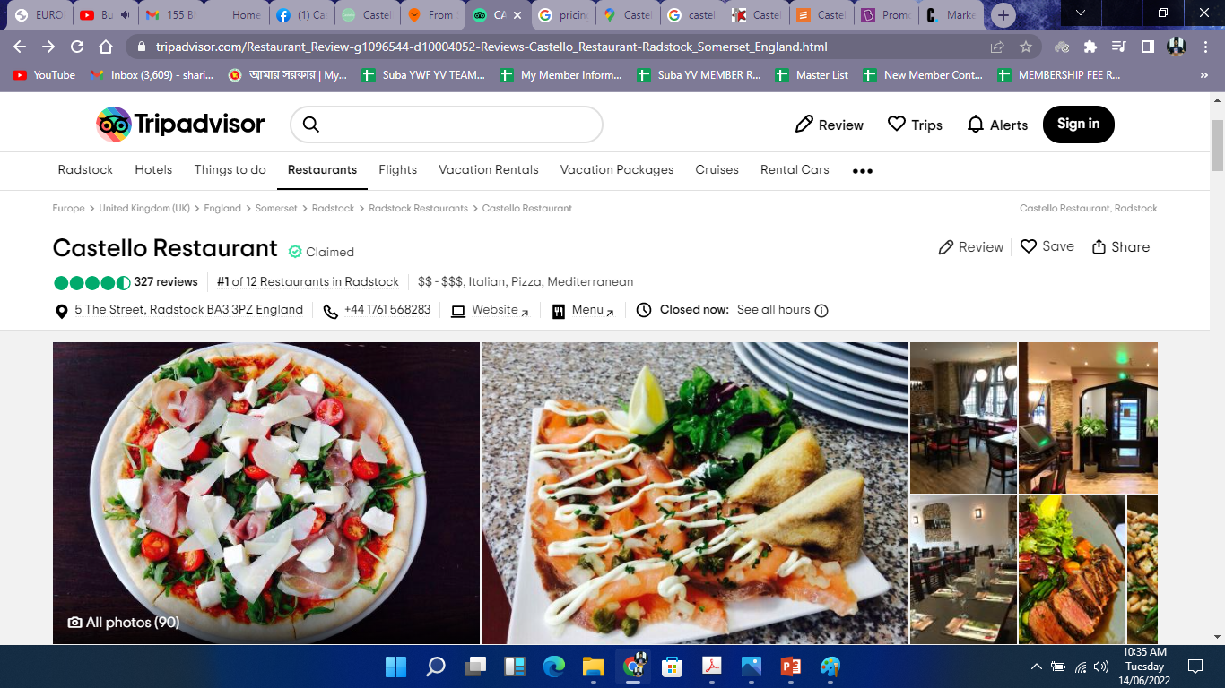
PROMOTIONAL ACTIVITY
Promotion basically refers to the marketing feature that sets up the communication between the seller and the customer. With the help of the promotion, an owner presents the product to the customer and tries to convince the customer about the product. This marketing feature helps to spread the service to particular individuals (Daugherty, 2012).
Castello follows a marketing mix approach regarding the promotion of the restaurant. It is a combination of several marketing approaches that are used to influence and convince the customers. It mainly depends on the condition of a company and the current situation to strategize what approaches should be initiated (BYJUS, 2022).

Slide 9
PRICING STRATEGY
A multiple set of calculations, market condition assessment result and measurement of worth is named Price. It is decided on a few aspects such as current market condition, making costs and other costings, people’s affordability, profit margin, Etc. (Decker, 2022).
Castello restaurant company follows a dynamic pricing strategy while setting up its business policies. This pricing is also known as demand or surge pricing, as the pricing is flexible according to the market condition. It can fluctuate in market conditions, customer demand, and competitors' actions. It helps the product to stay on track and never loses away. It also alerts the companies when they set up the marketing algorithm and initiate an offer when the market needs one. It plays a significant role in maximizing companies' profit in real-time.

Slide 10
CREATING CUSTOMER VALUE
What value a product carries to a customer is referred to as customer value. It is only defined by money; instead, it is defined based on product quality, customer service, and price. Repeated customers play a crucial role in business, and it should always maintain stable relations with the existing customers by meeting the customer needs and the demands. Customer demands generally fluctuate over time based on the latest trends and several aspects. The company must know a customer's experience to get engaged with the customers, who also play a crucial role in making a customer loyal for a lifetime.
Measuring Customer Value
Increasing Customer Value
Provide customers with a feedback sheet to know their experience
Make a list of things that the company is doing right and what the company is not doing right in terms of adding customer value
Always keep track of the profit margins
Use particular support policies for every customer
Ensure several support options for the customers ⁻Prioritizing buyers satisfaction
Make a pattern to understand the issues
Always make customers feel they are value
Give surprises on the special occasions
Special treatment for the loyalty of the customers (Zendesk, 2022)

Slide 11
WHAT IS OFFERING
Quality Italian cuisine in the UK (ranked #2 in the UK)
Maintaining social distancing & hygiene.
Professional and friendly staffs
Offering vegan & Gluten-free food options
Free Wi-Fi.
Well informative website and social media management.
Highchair & wheelchair accessibility
All kinds of credit cards such as VISA, MasterCard are accepted
(About US - Castello, 2022)

Slide 12
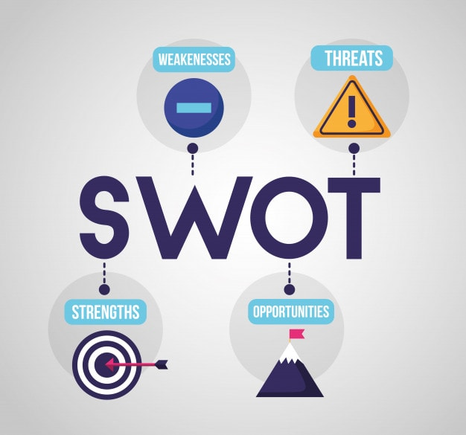
BUSINESS MODEL
SWOT analysis generally lets know about the strength, weaknesses, opportunities, and threats of the business model of the restaurant (Bhasin, 2022).
CASTELLO BUSINESS MODEL
Castello restaurant is mainly a family restaurant. Families and children are prioritized while setting up such restaurants. Customers of such restaurants expect to have a good meal at reasonable pricing. They not only expect a reasonable price but also to have tasty, delicious and healthy food, which would add an extra dimension to food expectations, especially for children. So while planning for such restaurants, one should never forget that the food is excellent and affordable.
Business Plan for a Restaurant Business Model
- Marketing of the restaurant
- Target customers
- Location of the restaurant
- Employees and management team
- Branded cover

Slide 13
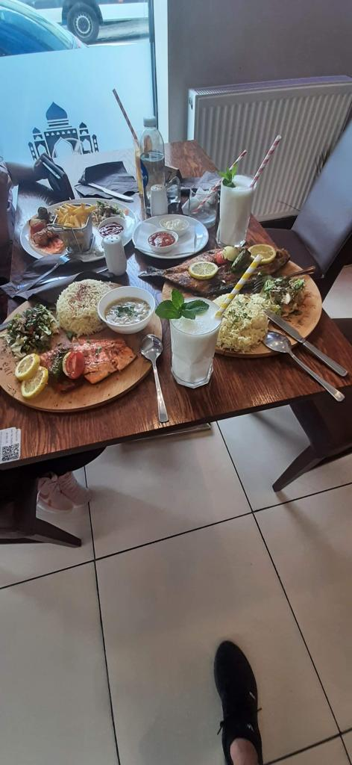
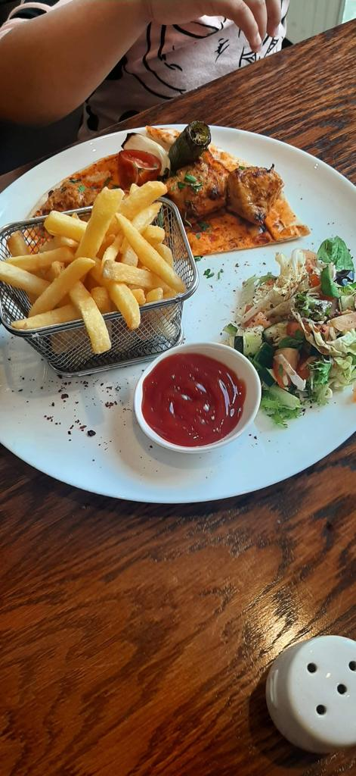
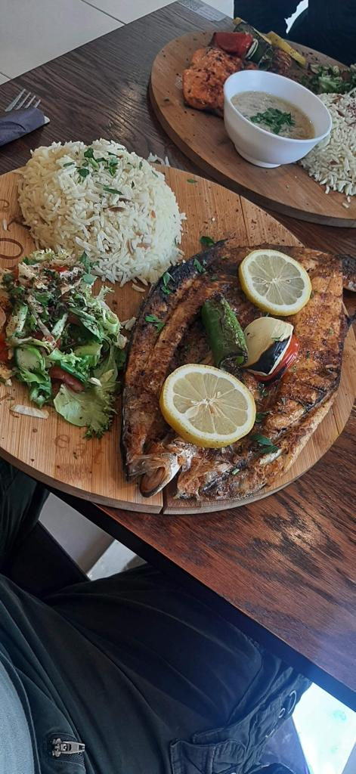
EXPERIENCE SHARING
Went there seeing the location and some earlier reviews. However glad to say that it was pleasant experience. The decor is modern and clean. The staffs were quite professional and equally well-behaved. The restaurant was about two thirds full which thought was unusual for a Thursday evening but this did not stop us receiving timely service. The menu was reasonable in extent and did not have to wait long for our food to be served. The meals were excellent and we had nothing but praise for the starters and main courses nor for the bill of two starters, two mains, an Irish coffee and a very nice bottle of wine. All delighted by the ambience of the place, its location, the food and service.
Food Service Value

Slide 14
EXPERIENCE ANALYSIS
POSITIVES
NEGATIVES
Great environment for dine-in
Well-behaved staffs
Quality Italian food
Well decored family places
Good options for the kids
Every staff is neat-clean and ensure hygiene and social distancing
No sustainable delivery options available
Lack of variety in the menu
Foods are bit of overpriced in terms of value
Handle media management particularly with a different team

Slide 15
SUGGESTIONS
Pricing can be revised keeping the value in the mind
Hire a individual team for social media management
Set up a sustainable delivery option for the restaurant & associate with the 3rd-party delivery companies.
Provide customers a feedback form to measure the value.
Maintain individual websites for all the branches.

Slide 16
REFERENCES
About US - Castello, (2022) Castellorestaurants.com, [online] Available at: https://castellorestaurants.com/ (Accessed 14 June 2022).
Bhasin, H. (2022) Business Model of Restaurant Explained (with Restaurant SWOT), Marketing91, [online] Available at: https://www.marketing91.com/business-model-of-restaurant/ (Accessed 14 June 2022).
Castello to Somerset & Dorset Railway, (2022) Castello to Somerset & Dorset Railway, [online] Available at: https://www.google.com/maps/dir/Castello,+5+The+St,+Radstock+BA3+3PZ,+United+Kingdom/Somerset+%26+Dorset+Railway (Accessed 14 June 2022).
Castello, (2022) Castellorestaurants.com, [online] Available at: http://www.castellorestaurants.com/ (Accessed 14 June 2022).
Daugherty, P. (2012) Marketing Promotional Programs, Journal of Promotion Management, 2(1), pp. 5-26.
Decker, A. (2022) The Ultimate Guide to Pricing Strategies, Blog.hubspot.com, [online] Available at: https://blog.hubspot.com/sales/pricing-strategy (Accessed 14 June 2022).
From Somerset & Dorset Railway to castello radstock by Bus, Train or Ferry, (2022) Moovitapp.com, [online] Available at: https://moovitapp.com/south_west-2106/poi/castello%20radstock/Somerset%20&% (Accessed 14 June 2022).
Promotion: Meaning, Definition, Types, example, solved questions, (2022) BYJUS, [online] Available at: https://byjus.com/commerce/what-is-promotion/ (Accessed 14 June 2022).
Tripadvisor.com - Castello, (2022) Tripadvisor.com, [online] Available at: https://www.tripadvisor.com/Restaurant_Review-g1096544-d10004052-Reviews-Castello_Restaurant-Radstock_Somerset_England.html (Accessed 14 June 2022).
What is customer value?, (2022) Zendesk, [online] Available at: https://www.zendesk.com/blog/customer-value/ (Accessed 14 June 2022).

Slide 17
THANK YOU

