Slide 1
Student Name: Md Ismail Sheikh
Student ID: 2541516
Lecturer’s Name: Yetunde Everard-Igweh
Module Code: LCLM 4004
Module Name: Problem Solving and Decision-Making
Component 1: Basil’s Bakery

Slide 2
Overview of presentation.
Good morning. My name is Md Ismail Sheikh
In my presentation I will:
  Provide an overview of Basil’s Bakery and the nature and scope of the problems they are encountering.
  Critique and application of the PESTEL framework.
  Critique and application of the Cause-and-Effect model.
  And, finally, provide a summary of the key findings.

Slide 3
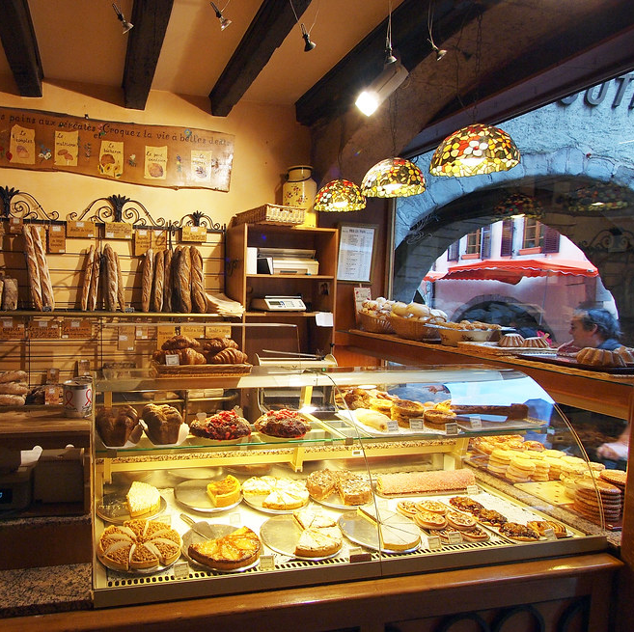
Overview of Basil’s Bakery
Basil’s Bakery is a small independent business located in a retail park in Coventry. It opened in 2015 and is run by Basil, a skilled baker who makes bread, cakes and pastries using high-quality organic ingredients.
Its customers are local shoppers, plus office and warehouse workers from nearby industrial areas. Sales grew steadily until 2020, fell sharply during Covid, and have remained around 25% below 2019 levels ever since.
This Photo by Unknown Author is licensed under CC BY

Slide 4
Nature & Scope of Problems.
Factor | Detail | Type | Level of Control
Retail park decline | Empty units, fewer visitors, job losses | External | None
Hybrid/remote work | Fewer office workers visiting daily | External | None
No delivery service | Customers cannot order from home | Internal | High
Unreliable pre-ordering | Missed phone calls, long wait times | Internal | High
Rising overheads | Rent, utilities, rates, insurance up sharply | Mixed | Low–Medium
Volatile supply costs | Organic produce pricing unpredictable | Mixed | Low
The core problem is stagnant sales at 25% below 2019 levels. Several contributing factors fall into internal and external categories:
External factors are structural and largely outside Basil’s control. Internal factors are service gaps that he can address directly.( Management, Institute of Leadership &, 2026).

Slide 5
Critique of the PESTEL Framework
PESTEL is a strategic tool used to analyse the external macro-environment, breaking it into six categories: Political, Economic, Social, Technological, Legal and Environmental.
It helps identify opportunities and threats outside the business that may impact performance (Johnson et al., 2022).
Benefits: Provides broad systematic coverage; encourages long-term thinking; highlights emerging external risks.
Criticisms: Can produce large amounts of low-impact information; does not indicate which factors matter most; is static and does not account for rapid change; treats factors as separate when they often overlap (Henry, 2021)

Slide 6
Application – PESTEL Analysis
Factors Affecting Basil’s Bakery
Here is the tabular PESTLE analysis of Olive Tree Bistro.
(Ingham, 2026).
Political Factors | Economic Factors | Social Factors | Technological Factors | Legal Factors | Environmental Factors
• Local business support • Economic regeneration policies | • Cost-of-living squeeze • Higher rent, energy & rates | • Hybrid work → fewer daily visitors • Customers want delivery & pre-ordering | • Online ordering is standard • Digital marketing reaches customers | Food safety & hygiene rules Lease & business rate obligation | • Climate affects organic crop supply • Buyers seek sustainable sourcing

Slide 7
Critique of the Cause-and-Effect model
The Cause-and-Effect or Fishbone Diagram was developed by Kaoru Ishikawa.
It visually maps all potential causes of a problem, grouping them into categories: Methods, Machines, People, Materials, Measurement and Environment (Ishikawa, 1982).
Benefits: Encourages structured, comprehensive thinking; separates symptoms from root causes; easy to communicate and collaborative; focuses attention on where action is needed (Oakland, 2020).
Criticisms: Can become cluttered if overpopulated; does not prioritise causes quantitatively; relies on user knowledge and objectivity; may identify issues without showing how they interact (Harrington, 2018).

Slide 8
Application- Cause-and-Effect diagram .
Methods
Machines
People
No online pre-order
No didicated ordering
Less people
Phone orders unreliable
Limited tech systems
Job losses
Sales 25% below 2019 levels
Bills overhead
No digital
Retail park shop close
Supplier availability uncertain
Waiting time
Covid
Materials
Measurement
Environment
Adapted from: Super series Solving Problems and Making Decisions (2013, page 31)

Slide 9
Summary of Key Findings
# | Finding
1 | The sales decline is driven by permanent structural changes — hybrid work and retail park contraction — not a temporary blip
2 | Basil’s core strengths — product quality, organic reputation, loyal customers — remain intact; the barrier is convenience and access, not product demand
3 | Internal service limitations (no delivery, unreliable pre-ordering) are directly preventable and are now the main brake on recovery
4 | Rising costs and supply volatility compound the problem, making status quo operation financially unsustainable
(Sophie, 2025)

Slide 10
Reference List:
Harrington, H.J. (2018) Process Improvement in Quality Management. London: Kogan Page.
Henry, A. (2021) Understanding Strategic Management. 3rd edition. Oxford: Oxford University Press.
Ingham, A. (2026). 5,500 Small firms urge Reeves to halt ‘apocalyptic’ business rates shock. [online] Business Matters. Available at: https://bmmagazine.co.uk/news/5500-small-businesses-business-rates-review-reeves.
Ishikawa, K. (1982) Guide to Quality Control. Tokyo: Asian Productivity Organisation.
Johnson, G., Whittington, R. and Scholes, K. (2022) Exploring Corporate Strategy. 12th edition. Harlow: Pearson.
Management, Institute of Leadership & (2026). Shibboleth authentication request. [online] Oclc.org. Available at: https://www-vlebooks-com.uwtsd.idm.oclc.org/Product/Index/253239?page=0&startBookmarkId=-1.
Oakland, J.S. (2020) Total Quality Management: Text and Cases. 4th edition. Oxford: Butterworth-Heinemann.
Sophie (2025). The sandwich revolution: From humble Sarnie to hottest food trend - NCASS. [online] NCASS. Available at: https://www.ncass.org.uk/news/the-sandwich-revolution-from-humble-sarnie-to-hottest-food-trend.

Slide 11
Thank you for listening

Slide 12


