Slide 1
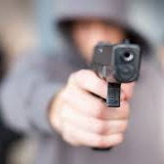
Illegal Firearms and Gun Crime
Notes:
Quick introduction

Slide 2

Before Easter Break
Prior to Easter, we learnt:
We had a visit from South Wales Police
Learnt about Cyber Crime
Notes:
Ask questions about what was previously leant

Slide 3

Learning Objectives
In today’s lesson we will learn:
The history of firearms in the UK?
What are the firearm legislation in the UK?
The use of firearms by organised crime groups?
Notes:
Read the objectives

Slide 4
Pre 1996 legislation
The Firearms (Amendment) Act 1988 was in place.
The Act made it mandatory for registering the owning of shotguns and banning semi-automatic weapons.
Prior to 1996 there were 200,000 legally-registered handguns in the UK.
Notes:
Before 1996 the legislation in UK was:
The Firearms (Amendment) Act 1988 was in place
It was mandatory for the registring shotguns and the banning of semi- automatic weapons.
Prior to 1996 there were 200,000 legally- registered handguns in the UK.

Slide 5
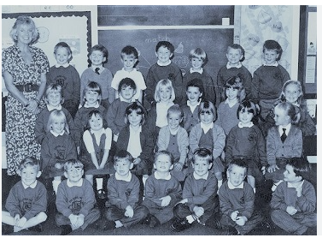
Dunblane 1996 school massacre
Thomas Hamilton walked into a school and killed 16 small children and a teacher.
The whole incident took 3 minutes.
Hamilton was a disgraced former scout master.
Hamilton killed himself after the attack.
The incident brought in tighter gun laws in the UK.
Notes:
https://www.theguardian.com/theguardian/2013/mar/14/dunblane-massacre-scotland-killing
Thomas Hamilton walked into a school and killed 16 small children and a teacher.
The whole incident took 3 minutes.
Hamilton was a disgraced former scout master.
Hamilton killed himself after the attack.
The incident brought in tighter gun laws in the UK.
Famous person attended that school at the time?

Slide 6
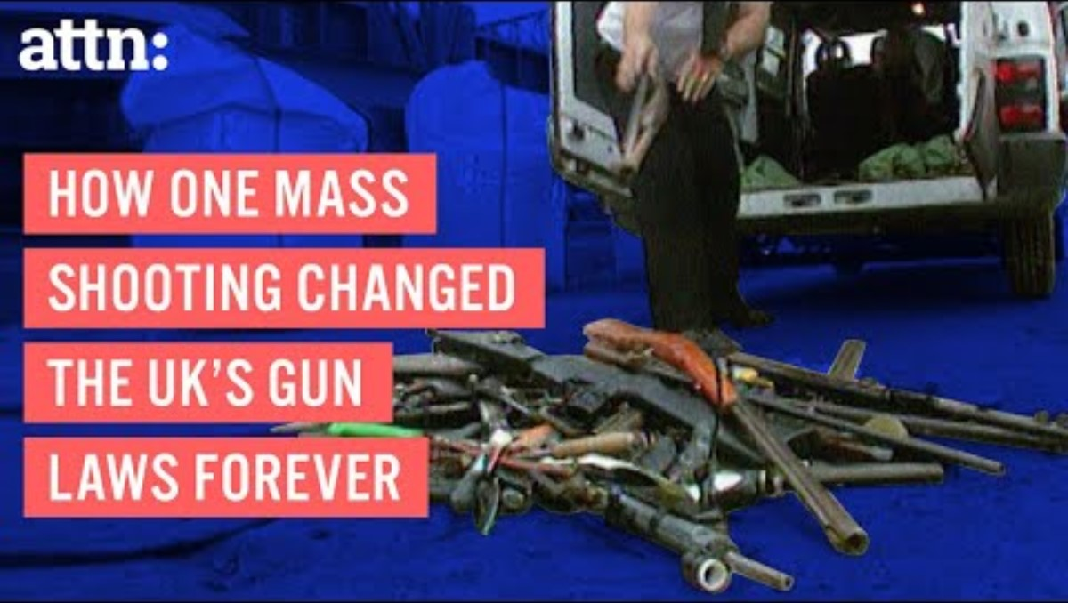
Notes:
https://www.youtube.com/watch?v=2OzhUKd23DI&t=0s

Slide 7
Legislation after Dunblane
The Cullen Report resulted from the Dunblane massacre.
Recommended that the government introduce tighter controls on gun ownership.
The report asked for the potential to ban on private ownership of firearms.
The Firearms Act of 1997 was brought in and it banned “High Calibre” handguns and rifle calibres greater than .22 calibre.
Notes:
The Cullen report resulted from the Dunblane massacre.
Recommended that the government introduce tighter controls on gun ownership.
The firearms act of 1997 was brought in and it banned "High Calibre" handguns and rifles calibres greater than .22 calibre.

Slide 8
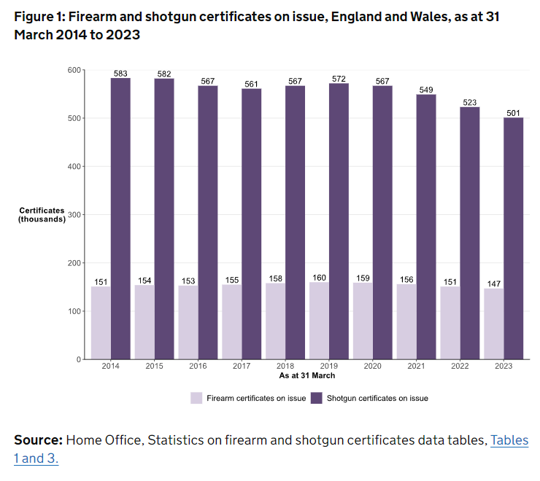
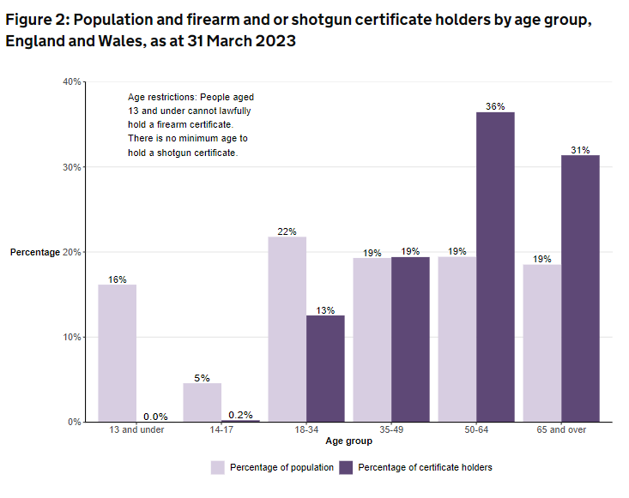
Statistics on legal firearms in the UK
Home Office (2023)
Notes:
22 firearms and shotguns were reported as lost or stolen, of which 216 were lost and 306 were stolen.

Slide 9
Statistics on the number of illegal firearms in the UK
In 2018, according to the Small Arms survey there were an estimated 978,000 unregistered firearms in England, Scotland and Wales.
An NCA operation recovered more than 700 firearms.
This operation was 5 years long and was done in conjunction with Spanish police, UK Border Force and international gun retailers.
This operation focused on Forward-venting blank firearms (FVBF) which are illegal to possess or import in the UK.
Notes:
In 2018, there were an estimated 978,000 unregistered firearms in England, Scotland and Wales.
An NCA operation recovered more than 700 firearms.
The operation took 5 years and was done in conjunction with Spanish police, UK border force and international gun retailers.
This operation focused on Forward-venting blank firearms which are illegal to possess or import in the UK.
These are fake replica of real guns.
These can be re-manufactured to become real guns.

Slide 10
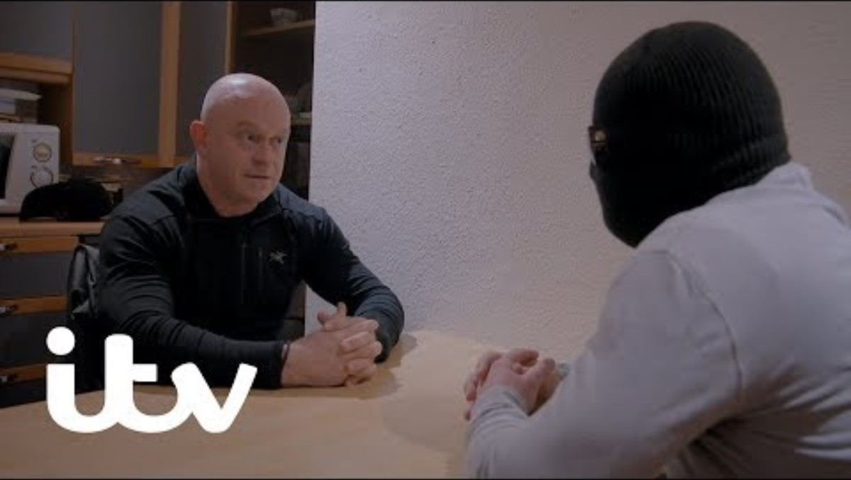
Notes:
https://www.youtube.com/watch?v=khuWBHsy_2U

Slide 11
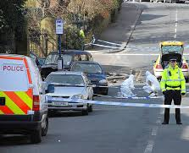
Homicide using firearms
In the year ending March 2021, there were 35 homicides that had been committed by the use of a firearm.
This accounted for just 6% of homicides in that year.
Of these 35 victims, 11% were female and 89% were male.
Notes:
There were 35 homicides that had been committed by the use of a firearm in the year ending March 2021.
This accounted for just over 6% of homicides in that year.
Of these 35 victims, 11% were female and 89% were male.

Slide 12
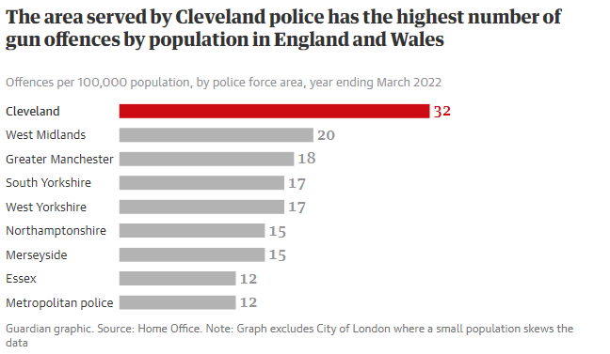
Vinter (2022)
Notes:
https://www.theguardian.com/uk-news/2022/sep/01/gun-rising-in-two-thirds-of-police-force-areas-in-england-and-wales

Slide 13
Task
I want you to look at examples of crimes where there has been a use of a firearm or gun?
What was the crime?
Was there any victims?
What were the repercussions?

Slide 14
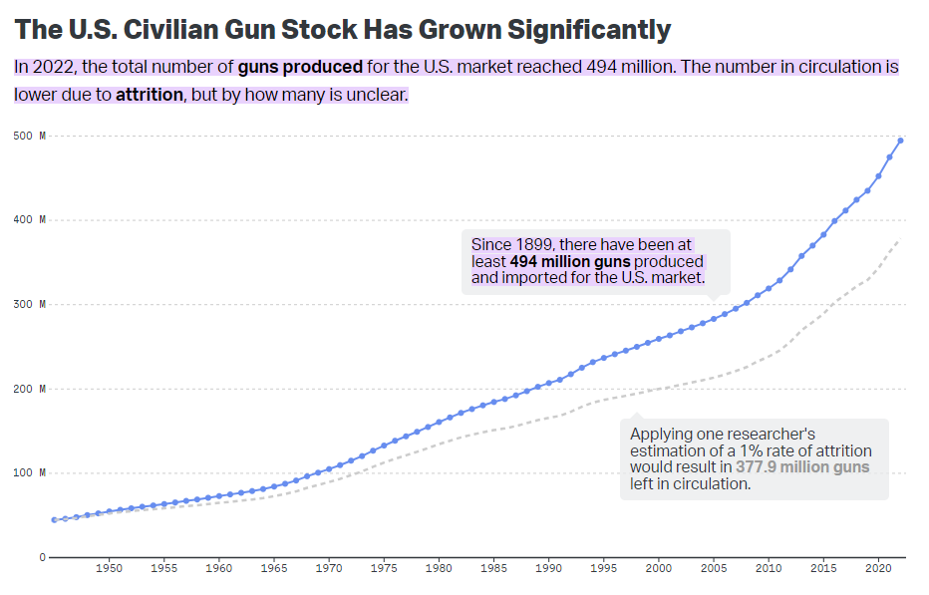
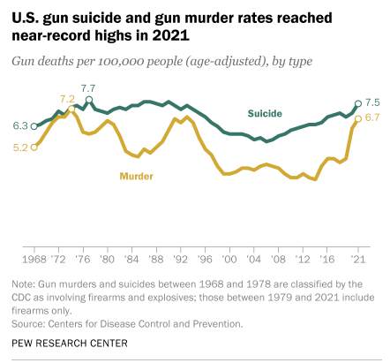
Comparison with the US
Mascia and Brownlee (2023)
Gramlich (2023)
Notes:
Current statistics say that nearly 43,000 people died from gun violence in 2023.
In 2022, gun violence cost the US over $557 billion.
For taxpayers, the average cost is $1,700 per taxpayer.

Slide 15

Operation Trident
Was originally a Metropolitan Police Specialist Unit to tackle gun crime in London’s Afro-Caribbean communities after there had been several fatal shootings.
Since 2012 the unit has mostly dealt with all non-fatal shootings.
It has also become the Trident Gang Crime Command which has a larger remit other than fatal shootings.
Notes:
Was originally a Met police specialist unit to tackle gun crime in London’s Afro-Caribbean communities after there had been several fatal shootings.
Since 2012 the unit has mostly dealt with all non-fatal shootings
It has since become the Trident gang crime command
This has unit has a larger remit other than fatal shootings

Slide 16
Recap
In today’s lesson we have learnt:
The history of firearms in the UK
The legislation that covers firearms in the UK
The use of firearms by organised crime groups

Slide 17

Any Questions?

Slide 18

Thank you

