Slide 1

Advanced Coaching
&
Mentoring
Notes:
https://www.youtube.com/watch?v=VV9TSa7XwA0

Slide 2
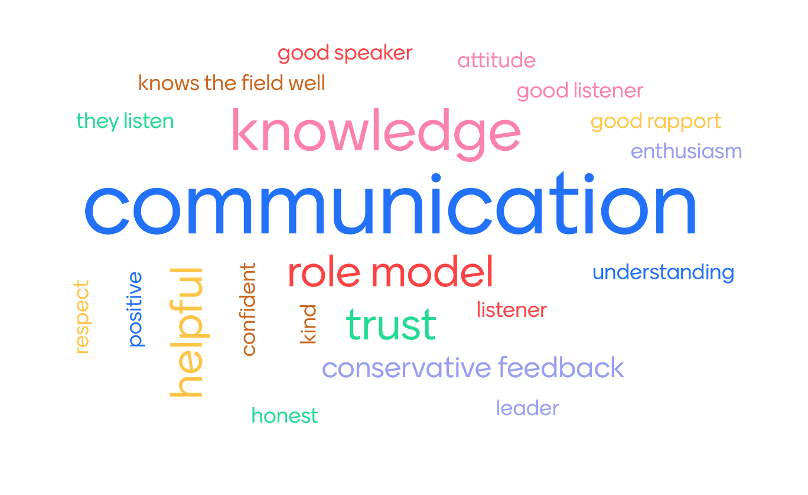
Qualities of a good mentor

Slide 3
Aims-
1-Mentoring- Your experience
2- A schedule for a 14 year old male athlete / completing the mentee form
Mentoring and research

Slide 4
Mentors and how they affect you
Think of someone who has mentored you
How did they support you
Positives
What you changed as a result
www.menti.com
Code- see screen

Slide 5
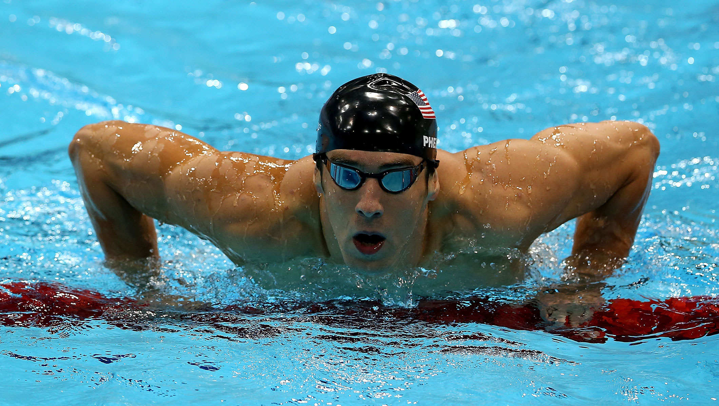
Setting Goals- How many years under water training / competing
https://www.youtube.com/watch?v=ArdvcoHcqYQ

Slide 6
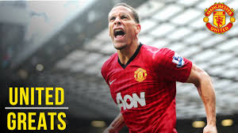
Rio Ferdinand
https://www.youtube.com/watch?v=t-mu0Oq5LFQ

Slide 7
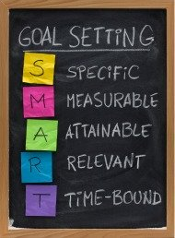
Example- Basketball coach
Action plan-
In the next 5 week block of sessions to continue to engage participants by planning a variety of skill drills and transferring these skills into game / game sense situations.
Look to plan in 2 times (during the next session on the 27th March) for participants to discuss tactical situations to give them more ownership of the session. A short stoppage in the game or in a game sense game should be planned in for this.

Slide 8
A schedule for a 14 year old male / female athlete:
Task 3- Produce an annual schedule in a template format- an overview of the year (2019/20) or the 2020 year cycle) for a 14 year old male/female athlete. Has to be on one of the following sports:
Football, tennis, badminton, basketball, netball, rugby, hockey, dance

Slide 9
14 Year old athlete
https://www.youtube.com/watch?v=If7Hrcf04Dw
https://www.youtube.com/watch?v=X_d33tTKzu8

Slide 10
Mentoring A 14 Year old
Task- Scrumblr- http://scrumblr.ca/Mentor%20an%20athlete
1-What are the factors to consider? What aspects do they need to improve and what needs to be planned into training?
2-What considerations for a 14 year old may need to be thought of carefully?
3-What might happen in a calendar year of a 14 year old outside of sport?

Slide 11
A schedule for a 14 year old male / female athlete:
Template needs to include information on the year cycle and how the athletes development is planned under Technical, Tactical, Physical and Physiological perspective:
Consider the following- Season dates, school holidays / school week, competition / fixture dates, Pre season / in season training, volume of training, types of training, intensity of training
Template format don’t provide individual plans. See examples but do not copy! Research / devise your own

Slide 12
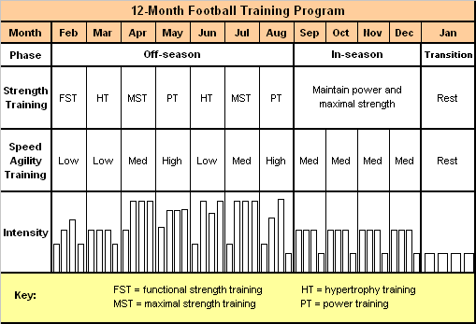

Slide 13
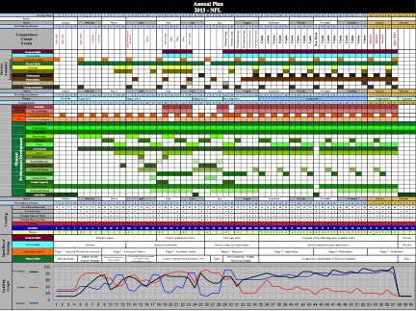

Slide 14
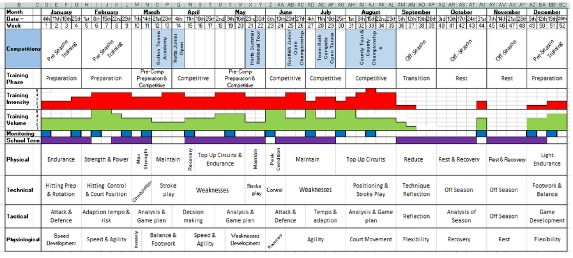

Slide 15
How to achieve your grade:
Task 4- Complete an athlete development plan
Do this by 12th February
20% for this
20% to be handed out next Friday
(40% completed by 19th Feb)

Slide 16
How to achieve your grade:
Task 1- Complete 5 mentee assessment forms (40%)
Task 2- Practical mentoring competency checklist (completed by your lecturer) demonstrate each of the competencies on at least 3 occasions (10%) a further (10%) awarded for reflection. (20 %)- (9th March)
Task 3-750 words (20%)
Task 4- Athlete development plan (20%)

