Slide 1

Student Name Clarita Fernandes
Student Number: 2017711
Module: Enterprise & Entrepreneurship (LCLM4006_LON)
Assessment Task2: Individuel Présentation Pitch
Lecturer: Richard Ashaye

Slide 2
Introduction
Business Concept
Legal Format and Management Structure
Organisational chart
PESTEL Analysis
Marketing Strategies
Funding Requirements and Allocation
References
Table of Contents

Slide 3
Introduction
Clarita Fernandes –Managing Director, Goa Serenity Cottages
With a strong background in hospitality and a genuine passion for the industry, I am focused on developing and positioning high-quality accommodation products that deliver exceptional guest experiences.
www.goaserenitycottages.com (under development)
Goa Serenity Cottages
Our business will offer premium private holiday cottages designed to provide comfort, privacy, and a boutique hospitality experience. Our product strategy focuses on delivering a high-quality guest experience that sets us apart from budget accommodations and shared villas.
Notes:
When introducing yourself remember to Keep the introduction section concise but impactful. The goal is to establish trust and confidence in your ability to lead the business successfully. Remember to focus on relevant information that aligns with your business idea and creates a positive impression of you. You may include the following information.
Name and Role: Start by stating your name and your position or role in the company. If you are the founder or one of the key team members, mention your title (e.g., CEO, Co-founder).
Background and Experience: Briefly share your relevant background and experience. Highlight any expertise, qualifications, or achievements that demonstrate your capability to lead and execute the business idea effectively.
Passion and Motivation: Explain why you are passionate about the business and the problem you are solving. Share your vision for the company and what drives you to pursue this venture.
Connection to the Industry: If you have a personal or professional connection to the industry in which your business operates, share that information. It could be an experience, personal story, or a passion for the industry that led you to start this venture.
Keep the introduction section concise but impactful. The goal is to establish trust and confidence in your ability to lead the business successfully. Remember to focus on relevant information that aligns with your business idea and creates a positive impression of you and your team.

Slide 4
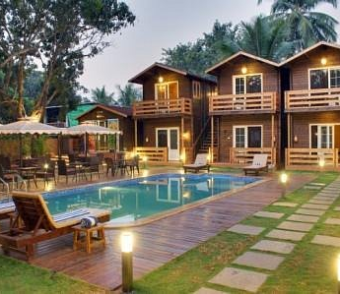
Overview of the Business Idea
Goa Serenity Cottages is a boutique holiday accommodation business offering premium private cottages in North Goa.
The concept focuses on providing travellers with privacy, comfort, and a personalised hospitality experience.
In recent years, travellers have increasingly preferred private stays over traditional hotels, especially families, couples, and digital nomads seeking privacy, space, and flexibility.

Slide 5
Legal Format and Management Structure
Goa Serenity Cottages will operate as a Private Limited Company.
The business will operate with a simple management hierarchy to ensure efficient operations and high service standards.
Notes:
Refer to week 3 slides: Legal format of Enterprises & Building a Founding team

Slide 6
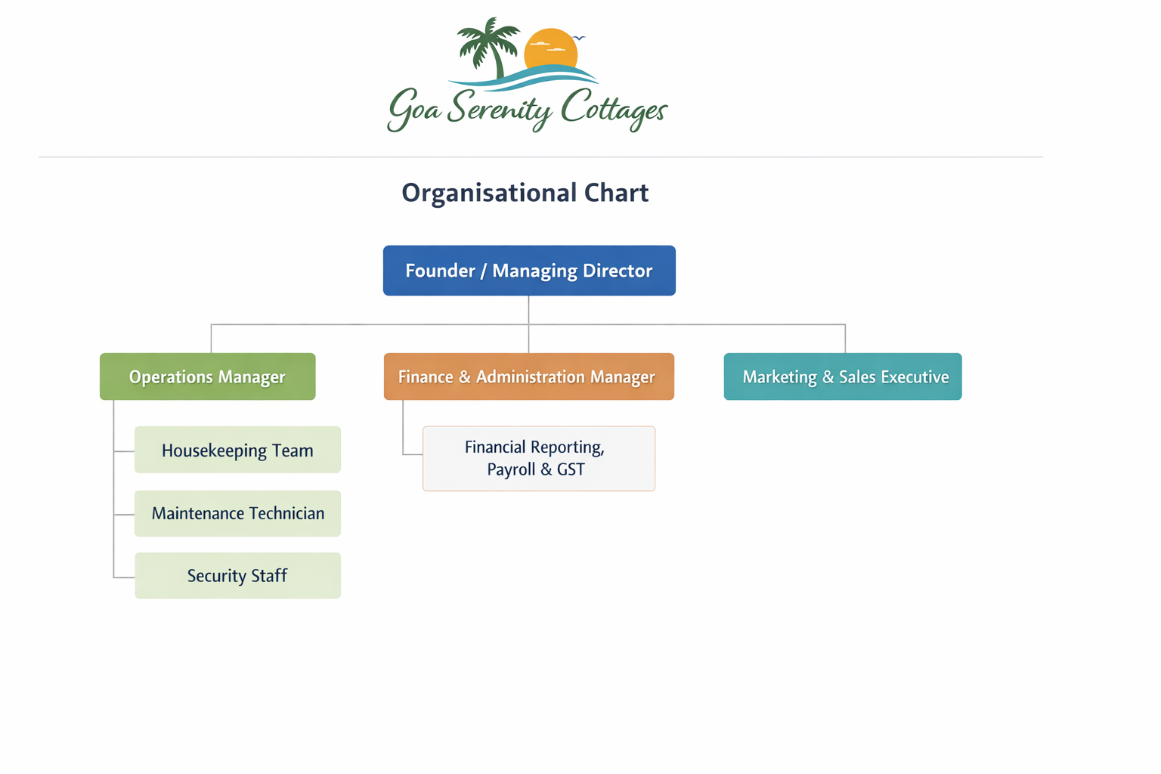
An organisational chart of a Goa Serenity Cottages
Notes:
You can use either MS Visio or MS Word to create this.

Slide 7

PESTEL Analysis
Political Factors
Tourism is strongly supported by the government in Goa through various policies and tourism initiatives aimed at attracting both domestic and international travellers.
Economic Factors
The growing Indian middle class and increasing international tourism have significantly increased demand for holiday accommodation. Tourism is a major contributor to Goa’s economy.
Social Factors
Following the COVID-19 pandemic, travellers increasingly prefer private accommodations such as cottages and villas rather than large hotels. There is also a growing demand for unique and personalised travel experiences.
Technological Factors
Online booking platforms such as Airbnb and Booking.com allow small hospitality businesses to reach global customers. Social media platforms also play an important role in influencing travel decisions.
Environmental Factors
Goa’s coastal environment is a key attraction for tourists; however, businesses must comply with coastal regulations and environmental protection policies.
Legal Factors
The business must comply with property registration laws, tourism licensing requirements, and Goods and Services Tax (GST) regulations.
Notes:
Apply PESTEL analysis taught in week 4:
Analyse the following factors:
Political – Government policies, regulations, tax laws, trade restrictions.
Economic – Inflation, interest rates, economic growth, consumer spending.
Social – Demographics, cultural trends, lifestyle changes, education.
Technological – Innovation, digital transformation, automation.
Environmental – Sustainability, climate change regulations, waste management.
Legal – Employment laws, intellectual property rights, industry-specific regulations.
2. Align PESTEL with Business Strategy
After identifying key external factors, explain how they impact your business and what strategies you will adopt to mitigate risks or leverage opportunities.

Slide 8
Marketing Strategies
Marketing Strategies
Online Travel Agencies (OTAs) to gain global exposure and improve booking conversion rates by being visible on trusted booking sites
Implement digital marketing strategies to enhance brand awareness and generate direct bookings.
Primary Customer Segments
Domestic tourists from major Indian cities
International travellers from the UK and European markets
Digital nomads and remote workers –
Couples and families seeking private holiday accommodations
Unique Selling Points:
Private cottages instead of shared villas
Boutique guest experience
High-speed Wi-Fi for digital nomads –
Optional breakfast, tours, and airport transfers
Competitive premium pricing
Notes:
Refer to week 5: Market Segmentation, Targeting, Positioning and marketing mix
Here are some key aspects of Unique Selling Points:
Differentiation: USPs highlight what makes a product or service unique and differentiates it from similar offerings in the market. It can be a feature, quality, or capability that competitors do not offer or cannot replicate easily.
Customer-Centric: USPs are designed to address the needs, wants, or pain points of the target market. They showcase how the product or service fulfills a specific customer demand or solves a particular problem effectively.
Value and Benefits: USPs emphasize the value customers will gain by choosing the product or service. They demonstrate the benefits and advantages the customers will experience by using the offering.
Memorability: A compelling USP is memorable and easy to communicate. It should be concise, clear, and leave a lasting impression on the audience.
Emotional Appeal: USPs can tap into emotions and aspirations of customers. They can create an emotional connection, making the product or service more appealing and desirable.
Competitive Advantage: USPs help companies gain a competitive edge in the market. They provide a reason for customers to choose their offerings over alternatives from competitors.
Examples of Unique Selling Points:
A smartphone with an exceptionally long-lasting battery life.
A cleaning product that is eco-friendly and non-toxic, appealing to environmentally conscious consumers.
An online platform that offers 24/7 customer support and assistance.
A restaurant that serves unique fusion cuisine not available anywhere else in the area.
An e-commerce website with free and fast shipping, setting it apart from competitors with longer delivery times and shipping fees.
Identifying and effectively promoting USPs is crucial for successful marketing and business growth. It allows businesses to position themselves as the best solution for their target customers and build a loyal customer base.
Regenerate

Slide 9
Funding Requirements and Allocation
The total investment required to establish Goa Serenity Cottages is estimated at £200,000.
Sources of Funding
The funding will come from three main sources:
Owner Investment: £80,000
Bank Loan: £100,000
Private Investors: £20,000
This financing mix will provide sufficient capital for construction, operations, and marketing during the initial stages.
The cash flow forecast indicates the business will operate at a loss during the first two months due to low occupancy and the time needed to establish market presence. From March, increased bookings from marketing, improved online visibility, and seasonal demand will drive profitability.
The steady revenue increase from March to June reflects higher occupancy and growing brand recognition, demonstrating the business’s ability to achieve profitability quickly while controlling costs.

Slide 10
Start-up Cost | Amount
Land / Lease | £70,000
Construction | £80,000
Furnishing & Interiors | £20,000
Licenses & Legal | £5,000
Marketing Setup | £5,000
Working Capital Reserve | £20,000
Total | £200,000
Fixed Costs | Per month
Salaries (3–4 staff) | £4,000
Utilities | £1,000
Maintenance | £1,000
Marketing | £1,500
Loan repayments | £2,000
Insurance and licenses | £500
Miscellaneous | £500
Total cost | £10,500

Slide 11
Variable Costs
Variable Costs | Jan | Feb | Mar | Apr | May | June
Utilities | £200 | £200 | £250 | £250 | £300 | £300
Housekeeping and Laundry | £150 | £200 | £250 | £300 | £350 | 400
Consumables / Supplies | £150 | £200 | £250 | £250 | £300 | 300
Marketing Costs | £200 | £250 | £300 | £300 | £350 | 400
Total Variable Costs | £700 | £850 | £1,050 | £1,100 | £1,300 | £1,400

Slide 12
Cash Flow Forecast | Jan | Feb | Mar | Apr | May | June
Fixed | £10,500 | £10,500 | £10,500 | £10,500 | £10,500 | £10,500
Variable cost | £700 | £850 | £1,050 | £1,100 | £1,300 | £1,400
Total cost | £11,200 | £11,350 | £11,550 | £11,600 | £11,800 | £11,900
Revenue | £6,000 | £8,000 | £12,000 | £13,500 | £14,500 | £15,500
Profit/loss | -£5,200 | -£3,350 | £450 | £1,900 | £2,700 | £3,600
£200,000 +8,550 = £208,550
Investment needed = Total Startup Cost + (Operational Cost– Revenue up to the break-even point)
Notes:
Investment needed = Total Startup Cost + (Operational Cost– Revenue ) - up to the break-even point

Slide 13

Conclusion
Goa Serenity Cottages offers a strong investment opportunity by targeting the growing demand for private, boutique accommodations in Goa. With a unique combination of comfort, privacy, and personalised services, the business is well-positioned to attract domestic and international tourists, digital nomads, and long-stay guests.
With careful financial planning, phased growth, and a robust marketing strategy, the business expects to become profitable by the third month and achieve sustainable growth. The proposed £200,000 funding will support the establishment of initial cottages, cover operational costs, and fund marketing to build a loyal customer base.

Slide 14
References
Airbnb (2024). Harnessing the short‑term rental advantage in Europe. Airbnb and Oxford Economics. Available at: https://news.airbnb.com/.../Harnessing-the-Short-Term-Rental-Advantage-in-Europe‑December‑2024.pdf (Accessed: 29th March 2026)
Airbnb Demand and Supply Available at: https://dspace.mit.edu/handle/1721.1/153715 (Accessed: 29th March 2026).
Goa Tourism Department (2024) Tourism Statistics Annual Report. Government of Goa. Available at Goa Tourism Department (2024) Tourism Statistics (Accessed: 29th March 2026).
https://testbank4textbook.com/pdf_samples/Test_Bank_for_Entrepreneurship_Starting_and_Operating_a_Small_Business_3rd_Edition_by_Mariotti_sample_chapter.pdf (Accessed: 29th March 2026).

