Slide 1
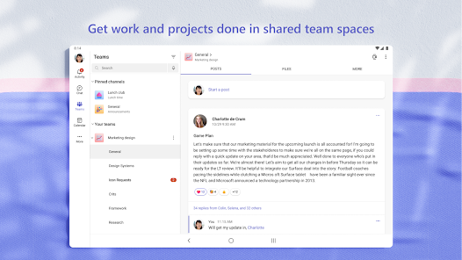
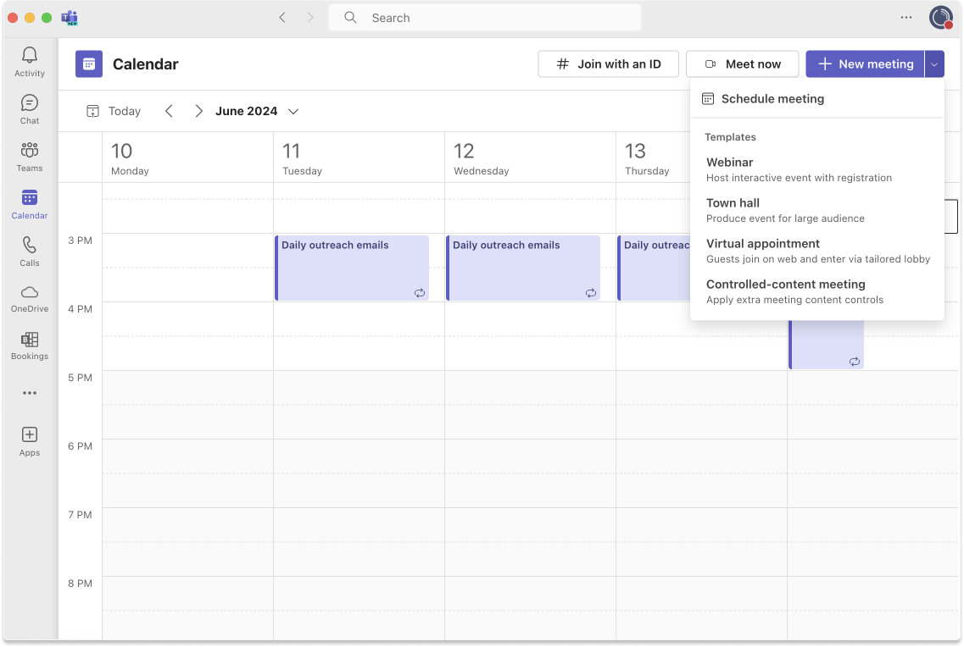
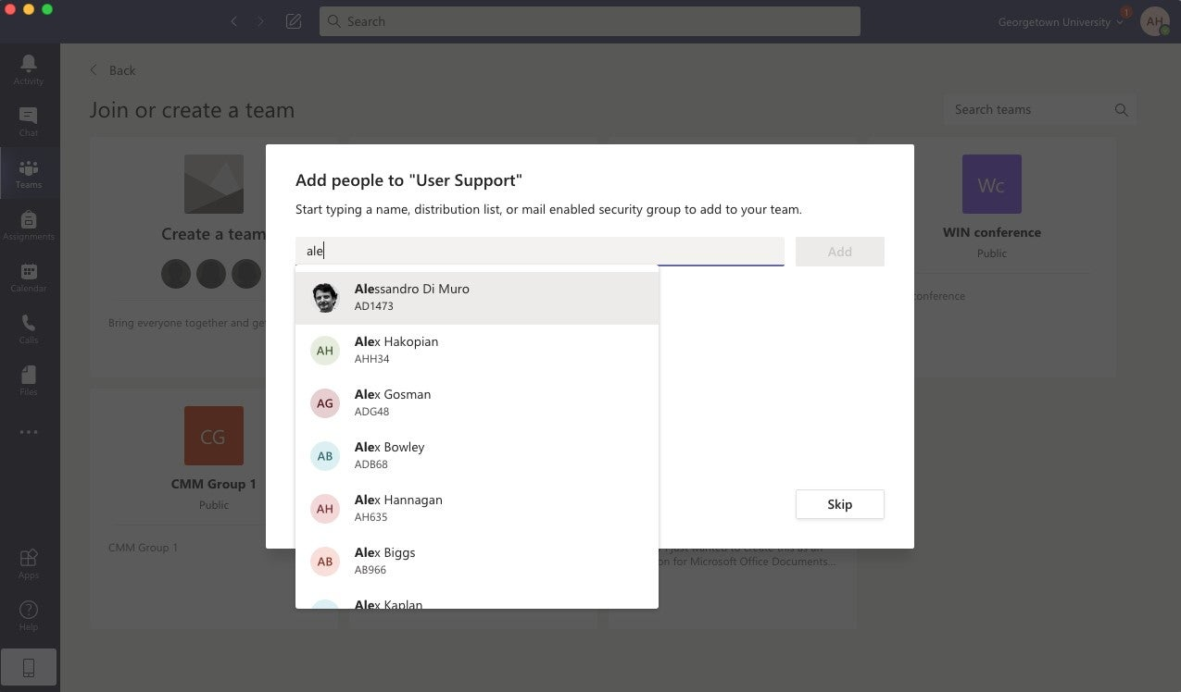
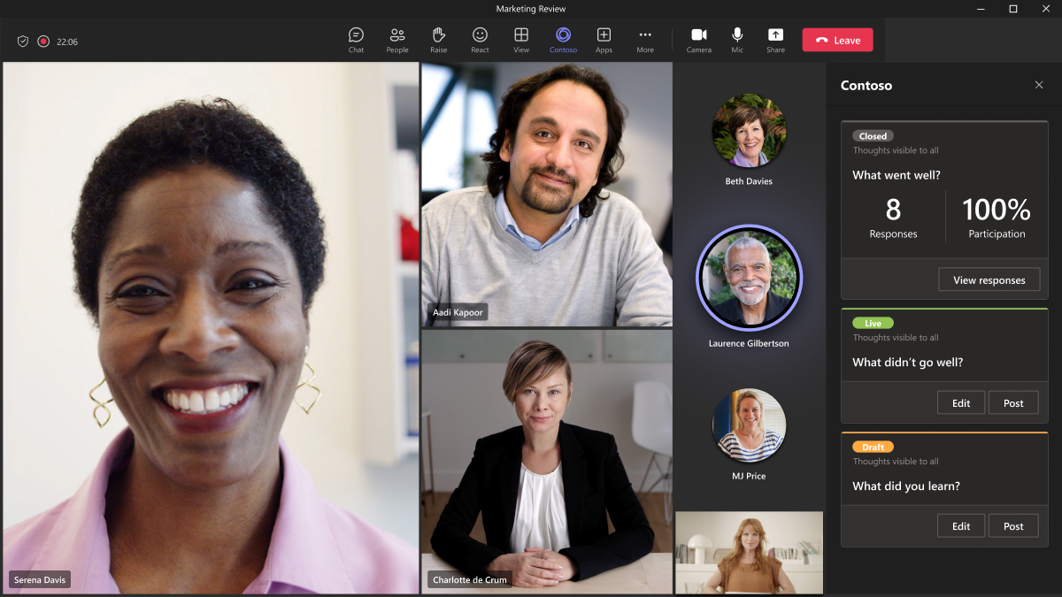
How to create a new Teams meeting
1-first step is to open the teams app.
2-open calendar and then on the top right of the page is the tab: New meeting.
3-then you'll need to add: title , people that you want on the meeting , date of the meeting.
4- after that all the invites will be automatically sent to the people that you invite.

