Slide 1
Health, Wellbeing & Sustainable Developments
Measuring Health and Wellbeing – An overview of national indicators measuring health and Wellbeing

Slide 2
Lesson Objectives
Understanding what Wellbeing means
Why Wellbeing matters for the individual and for the national population
Measuring Wellbeing: indicators and surveys
Organisations responsible for health and Wellbeing

Slide 3

Understanding Wellbeing
Wellbeing is not just the absence of disease or illness. It’s a complex combination of a person's physical, mental, emotional and social health factors. Wellbeing is strongly linked to happiness and life satisfaction. In short, Wellbeing could be described as how you feel about yourself and your life.
It is the complete integration of body, mind and spirit.
Everything we do, think, feel and believe influences our Wellbeing.

Slide 4

Wellbeing in a Nutshell
Wellbeing is about feeling good and functioning well and comprises an individual’s experience of their life; and a comparison of life circumstances with social norms and values.
This Photo by Unknown Author is licensed under CC BY-NC-ND

Slide 5

How is Wellbeing understood under the Care Act (2014)?
An introduction to the Care Act 2014 - YouTube
‘Wellbeing’ is a broad concept. It is described as relating to the following areas in particular:
personal dignity (including treatment of the individual with respect)
physical and mental health and emotional Wellbeing
protection from abuse and neglect
control by the individual over their day-to-day life (including over care and support provided and the way they are provided)
participation in work, education, training or recreation
social and economic Wellbeing
domestic, family and personal domains
suitability of the individual’s living accommodation
the individual’s contribution to society.

Slide 6
How is Wellbeing understood under the Care Act (2014)?Contd.
There is no hierarchy in the areas of Wellbeing listed in the previous slide as all are equally important. There is also no single definition of Wellbeing, as how this is interpreted will depend on the individual, their circumstances and their priorities.
Wellbeing applies to several areas of life, not to one or two. Therefore, using a holistic approach to ensure a clear understanding of the individual’s views is vital to identifying and defining Wellbeing for each person.
Improving individual, and hence national, Wellbeing might best be achieved through improving people’s health.

Slide 7
Activity -1 – 20 minutes
Identify practical ways to improve your Wellbeing
Identify practical ways to improve the Wellbeing of your family?

Slide 8
Factors affecting Health and Wellbeing
A range of different types of factors affect the health and Wellbeing of individuals.
These include socio-economic, physical, environmental and behavioural factors.
The three aspects of health and Wellbeing that can be affected by any of these factors are physical health and Wellbeing, social health and Wellbeing and psychological health and Wellbeing.
Socio-economic factors- These are to do with a person’s place in society or the opportunities some people have in society relative to others, which has a major influence on health.
Gender In terms of physical health and Wellbeing women are known to live longer than men but also to have higher rates of morbidity. It has been suggested that towards the end of the last century and in the early part of this century the gender difference in life expectancy is reducing.

Slide 9
Factors affecting Health and Wellbeing
2. Social class -It is widely understood that those who belong to the higher social classes have higher incomes and more opportunities in life generally than the lower social classes.
The class system can simply be viewed as consisting of three groups-
An upper class
A middle class and
A working or lower class.
People might decide what class someone belongs to on the basis of a whole range of indicators, for example where they live, the clothes they wear, the school they go to, the way they talk, the places they go on holiday or the leisure activities they engage in. Sociologists use an individual’s job title to place them in one of the social classes. Traditionally they used the Registrar General’s Classification to do this.

Slide 10

Factors affecting Health and Wellbeing
3.Housing- It impacts on social health and Wellbeing. For example, living in high rise flats with no gardens makes it more difficult for children to interact with others through play. Also, people who live in sub-standard housing are less likely to invite friends to their house. Conversely, good housing may encourage social contact as both adults and children will invite others to their home.
4.Culture and ethnicity-Culture refers to the practices, beliefs, traditions and customs of a particular group of people. This is often linked to ethnicity but can also be applied to other groups of people in society e.g., middle class culture or youth culture.

Slide 11
Factors affecting Health and Wellbeing
A person’s ethnicity refers to his belonging to a group of people of similar origin and culture and the adjective ethnic is often used to refer the culture a minority group within the wider population e.g., the Chinese population in Northern Ireland.
In terms of physical health and Wellbeing, belonging to a particular ethnic group can be associated with increased risk of suffering from a particular disease or condition e.g. within the UK all ethnic minority groups (apart from Irish and Chinese) are more likely to suffer from diabetes than the wider population; Asian men are more at risk of angina and heart attack than other groups;

Slide 12
Factors affecting Health and Wellbeing
b)Physical Factors- Physical factors that can impact on physical, social and psychological health and Wellbeing include a range of conditions, illnesses or diseases. These may be genetically inherited or associated with ageing.
1)Genetically inherited conditions Whilst genetics can often predispose people to a whole variety of illnesses and diseases, there are some conditions that have a proven genetic cause i.e., they are directly genetically inherited. Examples include-
Sickle cell anaemia www.nhs.uk/conditions/Sickle-cell-anaemia/pages/introduction.aspx
Cystic Fibrosis www.cysticfibrosis.org.uk/about-cf/what-is-cystic-fibrosis
Turner Syndrome www.nhs.uk/conditions/turners-syndrome/Pages/Introduction.aspx

Slide 13

Factors affecting Health and Wellbeing
2)Chronic illness or disease associated with the ageing process. Most people develop chronic conditions as they grew older, and many are classified as disabled as a result. Examples include type 2 diabetes, coronary heart disease, osteoarthritis and osteoporosis.

Slide 14
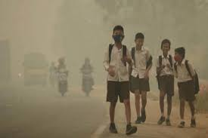
Factors affecting Health and Wellbeing
c)Environmental factors
1)Geographical location Where someone lives within the UK can have an influence on health and Wellbeing.
In terms of the effects of geographical location on physical health and Wellbeing, there may be services available in one area and not another, some health trusts may allow doctors to prescribe a drug that is unavailable to patients in another part of the country, or staff shortages may mean long waiting lists in some parts of the country.
This has been referred to as ‘the postcode lottery’ in health and clearly there can be a negative impact on the physical health and Wellbeing of service users. Some may suffer unnecessary pain and distress and they may even suffer premature death when waiting for care and treatment.

Slide 15
Factors affecting Health and Wellbeing
2) Pollution There are different types of pollution, and they all have different effects. For ex- Noise pollution e.g., from air traffic can also impact on physical health and Wellbeing by disrupting sleep patterns, causing excessive tiredness.
People suffering from pollution related illnesses might feel depressed, as they may not be able to go out as often as they would like due to their illness.
There is also some evidence that children exposed to high levels of lead from traffic fumes are prone to behavioural disorders.

Slide 16
Factors affecting Health and Wellbeing
d)Behavioural factors- A range of health behaviours can contribute to all aspects of health and wellbeing. These include exercise, diet, smoking, alcohol consumption and illegal drug use.
1)Exercise and lack of exercise-Exercise is known to be very beneficial for the physical health and Wellbeing of individuals, whilst a lack of exercise contributes to poor health.
Exercise makes the heart stronger and larger so it can pump more blood around the body and can sustain its maximum level with less strain.
This lowers the risk of heart problems and improves circulation.
Exercise reduces obesity and prevents diabetes. It builds bone strength and prevents osteoporosis. It helps to protect individuals from developing cancers such as colon or breast cancer. Exercise tones the body and improves muscle strength.

Slide 17
Factors affecting Health and Wellbeing
2)Diet-A healthy diet is often referred to as a balanced diet, which means consuming from all the different food groups in the recommended proportions.
According to nutritionists there are five main food groups – these are whole grains, fruit and vegetables, protein, dairy products, and fat and sugar.
3)Smoking- Smoking has many negative effects on the body as described by the NHS. Click on this link for a description of the negative impact of smoking on circulation, the heart, stomach, skin, bones, brain, lungs, mouth and throat, as well as its impact on reproduction and fertility.
www.mentalhealth.org.uk/a-to-z/s/smoking-and-mental-health

Slide 18
Factors affecting Health and Wellbeing
4)Alcohol misuse- Drinking too much alcohol has a very negative impact on physical health and Wellbeing. . Alcohol misuse can also lead to death or injury due to drink driving or accidents in the home and at work. In the longer term, alcohol misuse can lead to a whole variety of health problems, including diabetes, inflammation of the pancreas, internal bleeding, weakening of the heart, high blood pressure and stroke.
With reference to the impact on social health and Wellbeing, it is well known that aggressive and criminal behaviour and the consumption of alcohol are linked- nearly half of the offenders of sexual offences, burglaries, street crime and crimes in pubs and clubs have been found to be intoxicated.
Many alcoholics are more likely to stay in their homes while drinking to try to disguise their problem, which means they can be quite isolated.

Slide 19
Factors affecting Health and Wellbeing
5)Illegal drug use- Illegal drugs include cannabis, cocaine, mephedrone, ecstasy and amphetamines.
All have both short- and long-term effects, although these vary from one type of drug to another. Drug users often experience difficulties in family and other relationships and may experience loneliness and isolation as a result.
Financial problems may arise because of the expense of buying drugs and the user may have no money for any other social activities.
Work attendance record and level of performance may drop, and the user may become unemployed, losing contact with work colleagues.

Slide 20
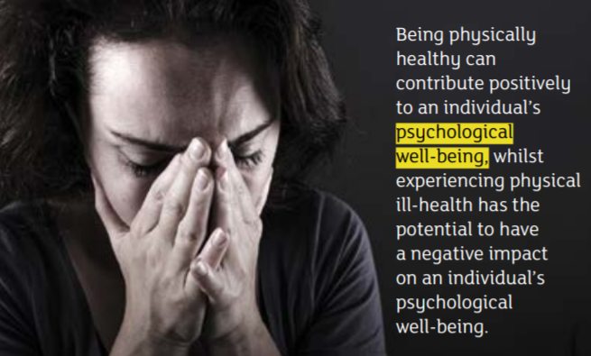
Activity Time – 2 – 25 minutes
Evaluate the potential impact of physical health on psychological Wellbeing.
Discuss this issue in a group. Without mentioning any names, discuss how someone you know has been affected psychologically by their physical ill-health.
Perhaps this person has a chronic condition or has been diagnosed with a serious illness. How did affect their emotions?

Slide 21
Why Wellbeing for the Individual and our Nation Matters?
Adds years to life
Improves recovery from illness
Is associated with positive health behaviours in adults and children
Is associated with broader positive outcomes
Influences the Wellbeing and mental health of those close to us
Affects how staff and health care provider's work
Has implications for decisions for patient care practices and services
Has implications for treatment decisions and costs
Affects decisions about local services
Has implication for treatment decisions and costs
May ultimately reduce the healthcare burden

Slide 22
Measuring Wellbeing: Focusing on Two Dimensions of Wellbeing
Wellbeing is viewed as having two dimensions: objective and subjective Wellbeing.
Objective Wellbeing is more of a proxy measure based on assumptions about basic human needs and rights, including aspects such as adequate food, physical health, education, and safety.
Objective Wellbeing can be measured through self-report (e.g., asking people whether they have a specific health condition), or through more objective measures (e.g., mortality rates and life expectancy).
Subjective Wellbeing (or personal Wellbeing) is measured by asking people directly how they think and feel about their own Wellbeing and includes aspects such as life satisfaction (evaluation), and positive emotions (hedonic).

Slide 23
What are the Basic Principles of Measuring Wellbeing?
Measuring Wellbeing can be done in a number of ways – there is no ‘one size fits all’ approach. In general, however, Wellbeing measurement tends to be based on:
Individuals-Individuals, rather than groups, are the ‘unit of measurement’, even if we are ultimately interested in the Wellbeing of a particular group of people.
Subjective indicators-Subjective, rather than objective, indicators provide the data. ‘Subjective indicators’ refers to questions which ask about feelings, experiences and judgements about life.

Slide 24
Tools/Instruments used for Measuring Wellbeing
Using questionnaires to gather information is most common
Questionnaires are a good way of gathering information on people’s Wellbeing: they provide information in the form of numbers (“quantitative data”) and they offer the advantage that they can be repeated at different times to show trends and patterns in results.
However, there are other ways of gathering information on Wellbeing. These include:
research interviews
discussion groups and focus groups
community consultation events
research diaries (where people write down their feelings, behaviours and activities over a set timeframe)
Most of these methods provide information in the form of words (“qualitative data”) and can be used alongside questionnaire data to help explore findings in more detail.

Slide 25

Recommended Wellbeing measures
1)The Short Warwick-Edinburgh Mental Wellbeing Scale (SWEMWBS)- SWEMWBS is a scale of seven positively worded items, with five response categories
The SWEMWBS uses seven of the WEMWBS’s 14 statements about thoughts and feelings, which relate more to functioning than feelings and so offer a slightly different perspective on mental wellbeing.
These questions meet various statistical tests of robustness, and they also have ‘face validity’

Slide 26
Recommended Wellbeing Measures
For example, good feelings (‘feeling relaxed’), sense of meaning (‘feeling useful’) and good relationships (‘feeling close to other people’).
The SWEMWBS is a shortened version of the longer Warwick and Edinburgh Mental Wellbeing Scale (WEMWBS).
Warwick and Edinburgh Universities were commissioned to develop this in 2006, and it has been academically validated as having good psychometric properties, good validity and reliability with the ability to distinguish between population groups.
It has been widely used in population surveys in the UK and elsewhere, including in the Health Survey for England in 2011.

Slide 27
Recommended Wellbeing Measures
2)The Office for National Statistics’ (ONS) subjective Wellbeing questions- The Office for National Statistics’ subjective Wellbeing questions are a set of 4 questions with a response scale of 0-10, intended to capture what people think about their Wellbeing.
From April 2011 these questions have been included in the Integrated Household Survey, which is a composite survey that gathers information from over 200,000 people in UK.

Slide 28
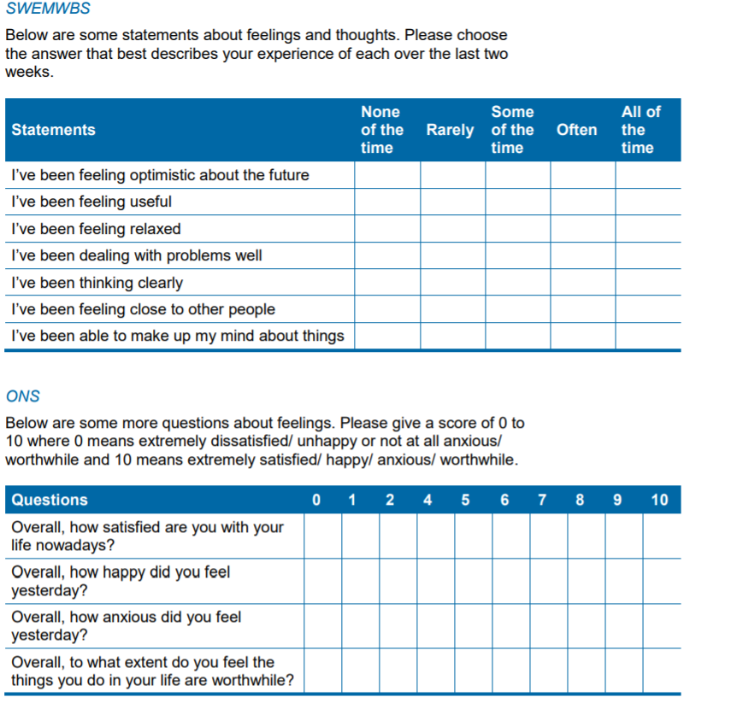
Examples of Wellbeing Questionnaires

Slide 29
Activity 2- 15 minutes
Complete the scale and reflect personally on your wellbeing score

Slide 30
Organisations Responsible for Health and Wellbeing
A whole range of organisations, large and small, contribute to the health and Wellbeing of the populations they serve.
The World Health Organisation (WHO)-WHO is an international organisation that is attached to the United Nations and is concerned with public health on a global scale. This organisation provides advice, guidance and practical support on health for countries all over the world.
Public health England now called UK Health Security Agency and Office for Health Improvement and Disparities refers to the activities of the state in promoting good health and Wellbeing and preventing ill-health and disease; it aims to improve the health and Wellbeing of the whole population rather than focusing on individuals.

Slide 31
Organisations responsible for Health and Wellbeing
Private or commercial organisations These are businesses that aim to make a profit and are also part of the independent sector. Pharmacies These are businesses in the retail sector that contribute to health and Wellbeing in a number of ways.
They usually provide treatments e.g. a range of medicines that people can buy over the counter like pain killers
sell products relevant to health and Wellbeing e.g. vitamin supplements or aids to daily living
advise individuals on health issues by having pharmacists or even doctors available for consultation in person or online
measure health indicators such as blood pressure or blood sugar
provide tests for infections, for example some provide free tests for chlamydia
run health promotion campaigns and activities, for example smoking cessation support
www.boots.com www.lloydspharmacy.com www.gordonsdirect.com

Slide 32
Organisations responsible for Health and Wellbeing
Drug companies-Examples of drug companies include GlaxoSmithKline, Pfizer and Merck.
They conduct research on physical and mental health issues and develop innovative drug treatments to prevent, manage or cure a range of illnesses and diseases.
They carry out extensive drug testing to try to ensure the efficacy and safety of their products.
Drug companies distribute their products to pharmacies and hospitals, providing information on safe dosage and any potential side effects and contraindications.
This enables pharmacists and doctors to choose the best drug treatments for individuals as well as to give appropriate advice for their use.
www.gsk.com www.pfizer.co.uk www.merck.com

Slide 33
Organisations responsible for Health and Wellbeing
Holistic therapists There are a whole variety of holistic therapists running businesses where they provide therapies like reflexology, acupuncture, chiropractic care, homeopathy and massage.
Whilst these therapies may sometimes be provided by the NHS or via voluntary organisations, most people pay the therapist directly for the services.
Holistic therapists provide treatments that can help people manage chronic conditions such as back pain or recurring headaches.
These treatments often complement conventional medical treatments such as drugs. Holistic therapists advise individuals on managing their condition, for example through making appropriate lifestyle choices.

Slide 34
Organisations responsible for Health and Wellbeing
Private practitioners Many different health professionals work as private practitioners. Some practitioners have full-time businesses in the private sector, whilst others work part-time in private practice whilst also working for the local trust.
Examples include – doctors, usually specialists such as gynaecologists, neurologists, paediatricians, psychiatrists, rheumatologists, orthopaedic surgeons or plastic surgeons
allied health professionals, such as physiotherapists, podiatrists or occupational therapists, counsellors and psychologists.
These practitioners have varying roles in contributing to health and Wellbeing, according to their skills and specialisms.

Slide 35
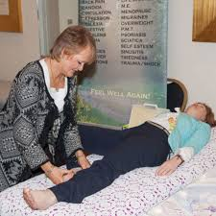
Organisations responsible for Health and Wellbeing
Private nursing homes -These range from small family run businesses of one nursing home to larger corporations with many homes across the UK
Many service users pay to live in a private nursing home from their savings, pension income or other assets, whilst others have their care funded by their local trust.
Nursing homes contribute to health and Wellbeing by providing full-time, permanent residential care where individuals can receive help with the activities of daily living as well as nursing care, such as medication for the illnesses and conditions they have.

Slide 36
Organisations responsible for Health and Wellbeing
Home care providers –
These are businesses that employ and provide carers to do home visits to help with personal care and the activities of daily living with much of their work being through contracts with local trusts.
They also provide sitters who will stay with vulnerable people, often overnight, under a private contact.
They can also provide respite for carers by taking over the care of a relative they care for, to allow them to have some time off or go on holiday.

Slide 37
Conclusion
Social scientists, psychologists and other researchers around the globe have developed their own defining characteristics, but simply put, it’s the feeling of being comfortable, healthy and happy.
A high level of Wellbeing would be when you feel satisfied or feel a sense of excitement for life.
On the other hand, if you were to have a low level of Wellbeing, you would likely feel a sense of dissatisfaction overall.
Your sense of Wellbeing isn’t necessarily tied to the amount of money you earn, the type of car you drive or where you went to university. Each person attaches importance to different aspects of life, complete with their own value system that they judge themselves and others by. While one person may place their career above all, another might care most about being adored by everyone around them.

Slide 38
Assignment workshop – 45 minutes

