Slide 1

The transmission of astrological and astronomical ideas from the Islamic world into Europe:
The Translation Movement of the Twelfth Century
Chris Mitchell cjm63@le.ac.uk

Slide 2
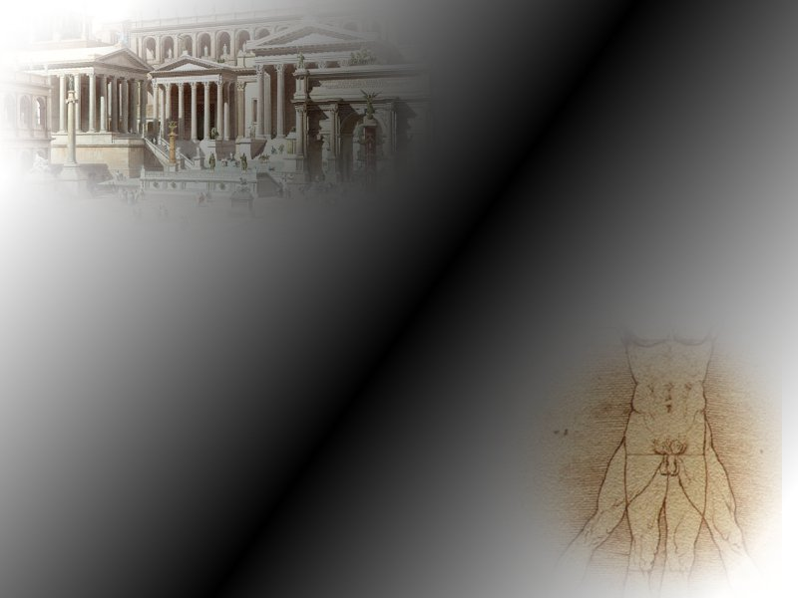
“Millennium of darkness”

Slide 3
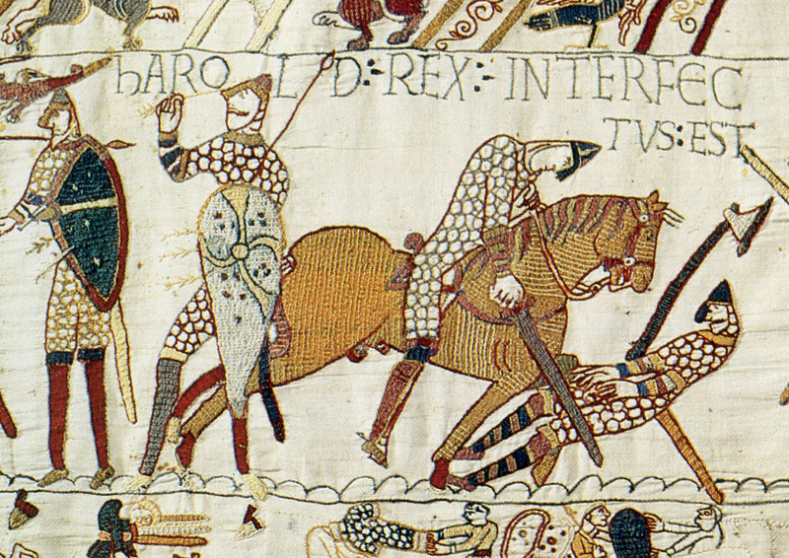

Slide 4
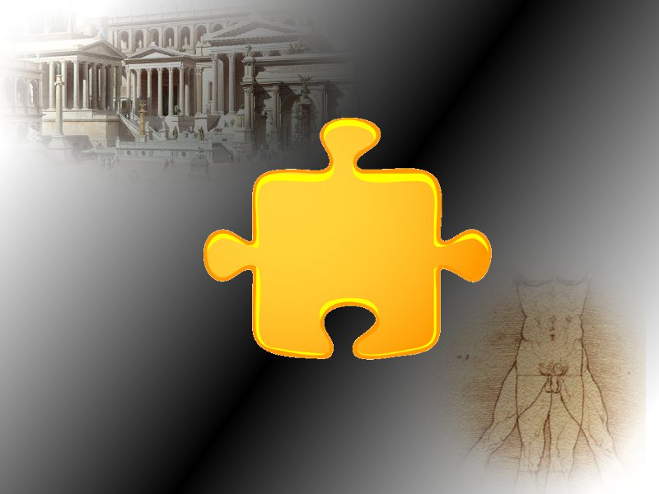

Slide 5
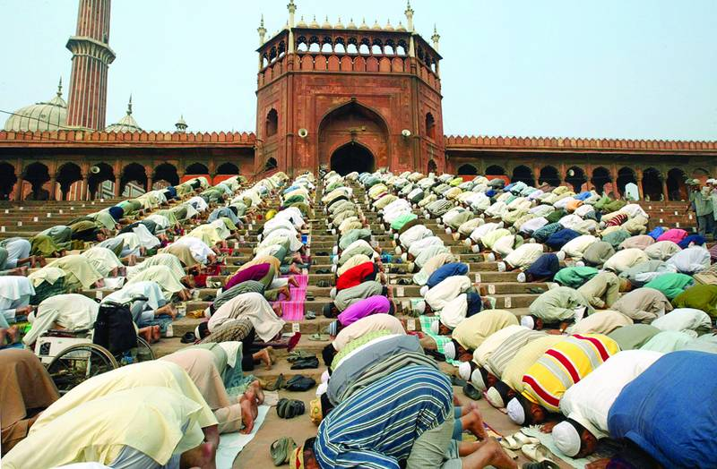

Slide 6
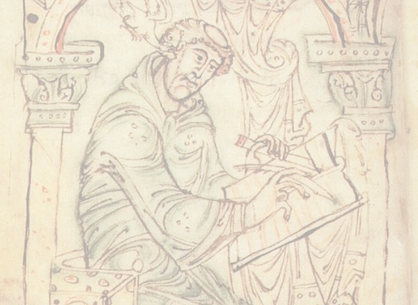
BACKGROUND
“Science was truly at a low ebb” (Grant)
Pliny
2/3 of Timaeus
Isidore of Seville
Bede
Most Greek texts lost
“Christianity allowed little space for the horoscopic arts” (Campion)

Slide 7
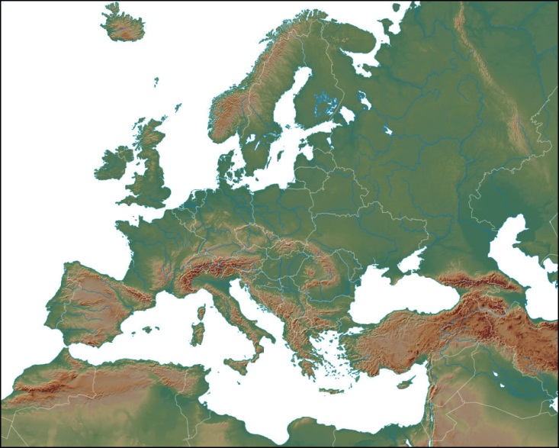
529
765
8th C

Slide 8
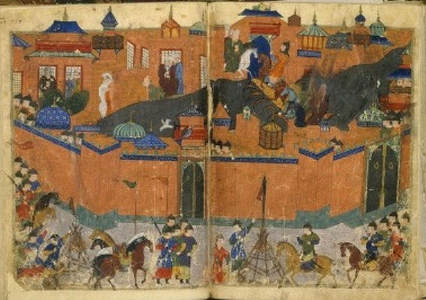

Slide 9
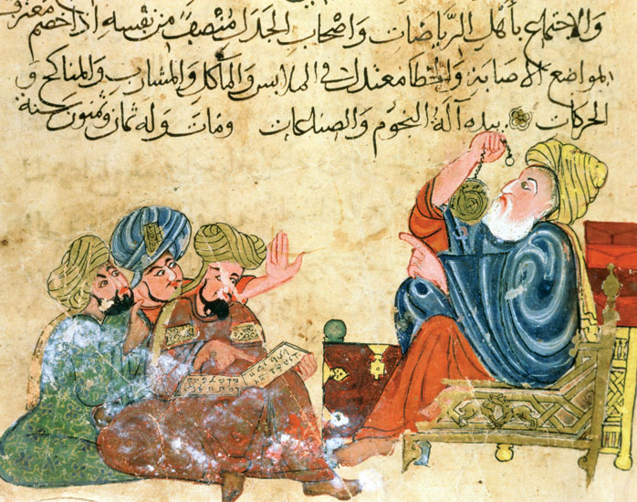
Was there an “Arabic science”?

Slide 10
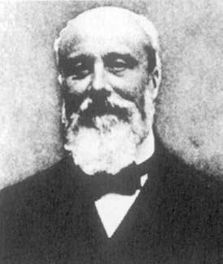
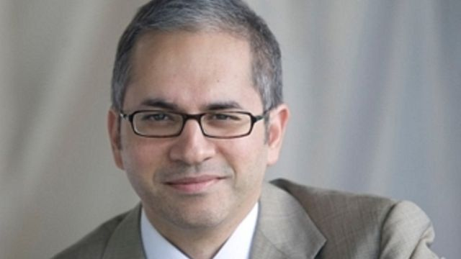
Was there an “Arabic science”?
“There is no Arabian science. The wise men of Mohammedanism were always the more or less faithful disciples of the Greeks, but were themselves destitute of all originality” (Duhem)
“Islamic scientists discovered pulmonary circulation, worked out theories of flight, invented algebra, and made great advances in engineering” (Masood)

Slide 11
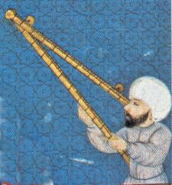
My question: “Was there an Arabic astrology?”

Slide 12
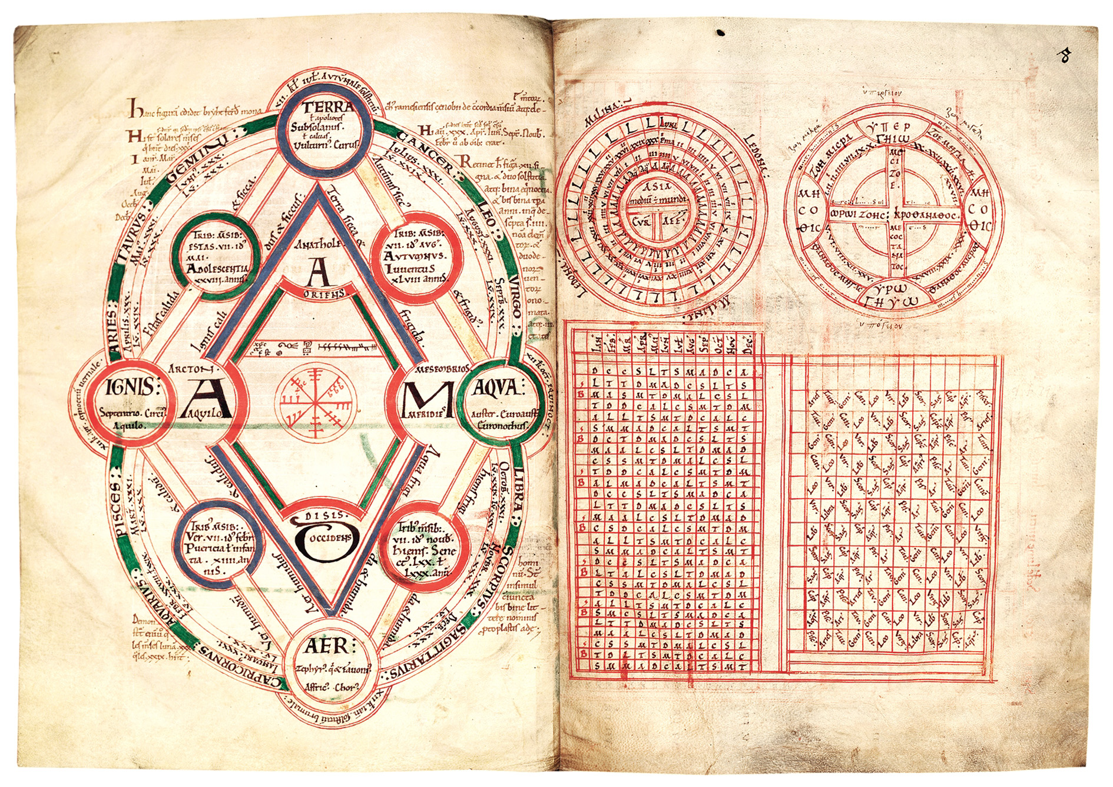
COMPUTUS

Slide 13
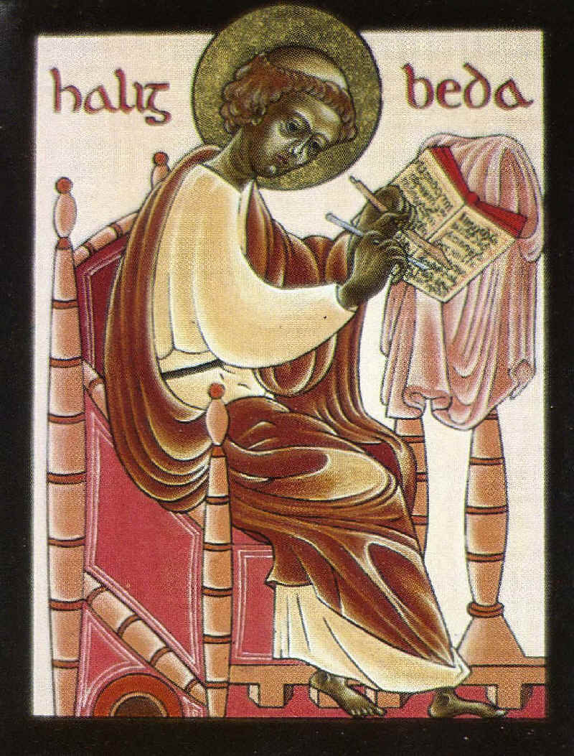
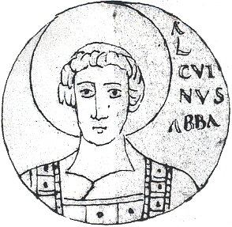
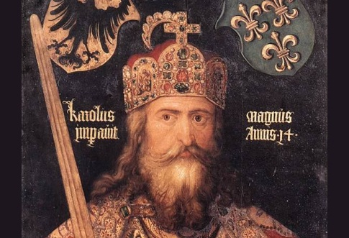
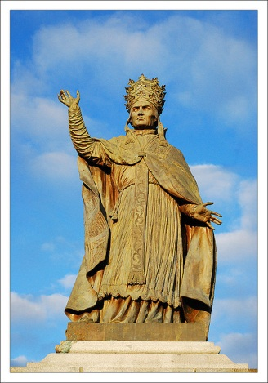

Slide 14
529
765
8th C

Slide 15
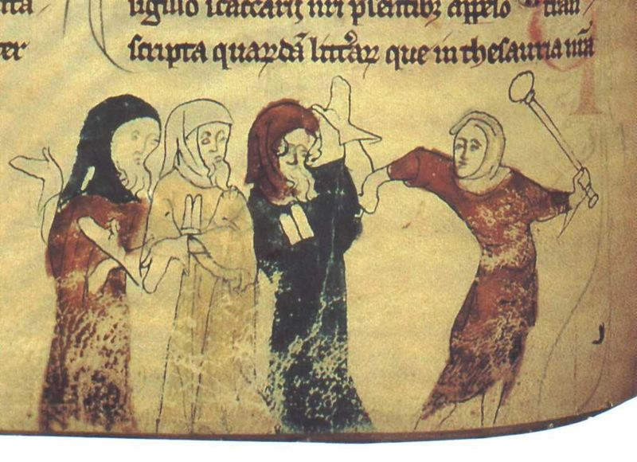
“William invited, even ordered, Jews into England”
(Huscroft)

Slide 16
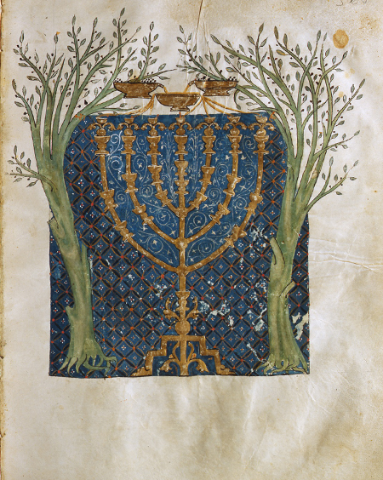

Slide 18
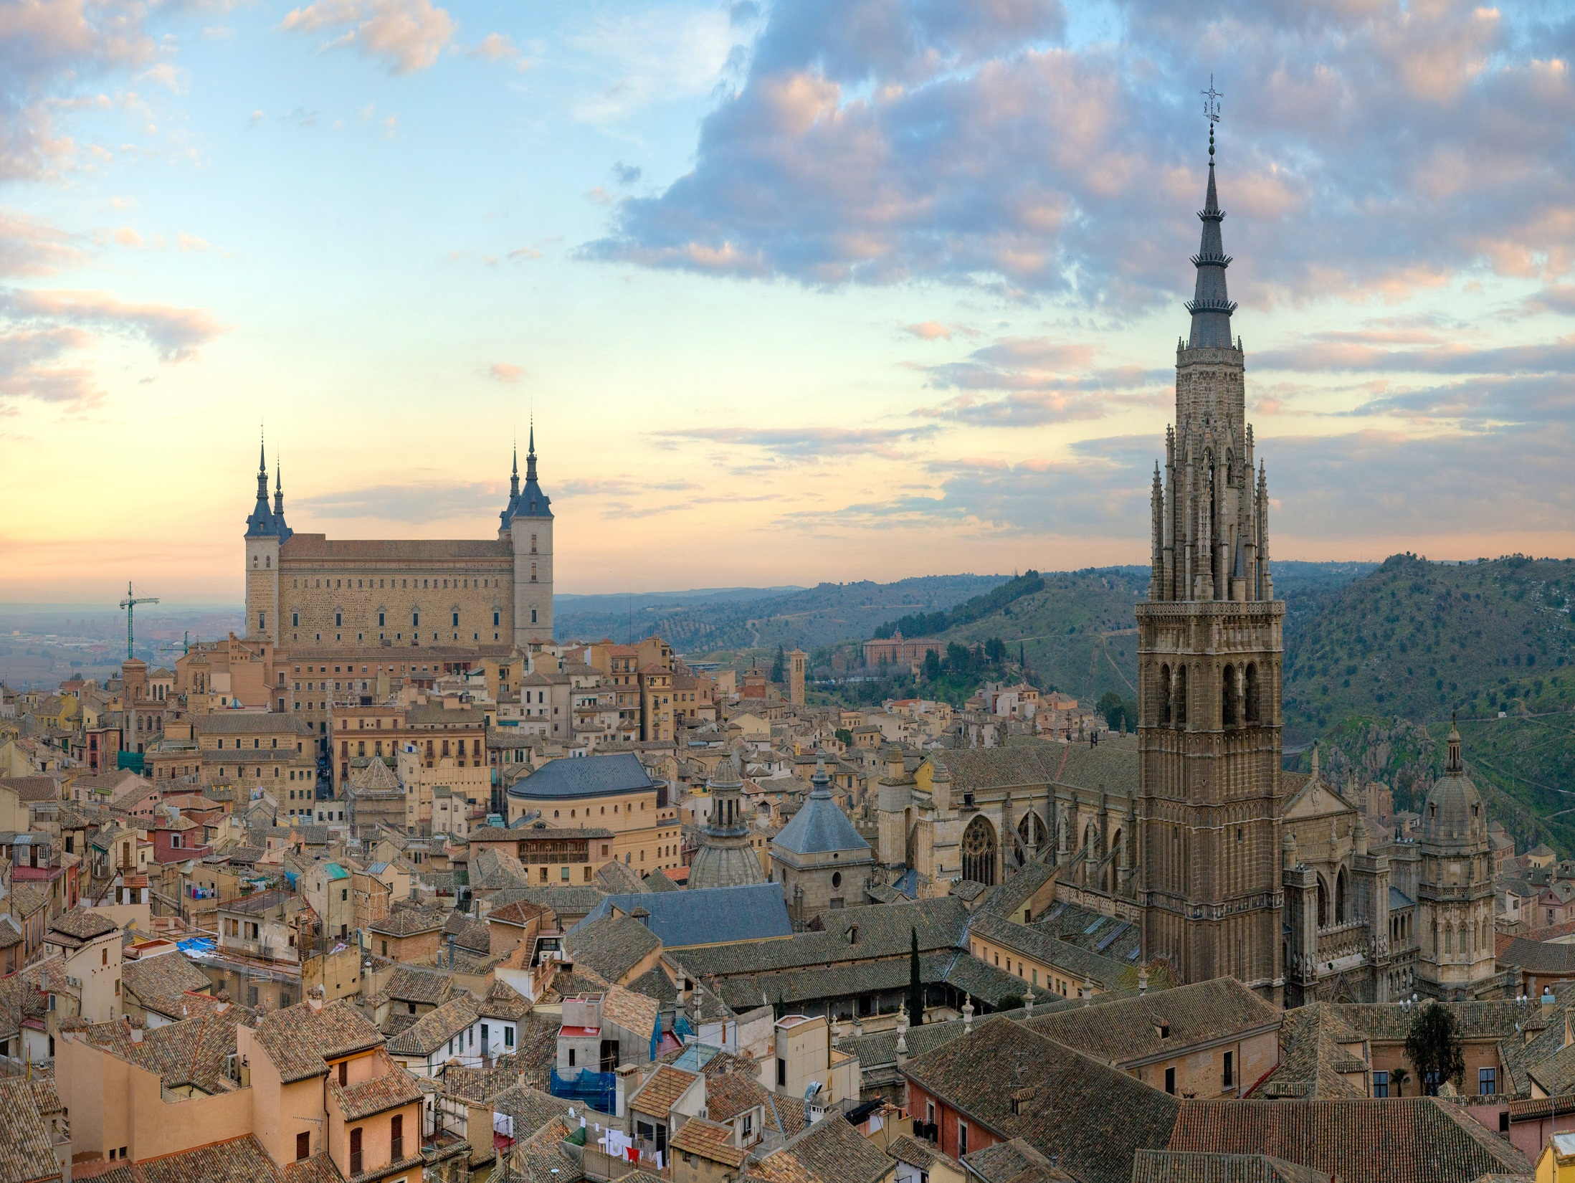

Slide 19
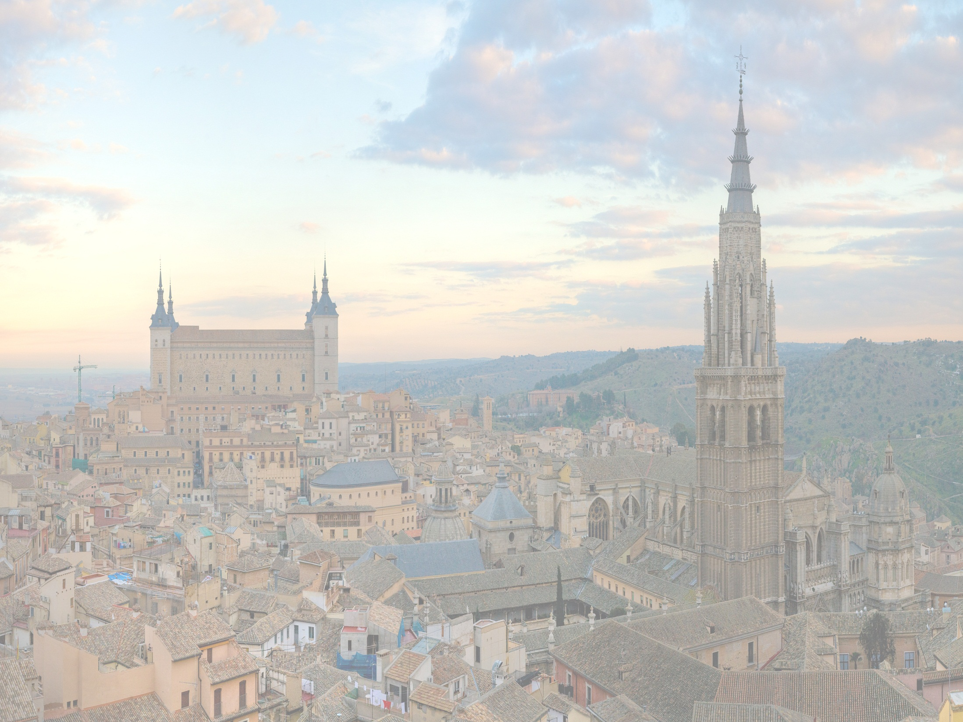
KEY PLAYERS
Ibn Ezra
Adelard of Bath
Gerard of Cremona
Plato of Tivoli
Abraham ben Hiyya
Daniel of Morley
Hermann of Carinthia
Robert of Chester
John of Seville
Roger of Hereford

Slide 20
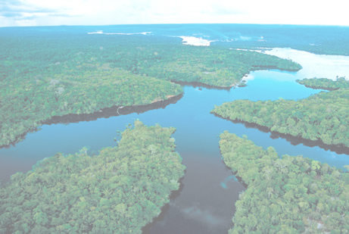
“the diaspora of classical learning… took root in the new civilizations that emerged in Western Europe, Byzantium, and the Islamic world, three streams of culture whose eventual confluence would produce a renaissance of science”
(Freely)

