Slide 1

Student name : Tania Habib
Student number 2336623
Submission Date: 28-07-2026
BMHP6029
Psychopathological Classifications and Provisions Component
Confession on use of AI tools :
I Tania Habib, confessing that AI generated tools not included in this report. I only took support from Microsoft Power point autocorrect for spelling and grammar check.

Slide 2

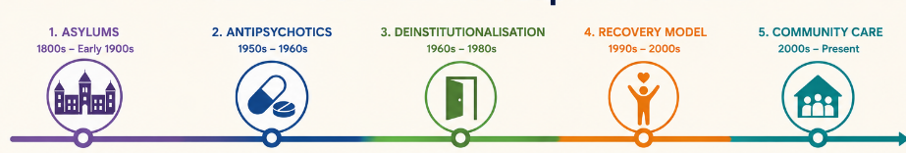
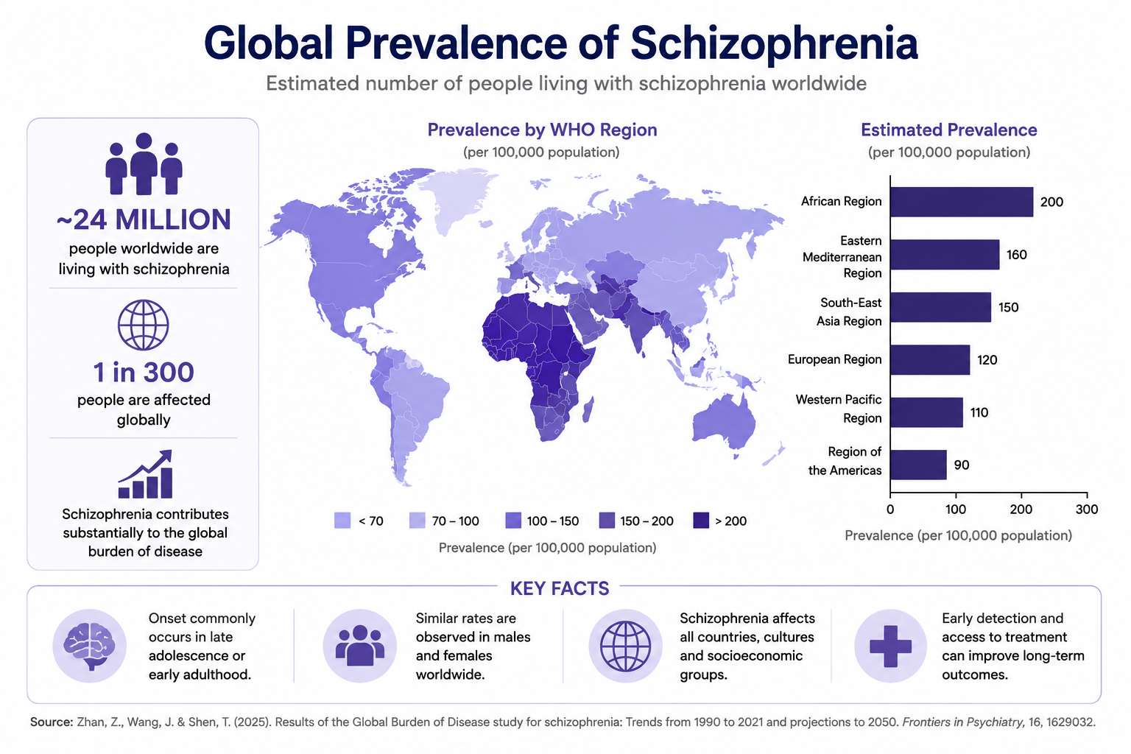
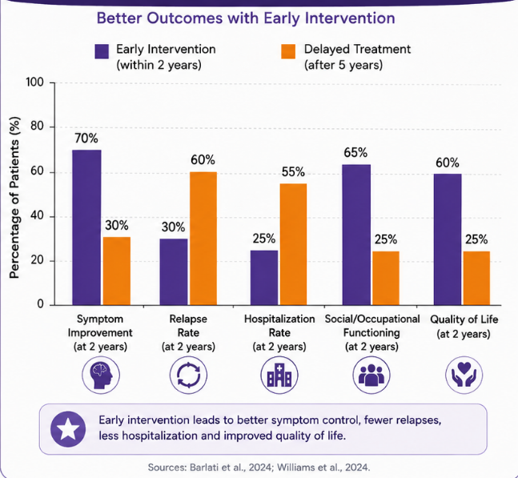
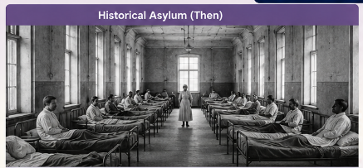
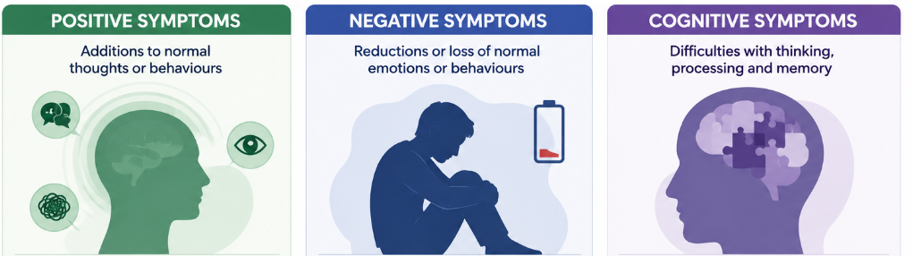
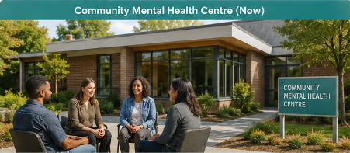
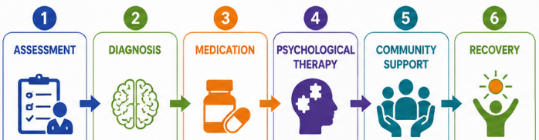
6A20 SCHIZOPHRENIA
6A20 SCHIZOPHRENIA
ICD-11 Schizophrenia Spectrum and Other Primary Psychotic Disorders
Introduction
Historical perspectives and treatments
Current services and treatments
Recommendations
Definition
Severe mental disorder affecting thoughts, emotions, perception and behaviour (WHO, 2024).
Persistent psychotic symptoms reduce daily functioning (Nickl-Jockschat et al., 2025).
ICD-11 Category
Schizophrenia (6A20) belongs to the family Schizophrenia Spectrum and Other Primary Psychotic Disorders.
Prevalence
Around 24 million people live with schizophrenia worldwide.
The global disease burden remains substantial (Zhan et al., 2025)
Historical attitudes
People were feared and socially excluded.
The disorder was linked with dangerousness.
Institutional care restricted autonomy (George et al., 2023).
Historical treatments
Long-term psychiatric hospitals.
Physical restraints.
Electroconvulsive therapy.
Early antipsychotic medication.
Key developments
Care shifted from institutions to communities.
Community services improved inclusion (Calabria & Cullen, 2024).
Service gaps remain after deinstitutionalisation (WHO, 2024).
Continuing challenges
Historical stigma still affects treatment access.
Inequalities remain across mental health services (George et al., 2023).
Current interventions
Antipsychotic medication.
Early intervention services.
Community Mental Health Teams.
Crisis Resolution Teams.
Family interventions.
CBT for psychosis (CBT).
Supported employment programmes.
Evidence
Psychosocial care improves recovery outcomes (Barlati et al., 2024).
Early intervention reduces relapse (Williams et al., 2024).
Current challenges
Delayed diagnosis limits recovery.
Stigma reduces quality of care (Kruse & Dodell-Feder, 2025).
Social inequalities worsen outcomes (Kirkbride et al., 2024).
Expand early intervention programmes nationally.
Increase access to evidence-based psychosocial interventions.
Strengthen community mental health services after deinstitutionalisation (WHO, 2024).
Reduce healthcare stigma through professional education.
Address social determinants including housing, employment and poverty.
Promote anti-discrimination policies and public awareness campaigns.
Conclusions
Schizophrenia remains a complex disorder requiring integrated biological, psychological and social care.
Historical institutional approaches have shifted towards recovery-focused community services.
Early diagnosis, psychosocial interventions and coordinated care improve recovery.
Reducing stigma and addressing social inequalities should remain future policy priorities.
References
Causes, Symptoms, Diagnosis
Barlati, S., Nibbio, G. and Vita, A. (2024) ‘Evidence-based psychosocial interventions in schizophrenia: A critical review’, Current Opinion in Psychiatry, 37(3). Available at: https://doi.org/10.1097/YCO.0000000000000925
Calabria, V. and Cullen, L.T. (2024) ‘Deinstitutionalisation and the move to community care: Comparing the changing dimensions of mental healthcare after 1922 in the Republic of Ireland and England’, History of Psychiatry, 35(2). Available at: https://doi.org/10.1177/0957154X241231057
George, P., Jones, N., Goldman, H. and Rosenblatt, A. (2023) ‘Cycles of reform in the history of psychosis treatment in the United States’, SSM – Mental Health, 3, p.100205. Available at: https://doi.org/10.1016/j.ssmmh.2023.100205
Kirkbride, J.B., Anglin, D.M., Colman, I., Dykxhoorn, J., Jones, P.B., Patalay, P., Pitman, A., Soneson, E., Steare, T., Wright, T. and Griffiths, S.L. (2024) ‘The social determinants of mental health and disorder: Evidence, prevention and recommendations’, World Psychiatry, 23(1), pp.58–90. Available at: https://doi.org/10.1002/wps.21160
Kruse, E.A. and Dodell-Feder, D. (2025) ‘Schizophrenia spectrum stigma in healthcare: A systematic review’, Frontiers in Psychiatry, 16. Available at: https://doi.org/10.3389/fpsyt.2025.1648957
Nickl-Jockschat, T., Steiner, J., Hirjak, D. and Hasan, A. (2025) ‘Schizophrenia and catatonia: From ICD-10 to ICD-11’, Der Nervenarzt. Available at: https://doi.org/10.1007/s00115-025-01861-3
Orsolini, L., Pompili, S. and Volpe, U. (2022) ‘Schizophrenia: A narrative review of etiopathogenetic, diagnostic and treatment aspects’, Journal of Clinical Medicine, 11(17). Available at: https://doi.org/10.3390/jcm11175040
Thornicroft, G., Sunkel, C., Aliev, A.A. et al. (2022) ‘The Lancet Commission on Ending Stigma and Discrimination in Mental Health’, The Lancet, 400(10361), pp.1438–1480. Available at: https://doi.org/10.1016/S0140-6736(22)01470-2
Williams, R., Ostinelli, E.G., Agorinya, J., Minichino, A., Franco De Crescenzo, M., Maughan, D., Puntis, S., Cliffe, C., Kurtulmus, A., Lennox, B.R. and Cipriani, A. (2024) ‘Comparing interventions for early psychosis: A systematic review and component network meta-analysis’, EClinicalMedicine, 70, p.102537. Available at: https://doi.org/10.1016/j.eclinm.2024.102537
World Health Organization (2024) Clinical descriptions and diagnostic requirements for ICD-11 mental, behavioural and neurodevelopmental disorders (CDDR). Geneva: World Health Organization. Available at: https://www.who.int/publications/i/item/9789240077263
Zhan, Z., Wang, J. and Shen, T. (2025) ‘Results of the Global Burden of Disease study for schizophrenia: Trends from 1990 to 2021 and projections to 2050’, Frontiers in Psychiatry, 16. Available at: https://doi.org/10.3389/fpsyt.2025.1629032
Causes
Genetic vulnerability increases susceptibility.
Childhood adversity and substance misuse increase risk.
Urban living and social deprivation contribute to onset (Kirkbride et al., 2024).
No single cause explains schizophrenia (Orsolini et al., 2022).
Symptoms
Delusions
Hallucinations
Disorganised speech
Reduced motivation
Emotional blunting
Social withdrawal
Poor attention
Memory problems
Reduced executive functioning (Orsolini et al., 2022).
Diagnosis
Clinical assessment follows ICD-11 criteria (WHO, 2024).
Symptoms cause persistent functional impairment.
Alternative medical conditions should be excluded (Nickl-Jockschat et al., 2025).
Notes:
Introduction
Schizophrenia is a serious mental illness that impacts thoughts, feelings and behaviour. The disorder distorts one's perception of reality and of everyday life. Hallucinations, delusions and confused thinking are common during illness for many people. Life can be challenging when there is not adequate treatment and support. Schizophrenia is a disorder listed under primary psychotic disorders in the ICD-11. Persistent symptoms of psychosis with functional impairment (World Health Organization, 2024) are used for diagnosis. There are currently approximately 24 million people who suffer from schizophrenia worldwide. This condition is still a big problem around the world. For many, lifelong treatment and ongoing support is needed. Comprehending better helps to improve early diagnosis and long-term recovery (Zhan et al., 2025).
Causes, Symptoms and Diagnosis
Multiple biological and environmental risk factors are involved in the development of schizophrenia. This disorder is more likely to occur in people who are genetically susceptible. Biological risk factors include family history. Childhood trauma can add up to significantly affect mental health in the future. Vulnerable individuals may have symptoms after using drugs or alcohol. Urban life and social deprivation also are risk factors for diseases. Stressful life events can aggravate the symptoms over the long term. At the present time, it is known that there is not a single trigger which causes schizophrenia. Several factors interact to cause the disorder (Kirkbride et al., 2024).
Symptoms generally present as positive, negative and cognitive symptoms. Positive symptoms are hallucinations, delusions and disorganised speech. Hearing voices when there is no one else is a common hallucination. Delusions produce strong beliefs that are not based on facts. Negative symptoms make motivation and emotional expression significantly diminished. Many people also cease to attend family and social gatherings. Cognitive symptoms include impaired memory, attention and problem-solving skills. These symptoms impact education, work and independent living. Severity of the symptoms varies between patients (Orsolini et al., 2022).
Detailed mental assessment and diagnostic evaluation are done based on clinical requirements as outlined in ICD-11. Symptom severity and functional impairment are closely evaluated by health care providers. The clinical interview is still significant in the diagnostic process. Other neurological and medical diseases should be ruled out first. Special attention should also be paid to substance-related disorders when making a clinical assessment. The revised ICD-11 also enhances the consistency of healthcare diagnostic processes (Nickl-Jockschat et al., 2025).
Historical Perspectives and Treatments
The definition and treatment of schizophrenia at the time were quite different to what is accepted today by healthcare professionals. People with severe mental illnesses were feared by many. Schizophrenia was often linked to chaos and threat in society. There was growing confusion about public understanding and discrimination and social exclusion. The primary care environment was the large psychiatric hospital. Institutionalization was predominantly for protection and not for recovery. The majority of patients had limited personal independence and freedom of movement. Physical restraints were commonly used within psychiatric institutions. The advent of electroconvulsive treatment was yet another historical treatment method. Later, the use of early antipsychotic drugs helped to gradually manage symptoms. Institutional care often however, diminished dignity and social participation (George et al., 2023).
The process of deinstitutionalisation altered mental healthcare. Long term psychiatric hospitals were replaced by community services. This practice was successful in achieving independence and social inclusion. Improved quality of life was noted in many after discharge. More emphasis was placed on family involvement during recovery as well. But there are ongoing service gaps that continue to impact recovery and continuity of services. There is a need for specialist mental health service provision in some communities. A robust community investment is still needed for effective deinstitutionalisation (Calabria & Cullen, 2024). Community based mental healthcare is also recommended internationally (WHO, 2024).
Current Services and Treatments
Treatment of schizophrenia in modern times includes medication and community services. Treatment of the psychotic symptoms is primarily with antipsychotic drugs. Unfortunately, medication is very effective at reducing hallucinations and delusions. Psychological therapy will help with emotional wellbeing and symptom management. Cognitive Behavioural Therapy (CBT) is a therapy that can be used effectively to control distressing thinking. Family interventions enhance communication and participation in treatment. Community Mental Health Teams offer time on-going professional support. Crisis Resolution Teams are available for mental health care in emergency situations. Supported employment programmes promote independence and the participation of individuals in the workplace. Recovery planning is based on optimizing functioning and personal aspirations on a day-to-day basis.
Studies indicate combined treatment has better efficacy than medication alone. Psychosocial interventions increase functioning and functioning in daily life (Barlati et al., 2024). Early intervention service helps to prevent relapse and enhance future outcomes. Recoveries after the first episode are greater when treatment is started early. Early support also helps to prevent long-term disability and hospital admissions (Williams et al., 2024).
There are still a number of important issues in the treatment of schizophrenia. A late diagnosis decreases the chances for successful recovery. Many people don't seek professional help because of the stigma associated with health care. Negative feelings can impact the quality of treatment and patients' trust (Kruse & Dodell-Feder, 2025). Recovery is also impacted by poverty, unemployment and housing issues. A lack of social support can worsen mental health challenges in the future. Overall recovery outcomes are affected by these broader social issues (Kirkbride et al., 2024).
Recommendations
Earlier intervention services should be enhanced in all communities in the future. Treatment early in the course consistently results in better recovery and lower rate of relapse (Williams et al., 2024). In routine clinical practice, psychosocial interventions should be given in addition to medication. Treatment with both drugs helps people be more independent and have a better quality of life (Barlati et al., 2024). There is a need to invest more in community mental health services and expand their staffing. People in the health sector need to be regularly updated on anti-stigma education programmes. Treatment experiences are greatly enhanced when professional attitudes are better (Kruse & Dodell-Feder, 2025). Governments should enhance housing, job and financial assistance facilities. Recovery is promoted and community participation is encouraged by strong social support. Public education should tackle discrimination and foster social inclusion (Thornicroft et al., 2022).
Conclusion
In short, schizophrenia is still a complex disorder and will need a holistic extended care support. Modern care encompasses a blend of biological, psychological and social treatment modalities. There are many countries in which community services have taken the place of institutional treatment. Early diagnosis means recovery and independence in the future can be greatly improved (World Health Organization, 2024). But there are still many people today that are victim to stigma and inequality. Future investments in community services are still very important for improved outcomes. Good community education can help to diminish discrimination within society. An improved policy will further boost equality and access to treatment. Future care of individuals with schizophrenia will be enhanced by evidence-based practice.

