Slide 1
Psychology in Health and Social Care (LCHS4010_LON)
Lesson 03: Theoretical perspectives

Slide 2
Objectives
By the end of today’s session learners will be able to understand the following:
Stage versus Open-ended theories
Continuity versus Discontinuity
Static versus Dynamic theories
Idiographic versus Nomothetic perspectives on personality

Slide 3
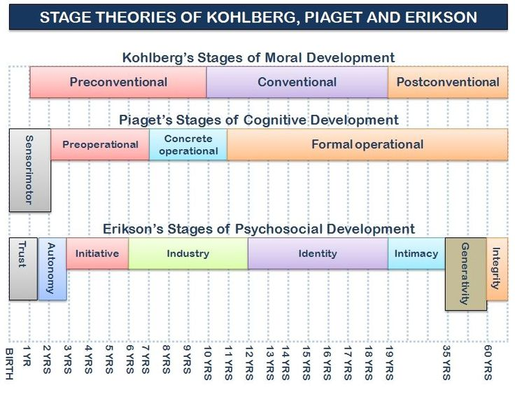
Stage versus Open-ended theories
Developmental theories

Slide 4
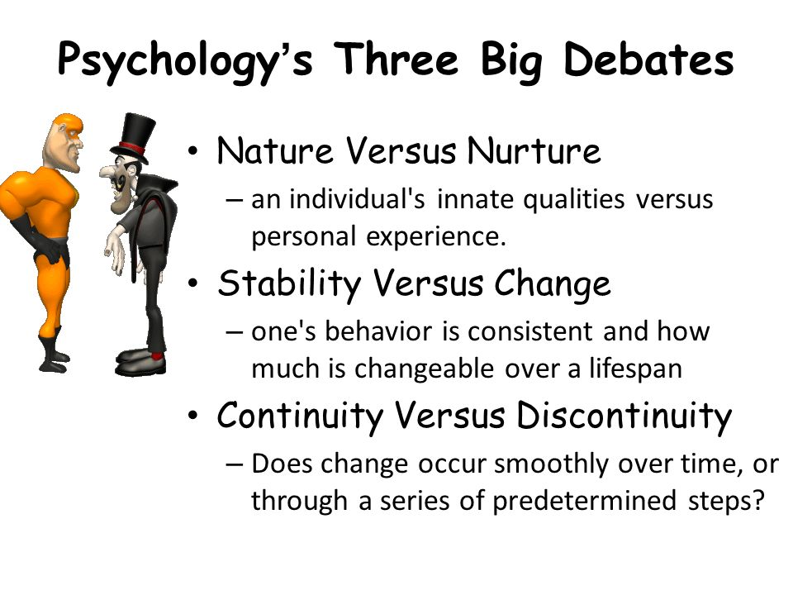
Continuity versus Discontinuity

Slide 5
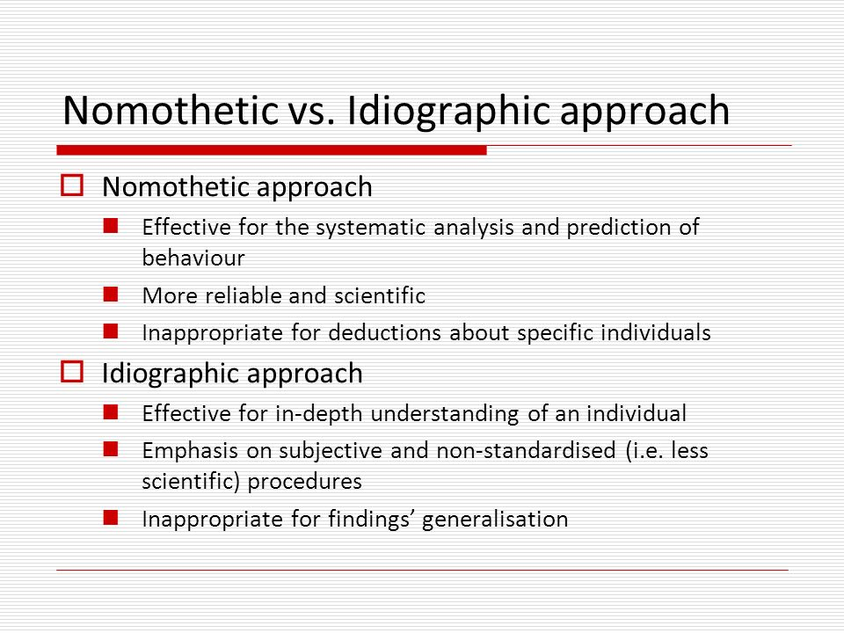
Idiographic versus Nomothetic perspectives on personality

Slide 6


Activity- Kindness Scavenger Hunt

Slide 7

Activity- Spreading Good Vibes and Kindness Only

Slide 8
CARL JUNG’S MODEL OF THE PSYCHE
Carl Gustav Jung was a Swiss psychiatrist whose research was deep-rooted in psychoanalysis.
He was greatly influenced by Sigmund Freud and even conducted research alongside him. Eventually, though, Jung disagreed with many of Freud's theories.
Jung is best known for his research in personality, dream analysis and the human psyche.
His theories are so revered that they were made into their own school of psychotherapy: Jungian psychology, which is also called analytical psychology.
For Yung, the psyche is the totality of all psychic processes, conscious as well as unconscious’, so we use the term ‘psyche’ rather than ‘mind’, since mind is used in common parlance to refer to the aspects of mental functioning which are conscious.
Jung maintained that the psyche is a self-regulating system (like the body).
The psyche strives to maintain a balance between opposing qualities while at the same time actively seeking its own development or as he called it, individuation.
The Human Psyche Model
The Ego- Jung saw the ego as the centre of the field of consciousness which contains our conscious awareness of existing and a continuing sense of personal identity. It is the organiser of our thoughts and intuitions, feelings, and sensations, and has access to memories which are not repressed. The ego is the bearer of personality and stands at the junction between the inner and outer worlds.
The Personal Unconsciousness-
The personal unconscious is a product of the interaction between the collective unconscious and the development of the individual during life. Jung’s definition of the personal unconscious is as follows-
“Everything of which I know, but of which I am not at the moment thinking; everything of which I was once conscious but have now forgotten; everything perceived by my senses, but not noted by my conscious mind; everything which, involuntarily and without paying attention to it, I feel, think, remember, want, and do; all the future things which are taking shape in me and will sometime come to consciousness; all this is the content of the unconscious”

Slide 9
CARL JUNG’S MODEL OF THE PSYCHE
The Collective Unconsciousness- The theory of the collective unconscious is one of the distinctive features of Jung’s psychology. He took the view that the whole personality is present in potential from birth and that personality is not solely a function of the environment, as was thought at the time when he was developing his ideas, but merely brings out what is already there. The role of the environment is to emphasise and develop aspects already within the individual.
The Self - For Jung comprises the whole of the psyche, including all its potential. It is the organising genius behind the personality, and is responsible for bringing about the best adjustment in each stage of life that circumstances can allow. Crucially, it has a teleological function: it is forward looking, seeking fulfilment. The goal of the Self is wholeness, and Jung called this search for wholeness the process of individuation, the purpose being to develop the organism’s fullest potential.
The Persona- This is a part of the personality which comes into existence ‘for reasons of adaptation or personal convenience’.One might say that one’s social success depends on having a reasonably well-functioning persona, one which is flexible enough to adapt to different situations, and which is a good reflection of the ego qualities which lie behind it.
The Shadow- The shadow is a complex in the personal unconscious with its roots in the collective unconscious and is the complex most easily accessible to the conscious mind. The shadow is an important aspect of our psyche and part of what gives depth to our personalities.
Anima and Animus-The next two complexes in the personal unconscious are perhaps the most difficult to understand and the most contentious. Jung conceived of there being at another psychic level a contrasexual archetype, designated as anima in the man and animus in the woman. These figures are derived in part from the archetypes of the feminine and masculine, and in part from the individual’s own life experience with members of the opposite sex beginning with mother and father. They inhabit the unconscious depths as a compensation for the one-sided attitude of consciousness and a way of rounding out the experience of belonging to one sex or the other.
Individuation-Jung called the search for wholeness within the human psyche, the process of individuation. It may be described as a process of circumambulation around the Self as the centre of personality. The person aims to become conscious of him or herself as a unique human being, but at the same time, no more nor less than any other human being.

Slide 10
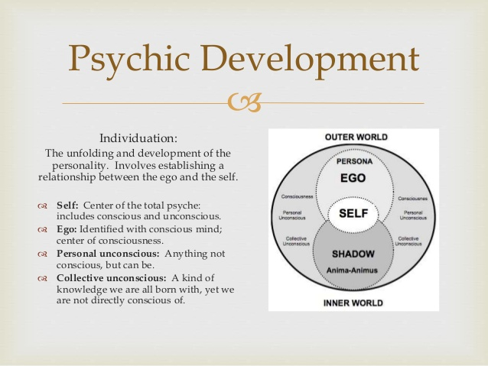
Static versus Dynamic theories

Slide 11

https://www.youtube.com/watch?v=KUWn_TJTrnU

Slide 12
Lesson 03-Seminar
Form small groups and discuss how psychological theoretical perspectives can be applied in health and social care research.
Present your research ideas as group.
Students are encouraged to debate and critique to validate research prospects.

Slide 13
References and Bibliography
Banyard, and Banyard, Philip. Essential Psychology. 2nd ed. 2015. Print.

