Slide 1

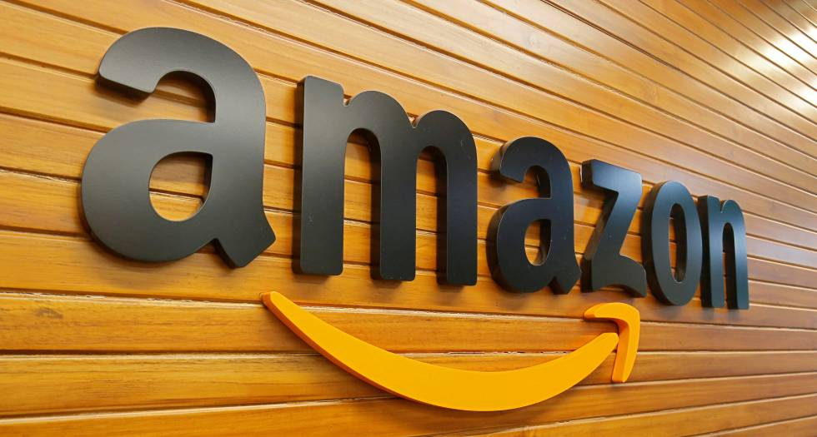
BMSW4003
Digital Skills and Research Methods
Amazon.com

Slide 2
Amazon.com
Student Name | Student ID | Topic
1. Fatima Haji | 1920011 | Introduction / conclusion & references.
2. Florentina Alistar | 1918688 | Background of the organization.
3. Madalina-Andreea Balasoiu | 1918689 | Challenges before introducing modern technology.
4.Vishal Singh Kaur | 1919031 | Insights of Modern Technology Introduced. (PP design)
5. Ionut Claudiu Paraschiv | 1918687 | Impacts of Modern Technology Introduced.
6. Eduard Dan Vaida | 1915904 | Lessons drawn from the case study.
Name of the Lecturer: Dr Olusoyi Ashaye
Name of the University: University of Wales Trinity Saint David
Presentation date: 22 August 2020

Slide 3

Amazon.com
Table of Contents
INTRODUCTION
BACKGROUND OF THE ORGANIZATION
CHALLENGES BEFORE INTRODUCING MODERN TECHNOLOGY
INSIGHTS PF MODERN TECHNOLOGY INTRODUCED
IMPACTS OF MODERN TECHNOLOGY INTRODUCED
LESSONS DRAWN FROM THE CASE STUDY
CONCLUSIONS & REFERENCES
Q&A

Slide 4

Introduction
Our presentation is about Amazon we are going to give you insights on Amazon
And what they do and how they do.
Amazon is a American multinational technology company based in Seattle, Washington.
Amazon is considered one of the Big Four Technology companies.
Technologies are the largest part of a modern business organisation like Amazon.
Amazon mainly deals with modern technologies like cloud computing, AI (Artificial Intelligence), e-commerce and digital streaming. It provides the rationale, discusses the academic literature in relation to the issue.
However, there are some significant challenges faced by this organisation before introducing advanced technologies.

Slide 5


Background of the organization
History of the organization:
According to Mc Faden (2019), Amazon was registered for the first time on 1st of November 1994. The founder of the company is Jeff Bezos. At first Amazon was an online book store. Amazon was originally created under the name Cadabra (from Abracadabra). Bezos tried different name like Awake.com, Browse.com and Bookmall.com
Company had a very big success because the model their choose to deliver their product was online directly to the customer.

Slide 6
Aim and objectives:
In this article Pramley (2018) says that Amazon was considering that Target Corp to take over the company, although this is not the only target they have. Amazon started “Amazon smart home experience” where customer can buy smart home devices and services directly from the giant platform.
Amazon aims to be one-stop shop with free food deliveries “. In this article Armstrong (2020) says that Amazon founder Jeff Bezos, has and ambition to increase the online retailer’s dominance in the food delivery market. During this pandemic of corona virus, while we were in lockdown, people start buying more goods over the internet. In the last 4 months of pandemic their profit grows up to 14 per cent, considering that in the last 22 years they get up to 7 per cent. At the moment Amazon have a one-hour grocery service with Morrisons on Prime Now App.

Slide 7
Mission and vision of the organization
According to Gregory (2019) mission and vision contribute to the Amazon company as the largest online retailer in the world. Amazon has very good goals and guides strategic management. Based on this statement Amazon mission focus on effective and high-quality services. They are looking for the company to have success for long term, developing strategies against other companies like Google, eBay, Apple, Walmart and Costco Wholesale.
Scope & Purpose
According to Hartman’s (2020) Bezos knew from beginning that he wants his store to be “an everything store” and he is keep trying the best to do it.

Slide 8
Current status & Services
According to Rouse (2014) Amazon the biggest online retailer in the world started from an online book store. At the moment it expands to sell a lot of variety goods, digital media also is a prominent cloud service provider and web services. Company has their own electronic devices, such as e-book reader, Kindle Fire tablet and Fire TV, a streaming media adapter.
Amazon has his main location in Seattle, Washington. At the moment they are holding a website, software development centres, customer service centre and fulfilment centre around the world.

Slide 9


Challenges before introducing modern technology
Making staffs capable of adapting with the technologies
Although technologies are being introduced by the top authority of the organization like Amazon, it is being operated and managed by the staffs and employees (Murashbekov et al., 2019).
In this case, employees of Amazon need special training to operate modern technologies like cloud computing and AI.
For example, in 2008 Amazon has introduced a cloud computing system and before this, it has provided training to 765 staffs to operate this technology (Amazon, 2020).

Slide 10
Capital requirement
High volume of capital requirement is another big challenge for introducing modern technologies.
Amazon spends more than 27% of its total spending on the introduction and the implementation of modern technologies.
It is also challenging for this organization to capitalize a large volume of capital on these modern technologies (Amazon, 2020).

Slide 11
Continuous change or update of the modern technologies
Another big challenge of introducing modern technology is to facilitate the continuous improvement or change management of the technologies.
A modern business organization like Amazon also needs to update advanced technologies continuously.
This is another key challenge for Amazon to introduce as well as to maintain modern technologies within the organizational functions.
Before introducing modern technology, Amazon needs to forecast possible change that is not easy as well as challenging for this organization.

Slide 12
Resistance to changes
By nature, most of the human being is not willing to accept change (Demina et al., 2020). Most of the employees of Amazon are also give their opinion or show resistance to the change.
In this case, introducing new technologies are being resistance by the existing employees of Amazon (Grubor et al., 2020).
For example, before introducing AI Amazon has surveyed the employees whether it should introduce AI within the organization.
Among the employees, 65% were interested to introduce AI within Amazon but the rest of the 35% were against the introduction of the AI (Amazon, 2020).
However, still, a big portion is resisting modern technologies within this organization that are working as a challenge for Amazon before introducing modern technologies.
Overcoming this concept is another key challenge faced by Amazon before introducing modern technologies.

Slide 13


Insights of Modern Technology Introduced
Amazon Robotics
Definition of Amazon Robotics
Amazon.com acquires Kiva Systems in march 2012* for $777 million.
Is a company that manufactures mobile robotic fulfilment systems based in Massachusetts, but the company officially changed its name from Kiva Systems LLC to Amazon Robotics LLC in August 2015.

Slide 14
Characteristics of Amazon Robotics
The robots (Kiva) make a big difference from regular machinery, Robots can adapt to the variations in the environment and to errors in prior performance, usually function by themselves and are very sensitive to their environment.
Each of them is task oriented and they have the ability to try different methods to complete the task. It’s not humans vs. robots, it’s humans + robots, humans and robots work harmoniously to get packages to customers on time.

Slide 15
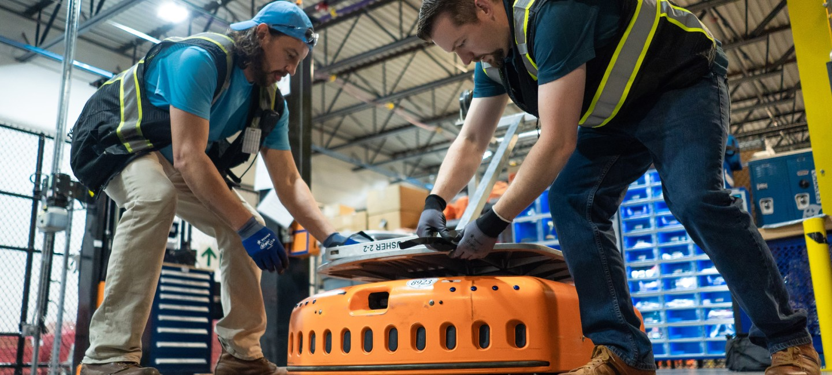
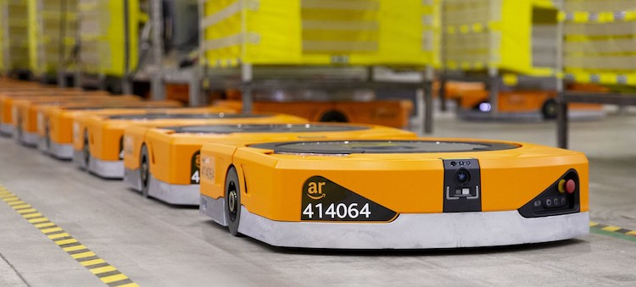
Models of robots:
There is two different robot models:
• The smaller model approximately 2 feet by 2.5 feet, and 18 inches high capable of lifting 1.000 pounds.
• The larger model capable of carrying a pallet of 3.000 pounds heavy loads. The maximum velocity of the robots is 1.3 meter per second, the bots are battery-powered and need to be recharged every hour for five minutes.

Slide 16
Advantages/Disadvantages of Kiva Systems:
The efficiency and safety at fulfilment centres increase a lot introducing the robots. They make it possible to store 40 percent more inventory and a significant contribution in Amazon’s drive to deliver a smarter, faster and more consistent customer experience, making easier Amazon Prime and other orders fulfil on time and it’s less likely an item will run out.
• Amazon has added more than 300,000 full-time jobs globally, including positions in IT and in servicing and maintaining robots.
• The products label must be in the right site and clearly readable, if the robot can’t read the label will show an error and need assistance. They are very expensive, they going to need maintenance. They have to hire people specially trained on the automated systems.

Slide 17

Importance of Robotics technology:
• Robotics has the potential to positively transform lives and work practices, influences every aspect of work and home, raise efficiency and safety levels and provide better levels of service.
• Is the key driver of competitiveness and flexibility in large scale manufacturing industries.
• Without robotics many of Europe’s successful manufacturing industries would not be able to complete from their current European bases of operation.

Slide 18


Impact of modern technology introduced
Amazon Robotics
Positive impacts:
According to Rey (2019) Amazon is using robotics that in one day will have a huge impact in warehouse industry. This robot is capable of reading barcodes and carry shelfs of products.
With this facility Amazon have the possibility to create a warehouse of robotics for the future, and the only human that will work in it will be the one who will help maintain and fix the automatic robots.
Also, Rey (2019) relate that the good thing about robotic use at Amazon, it helping the warehouse workers to remain stationary on they work station more comfortable, rather than walk up and down the aisle.
So those who work in a warehouse with robotic facility have an easy job regarding carry and lifting heavy parcels. Rey (2019) in his article describe that one amazon spokesperson says that this technology helps the company to store more inventory up to 40 percent.
(Brien,2019) says that without this robotic technology use, the company could not fulfil the consumer demand for packages that they can have it next day on their door steps.

Slide 19
Negative impact:
According to Rey (2019), along with robotic use, comes more expectation from workers. As robots can pick up things much faster, workers have higher target and Amazon expect from workers to develop better skills.
(Brien, 2019), says in his article that soon or latter Amazon will have a warehouse that will replace human workers with robotics. At the moment warehouses that operated by robotics are giving more pressure and work to the workers, even if they get trained to work along with robotic their standard are set to high to human capability comparing to robotic.
(Brien,2019) says in his article that amazon warehouse that use robotic technologies are reporting more injuries then those without.
According to Silverman (2019), critics and advocates are worry that automatic robots will replace totally the human work and that this are unsafe working environment. (Silverman,2019) 6 workers have died in U.S Amazon since November 2018 and 13 have died since 2013, according to this article.

Slide 20
Lessons drawn from the case study
Modern techniques are important to organizations such as amazon as it improves the overall experience for the customer.
By using modern techniques amazon can ensure that people can get their goods faster, they feel secure when giving out their payment information and makes their experience shopping with amazon stress free.
They have combined lots of different areas of shopping and made this available under 1 roof.
They are constantly evolving and looking for the latest software to unsure they can make their efficiency even better.
If amazon were to stop continually trying to improve, it will fall behind their competitors and the public will begin to shop elsewhere. By being a leader in the online shopping industry and always being first to introduce a new way of shopping or receiving goods they keep their label as the market leader.

Slide 21
When Jeff Bezos started the company, a former Wall Street hedge fund executive, incorporated Amazon.com, choosing the name primarily because it began with the first letter of the alphabet and because of its association with the vast South American river. On the basis of research, he had conducted, Bezos concluded that books would be the most logical product initially to sell online. Amazon.com was not the first company to do so; Computer Literacy, a Silicon Valley bookstore, began selling books from its inventory to its technically astute customers in 1991. However, the promise of Amazon.com was to deliver any book to any reader anywhere.
While Amazon.com famously started as a bookseller, Bezos contended from its start that the site was not merely a retailer of consumer products. He argued that Amazon.com was a technology company whose business was simplifying online transactions for consumers.

Slide 22

Conclusion
A modern business organization like Amazon cannot stand without the help of modern technologies.
Although it is challenging for them to introduce advanced technologies, it can provide long term competitive advantage to the business.
providing special training, the high volume of capital requirement, continuous change management, professional development, security and operating skills, resistance to change among the staffs are the key challenges faced by Amazon before introducing modern technologies.

Slide 23


References
A Very Brief of Amazon: The Everything Store
By Christopher McFadden. November 02, 2019
https://amp.interestingengineering.com/a-very-brief-history-of-amazon-the-everything-store.
Suzette Parmley. The Philadelphia inquired (1969), 2018-02-04
Armstrong, Ashley. The Time; London(UK) 29 July 2020.
Amazon.com Inc.’s Mission Statement & Vision Statement(an Analysis) by Lawrence Gregory. February 13, 2019
http://panmore.com/amazon-com-inc-vision-statement-mission-statement-analysis
Avery Hartman's, July 2020. http://www.businessinsider.com/jeff-bezos-amazon-history-facts-2017
What is Amazon? By Margaret Rouse. 2014 https://whatis.techtarget.com/definition/Amazon
Murashbekov, O., 2019. CHALLENGES ON INTRODUCING INFORMATION SECURITY STANDARDS: A CASE STUDY. Journal of Security & Sustainability Issues, 8(4).
Amazon.com. 2020. Amazon. [online] Available at: https://www.amazon.com/
Demina, E., Atemaskina, Y., Kazyuk, N. and Mikova, M., 2020, January. Problems of Introducing Modern Technologies into the Practice of Preschool Education. In International Scientific and Practical Conference on Education, Health and Human Wellbeing (ICEDER 2019). Atlantis Press.
Grubor, A., Končar, J. and Marić, R., 2020. Challenges of introducing intelligent packaging to the retail market of AP Vojvodina. Strategic Management, 25(2), pp.18-26.

Slide 24

How robots are transforming Amazon warehouse jobs-for better and worse. By Jason Del Rey, on December 11,2019 8:00 am.
http://www.vox.com/recode/2019/12/11/20982652/robots-amazon-warehouse-jobs-automation
As robots slowly take over Amazon’s warehouses, are they causing more harm tan good?
By Matt O'Brien, Monday 30 December 2019, 12:12
https://www:independent.co.uk/news/business/rebots-amazon-delivery-artificial-intelligence-technology-a9264036.html.
How humans and robots work side-by-side in Amazon fulfilment centre. By Ellie Silverman, June 19,2019.
https://phys.org/news/2019-06-humans-robots-side-by-side-amazon-fulfillment.html.

Slide 25


Questions and Answers

