Slide 1

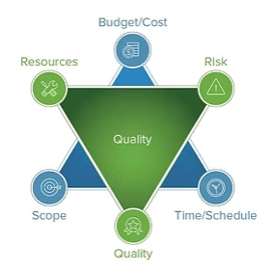
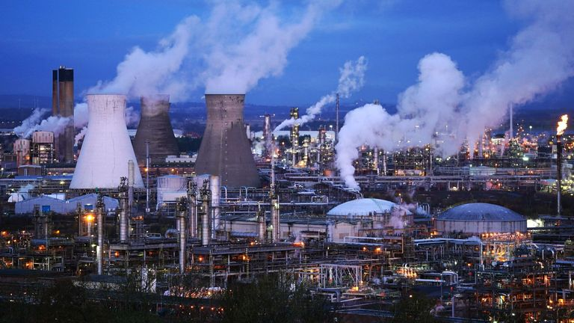
Modern Methods of Construction (MMC) in UK Chemical Manufacturing
Joseph Goodrum | ACBA5024 – Research Project Design
Introduction
What impact do MMC have on risk, quality, and resources in UK chemical manufacturing projects?
Why???
(Systec Construction, no date)
Iron triangle
Scope
Cost
Time
Risk
Quality
Resources
(Infogram, no date)
Literature review
Modern Methods of Construction (MMC) comprise modular and off-site fabrication, automation and digitalisation (e.g., BIM) to improve efficiency and predictability versus traditional vernacular construction.
Literature links MMC to better performance across the iron triangle: shorter durations via parallel off-site manufacture and improved cost predictability through early coordination and BIM-enabled clash detection.
Quality can improve through factory-controlled conditions, standardisation and stronger documentation/traceability—important for COMAH-regulated chemical facilities.
MMC may reduce risk and exposure by minimising on-site work but can introduce logistics and supply-chain risks.
MMC could alleviate skill shortages and gaps yet requires new digital/manufacturing capabilities and organisational readiness.
Sustainability benefits include reduced waste and embodied carbon; long-term operational impacts in chemical manufacturing remain under-studied.
A clear research gap persists with limited UK, industry-specific evidence and case studies on MMC effects in chemical manufacturing.
Methodology
Approach: Mixed-methods design combining qualitative case-study review with quantitative/structured comparisons from project records.
Case studies: Five MMC case-study taken from chemical manufacturing environment are reviewed and identify MMC techniques and the traditional methods they replace.
Sampling: UK projects only; site projects identified via an SAP download, filtered to construction project codes (excluding maintenance) and limited to completed projects from the last three years.
Survey: Sent via Outlook to construction leaders/managers/supervisors to confirm the MMC definition, select relevant MMC techniques, and identify if these had positive or negative influences.
Comparison: Builds two matched project lists (MMC vs traditional) and compares selected activities using qualitative and quantitative data sets.
Figure 1. chemical plant closures
 | Sep | Oct | Nov | Dec | Jan | Feb | Mar | Apr | May | Jun
High level question
Define research question
Complete aims and objectives
Complete literature review
Compose methodology
Compose surveys
Review data
Complete synthesis
close research project
Figure 2. iron triangle
Aim & Objectives
The aim of this research is to evaluate the effects of modern methods of construction have on the number and skills of resources, the quality of the tasks completed using MMC, and the project risks when using MMC on projects undertaken in a COMAH manufacturing facility.
To identify projects that use MMC and what the MMC have been used in lieu of traditional construction activities in a COMAH chemical manufacturing facility.
To Compare the effect of using MMC compared to traditional construction on a high hazard construction activity in terms of resources.
To evaluate the effect of using MMC on activities within a construction project in terms of the effect on controlling risk on a construction project.
To Evaluate the effect of MMC compared to traditional construction on construction activities in terms of the quality of the completed work.
Figure 3. chemical plant
References
Infogram (no date) European plant closures map [Infographic]. Available at: https://infogram.com/european-plant-closures-map-1hxj48mr8orrq2v (Accessed: 28 April 2026).
Systec Construction (no date) The triple constraint or iron triangle in project management [Image]. Available at: https://www.systec-construction.com/post/la-triple-restriccion-o-triangulo-de-hierro-en-la-gestion-de-proyectos-1?lang=en (Accessed: 28 April 2026).
Sky News (2021) Christmas cheer for Britain's biggest chemical plant but there are two distinct problems [Image]. Available at: https://news.sky.com/story/christmas-cheer-for-britains-biggest-chemical-plant-but-there-are-two-distinct-problems-13484563 (Accessed: 28 April 2026).

