Slide 1
Writing the research Proposal
Week 10 – Last Lecture
Dr Roisin Mullins
Notes:
The proposal is a summary of a piece of research that could take place in the future.
The document indicates what will be done.
At the point of writing a proposal you do not actively engage in any primary collection of data.
It is a type of scoping document where you report what area is of interest, what issue needs to be addressed and why, what you intend to do, what methods will you use, what timeline will be required.

Slide 2
Learning Objectives
By the end of this Session, you will be able to:
Identify the components of successful research proposals.
  appreciate the importance of your decisions and justification when designing research
  need to achieve methodological coherence throughout your research design;
  understand the differences between quantitative, qualitative and mixed methods and choose between these;
  identify the main research strategies to choose from among these to achieve coherence throughout your research design;
  consider the implications of the time frames required for each stage;
  consider some of the main ethical issues implied by your research design;
  take into account the constraints of your role as researcher (limitations).
Write clear research objectives, theoretical backgrounds and methodologies.
Prepare a proposal for a dissertation.
Notes:
You ned to have identified an are that needs to be studies.
You need to know what methods will be suitable to address the question.
Use research terms appropriately.
What research strategy – methods associated with each paradigm and how you will address this through sampling, address bias ethics etc.
What timeline will you allow for each stage of the research (e.g. desk research (months?) , design of interview, design of survey, live data capture (months),
This is good practice for next year, as next year before you embark on your Independent project, the Dissertation you will have to produce a proposal for your supervisor so that the study can be confirmed for you to begin, and you will have to submit the ethics form as well.

Slide 3
Research Proposal
A document (report) in which you explain the background and rationale for carrying out a piece of research, and your plans for the research.
It allows funders or supervisors to assess the value and feasibility of your project before you begin.
Note **
A research proposal must be accompanied by a new ethics form. (you must complete this for your assignment 2 and upload as well).

Slide 4
Research proposal Structure
Title
Introduction
  outline the topic area and question, aim and objectives
  brief literature review (identify any relevant theories)
Detailed strategy explaining what choice of research methods, what data will be collected and how access to data sources will be obtained (sample, consent, bias) – refer to the research terminology.
Realistic timetable for completion (Oct –April 2022), show key activities and when to complete (Gantt chart slide 19)
Discussion of logistical and ethical considerations
(reliability / validity)
Limitations of the proposed research
References
Notes:
Take care to writ the topic clearly.
The question must also be clear and understandable.
For example –
An investigation into benefits of maintaining personal fitness in an outdoor environment and how this contribute towards overall well-being.
What are the associated benefits of maintaining personal fitness levels within an outdoor environment and how can this contribute towards an individual’s overall well-being?
Objectives
Review the literature to determine studies that have indicated the associated benefits of maintaining personal fitness levels
Determine the positive impacts that occur when spending time connecting with outdoor environments.
Assess the fitness levels (within outdoor environments) and relationship with an individual’s overall well-being.
Investigate the possible link between maintaining fitness levels and well-being using a mixed methods research approach (qualitative and quantitative) to gather rich and appropriate data.
Critically analyse the quantitative research findings using specialist data analysis software (SPSS) and apply Braun and Clark’s (2006) thematic analysis technique for the qualitative data analysis.
Interpret and evaluate the findings in light of current research.
Include a Gantt chart – see an example on slide 18 – very important to state when each activity will start and end. Some activities will overlap.

Slide 5
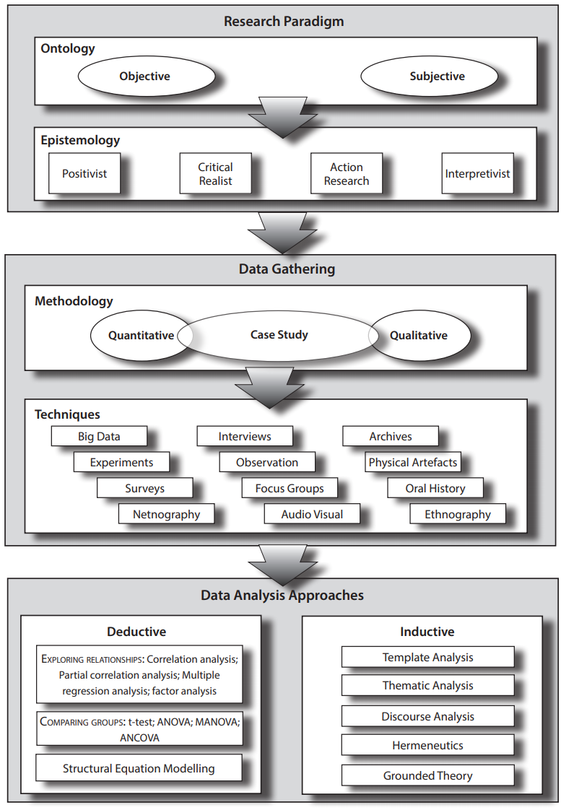
Week 3 and 4
Left side of Research Terms
Map
Orange lines are terms associated with Assignment 1
Part 2
week 1 and 2
right side of research terms
map
blue lines are terms associated with assignment 1
part 1
In your proposal use the research terms
appropriate to the type of study
you intend to undertake

Slide 6
Tips for good proposals
Very clear research question and aims: the reviewer should understand exactly what you want to find out.
Clear use of research terms.
Clear and sound theoretical basis.
Justification for methodology: why is this the best way to find out what you need to know?
Detailed methodology.

Slide 7
Tips for proposals, cont.
Thoughtful discussion of ethical considerations and limitations of research.
Discussion of reliability and validity of results.
Realistic timetable.
Good value for money (important if budget is being requested only).

Slide 8
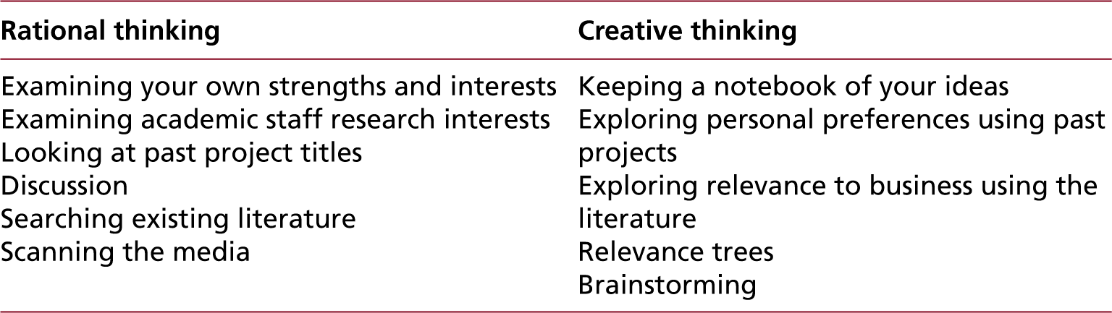
Table 1 - More frequently used techniques for generating and refining research ideas
The starting point is here – things to think about before you decide you research topic.
So what area do you have you an interest in, and is there something you enjoy that you want to know more about in that area?
Saunders, M., Lewis, P., Thornhill, A. & Bristow, A., (2016). Research Methods for Business. 7th ed. Harlow: Pearson.
Notes:
You embark on research because you want to answer a question. It should be an enjoyable experience. You don’t quite know what the answer will be so you are keeping an open mind and being as careful and thorough in your research design to get the best out of your study. Usually in a business or educational environment you would present your proposal to others who will have questions about why you ntend to do this did this, or will not do that. So you have to have shown you understand the current literature, what has been done, where there is a gap, and why this is a relevant area to address. In doing this you show you understand the literature and are able to provide a rational, or justification for your proposed research study.

Slide 9
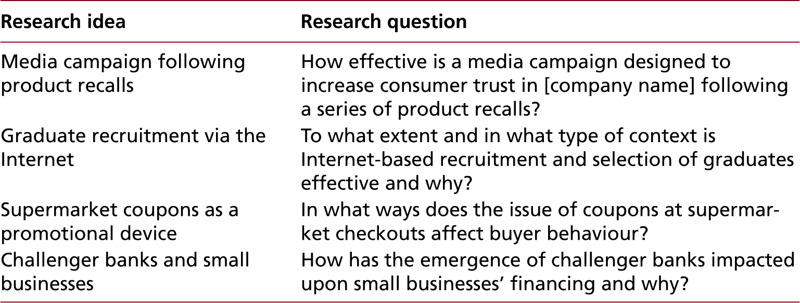
Table 2 - Examples of research ideas and resulting general focus research questions
Next step –
Once you have decided on the area that interest you.
Then write out the main question you want to address.
Saunders, M., Lewis, P., Thornhill, A. & Bristow, A., (2016). Research Methods for Business. 7th ed. Harlow: Pearson.
Notes:
It is a useful style to create a table and reduce the main topic to a number of different questions. Settle on one main question to explain in a proposal how that question would be addressed.
e.g. To examine whether outdoor instructors have a lasting impression on participants sustainability and ecological literacy.
Sense of place, connectedness, role models, environmental knowledge, etc

Slide 10
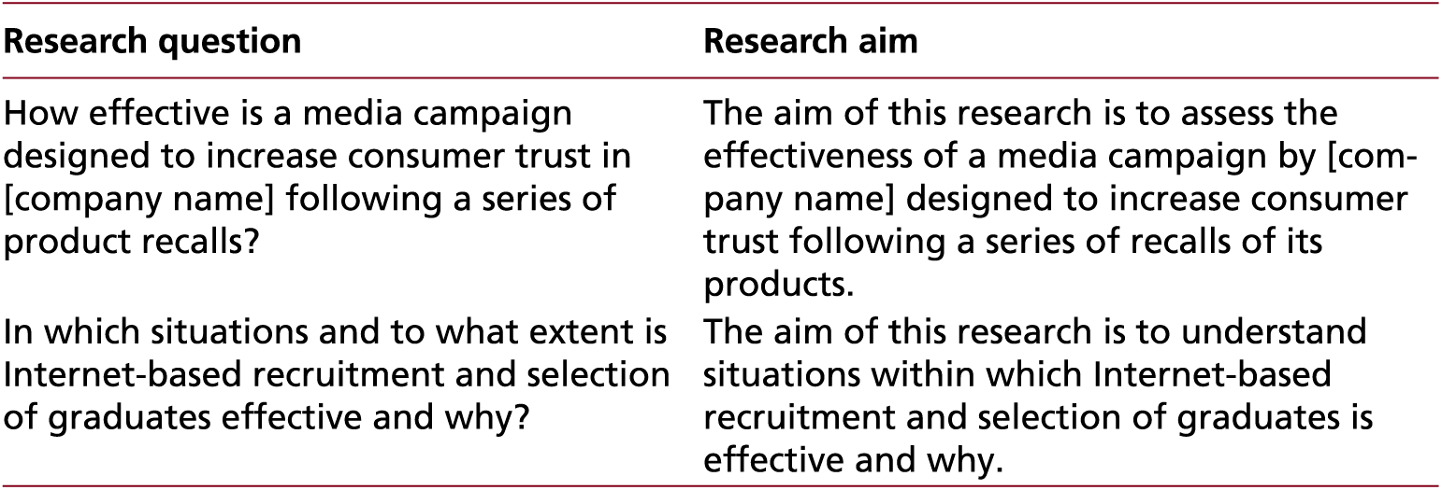
Table 3 - Examples of research questions and related research aims (1 of 2)
Next step –
Once you have decided on the main question to address. Convert that into the Aim for the research study.
Saunders, M., Lewis, P., Thornhill, A. & Bristow, A., (2016). Research Methods for Business. 7th ed. Harlow: Pearson.
Notes:
Now in another table convert the question into an aim. So restating the question
To develop something,
To critically examine something
To evaluate something
So higher level descriptors of your intentions

Slide 11
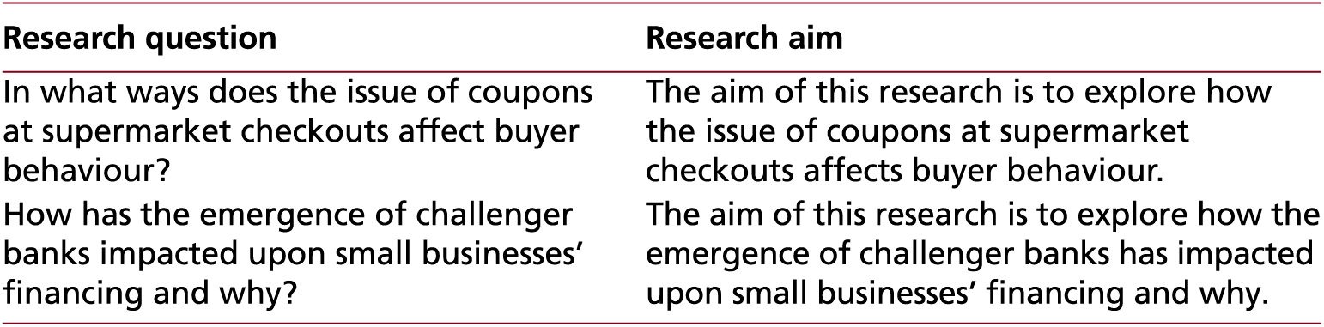
Table 4 - Examples of research questions and related research aims (2 of 2)
Same step –
More examples of how to convert the main question into the Aim for the research study.
Saunders, M., Lewis, P., Thornhill, A. & Bristow, A., (2016). Research Methods for Business. 7th ed. Harlow: Pearson.

Slide 12
Objectives
Next step –
The aim will be achieved through carefully planned objectives.
These are the things you will do to achieve the study aim and address the research question.
  Write these as bullet points
  Start each objective as a verb.
  Objectives are actions. Best not to have more than 6 objectives for a level 6 proposal. Some examples
    Review the literature on….
    Assess the status of ….i.e. elderly taking exercise…
    Determine the reasons for …..
    Explain and evaluate the results …
    Propose a model / framework / set of guidelines to encourage elderly taking exercise …..

Slide 13
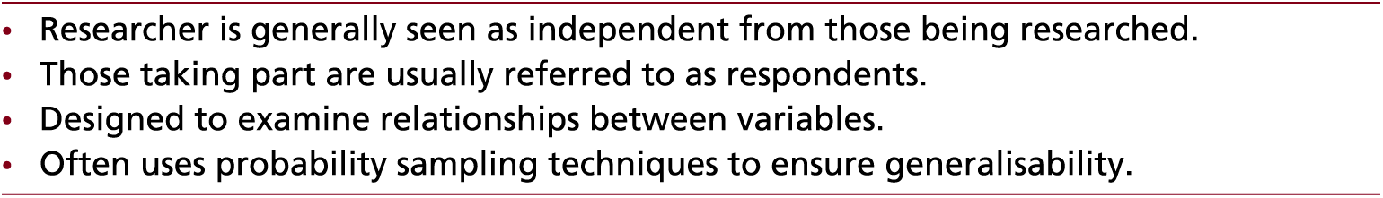
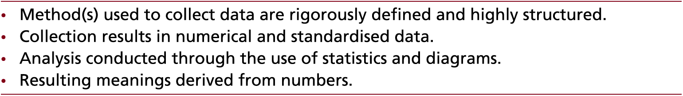
Table 5 - Characteristics of quantitative research
If you intend to design a questionnaire – online survey this would allow you to collect data for analysis - positivism
You would report what tools would be used for the survey design and the data analysis – Forms for Excel and SPSS etc
Saunders, M., Lewis, P., Thornhill, A. & Bristow, A., (2016). Research Methods for Business. 7th ed. Harlow: Pearson.

Slide 14
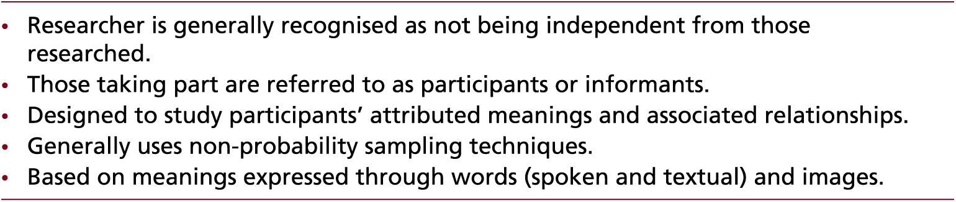
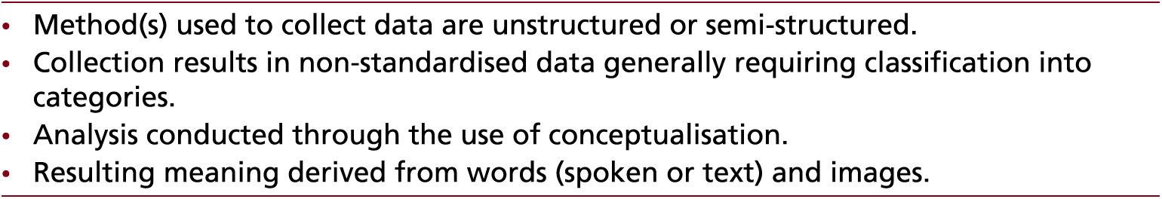
Table 6 - Characteristics of qualitative research
If you intend to design an interview – Interpreting a phenomenon then qualitative research is the approach to collect data for interpretation
You would report the techniques to use for the data gathering (questionnaire / interviews), as well as the analysis - the interpretative technique – Thematic Analysis etc
Saunders, M., Lewis, P., Thornhill, A. & Bristow, A., (2016). Research Methods for Business. 7th ed. Harlow: Pearson.

Slide 15
Mixed methods
It is of course possible to use mixed methods.
  E.g. the study may include a survey as well as use an interview process.
You may follow a qualitative and quantitative paradigm and used a variety of methods.

Slide 16
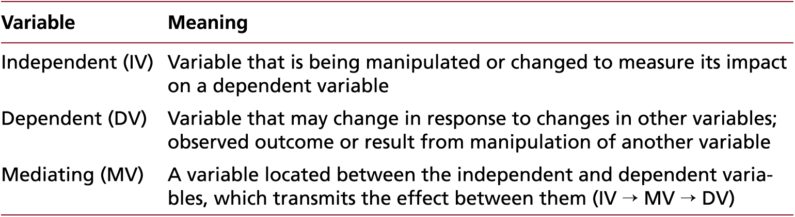
Table 7 - Types of variable
Next step
If you are using quantitative approach, then think about the design of the questions carefully, so that you can code them numerically to allow analysis.
Think about the relationships between questions (variables) . Think about how you want to use descriptive and inferential statistics on the data.
Saunders, M., Lewis, P., Thornhill, A. & Bristow, A., (2016). Research Methods for Business. 7th ed. Harlow: Pearson.
Notes:
Independent variable (X) Nominal - Gender ( M / F )
Dependent variable (Y) Ordinal – skate board ownership ( Y / N )
The independent variable is the one the researcher will experiment with i.e. will change to see the change on the dependent variable.
Independent – types of beverage consumed –(non alcohol vs alcohol)
Dependent – measures of anxiety, mood, life satisfaction, energy levels, brain wave activity, …

Slide 17
Table 8 - Threats to reliability
Next step
If you are using quantitative approach, then think about the reliability of your study.
Reliability - the extent to which you would generate similar results by repeating your research multiple times under the same conditions.
Threat | Definition
Participant error | Any factor which adversely alters the way in which a participant performs.
Participant bias | Any factor which induces a false response.
Researcher error | Any factor which alters the researcher’s interpretation.
Researcher bias | Any factor which induces bias in the researcher’s recording of responses
Saunders, M., Lewis, P., Thornhill, A. & Bristow, A., (2016). Research Methods for Business. 7th ed. Harlow: Pearson.
Notes:
Are the questions clearly stated, if you used an instrument or device was it tested beforehand –
Was data lost, inputted incorrectly
Did the researcher ask additional questions during the survey that influenced the participants response

Slide 18
Table 9 - Threats to internal validity
Next step
Validity - how well a research method yields findings that accurately represent some underlying reality. If you are using quantitative approach, then think about the validity of your study.
Threat | Definition
Past or recent events | An event which changes participants’ perceptions.
Testing | The impact of testing on participants’ views or actions.
Instrumentation | The impact of a change in a research instrument between different stages of a research project affecting the comparability of results.
Mortality | The impact of participants withdrawing from studies.
Maturation | The impact of a change in participants outside of the influence of the study that affects their attitudes or behaviours etc.
Ambiguity about casual direction | Lack of clarity about cause and effect.
Saunders, M., Lewis, P., Thornhill, A. & Bristow, A., (2016). Research Methods for Business. 7th ed. Harlow: Pearson.
Notes:
How feasible the results reflect the situation. i.e. COVID19 data may be different to other data collected in similar setting.

Slide 19
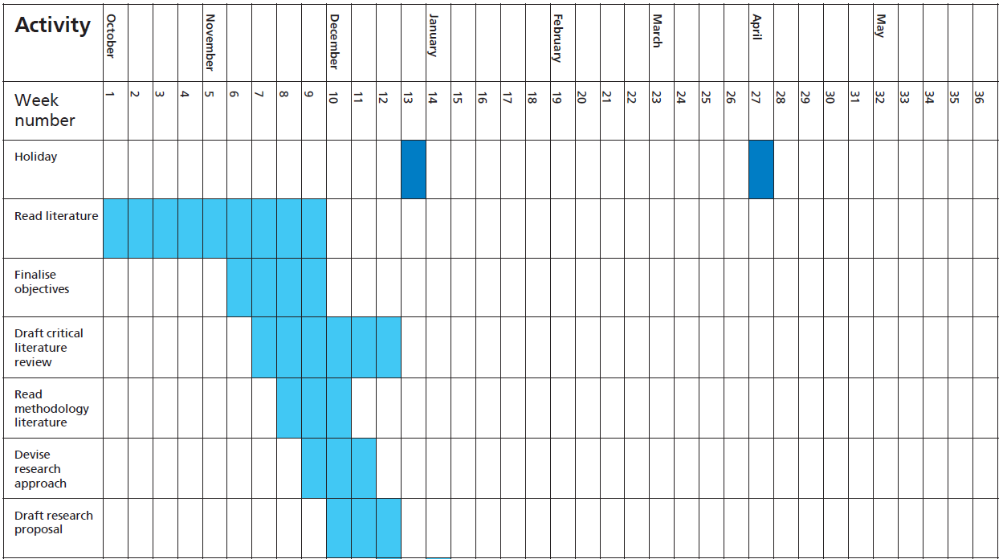
Gantt chart for a research project
Next step
Each stage in your study should have a timeline associated with it. This is called a Gantt chart. You can create this in Excel. It is allowable to have overlapping stages (tasks) over time. For example you may be doing a literature review each month during the study. Where as the methods only occur for a specific period of time. Your timeline for a prosed study would be October 2020-May 2021
Saunders, M., Lewis, P., Thornhill, A. & Bristow, A., (2016). Research Methods for Business. 7th ed. Harlow: Pearson.

