Slide 1
A three week training block focusing on tackle development
Sam Potter
2305965
BMSS6001

Slide 2
What will be discussed?
Aims and objectives
Theories
The content of the three sessions in the block

Slide 3
Aims and Objectives
Help increase confidence
Develop safe, effective technique
Apply the correct technique in dynamic, decision making situations
Apply the skill into realistic game scenarios

Slide 4
Theories
Bandura (1997) Social Learning Theory
Dewey (1938) Experiential Learning Theory
Fitts & Posner (1967) Stages of Motor Learning
B.F. Skinner (1953) Behaviourism
Vygotsky (1978) Social Development

Slide 5
Content of Session 1
Warm Up
Contact Prep
Two drills and a touch game
Resources: Cones, Balls, Tackle shields, Bibs

Slide 6
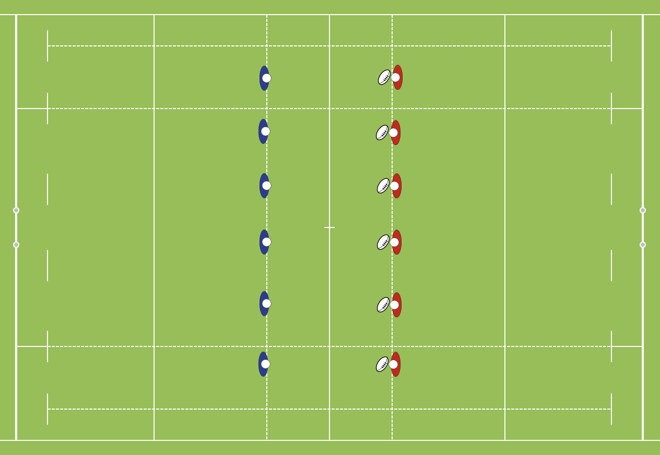
Activity 1
Technique work
1v1

Slide 7
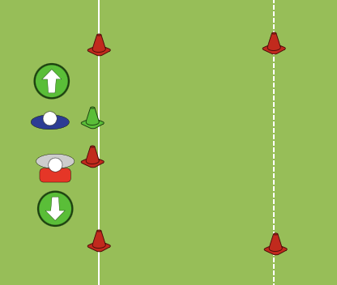
Activity 2
Tracking the man
1v1

Slide 8
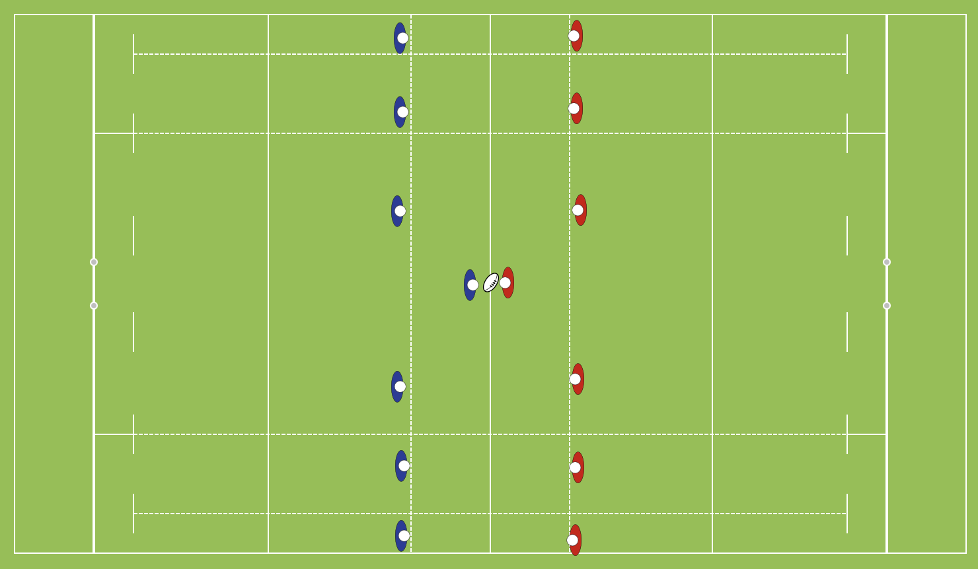
Game

Slide 9
Content of Session 2
Warm Up
Contact Prep
Three drills
Resources: Cones, Balls, Tackle shields, Bibs, Crash Mats

Slide 10
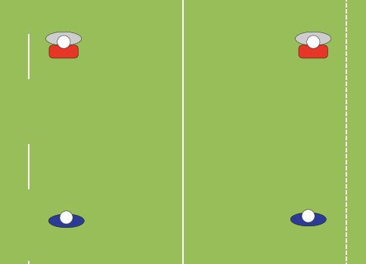
Activity 1
Crash
mat
Crash
mat
Completing the tackle
1v1

Slide 11
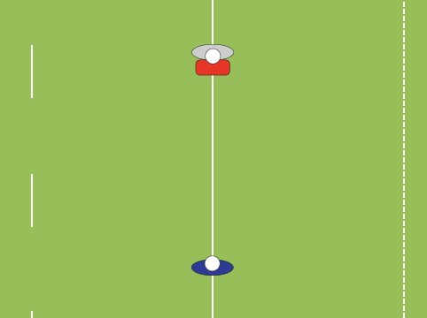
Activity 2
Crash
mat
Crash
mat
Decision making
1v1

Slide 12
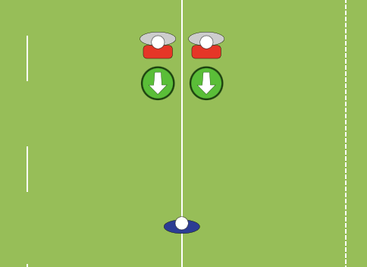
Activity 3
Crash
mat
Crash
mat
Decision Making

Slide 13
Game

Slide 14
Content of session 3
Warm Up
Contact Prep
Two drills and a touch game
Resources: Cones, Balls, Tackle shields, Bibs,

Slide 15
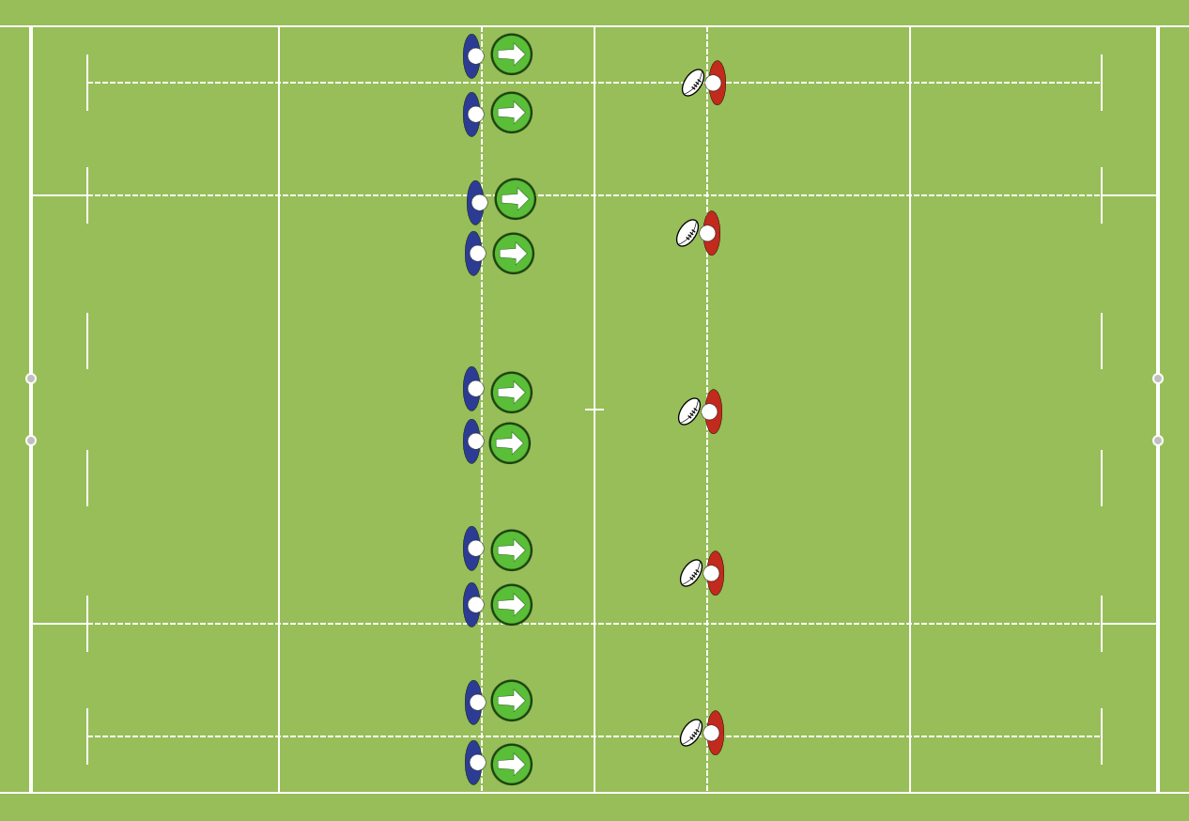
Activity 1
Learning
Two man Tackle (2v1)

Slide 16
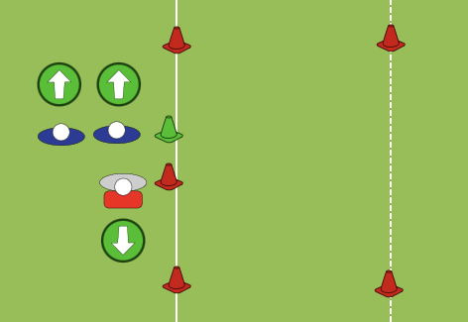
Activity 2
Two man Tackle
2v1

Slide 17
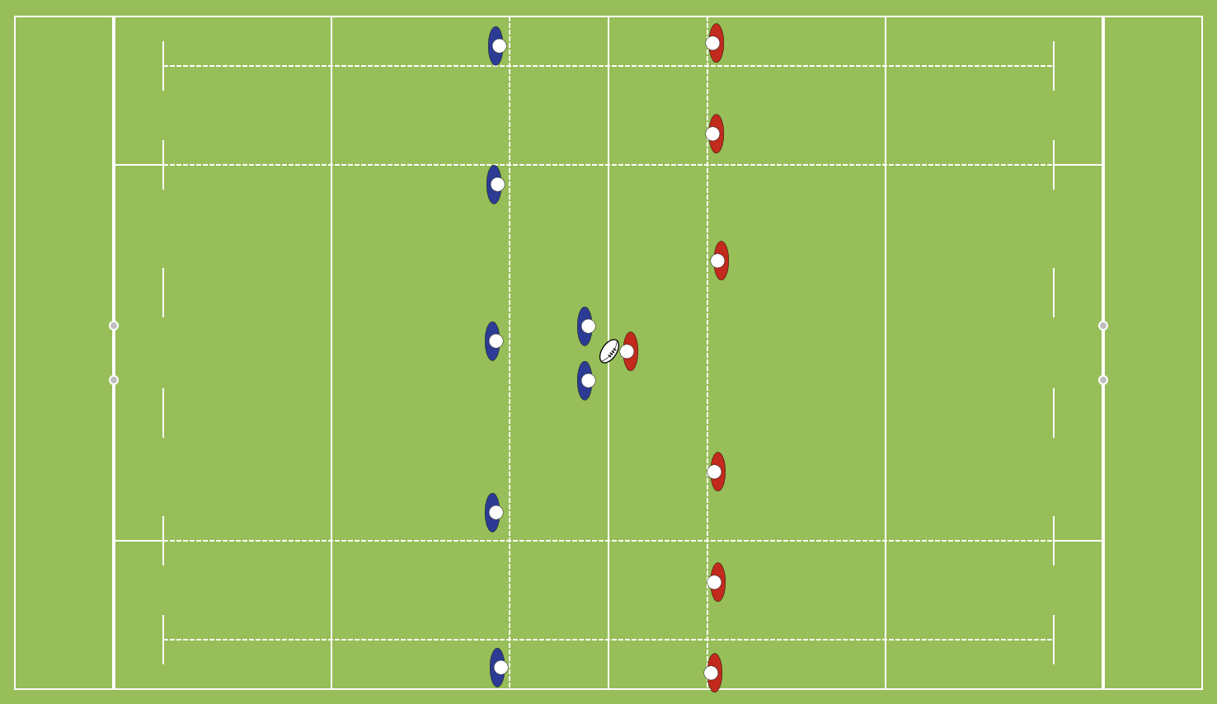
Game

Slide 18
Thank you!

Slide 19
Reference List
Bandura, A. (1977) Social Learning Theory. Englewood Cliffs, NJ: Prentice-Hall.
Bunker, D. and Thorpe, R. (1982) ‘A model for the teaching of games in secondary schools’, Bulletin of Physical Education, 18(1), pp. 5–8.
Dewey, J. (1938) Experience and Education. New York: Macmillan.
Fitts, P.M. and Posner, M.I. (1967) Human Performance. Belmont, CA: Brooks/Cole.
Mosston, M. and Ashworth, S. (2008) Teaching Physical Education. 1st online edn. Columbus, OH: Spectrum Institute for Teaching and Learning.
Skinner, B.F. (1953) Science and Human Behavior. New York: Macmillan.
Vygotsky, L.S. (1978) Mind in Society: The Development of Higher Psychological Processes. Cambridge, MA: Harvard University Press.

