Slide 1
Personal SWOT Analysis: Building My Professional Development in Health and Social Care
Student name: Naela Aslam
Student number: 2223215
Module code: LCHS4009
Lecturer: Olufemi Oluranti

Slide 2
Introduction
Brief self-introduction (Name, Program)
Career interest in Health and Social Care
Purpose: SWOT for professional development
Notes:
Good afternoon, my name is Naela Aslam , and I am currently studying on the Certificate of Higher Education Skills for the Workplace (Health and Social Care) program. My career goal is to develop within the Health and Social care Sector. Today, I will present a personal SWOT analysis to suuport my professional development.

Slide 3
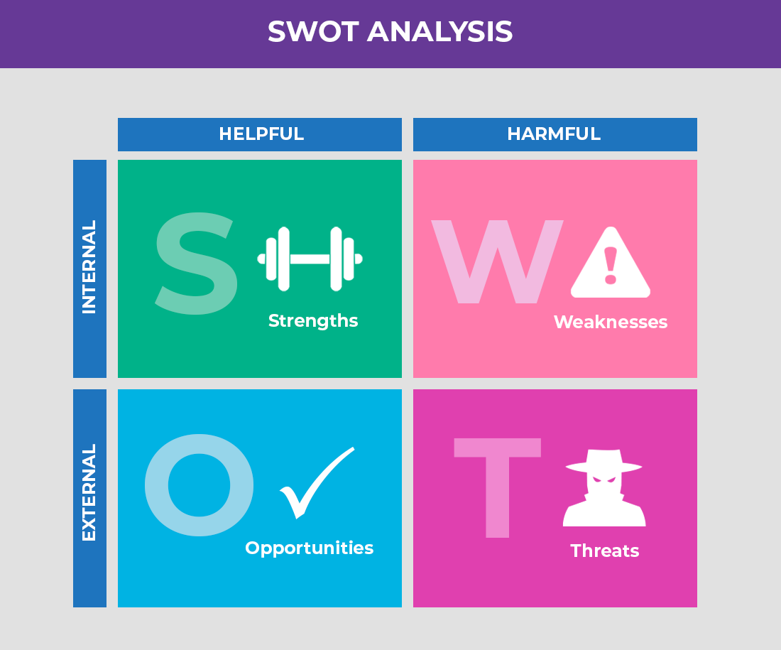
Strengths
Reliability and flexibility – willing to work shifts and adapt to different settings (hospital, community, care home).
Adaptability and effective time management – able to prioritise tasks and handle pressure efficiently.
Empathetic and a good listener.
Up-to-date mandatory training, e.g., manual handling, infection control, and safeguarding.
Notes:
One of my strongest qualities is being reliable and flexible. Reliability means colleagues and supervisors can trust me to deliver tasks consistently and to a high standard, which is vital in health and social care where service users depend on us for safe and timely support. Flexibility allows me to adapt to different shifts and environments, such as hospitals, community care, or residential homes. This adaptability enables me to respond effectively to the sector’s changing demands and diverse needs, making me a valuable team member. Adaptability and effective time management are crucial in health and social care. I can adjust quickly to new environments or changing circumstances, such as different shifts or patient needs. At the same time, I’m able to plan and prioritise tasks effectively to ensure that care is delivered safely and on time, even in high-pressure situations. I have strong interpersonal skills and able to understand others’ needs and communicate effectively. Another strength is my commitment to keeping mandatory training current. I hold certifications in manual handling, infection control, and safeguarding core requirements for safe and ethical practice. These skills ensure patient safety, protect vulnerable individuals, and give me confidence when working in new roles. By maintaining this training, I demonstrate professionalism, competence, and dedication to high-quality care.

Slide 4
Weaknesses
Limited formal qualifications may only hold a Level 2/3 Health and Social Care or Care Certificate.
Lack of specialist skills, e.g., ECGs, dementia care, or palliative care training.
Lack of confidence in leadership roles, not yet experienced in mentoring or supervising.
Lack of confidence in speaking up in front of others.
Notes:
One area I recognise as a weakness is having limited formal qualifications, as I currently hold only basic certifications such as Level 2/3 Health and Social Care or the Care Certificate. While these provide a foundation, they restrict my ability to take on more advanced roles. I also acknowledge a lack of specialist clinical skills, such as ECGs, or palliative care training, which would increase my versatility and employability. Another area of weakness is my limited confidence in leadership roles, as I have not yet had the opportunity to mentor or supervise others, I also lack confidence in speaking up in front of others. These weaknesses, however, also present opportunities for growth. By pursuing further training and professional development, I can gradually address these gaps. Acknowledging them demonstrates self-awareness, which is important in health and social care, as it allows me to set clear goals for improvement and move towards becoming a more skilled and confident practitioner.

Slide 5
Opportunities
There is a growing demand for health and social care professionals in the UK.
Availability of specialist training courses, e.g., dementia care, phlebotomy, palliative care.
Work placements and volunteering opportunities to gain practical experience.
Networking and mentorship in health and social care settings (Antoniadou and Kanellopoulou, 2024).
Career progression pathways through continuous professional development (CPD).
Notes:
The health and social care sector presents many opportunities for professional development. There is a growing demand for care professionals in the UK, which creates strong prospects for career progression. I can take advantage of specialist training courses such as dementia care, phlebotomy, or palliative care to build expertise and stand out in the field. Opportunities for work placements and volunteering allow me to gain hands-on experience and apply theoretical knowledge in real settings. Another opportunity lies in networking and mentorship, where building professional relationships can provide guidance, support, and access to career pathways. Continuous Professional Development (CPD) also offers structured routes for enhancing skills and qualifications (Antoniadou and Kanellopoulou, 2024). By leveraging my strengths such as willingness to learn and adaptability I am well positioned to maximise these opportunities. Ultimately, engaging with them will help me bridge weaknesses, expand my competence, and progress toward leadership roles in health and social care.

Slide 6
Threats
High competition for roles in health and social care sector.
Work–life balance challenges due to shift work and workload demands.
Emotional stress and risk of burnout in care environments.
Policy changes and funding cuts impacting service delivery.
Need to constantly update skills and training to meet regulatory standards.
Notes:
Despite the opportunities, there are also several threats to career growth in health and social care. One key threat is high competition, as many candidates are entering the sector, often with higher qualifications or specialist training. Another is the challenge of work–life balance, as shift work and demanding workloads can cause stress and fatigue. The nature of care roles also brings risks of emotional strain and burnout, particularly when working in high-pressure or emotionally demanding environments. In addition, policy changes and funding cuts may impact service delivery and job stability. Finally, the need to continuously update skills and training to meet regulatory standards can be demanding, especially alongside work responsibilities. However, by applying my strengths such as good time management, adaptability, and communication I can minimise these threats. Staying proactive, resilient, and committed to ongoing learning will help me sustain progress despite these challenges.

Slide 7
Leveraging Strengths to Overcome Weaknesses & Minimize Threats
Reliability & flexibility help adapt despite limited qualifications.
Empathy and active listening help me connect with others on a deeper level.
Up-to-date training offsets the lack of specialist clinical skills (Kumar and K.B, 2023).
Adaptability and effective time management – able to prioritise tasks and handle pressure efficiently.
Networking & mentorship enhanced through empathy & communication.
Notes:
My reliability and flexibility allow me to take on varied roles and shifts, helping overcome the barrier of limited formal qualifications. Empathy and active listening help me connect with others on a deeper level. These traits help me become more self-aware and emotionally intelligent. Having up-to-date training ensures I maintain safe and effective practice, even if I lack advanced clinical skills (Kumar and K.B, 2023). Adaptability and effective time management are crucial in health and social care. I can adjust quickly to new environments or changing circumstances, such as different shifts or patient needs. At the same time, I’m able to plan and prioritise tasks effectively to ensure that care is delivered safely and on time, even in high-pressure situations. Strong networking and mentorship, supported by empathy and communication, will help me advance professionally.

Slide 8
References
Antoniadou, M. and Kanellopoulou, A. (2024). Educational Approach: Application of SWOT Analysis for Assessing Entrepreneurial Goals in Senior Dental Students. European Journal of Investigation in Health, Psychology and Education, 14(3), pp.753–766. doi:https://doi.org/10.3390/ejihpe14030049.
Kumar, S. and K.B, P. (2023). SWOT ANALYSIS. ResearchGate. [online] Available at: https://www.researchgate.net/publication/374707908_SWOT_ANALYSIS.

