Slide 1
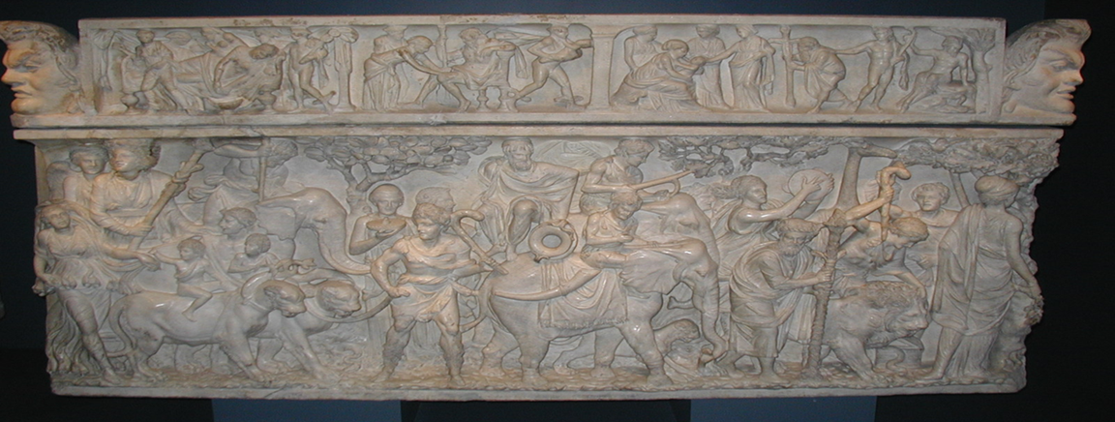
West meets East: Graeco-Roman Interaction with India
Indian and the Roman Imagination
HPAH5047; HPAH6047

Slide 2
Mediums of Description
Two overarching categories:
  The discussion of India as a primary focus (at least in part, cf. Strabo’s Geography (primarily the first half of book 15, also part of beginning of book 2) and Pliny the Elder’s Natural History (6.21-23.56-80, 6.26.96-106, see also 6.24.81-91 for Taprobane (Sri Lanka)).
  Short digression or anecdotes, India subordinated to larger concerns of the work.
“Some readers will perhaps ask themselves why, since most of what I have said relates to Africa and Spain, I have not said a word more about the mouth of the Mediterranean at the Pillars of Hercules, or about the Outer Sea and its peculiarities, or about the British Isle... I have omitted these subjects not because I think they are foreign to my history, but in the first place because I did not wish to be constantly interrupting the narrative and distracting readers from the actual subject, and next because I decided not to make scattered and casual allusions to such matters, but assigning the proper place and time to their special treatment to give as true an account of all as is in my power.” – Polybius 3.57.2-5.

Slide 3
Historiography: Diodorus Siculus Bibliothêkê; Quintus Curtius Rufus; Arrian Anabasis and Indica.
Geography: Strabo Geography; Pomponius Mela Chorographia; PME; Claudius Ptolemy Geography; Cosmas Indicopleustes Christian Topography.
Natural History: Pliny the Elder Natural History; Aelian On the Characteristics of Animals.
Novel and Mime: Xenophon of Ephesus Ephesian tale; Heliodorus Aithiopian tale; Longus Daphnis and Chloe; Charition Liberata – P. Oxy. 413.

Slide 4
Autopsy
Importance of indirect or “deflected” autopsy for the classical Indographers.
“Megasthenes says that the largest tigers are found among the Prasii…” – Strabo 15.1.37.
“Nearchus says that he had only seen a tiger’s skin but not a tiger…” – Arrian Indica 15.1.
“…since the merchants of Alexandria are already sailing with fleets by way of the Nile and of the Arabian Gulf as far as India, these regions also have become far better known to us of to‑day than to our predecessors.” – Strabo 2.5.12.
“As for the merchants who now sail from Egypt by the Nile and the Arabian Gulf as far as India, only a small number have sailed as far as the Ganges; and even these are merely private citizens and of no use as regards the history of the places they have seen.” – Strabo 15.1.4.

Slide 5
The Features of
“Indian” Society

Slide 6
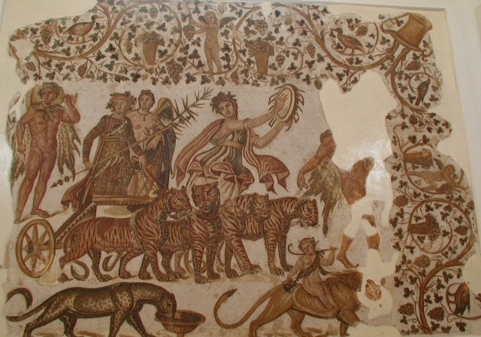
The History of India
Dionysus > Heracles > dynastic foundations.
Development of tradition by companions of Alexander?
“In the very centre of the garden there was a temple and alter of Dionysus… Within the temple there were representations of the life of the god… conquered Indians…” – Longus 4.3.
Pliny mentions that Indian history entails over 153 kings over 6,451 years and 3 months to count from Dionysus to Alexander (NH 6.59) = average reign of 42 years.
Tone of imperial conquest.
Triumph of Bacchus, Sousse, Tunisia, third century AD

Slide 7
The Populations of India
“In this country there are nations and cities which would be found to be beyond number, if a person should attempt to count them… The followers of Alexander the Great have stated in their writings, that there were no less than five thousand cities in that portion of India which they vanquished by force of arms, not one of which was smaller than that of Cos; that its nations were eight in number, that India forms one-third of the whole earth, and that its populations are innumerable—a thing which is certainly far from improbable, seeing that the Indians are nearly the only race of people who have never migrated from their own territories…” - Pliny NH 6.21.58-59.
“Megasthenes states that there are in all one hundred and eighteen tribes. I agree with Megasthenes myself that the Indian tribes are numerous, but I cannot conjecture how he learned and recorded the exact number, since he visited only a small portion of India, and these people do not all mix with each other.” – Arrian Indica 7.1.

Slide 8
The Divisions of Indian Society
Sevenfold division of Indian society Diodorus, Strabo, Arrian:
  Philosophers
  Farmers
  Shepherds
  Artisans
  Soldiers
  Overseers
  Councillors
Pliny’s division of the “more civilised” Indian societies:
  Cultivators
  Soldiers
  Long-distance traders
  Statesmen
  Wise men
  Elephant keepers
Fourfold division eminating from primeval giant Purusa - Rig Veda 10.90.12.
“The Egyptians are divided into seven classes: priests, warriors, cowherds, swineherds, merchants, interpreters, and pilots” – Herodotus 2.164.1.

Slide 9
“As for the customs of the Indians which are peculiar to them, a man may consider one which was drawn up by their ancient wise men to be the most worthy of admiration; for the law has ordained that under no circumstances shall anyone among them be a slave, but that all shall be free and respect the principle of equality in all persons. For those, they think, who have learned neither to domineer over others nor to subject themselves to others will enjoy a manner of life best suited to all circumstances; since it is silly to make laws on the basis of equality for all persons, and yet to establish inequalities in social intercourse.” – Diodorus Siculus 2.39.5.

Slide 10
Indian Women
Sati - Cicero Tusc. 5.77-78; Propertius 3.13.
“There is a uniquely felicitous custom of funerals among eastern husbands, whom the red dawn tinges with her own horses. For when the last torch has been thrown onto the funeral pyre, the dutiful crowd of widows stands with flowing hair, and hold a deadly competition as to which of them will, living, follow her husband: it is a source of shame not have had the chance to die… But we have a faithless race of brides, and among us no girl will be a faithful Evadne or a devout Penelope.” - Propertius 3.13.15-20, 23-24.

Slide 11
“Aristobulus mentions some novel and unusual customs at Taxila: those who by reason of poverty are unable to marry off their daughters, lead them forth to the market-place in the flower of their age to the sound of both trumpets and drums (precisely the instruments used to signal the call to battle), thus assembling a crowd; and to any man who comes forward they first expose her rear parts up to the shoulders and then her front parts, and if she pleases him, and at the same time allows herself to be persuaded, on approved terms, he marries her; and the dead are thrown out to be devoured by vultures; and to have several wives is a custom common also to others. And he further says that he heard that among certain tribes wives were glad to be burned up along with their deceased husbands, and that those who would not submit to it were held in disgrace; and this custom is also mentioned by other writers.” – Strabo Geography 15.1.62.

Slide 12
Somatic Characterisations
“In the regions which lie to the south of the Ganges, the people are tinted by the heat of the sun, so much so as to be quite coloured, but yet not burnt black, like the Ethiopians. The nearer they approach the Indus, the deeper their colour, a proof of the heat of the climate.” – Pliny NH 6.22.70.
“Physically the Indians are lean, tall and much lighter in movement than other men.” – Arrian Indica 17.1.
“…[Cathaean] men dye their beards with many most florid colours for the sole reason that they wish to beautify themselves; and that this practice is carefully followed by numerous other Indian peoples also (for the country produces marvellous colours, he says [Onesicritus]), who dye both their hair and their garments; and that the people, though shabby in every other way, are fond of adornment.” – Strabo 15.1.30.

Slide 13
The Natural Context
Bizarre and sometimes frightening animals (cf. Alexander’s army and snakes) and natural features, coexisting alongside descriptions of well-ordered Indian societies.
“And there was also danger from the snakes; for herbs grew on the sand-hills, and beneath these herbs the snakes had crept unnoticed; and they killed every person they struck. It was said that among the Oreitae the arrows, which were made of wood and hardened in fire, were besmeared with deadly poisons…” Strabo 15.2.7.
“…towards the east of the tribe of the Gandaridae, which possesses the greatest number of elephants and the largest in size. Consequently no foreign king has ever subdued this country, all alien nations being fearful of both the multitude and the strength of the beasts… Diodorus Siculus 2.37.2-3.

Slide 14
Comprehending India
Connecting the unknown and incomprehensible into familiar – drawing parallels with Egypt and Ethiopia:
  “But the Indus empties by two mouths into the southern sea, encompassing the country called Patalenê, which is similar to the Delta of Egypt.” – Strabo 5.1.13.
Inversion of the normal:
  “But in that region the earth so inverts the regular order of season that when other parts become hot with the sun’s heat snow covers India; and conversely, when other parts become cold, unbearable heat prevails there. There is no reason for this inversion of nature.” – Curtius Rufus 8.9.13.
Barbarism vs. Utopianism:
  Cf. Strabo 15.1.53.

Slide 15
The Visual Depiction
of India

Slide 16
Issues
Limited scholarly study – few images in the Lexicon Iconographicum Mythologiae Classicae.
Many of the representations rather late in date.
By what criteria are were identifying an artefact as unambiguously representing India?
To what extent can we know if Graeco-Roman representations were responding to traditions already existing in India, how do we deal with the issue of cultural influence?

Slide 17
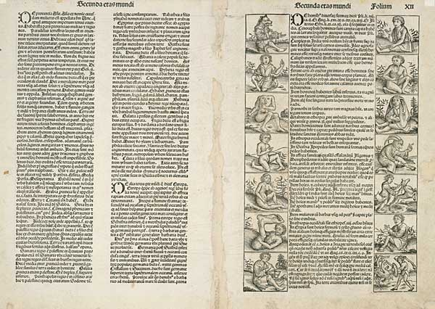
The Marvellous
The marvellous and freakish strong elements of Graeco-Roman literary tradition.
Notable absence of surviving visual representations prior to Middle Ages.
Hereford map and Nuremberg chronicle, manuscripts of the Alexander Romance.

Slide 18
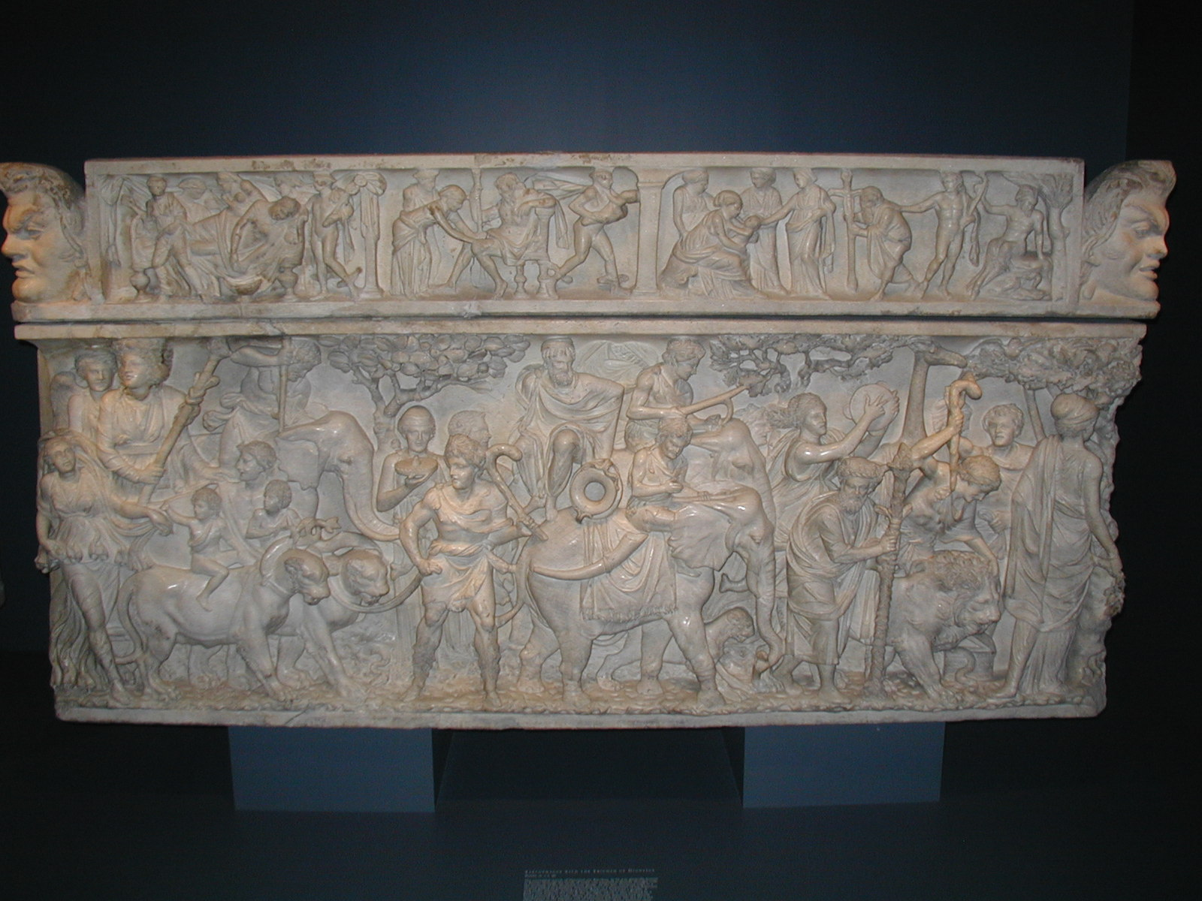
Bacchus and India
Bacchus popular on Antonine and Severan period sarcophagi – theme of conquest of India.
Theme of Bacchus’ triumph distinctive to Roman period.
Triumph of Bacchus, Walters Gallery, Baltimore

Slide 19
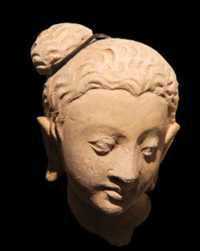
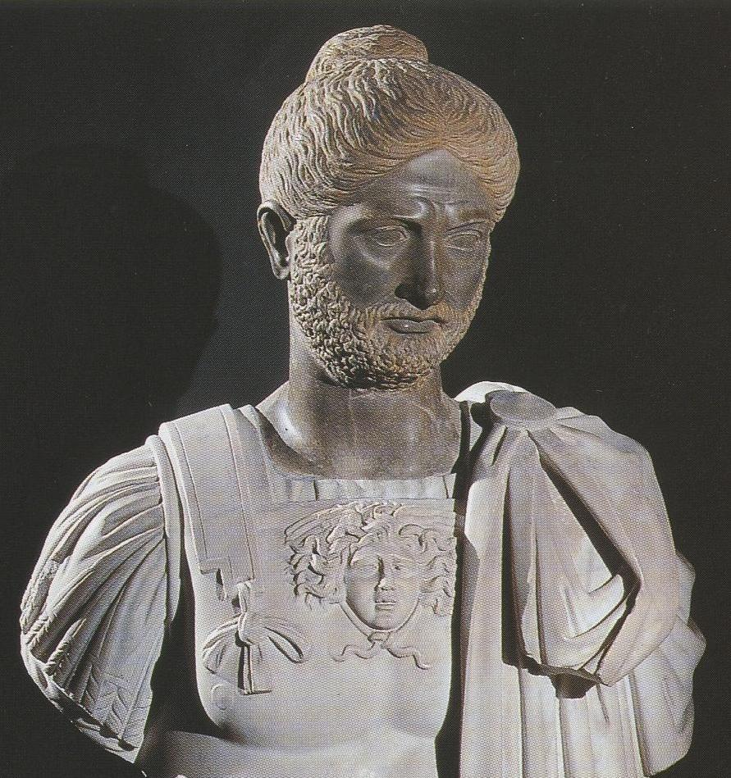
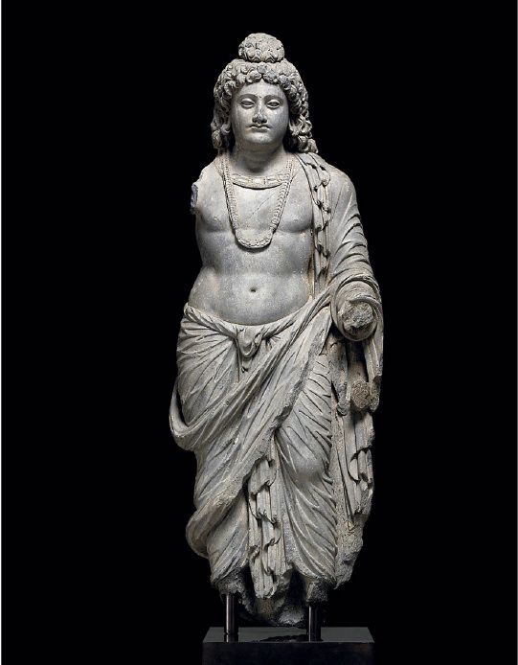
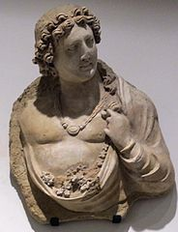
Indian Hairstyles?
Marble head with cirrus knot, Villa Borghese, Rome
Bodhisattiva figure, Gandhara, 2nd – 3rd C AD
Bodhisattiva from Hadda, Musee Guimet

Slide 20
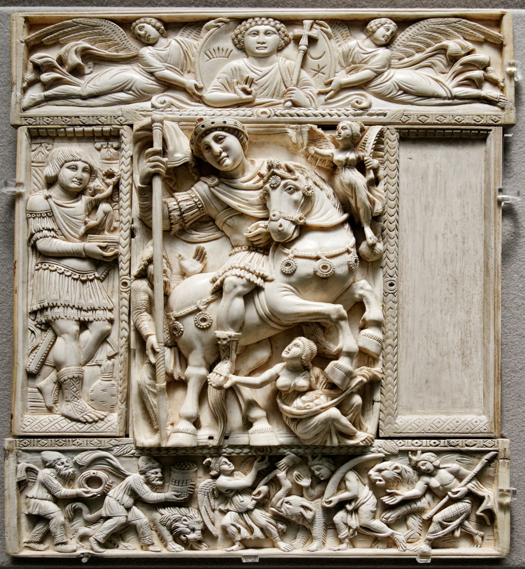
The Barberini ivory, sixth century AD, Justinian I?, Louvre, Paris

Slide 21
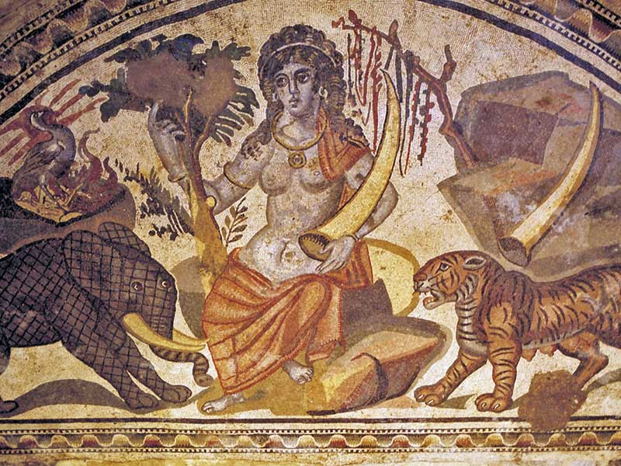
The Personification of India
Apse of the Great Hunt mosaic, Villa Filosofiana, Piazza Armerina, Sicily, fourth century AD

Slide 22
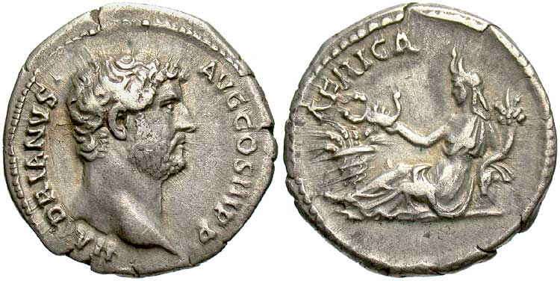
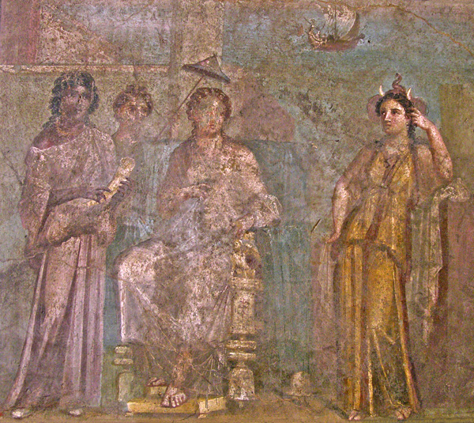
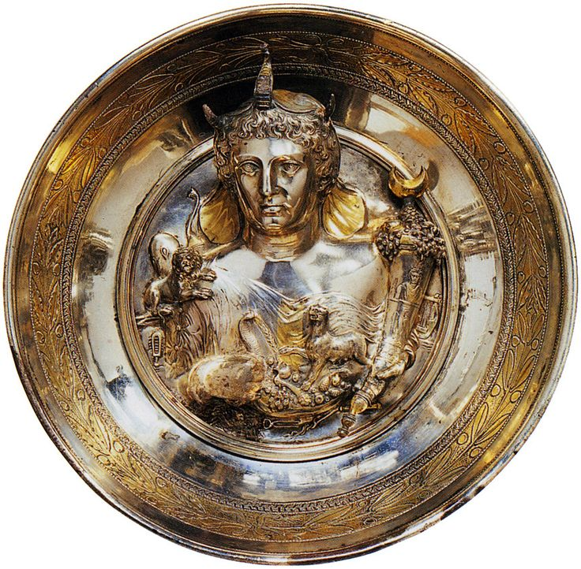
Personification of Africa
Coin of Hadrian (AD 136)
Phiale – Boscoreale Treasure – 1st C AD
Dido and Africa - House of Meleager in Pompeii, 1st C AD

Slide 23
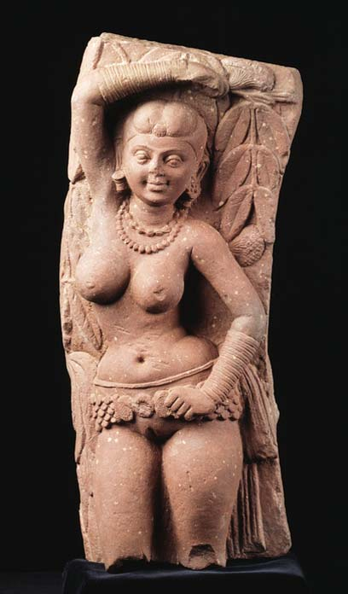
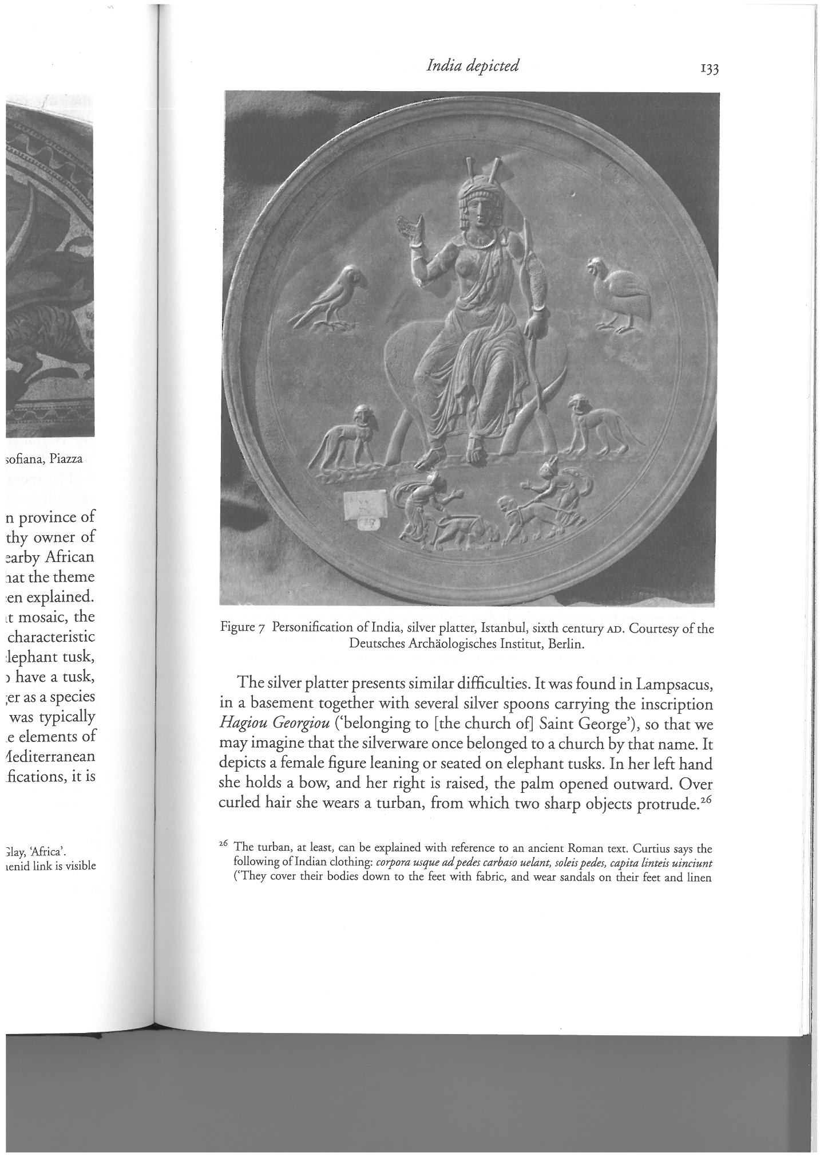
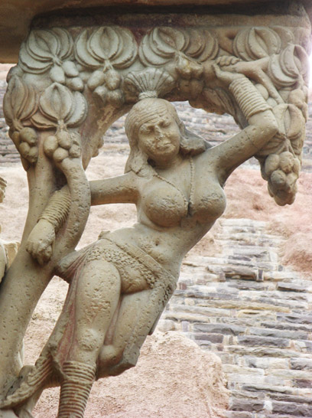
Silver platter from Lampsacus, now in Istanbul National Museum, sixth century AD
Salabhanjika

Slide 24
Visual Canon for India?
No simple or fixed manner of representing India.
Why was India so infrequently visually depicted?
  classical iconography already established?
Typologies:
  Provincial paradigm – female figures of India.
  Military conquest
  Eastern or Indian Ocean paradigm (overlap with in elements associated with Africa).

Slide 25
Bibliography
Ball, W. 2000. Rome in the East: The Transformation of an Empire. London: Routledge.
Parker, G. 2008. The Making of Roman India. Cambridge: Cambridge University Press.
Romm, J. S. 1992. The Edges of the Earth in Ancient Thought. Princeton: Princeton University Press.
Whittaker, C. R. 2004. Rome and Its Frontiers: The Dynamics of Empire. London: Routledge.

