Slide 1
Visions for Future - Theoretical Perspectives on Management
(LCDB7008)
Week 2 (Part 1 of 2)
Management theories & Criticality
Systems thinking

Slide 2
Today plan:
Management and ‘problem’
Systems Thinking, the Fifth Discipline
Being critical

Slide 3
Learning outcomes
Apply systems thinking tools to management and management problems
Know how to analyse management theories critically

Slide 4
Define problem

Slide 5
Problem is…
Outcomes, produced by the complexity of interaction, that people don’t want
Problems are outcomes of culture!
Culture is a problem-solving mechanism
Culture and problems are recursive
  How would you represent this relationship diagrammatically?

Slide 6
Management Problems
What is the major problem?
New product or service
  Electric cars
Poor quality products
  Recalls
Inefficiencies and ineffectiveness
  Overuse of resources
Cost overruns
  Unnecessary expenditures

Slide 7
Management Problems
Traditional Analysis
Systems Analysis
Problem
Decomposition
Analyse individual parts
Put it all back together
Problem
Look for events
Establish connections and interdependencies
Expand
Look for patterns
Create systems

Slide 8
Emerging Ideas: Management Sandpit
Philosophy of Management
What are your principles for doing business?
What are your business ethics?
Management Skill
What is the best advise you got?
‘Emerging ideas’ is itself a systems tool!
Notes:
Add value. Continuously develop yourself so that you can add more value for people.

Slide 9
Management
How would you manage Apple, $1 trillion capitalised company?

Slide 10
Management innovation: Define critical
To innovate management you need to be critical of the status quo
Individually, explain how yourself think critically and how you thinking critically about management
Being critical will improve the quality of your research project in Part 2 of the DBA

Slide 11
Being critical
‘Criticality is the predisposition that the object of attention can be better than it is.’ (Barnett, 1997)

Slide 12
Critical analysis
‘ARGUMENT Veracity of the argument. Is it believable? What is a counter argument?
ABSTRACTIONS Are they valid against your experience of reality? Definitions, concepts/constructs, relationships, and terms
PROPOSITIONS Are they believable?
ASSUMPTIONS What is stated without evidence?
EVIDENCE Is it reliable?
METHODOLOGY Is the data, data collection and analysis appropriate?
IMPACT/IMPLICATION Is it applicable to practice?
CONTRIBUTION Is the stock of knowledge improved?

Slide 13
Systems thinking
Start Thinking Differently About Management
Systems Thinking is the art and science of making reliable inferences about behavior by developing an increasingly deep
understanding of underlying structure.
Barry Richmond coined the term in 1987:

Slide 14
Learning organisation & systems thinking Peter Senge – The Fifth Discipline
Learning organisation is based on systems thinking
‘…those organisations that encourage adaptive and generative learning, encouraging their employees to think outside the box and with in conjunction with other employees to find the best answers to any problems.’
Democracy – decentralised problem-solving and decision making; no command and control but working together. An example of management innovation.

Slide 15
Definition
Systems thinking [is] a way of thinking about, and a language for describing and understanding, the forces & interrelationships that shape the behavior of systems. This discipline helps us to see how to change systems more effectively, and to act more in tune with the natural processes of the natural and economic world.
Peter Senge, The Fifth Discipline Fieldbook

Slide 16
System
A system is more than the sum of its parts
  Arms, legs, fingers, hands, ears, eyes, nose, head,
  All these together is the body (system)
  Where are the boundaries of the body?
  What are the sub-systems of the body?
How is an illness (problem) in the body cured?
  Allopaths treat the symptoms & isolated organism
  Naturopaths treat the whole body - holistic
Draw biological system

Slide 17
System
In the real world boundaries do not exist
You perceive boundaries
  Company
    Departments
      Sections
Are you part of a family?
People in a family produces consequences – feelings/actions that are not intended
How does that happen?
Webs of interdependence; complexity of interactions
Outcomes, produced by the complexity of interaction, that people don’t want (Problem)
  Systems Thinking is for understanding how outcomes or problems occur.
Draw a company as a system
The definition of a problem?

Slide 18
Systems thinking Keywords
Practice theory
Systems thinking
Learning organization
Organizational change
Human agency

Slide 19
Drawing simple organisational systems
Setting the system boundary
Identifying the sub-systems
Connecting system components and sub-systems
Learning and creating value
Select a company or industrial sector and assess its competitiveness problem/issues by applying systems thinking.

Slide 20
The Fifth Discipline: Learning Organisation
Managing the company as a learning organisation
Five characteristics of a learning organisation
  Personal Mastery – a person’s view of the issues
  Mental Models – a person’s deeply ingrained assumptions
  Team Learning – people acting together
  Building Shared Vision – experimenting & innovating together
  Systems Thinking – looking at the whole rather than a single problem
Leaders build organisations by enabling individuals’ to learn

Slide 21
The five Disciplines
First: "Personal mastery is a discipline of continually clarifying and deepening our personal vision, of focusing our energies, of developing patience, and of seeing reality objectively."
Second: "Mental models are deeply ingrained assumptions, generalizations, or even pictures of images that influence how we understand the world and how we take action."
Third: "Building shared vision - a practice of unearthing shared pictures of the future that foster genuine commitment and enrolment rather than compliance."
Fourth: "Team learning starts with 'dialogue', the capacity of members of a team to suspend assumptions and enter into genuine 'thinking together'."
Fifth: "Systems Thinking - The Fifth Discipline that integrates the other four."

Slide 22
Leaders as Designers (Management)
Building a foundation of purpose and core values (governing ideas)
Develop vision, strategies, policies, processes and structures that translate governing ideas into decisions
Develop learning processes

Slide 23
From Events to Systems
 | Example
Mental Models
Systems
Patterns of Behaviour
Events

Slide 24
Systems Adapt
Companies operate in a competitive market
They must change to deliver customers preferences, otherwise they fail or liquidate
  Nokia failed terribly losing in market domination

Slide 25
Systems Toolkit
Links are arrows that represent influence between elements in a system
  Cause-Effect
    Customer satisfaction →increased revenue
Loops are combination of links that reveal interdependencies
      Service Customer Satisfaction

Slide 26
Systems Toolkit
Balancing Loops
Reinforcing Loops
Causal Loop Diagrams
System Archetypes
Stocks and Flows
Iceberg
Examples of how to use these tools and many others can be found at:
https://www.burgehugheswalsh.co.uk/systems-thinking/tools.aspx
https://www.thwink.org/sustain/glossary/SystemsThinking.htm
https://www.slideshare.net/bargeguy/executive-systems-thinking-seminar-march-3-2015

Slide 27
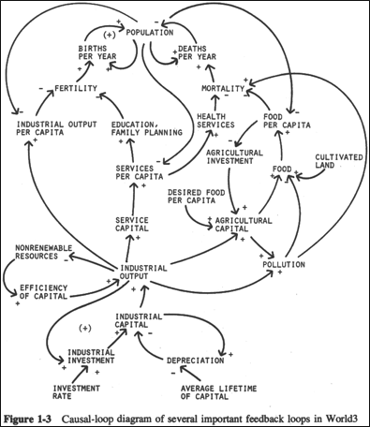
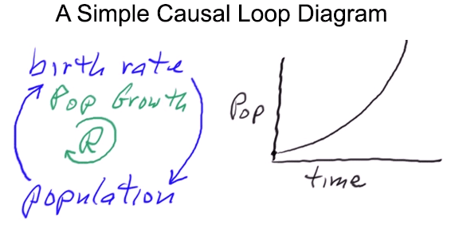
Causal loop diagram
R = reinforcing loop. Graph shows the loops general behaviour over time.
What HR management issue could you replace in the two nodes?

Slide 28
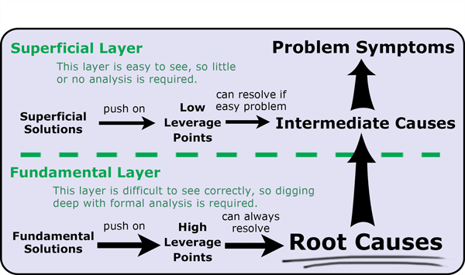
Root cause analysis

Slide 29
Putting Systems Thinking into Practice
Elon Musk is the best example of a systems thinker
  Tesla, SpaceX, Boring Company, Solar Glass Roof
Musk solves all his entrepreneurial and management problems by the First Principals of physics and systems thinking

Slide 30
Creating value
Systems Thinking can be applied to create value. Discuss.

Slide 31
Critique of Systems Thinking
The assignment requires critical analysis of management theory and its application in practice.
How do you do such a critical analysis?

Slide 32


