Slide 1
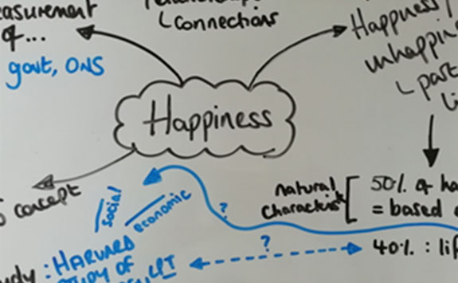
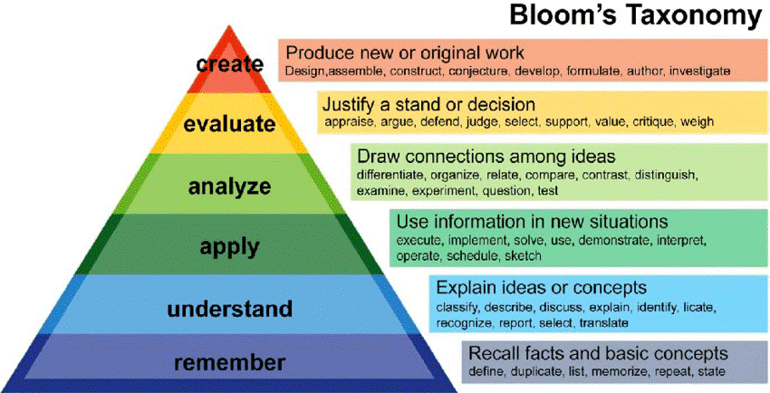
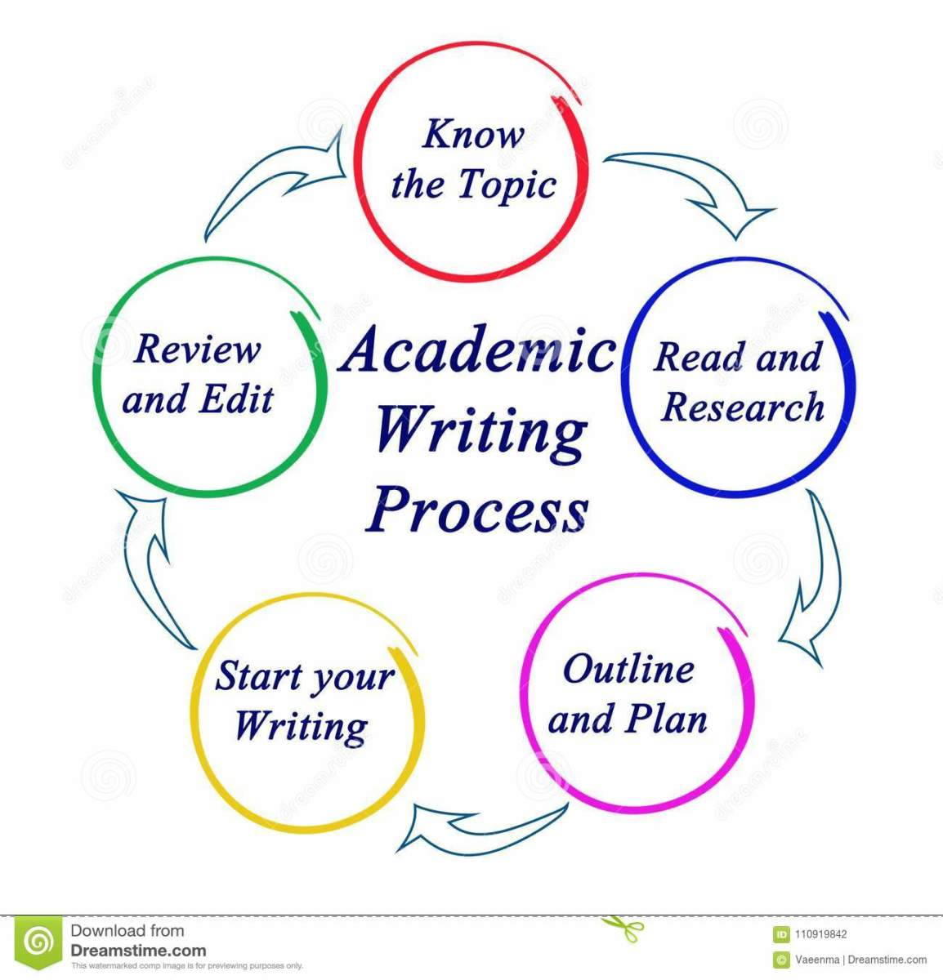
Study Skills for developing Academic Learning
ECEY4008
2219037
584 Word Count
Introduction
Critical Thinking Skills, Academic Writing Skills and Note Taking and why they are important.
Note Taking:
Note taking may not be mandatory to write down every single word, but it can be advantageous in terms of documenting relevant information by taking notes. It is common for lectures to offer guidance by encouraging students to "make a mental note of this". Macleod-Brudenell and Kay (2008, p.9).
Additionally, Burns and Sinfield (2022, p. 77- 78) states that the act of taking comprehensive notes may result in an overflow of information, causing a decrease in overall engagement and a potential lack of attention towards the information. Independent thinking can be hindered when individuals get trapped in the ideas and opinions of others.
Critical Thinking:
According to Skillsyouneed (2023) Critical thinking is a cognitive capacity that enables individuals to engage in objective and rigorous analysis, comprehending the inherent logical coherence and interrelation among concepts. However, Glaser (1941,) argued that critical thinking is `The process of fully evaluating beliefs or claimed knowledge involves a committed attempt to critically analyse them, taking into account the supporting evidence and the potential ramifications they could lead` (quoted in Cotrell, 2019, p. 254)
`A persistent
Academic Writing Skills:
Cottrell (2019, p. 273), says that academic writing is creating a carefully composed assignment poses a challenging undertaking but also brings about meaningful satisfaction as an essential aspect of learning. At this level of education, tasks are purposely created to push students' intellectual limits, requiring them to exert significant mental energy. Furthermore, the University of Sheffield (2023) defines academic writing as a various stages such as researching, analysing, and evaluating information, developing a strategic plan for writing, organizing ideas effectively, editing meticulously, and thoroughly proofreading one's work. In addition, it involves the thorough evaluation and reflection on received feedback, forming the basis for academic written assessments in the university context.
Image from: Bright Concept (2022)
(Image from discover (2021)
Image from Newcastle University (2023)
Conclusion: From these study skill that have been discussed throughout this presentation, there are many authors that have own take on these study skill.
For instance, Skills you need state that Critical thinking is a cognitive skill yet Glaser (1941) states that Critical thinking is the effort to examine. With academic writing Cottrell (2019) mentions that academic writing is creating a carefully composed assignment. However, the University of Sheffield (2023) states that academic writing is a way of researching, analysing and evaluating information to compose an essay. Lastly, there is note taking were Macleod-Brudenell and Kat (2008) mentions that note taking can have it advantages were Lectures and prompt to take a note of this. Yet Burns and Sinfield (2002) mentions that taking comprehensive notes can cause lack of attention to the information given

Slide 2
Bright Concept (2023) Critical thinking. Available at: https://www.brightconcept-consulting.com/en/blog/leadership/how-to-develop-the-7-skills-of-critical-thinking (Accessed 12 September 2023)
Bournemouth University (2021) Study Skills. Available at: https://www.bournemouth.ac.uk/news/2021-02-26/study-skills-resources-critical-thinking (Accessed: 09 September 2021)
Burns, T and Sinfield, S. (2022) Essential Study Skills. 5th edn. London: Sage
Cottrell, S. (2019) The study skills handbook. 5th edn. London: Red Globe Press.
Day, T. (2018) Success in Academic Writing. 2nd edn. London: Palgrave
Hubpages (2021) Academic Writing. Available at: https://discover.hubpages.com/literature/Skills-to-learn-in-Academic-writing (Accessed: 12 September 2023)
Discover (2023) Academic Writing. Available at:https://discover.hubpages.com/literature/Skills-to-learn-in-Academic-writing (Accessed: 12 September 2023)
Moore, S et al. (2010) The ultimate Study Skills Handbook. Maidenhead: Open University Press
Macleod-Brudenell, I and Kay (2008) Advanced Early Years. 2nd edn. London: Pearson Education LTD
Skills you need (2023) Critical thinking. Available at: https://www.skillsyouneed.com/learn/critical-thinking.html (Accessed: 09 September 2023)
University of Sheffield (2023) Academic Skills. Available at: https://www.sheffield.ac.uk/academic-skills/study-skills-online/academic writing#:~:text=Academic%20writing%20is%20part%20of,underpins%20written%20assessment%20at%20university. (Accessed: 09 September 2023)
Newcastle University (2023) Academic Skills. Reding and Note Taking. Available at: https://www.ncl.ac.uk/academic-skills-kit/study-skills/reading-and-note-taking/note-taking-strategies/ (Accessed: 12 Sept 2023)

