Slide 1

Transition in Early Years
The importance of Communication during Transitions
Handbook for Practitioners

Slide 2
Contents
Introduction to Transitions – p3
The Needs of the Child – p4
The Role of the Adult – p5-6
Partnerships – p7
Interventions – p8
Proposed Outcomes – p9
Reference List – p10-p11

Slide 3


Introduction
Early years practitioners play such an important role in the developmental process in children. Practitioners help children to learn, grow and develop their existing knowledge with encouraging behaviour.
Transitions
What are They?
Transitions are the steps that young people make in order to develop mentally, and physically (Parent zone Scotland, 2022).
As a practitioner, one of the most challenging but important situations, is transitioning. This is the time where the professional really has to get to know the child and take the time to research and develop their knowledge on how to meet their holistic needs. Not only this, but they need to be aware of their personal needs too, as each child is different, and learns in different ways.
Aims
The aim of this handbook, is to educate practitioners in the early years, and support is, and how important communication is throughout. them in supporting children who are starting their first experience of education in nursery. It will help practitioners realise what their role in this transition
At age 3, most children will start school. For some, this would be their first experience away from their parents or family. However, some children will have already been to flying start or a creche. Either way, the importance of the transition into part-time education is crucial. Practitioners need to be there t o support not only the children, but their parents or carers too.
Cliparts.co (2022)
According to Our Young Wonders (2020), there are 5 main ways a child can initially learn. These are visual, tactile, auditory, logical, and social. If children are presented with an activity, it is very likely that each child will approach the task differently, and complete it in certain ways. This means that the ‘key worker’ or practitioner must be able to meet their needs and realise what that specific child needs support with.

Slide 4
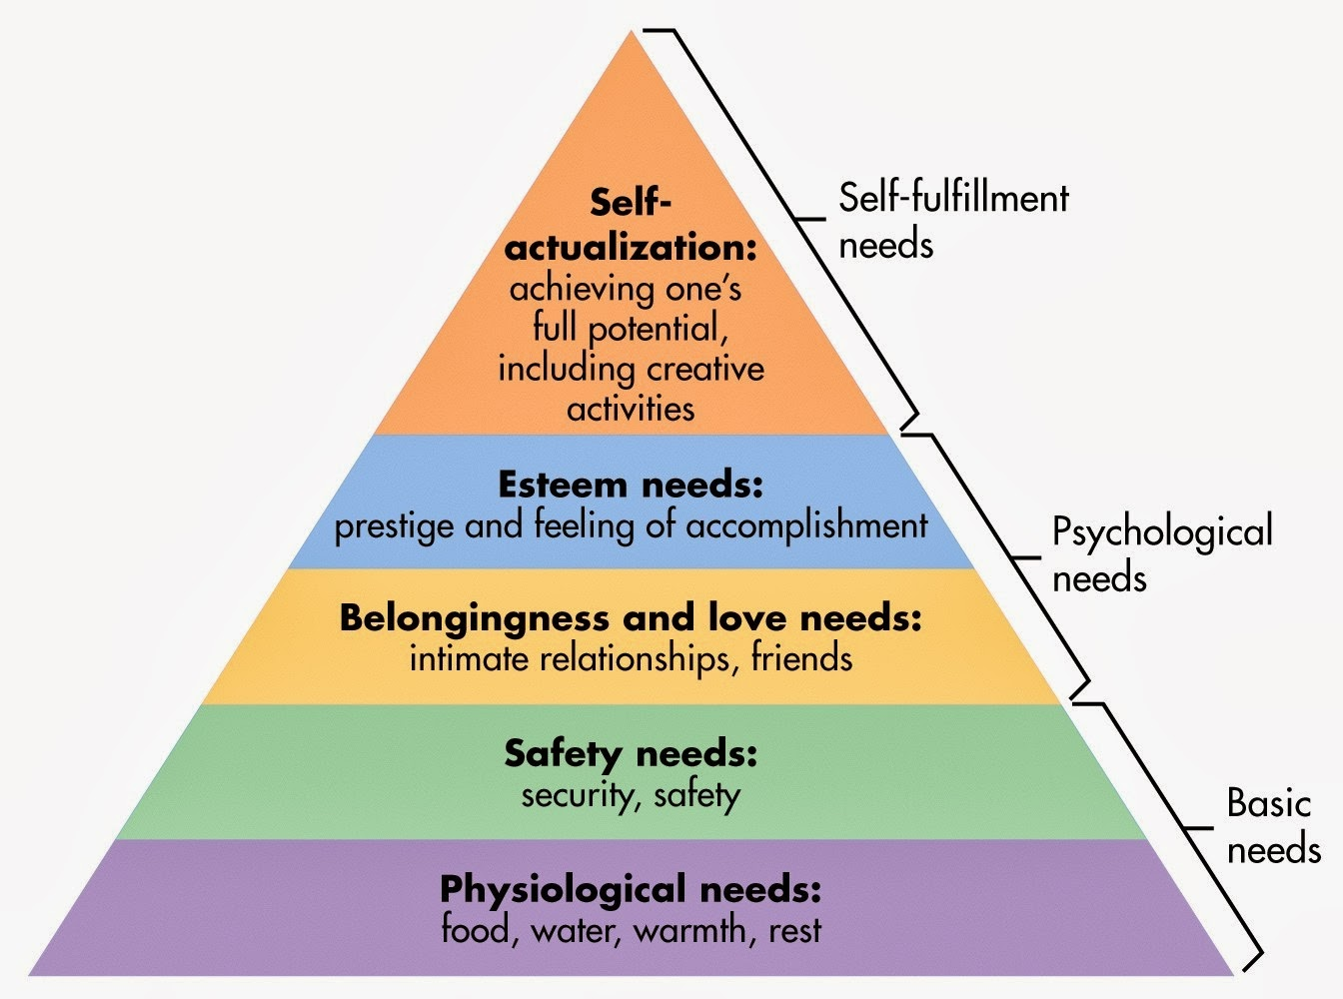
The Needs of The Child
When considering the needs of the child, practitioners must think about their needs holistically. This means that they consider all factors of the childs development, such as their environment, social abilities and mental abilities. It is important that the child is challenged, but not to the point where they stress out and cause more trauma or stress, as this could result in them not wanting to do activities that are similar again.
There are many theories that support the needs of the child. One of the most used theory, is Maslow’s Hierarchy of needs.
Maslow’s Hierarchy of Needs demonstrates 5 basic needs that a person needs to not only survive, but thrive. Maslow says that a child needs to have all of these needs met to fully develop. The needs are, physiological, safety, longingness, esteem, and self-actualisation. He suggests that if even one of these needs is not met, it can lead to issues when the child develops. The levels of needs are in order of importance, meaning without the basic physiological needs such as eating and drinking, the higher needs such as feeling accomplished are not even of thought.
McLeod (2007)
Children are very complex, and it is hard to know what they are feeling or thinking. This can be especially difficult when the child is non-verbal.
Supporting non-verbal children
In order for non-verbal children to feel safe and at ease with the transition from home to nursery, the practitioner must have the ability to find a way to communicate with the child, so that they fully understand what is going on. Ways in which a practitioner can do this is by using the Picture Exchange Communication System (PECS).
“PECS is a structured approach to developing communication with a pupil by ‘exchanging’ a symbol (picture) for a desired item.
It has a defined hierarchy that has to be followed (6 phases)
Colleagues need to have completed specialist training through Pyramid Education to be able to ensure that this is being implemented correctly” Kinderly (2018). This suggests that the use of pictures can help the child communicate with the practitioner, and is a way of telling them what they are comfortable doing, and what they have difficulties with.

Slide 5
The Role of The Adult
There are many skills required to ensure a smooth transition from home to school. It involves a large amount of liaise between the parent/carer, and the practitioner.
Good communication is one of the most important factors that play into transitions. Both practitioners and parents want the child’s transition to be as stress-free as possible, for everyone involved. The use of effective communication involves the practitioner talking to the parents and really getting to know the child and their needs before even starting at nursery. This can be achieved with welcome meetings, and allowing parents into the nursery or setting, with their child, to see the nursery itself. Also, the child will see that the parent and practitioner have a good relationship, meaning they will be able to trust the practitioner more.
Why is communication so important?
It is not only important to communicate with the parents, but the child too. Not all children are the same, and will adjust differently to their new setting. Creating visuals such as laminated cards with activities such as playtime, snack time, and home time may help some of the children feel more at ease with their first few times at nursery. Although, some children may need this every time they are in nursery, and may have needs that the practitioner must be able to support.
It is vital for parents and the practitioner to have effective communication as the parents are with the child for the majority of the day, and have been with them for roughly 3 years before starting nursery. Some children may not have been away from their parents or family before, so it may be hard to adjust. This shows that parents know their children best, they know what they like, dislike, and their general ability.
Building relationships between the practitioner and the child is vital, however it is just as important to build good relationships with the parents of the child. The parent will hopefully begin to trust the practitioner, allowing them to discuss openly with them any concerns they have for the welfare of their child, themselves or any other issues that may occur. If any concerns are endangering to the child or the parent, the practitioner can then pass on this to other professionals that can help in this situation, such as a social worker. This can only be done though, if the parent has allowed the practitioner to disclose their information, otherwise this must be kept confidential, unless of course, the adult or the child is in danger, is a threat to themselves, or has asked for help. Resources, N (2019)
Ways in which the practitioner can support the transition
Any transition can make a person feel anxious, so supporting the parents and children is a necessary step in order for the child to thrive and succeed at school. Starting nursery is a huge step as this is their first experience of the education system. The huge step can be reduced and easier if there is a key person for the child and parent. A key person is a specific person assigned to ensure the safety, and well-being of the child. Pilcher, M (2022).
A key worker can act as a role model to the children, and show them how to play nicely with others, learn to interact well and show them how to build relationships with other children.

Slide 6
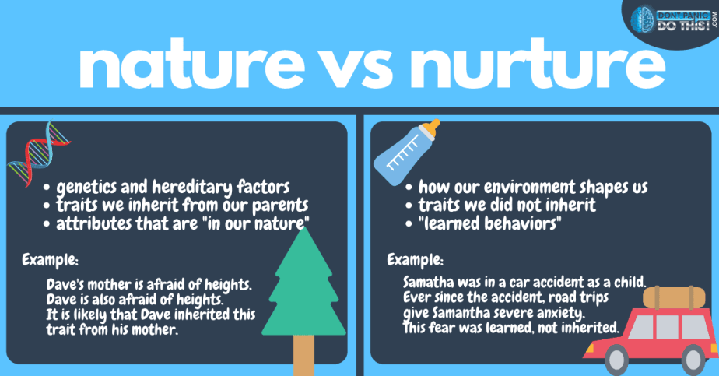
Nature vs Nurture
There is a big debate in psychology, over nature and nurture. This is whether or not a person is shaped by the environment around them (nature), or their genetics (nurture). It is thought that both nature and nurture are important factors that play into a child’s development.
Dontpanicdothis (2022)
The image above, suggest that either the environment, or genetics shapes a person. This means that they could have either inherited traits and behaviours, or have learnt these behaviours from past experiences.
John Watson performed an experiment on a child, commonly known as Little Albert. In the experiment, Watson proves that all behaviours can be learnt.
Method (1920’s)
The way in which Watson carried out the experiment was that he presented little Albert with a series of animals, such as a white rat, a rabbit, a monkey and a dog. Initially Albert was not afraid of the animals, however after conditioning him with a loud noise every time he went to touch the animal, the fear response started to appear.
Watson’s had proven that a child can be conditioned into liking or not liking something, this is the nature side of the debate.
Although, there were a lot of issues that came with this experiment, and is hard to be generalised into the modern day. There are issues such as consent, as the child was not old enough to understand what was happening. In the modern day, experiments like this would not be carried out as it has so many ethical issues involved.

Slide 7

Partnerships
Partnerships during transitions are a fundamental part of a child’s development. Partnerships ensure that both the child and the parent have someone in the school that they can trust, and will support them.
Barriers
According to Kelly (2016) partnership working is fundamental to a child’s development. However, it comes with barriers that need to be overcome. Some of these barriers are time, work and lack of ideas or research.
Ways to overcome barriers
Ways in which a parent and practitioner can overcome these barriers to the child’s development, especially during the transition from home to nursery is for time, the practitioner and parent will need to liaise back and forth to work out how the practitioner can learn more about the child. This will take time, and effort but the results will be more than worth it as the child should thrive. Some children just need a short-period od one to one with their key worker, or a practitioner in the setting, to flourish.
To overcome the issue with lack of ideas, the practitioner would be obligated to find out about the child, and the ways that they learn, then research to have the ability in supporting their transition period.
Beehive Day Nursery (2022)
Importance of Play Therapy
Play therapy in early years education is vitally important as it helps then understand their feeling, emotions and it is good for stimulation of the brain. Children almost use play as a communication method. For example, if a practitioner has any concern over the well-being of a child, they may be able to ask them questions and have better responses whilst the adult plays with the child. The child will feel more at ease and comfortable talking with an adult if they are distracted and playing something they enjoy. It is especially important with younger children and during transitions to use play therapy, so the child can demonstrate what they enjoy and any difficulties they struggle with. This way, the adult can help incorporate learning through play.

Slide 8


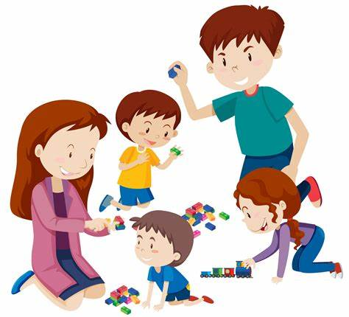
Interventions
Welcome Packs
Each child will receive a welcome pack before they start in nursery. In the pack, there a multiple forms for parents to fill out, and plenty of room to ensure the parents are telling the practitioners everything about their child, and their specific needs. This allows the practitioner to gain an understanding of how they can meet this child’s needs, before the child can even starts at nursery.
Welcome Meetings
Before the child starts at nursery, they will come into the setting, with their mother/father/parent/carer, to have a sense of understanding and for the setting to be familiar to them, when it is time to actually start at nursery. At the welcome meetings, the welcome packs will be given out, where the parents have the chance to write anything down that they want to practitioner to be aware of. Alternatively, they have the chance to pull the practitioner to one side, and discuss any issues or anything to be aware of. This will give the practitioner a head start, in a way, to plan any interventions needed in order for the child to feel safe at nursery.
Stay and Play
Some nurseries allow the parents to come in with their child, and play with them at the nursery. This allows the child to see that their parent and the practitioner build a relationship, meaning that they will be more likely to trust the practitioner more, seeing that their parents are friendly with the practitioner, and have trust in them.
Clipart Library (2016)
Webstock (2022)
Vecteezy (2022)

Slide 9

Proposed Outcomes
To be able to understand if the child’s transition from home to nursery is successful, the child should show positive signs, like engagement, confidence, and they feel settled in the setting.
Long term positive outcomes of the child having a successful transition is that the child will appear to confide and trust the practitioner and key worker more, meaning they will be able to speak freely, and address any issues they may encounter. This suggests that the practitioner and parent can feel more at ease, knowing that the child is happy and settled in their new environment.
Overall, the parent knows their child the most until starting school, but over time, the practitioner may become more of a support to the child, as they use Maslow’s hierarchy of needs, and meet all the child’s needs by working together to benefit the child’s development long term.
Holywell Church (2020)

Slide 10
Reference List
Parent Zone Scotland (2022) What are transitions? Available at: https://education.gov.scot/parentzone/my-child/transitions/what-are-transitions
Mcleod, S (2007) Simply Psychology. Available at: Maslow's Hierarchy of Needs - Simply Psychology
50minutes.com, (2015) Maslow’s Hierarchy of Needs. Available at: EpubReader (vlereader.com) (Accessed: 28/11/22)
Nursery Resources, (2019) The importance of communication with parents in the EYFS. Available at: Communication With Parents in EYFS and It's Importance : Nursery Resources | Blog. (Accessed: 28/11/22)
Pilcher, M (2022) Family Corner, What is a key person, and why are they important? Available at:What is a ‘key person’ and why are they important? | Family Corner. (Accessed: 28/11/22)
Clipart Files, (2016) Available at: Free Free Cliparts Files, Download Free Free Cliparts Files png images, Free ClipArts on Clipart Library. (Accessed: 01/12/22)
Webstock Review, (2022) Parent Love. Available at: Parent clipart parent love, Parent parent love Transparent FREE for download on WebStockReview 2022. (Accessed: 01/12/22)
Our Young Wonders, (2020) Five ways children learn in different ways. Available at: Five Ways Children Learn in Different Ways - Our Young Wonders. (Accessed: 02/12/22)

Slide 11
Clipart.co, (2022) Early Childhood Clip Art. Available at: Early Childhood Clip Art - Cliparts.co. (Accessed: 03/12/22)
Kelly (2016) Overcoming parent in partner relationships. Available at:Overcoming Parent In Partnership Barriers - Early Years Careers. (Accessed: 03/12/22)
Beehive Day Nursery (2022) Available at:Parent Partnerships – The Beehive Day Nursery. (Accessed: 04/12/22)
Dontpanicdothis (2022) Available at:Anxiety 101: What is the Root Cause of Anxiety? - Don't Panic, Do This! (dontpanicdothis.com) (Accessed:04/12/22)
Holywell Church (2020) Available at:Children – Holywell Church. Accessed:04/12/22)

