Slide 1
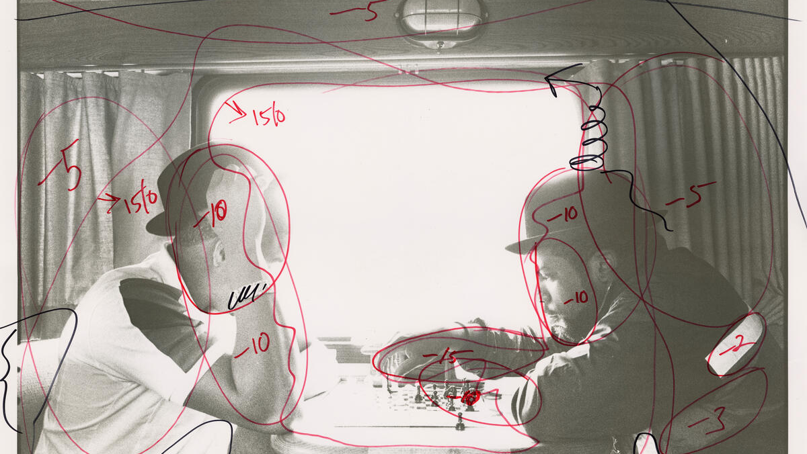
PROJECT CYCLE-
Editing & Evaluating

Slide 2
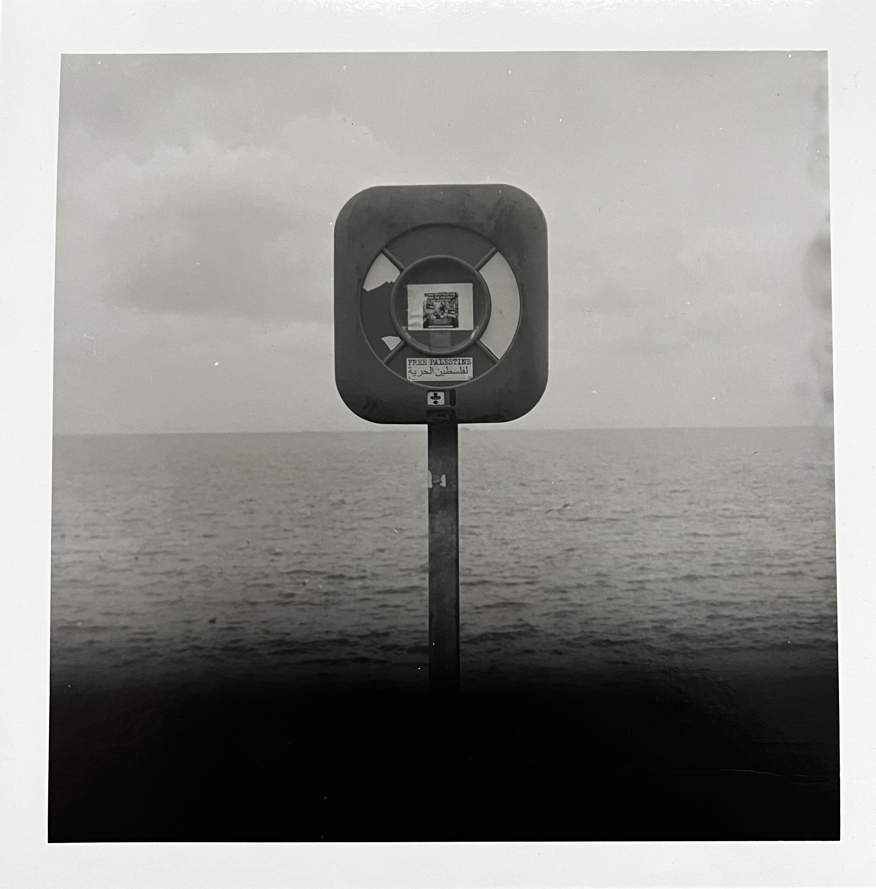
Editing
Documenting your darkroom editing is important because it helps you repeat successful results and avoid mistakes. By keeping track of your settings for the enlarger, crop choices, and contrast adjustments, you can make your process more efficient and consistent. The enlarger controls the size and sharpness of your image. Writing down settings like the exposure time, enlarger height and aperture helps you recreate the same look in future prints. Cropping affects the composition of your image. By noting how much of the image you crop out, you can easily repeat the same framing in future prints. Contrast gives your prints depth and detail. Recording the contrast filters or exposure times used ensures you can match the same look later. In short, keeping track of these details makes it easier to improve your skills, save time, and produce prints that look just how you want. It turns a trial-and-error process into a more controlled and repeatable one.

Slide 3
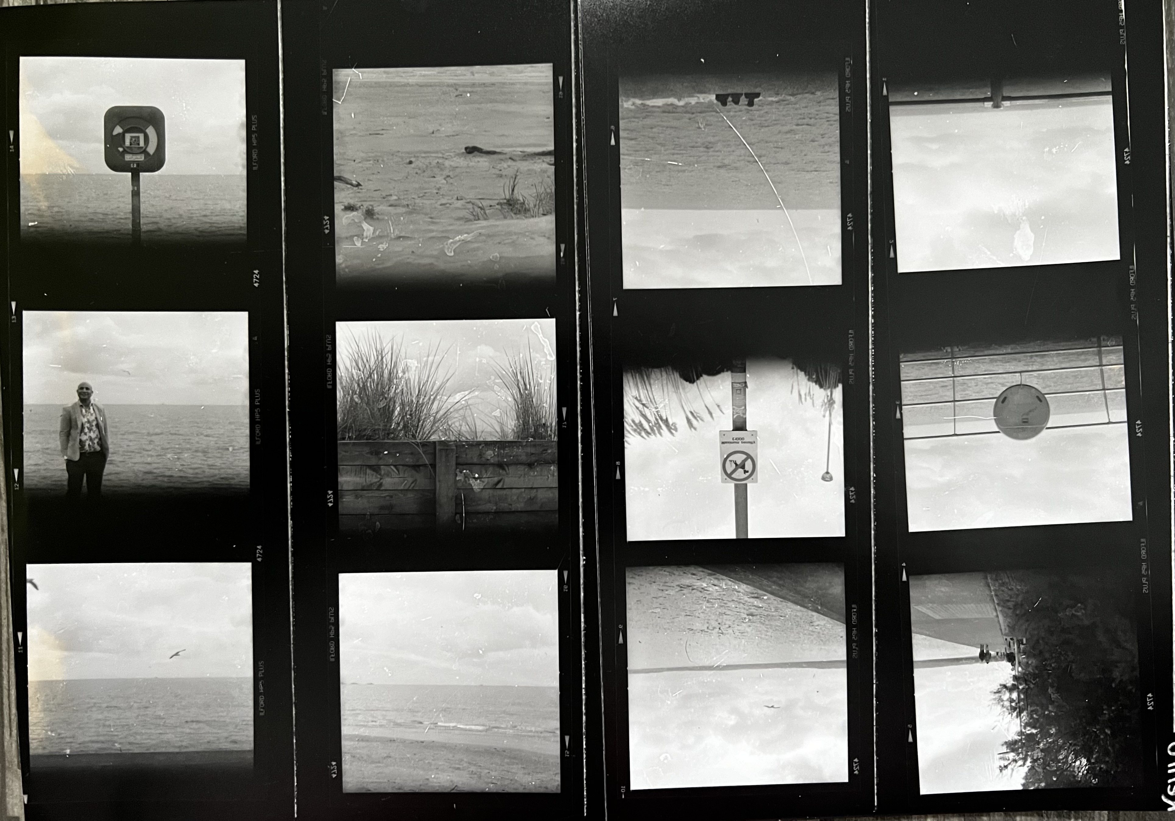
Evaluating
Evaluation is important because it helps you stay connected to your goals and understand how well you’re doing. By looking back at your work, you can see if you’re on track with what you wanted to achieve. When you evaluate your work, you can reflect on what you’ve learned. This might include new techniques or things you now understand better. It also lets you see where you’ve done well, which boosts your confidence and encourages you to keep improving. Overall I think the exposures on this roll were quite good and im really impressed with some of the shots I got. Looking at your mistakes is also a key part of evaluation. By thinking about what went wrong, you can avoid making the same errors in the future. I really enjoy working in the darkroom so I am somewhat disappointed with the outcome and neatness of this contact sheet and some other prints as I feel I could’ve been more careful and put more effort into the handling of them. Evaluation helps guide your next steps. It lets you decide what to focus on or try next, whether it’s improving certain areas or exploring new ideas.

Slide 4
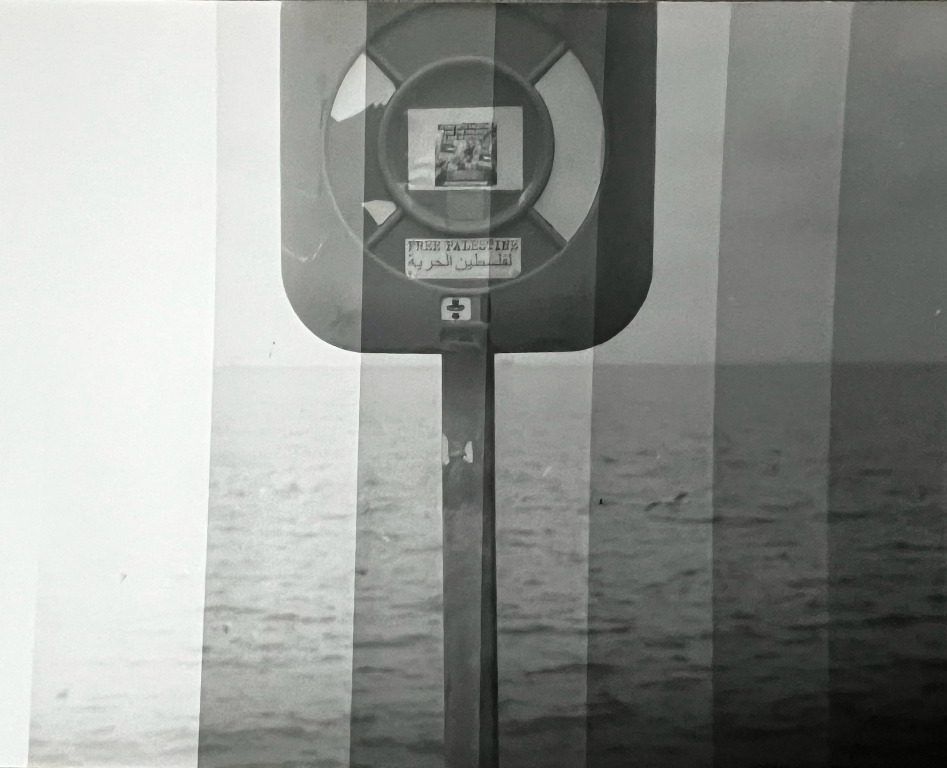
Editing – Darkroom Printing
Enlarging the Image: I placed the negative in the enlarger and adjusted the focus. Using the enlarger’s controls, I chose the appropriate aperture size to control the depth of field and exposure. I set the exposure time to 10 seconds at f/22 with no filters based on test strips and previous experiments.
Cropping: Using the easel, I decided on the crop. I adjusted the edges of the frame slightly but just enough to ensure I had clean crisp edges and perfectly centered subject. I made sure I had equal consistent borders.
Exposure: I turned on the enlarger light for the selected exposure time. After the exposure was complete, I quickly moved the paper to the developer tray.
Development Process: The paper went through a series of chemicals—developer, stop bath, and fixer—followed by rinsing and drying. I carefully monitored the timing in the developer, allowing about 1 minutes of exposure for proper contrast development. My chosen paper was fibre based so the wash time is prolonged by atleast 40 minutes.
Evalution: I was really happy with and proud of this print.

Slide 5
Critique
100-300 words noting your findings from the critique
Respond to 3 post it notes left about your work.
Reflect on how your work has been received.
Include an image of the critique

Slide 6
Evaluating
100-300 evaluation.
Aim – did you achieve your aim. Reflect on this
Planning – Did you plan well. What would you do differently?
Shoot – How did the shoot go? Did you perform well. Would you change anything?
Selection (from contact Sheet) – Does your selection make sense for your aims?
Editing/Printing– Are your edits good quality? Did you learn something new?
*Critique – What do other people think? Is your work talking to your audience?
Outcomes – Have your outcomes displayed new skills? Do they achieve aims? What can you improve?

