Slide 1
Student name: Elzbieta Danuta Kander
Student ID: 2007505
BA Leadership and Management Skills for the Workplace
Module: Developing Emotional Intelligence Skills for the Workplace
Module code: BMSW6106
Lecturer: Dr Sujeewa Herath
Assignment Title: Evaluation of Emotional Intelligence in Workplace

Slide 2
Content Page
Page 3 – Introduction
Page 4 – Emotional Intelligence Definitions
Page 5 – TK-max Retail Warehouse High Employees Turnover
Page 6 – Emotional Intelligence in TK-max – Examples
Page 7 – The impact of Emotional Intelligence on organizations (TK-max example)
Page 8 – Models of Emotional Intelligence
Page 9 – The Mixed Model: The Goleman Model and The Bar-on Model - Solution
Page 10 – Comparision of Emotional Intelligence Models
Page 11 – Justification of Goleman's Model in TK-max case to improve the employee's turnover
Page 12 - References

Slide 3
Introduction: Emotional Intelligence (EI) and its Impact on organization
EI Definitions
TK-Maxx: EI Case Example
Importance of EI
EI Models
Mix Model
Compares all Models
Justification of Mix Model

Slide 4
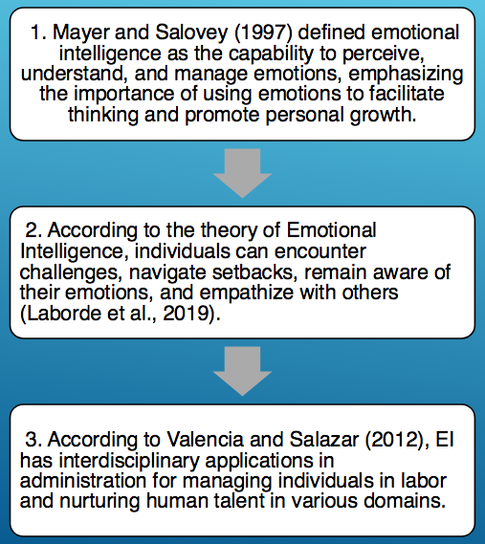
Emotional Intelligence (EI)
SELF AWARENESS
SOCIAL AWARENESS
RELATIONSHIP MANAGEMENT
SELF-MANAGEMENT
EI

Slide 5
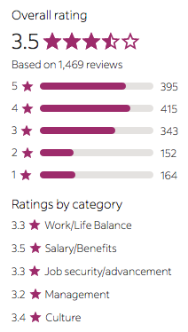

TK-Maxx Retail INTERNATIONAL COMPANY - the case example of EI in An Organization
In 2022 the company had 340,000 employees globally.
The Tk Maxx Employee Review on the Indeed Job UK website.

Slide 6
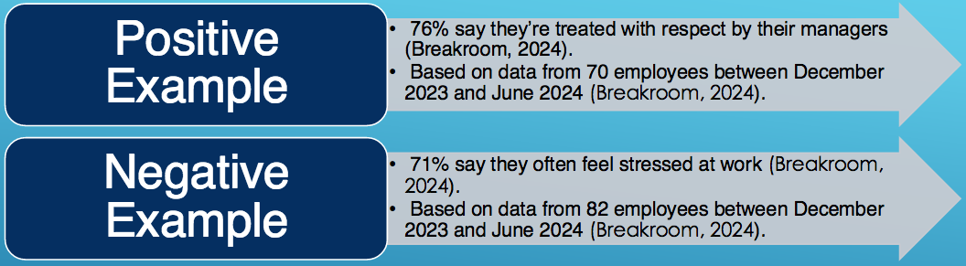
EI in Tk Maxx UK
"Our recruitment efforts aim to fill positions with high turnover and address seasonal staffing needs.[..] We also have faced and may continue to face potential challenges relating to Associates’ willingness or ability to staff our stores and distribution centers to continue employment due to economic pressures and health concerns" (TJX (AR), 2023, p.15).
The main problem: High employee turnover.

Slide 7
The Importance of EI in Organization
Benefits of high EI for organization
Employees: engagement, intrinsic motivation, development, creativity, problem-solving, stress management, well-being, performance, resilience...
Managers and Leaders: leadership qualities, change management, social skills, conflict management, professional growth, awareness, empathy...
Organization: positive culture, happy stakeholders, productivity, efficiency, low staff turnover, high retention, loyalty, high morale, profit, reputation.

Slide 8
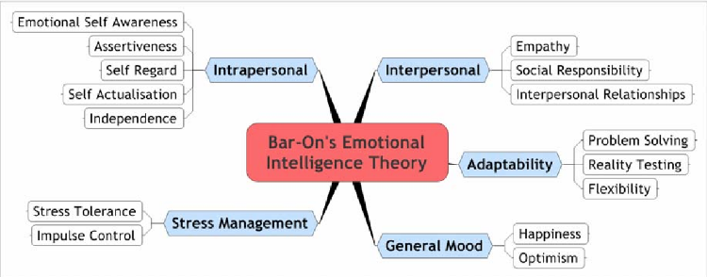
EI Models
Mixed Model: Goleman's Model
Salovey and Mayer (1997) Ability Model
Mixed Model: Bar-on Model (2006)
Self-awareness
Social Awareness
Self-Management
Relationship Management
Perceiving Emotions
Managing Emotions
Using Emotions
Understanding Emotions
The Trait Model
Emotionality
Social Skills
Self-control
Wellbeing

Slide 9
The Mixed Model as a solution for TK Maxx Case
The Goleman's Model
The Bar-on Model

Slide 10
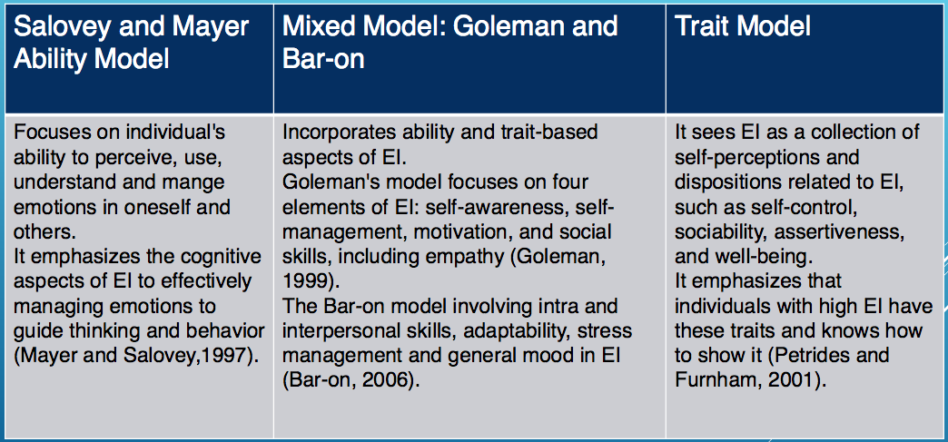
Let's Compare all 3 Models

Slide 11
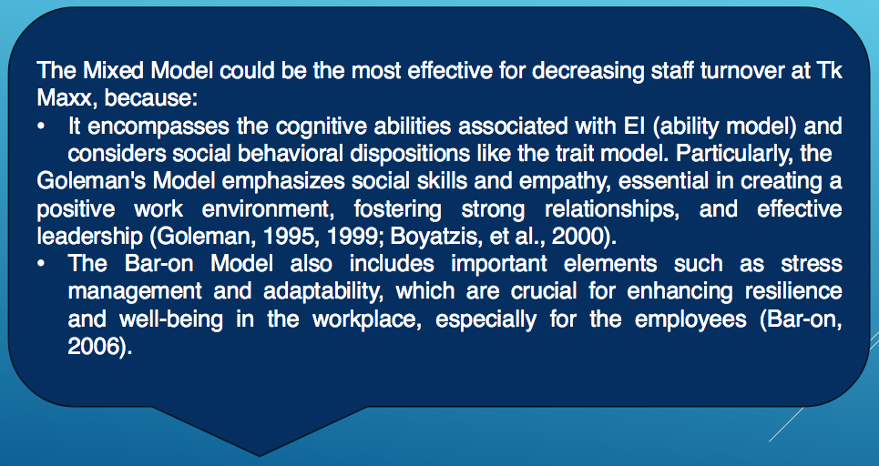
Justification of Mixed Model as a Solution

Slide 12
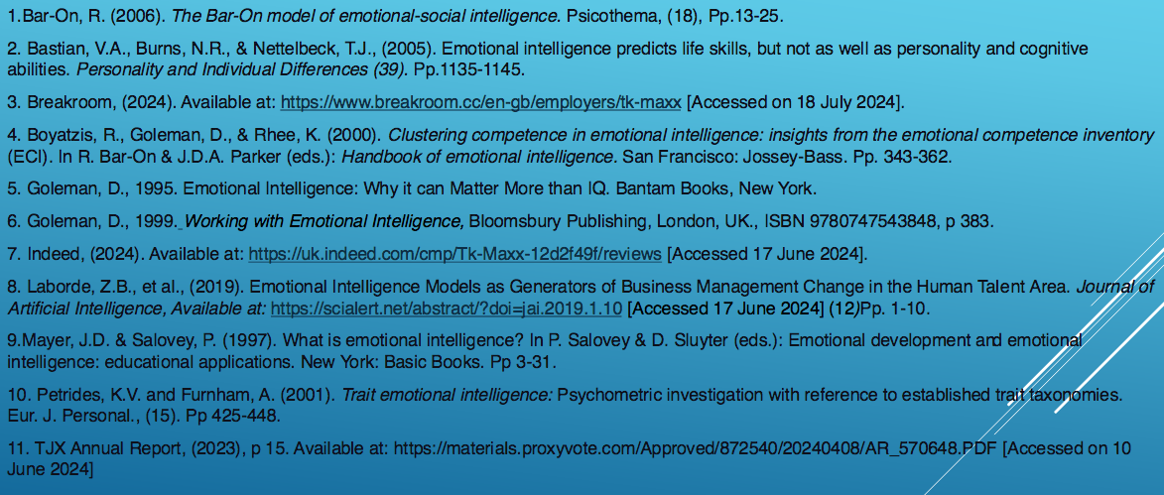
References

