Slide 1
Recycling of Composite Materials
By
Andrew Thorn

Slide 2
Introduction
Three types of composite materials are developed
Polymer-matrix composites
Metal + matrix composites
3. Ceramic-matrix composites

Slide 3
Introduction
Polymer-matrix is dominating the market, with thermoset composites accounting for more than two-thirds with growth increasing rapidly
Composites have recently become a primary material for the new generation of commercial aircrafts such as Boeing 787 (50%), Airbus A380 (25%) and the future A350 (53%)

Slide 4
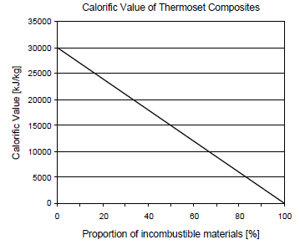
Calorific Values of Thermoset Composites

Slide 5
Introduction
Weight saving technology in automobiles is crucial for improved fuel efficiency
Composite materials are also used in sports and recreation facilities, boat and shipbuilding, in wind energy generation for wind turbines blades, as well as in oil and gas offshore exploration

Slide 6
Challenges/Problems
At present there are very limited commercial recycling operations for main stream composite materials, due to technological and economic constraints
Basic problem is the difficulty to liberate homogeneous particles from the composite materials
Composite recycling is hindered both by the fibre and other types of reinforcement, and by matrix or binders in particular the thermoset type

Slide 7
Challenges/Problems
Lack of markets
High recycling cost
Low quality of recyclates versus virgin materials

Slide 8
Need to Recycle
Concern for the environment
Use of finite resources
Need to manage waste disposal
Prevent waste through prevention at source during manufacture
Stopping of disposal of composite materials in landfill
Legislation that deal with particular waste streams

Slide 9
Recycling Technologies
Mechanical Recycling: - involves shredding and grinding followed by screening to separate fibre-rich and resin-rich fractions for re-use
Thermal processing: - uses high temperature to decompose the resin and separate the reinforcement fibres and fillers
Chemical recycling: - aims at chemical depolymerisation or removal of the matrix and liberation of fibres for further recycling by using organic or inorganic solvent

Slide 10
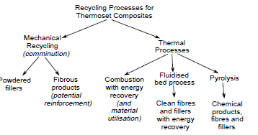
Recycling Thermoset Composites

Slide 11
Mechanical Recycling
Starts with the size reduction by crushing or low speed cutting to 50 – 100mm
Further size reduction occurs through milling operations to 10mm to 50µm
Afterwards particles of waste composites are classified to fibre-rich (coarser) and matrix-rich (finer)

Slide 12
Mechanical Recycling
The recyclates in the form of fine powders can be used as a substitute for calcium carbonate filler in new sheet or bulk moulding compound
At levels of 10% recyclate reductions in mechanical properties are tolerable, but higher levels give rise to processing issues because the recyclate absorbs more resin and increases the viscosity of the moulding compound

Slide 13
Mechanical Recycling
An advantage of the recyclate is that it has a lower density than calcium carbonate and so a component containing 10% recyclate as filler substitute can be 5% lighter than one using only calcium carbonate
The use of coarser fibrous recyclates in which the larger pieces of recyclate contain significant amounts of intact fibre, is more difficult and reductions in strength and toughness are reported
This is believed to be due to a lack of bonding between the recyclate and the polymer and the larger particles of recyclate acting as stress raisers in the composite

Slide 14
Thermal Recycling
Three principle types of operation
Combustion with energy and material utilisation
Fluidised-bed combustion recycling process
Pyrolysis with both fibre and fuel recovery

Slide 15
Combustion with Energy and
Material Utilisation
In order to recover some value from the incombustible material, burning scrap composites in cement kilns is an effective route as the glass reinforcement and mineral fillers commonly used in composites contain minerals that can be incorporated in cement
The only issue was the presence of boron which in the case of high levels (greater than 0.2%) can increase the time for the cement to set

Slide 16
Combustion with Energy and
Material Utilisation
Alternatively, if scrap composites are co-combusted with coal in a fluidised bed combustor any calcium carbonate filler in the composites will absorb oxides of sulphur from the combustion of the coal and so reduce the sulphur emissions

Slide 17
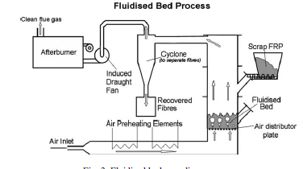
Fluidised-Bed Process

Slide 18
Fluidised-Bed Process
Scrap composites are initially reduced in size to about 25mm and fed into a fluidised bed of silica sand
The sand is fluidised with a stream of hot air and typical fluidising velocities are 0.4 – 1.0m/s at temperatures in the range of 450°C - 550°C
In the fluidised bed, the polymer volatilises from the composite and this releases the fibres and fillers to be carried out of the bed as individual particles suspended in the gas stream

Slide 19
Fluidised-Bed Process
The fibres and fillers are then separated from the gas stream which can then pass into a high temperature secondary combustion chamber where the polymer is fully oxidised
Energy may subsequently be recovered from these hot combustion products

Slide 20
Fluidised-Bed Process
The recovered fibres are clean and have a mean length of 6-10mm
Recovered glass fibres suffer from 50% tensile strength reduction at 450°C while carbon fibre has less degradation after treatment at 550°C with 20% loss in stiffness

Slide 21
Fluidised-Bed Process
A particular advantage of the fluidised bed process is that is very tolerant of mixed and contaminated materials
Mixtures of composites of any polymer type can be processed and the process is tolerant of painted surfaces or the presence of foam cores in composites of sandwich construction
Metal inserts moulded into a composite do not have to be removed before being fed into the fluidised bed as any metals are retained in the bed and could be separated by regrading the sand

Slide 22
Pyrolysis Recycling Process
Is the thermal decomposition of polymers or depolymerisation at high temperatures of 300 - 800°C in the absence of oxygen, allowing for the recovery of long, high modulus fibres
A higher temperature of 1000°C can be applied but the resulting fibre products will be more seriously degraded
It can be used for the treatment of polymers and polymer matrix composites

Slide 23
Pyrolysis Recycling
The pyrolysis process will breakdown networked resins into lower molecular weight organic compounds in the form of liquid, gas and solid carbon char
It generates the products with potential use as feedstock for further chemical processing
The solid product is normally a mixture of fibre glass or carbon fibre, filler materials, and solid carbon. Separation is needed in order to re-use the reinforcement fibres, or fillers

Slide 24
Pyrolysis Recycling
The condensated liquid product is often a mixture of complex organic compounds with relatively high calorific value similar to fuel oil (30 – 40 MJ/Kg)
The gaseous products are often a mixture of CO, CO₂ and hydrocarbons with relatively low calorific value (15 – 20 MJ/Kg) and can be used as heat source to sustain pyrolysis process

Slide 25
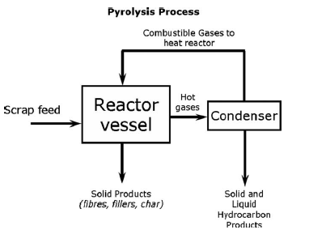
Pyrolysis Recycling Process

Slide 26
Chemical Recycling
Involves the process for Chemical depolymerisation or removal of the matrix by using chemical dissolution reagents for liberation of fibres.
The chemical recycling process can re-generate both the clean fibres and fillers as well as depolymerised matrix in the form of monomers or petrochemical feedstock

Slide 27
Chemical Recycling
The dissolution process is often is often called solvolysis, and depending on the solvent can be further classified as: hydrolysis (using water), glycolysis (glycols), and acid digestion (using acid)
When using alcohol or water, high temperature and high pressure are normally used under either sub-or supercritical conditions to gain a faster dissolution and a higher efficiency
For acid digestion, atmospheric conditions are normally applied but the reaction rate could be very slow

Slide 28
Chemical Recycling
Using water or alcohol is environmentally relatively clean, and both could be separated from the dissolved solution using evaporation (for water) and distillation (for alcohol)
The process could be used for different types of reinforcement materials (carbon and glass fibres)
The re-generated fibre retains most of its mechanical properties

Slide 29
Chemical Recycling
For reaching a higher dissolution efficiency an alkaline base is normally used as catalyst (e.g. NaOH, KOH)
However, separation of the used catalyst salt from the recovered oil and purification of the depolymerised products, highly viscous oil, is still a challenge

Slide 30
Discussion
The thermal recycling processes have the advantage of being able to tolerate more contaminated scrap materials
The fluidised bed process produces a very clean fibre product, but it is not in the same form as an existing virgin fibre products and the same applies to the pyrolysis

Slide 31
Discussion
The fibres from the pyrolysis may have varying degrees of char on them, which may limit the reuse options or require further processing to remove it
Pyrolysis process has the potential to produce chemical feedstocks from the polymer but these may be difficult to refine from the mixture of products produced
If a pyrolysis process only produces chemicals suitable for use as

