Slide 1

Airbnb – Digital Business

Slide 2



Introduction
Ben Rees - 2003741
Digital business
Dr Roisin Mullins
Notes:
This is Ben Rees Student number 2003741. In the presentation, I will be identifying themes within the book peer-to-peer accommodation networks, written by Sara Dolnicar, I will then be reviewing, critiquing, and linking these themes to Airbnb. I will select three chapters from the book selecting two themes from each chapter to analyse.

Slide 3


Chapter 2
Notes:
The first chapter that I will be looking at, is chapter 2. In this chapter, I will be looking at both the sharing economy as well as collaborative consumption.

Slide 4
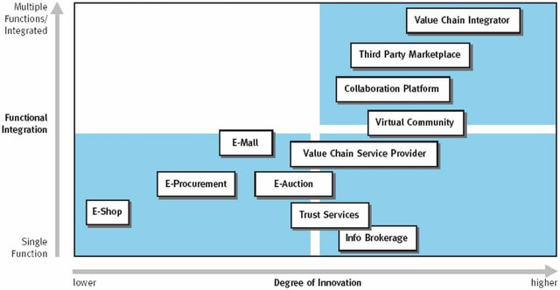
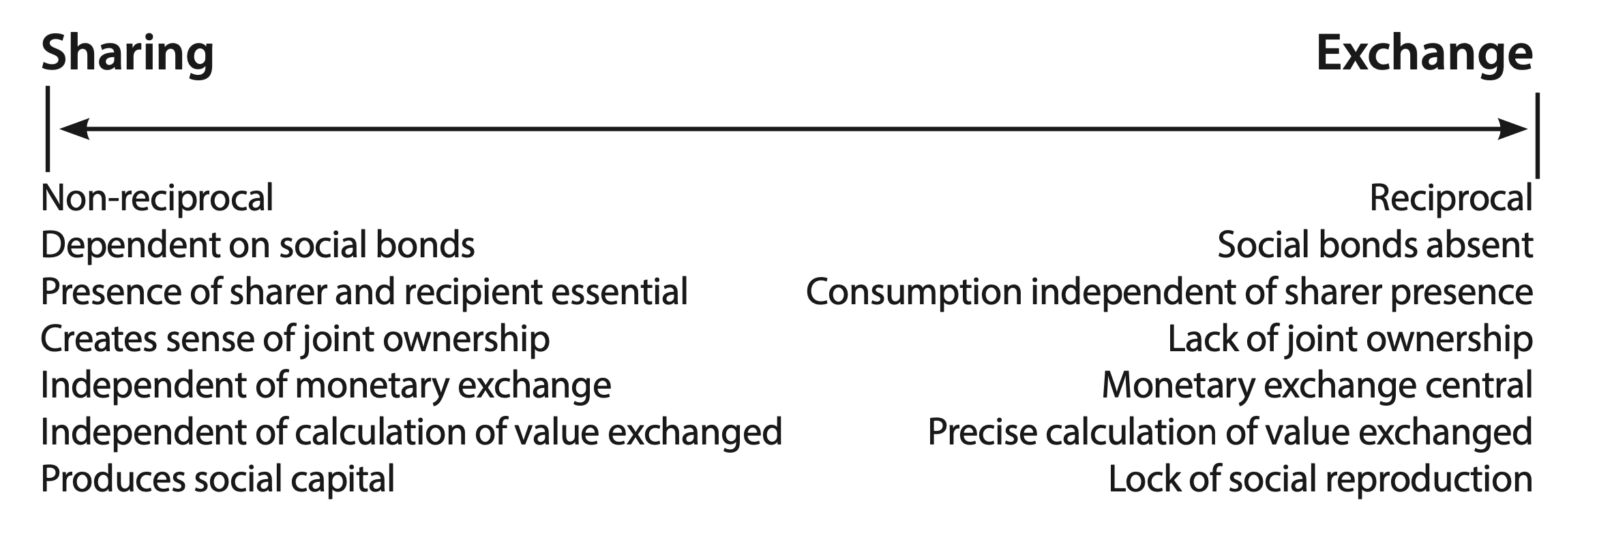
The sharing economy
Airbnb
The sharing-exchange continuum (Dolnicar,2017)
Classification of Internet business models (Timmers 1999).
Notes:
In chapter 2, I will be looking at both the sharing economy as well as collaborative consumption. The sharing economy has had a major effect on tourism and hospitality and according to Statista the sharing economy is set to reach a value of $335 billion by 2025 up from $15 billion in 2014, at the forefront of the is Airbnb. The sharing economy is defined by Allen as “a suite of emerging software platforms acting as an intermediary between private buyers and private sellers, allowing them to share their existing resources”. As stated by Dolnicar, there is a conflict regarding the definition of the word ‘sharing’ however the is a unanimous agreement according to Munoz & Cohen that the sharing economy refers to “a specific context of exchange”. According to Breidbach & Brodie, the transactions within the sharing economy are transactions between buyers and sellers for access to resources in exchange for rewards, whether it be monetary or non-monetary which are facilitated by a third party. Within the sharing economy, it is not possible for a buyer and seller interaction to occur without the facilitator, which is what Airbnb is, Airbnb is the platform that connects buyers and sellers, however, the final decision on whether the transaction takes place is ultimately up to the buyer and seller respectively.
Within the sharing economy, there are different levels of ‘sharing’. To demonstrate this Habibi et al created the sharing-exchange continuum. At one end is sharing and at the other is exchange. Airbnb is placed in the middle, as it shares characteristics of both sharing and exchange ends of the continuum, however, different types of peer-to-peer accommodation networks range across the entire sharing continuum, depending on their business model. Dolnicar states although Airbnb does not technically facilitate ‘sharing’ as there are monetary exchanges between hosts and guests, it is part of the broader sharing economy. Contrary, Phua suggests that based on their analysis of Airbnb they do not tend to fit the criteria of the sharing economy, they are more of a booking platform. Airbnb is the market leader in peer-to-peer accommodation, which suggests their underlying model which places them in the middle of the continuum is the most effective. Dolnicar goes on to state that Airbnb’s model is nothing new, it’s a variant of the multi-sided platform that was utilized before the conception of Airbnb. One of the many differences between Airbnb and other home-sharing platforms is the fact that they offer extensive information about both hosts and guests, which ensures both guests and hosts are happy for the exchange to take place before the exchange is finalised. Timmer’s, created 11 different types of business models that are each facilitated by the web, he categorised these models based on functionality and the degree of innovation, as seen on the slide Airbnb falls into the upper right-hand side of Timmer's model, this is due to Airbnb’s high functionality as well as their innovative approach.

Slide 5

Collaborative consumption
“A market model that enables individuals to coordinate the acquisition and distribution of a resource for a fee or other compensation” (Belk, 2014).
Notes:
One of the key aspects of the sharing economy is collaborative consumption. Belk states that collaborative consumption is a “market model that enables individuals to coordinate the acquisition and distribution of a resource for a fee or other compensation”. According to John, the internet was an enabler for collaborative consumption and states collaborative consumption is reliant on technology in three ways, firstly technology is an enabler, secondly, technology drives and encourages collaboration, for example, social media sites such as Twitter and Facebook and finally, the language that we are familiar with regarding collaborative consumption originated from high-tech start-ups. John also states that collaborative consumption is very much technology-based, and it became much more prominent as we entered web 2.0.
According to Dolnicar, Airbnb is the largest example providing peer-to-peer accommodation, and one of the key enablers of this is, the platform they use to connect hosts and guests, these online platforms are used not only for communication but also for service delivery. As stated by Dolnicar, Airbnb does not fall into the ‘sharing’ end of the sharing exchange continuum like couchsharing, primarily because there is a monetary exchange between the host and guest which means that Airbnb does not constitute true sharing. This, however, does mean that Airbnb would fall under the term collaborative consumption. Rowe states that Airbnb, as well as Uber, are two of the largest organisations that operate using collaborative consumption. According to Rowe, there are four types of collaborative consumption, these are market, government, advocacy and finally, social. Airbnb falls into the most common category of collaborative consumption which is the market category.

Slide 6


Chapter 6
What makes Airbnb so successful?
Notes:
In chapter 6 I will be looking at Airbnb's business model as well as the value that it offers its users in comparison to its competitors. According to Dolnicar Airbnb is the market leader in peer-to-peer accommodation in most countries across the globe with the exception of China, but what makes Airbnb so successful?

Slide 7
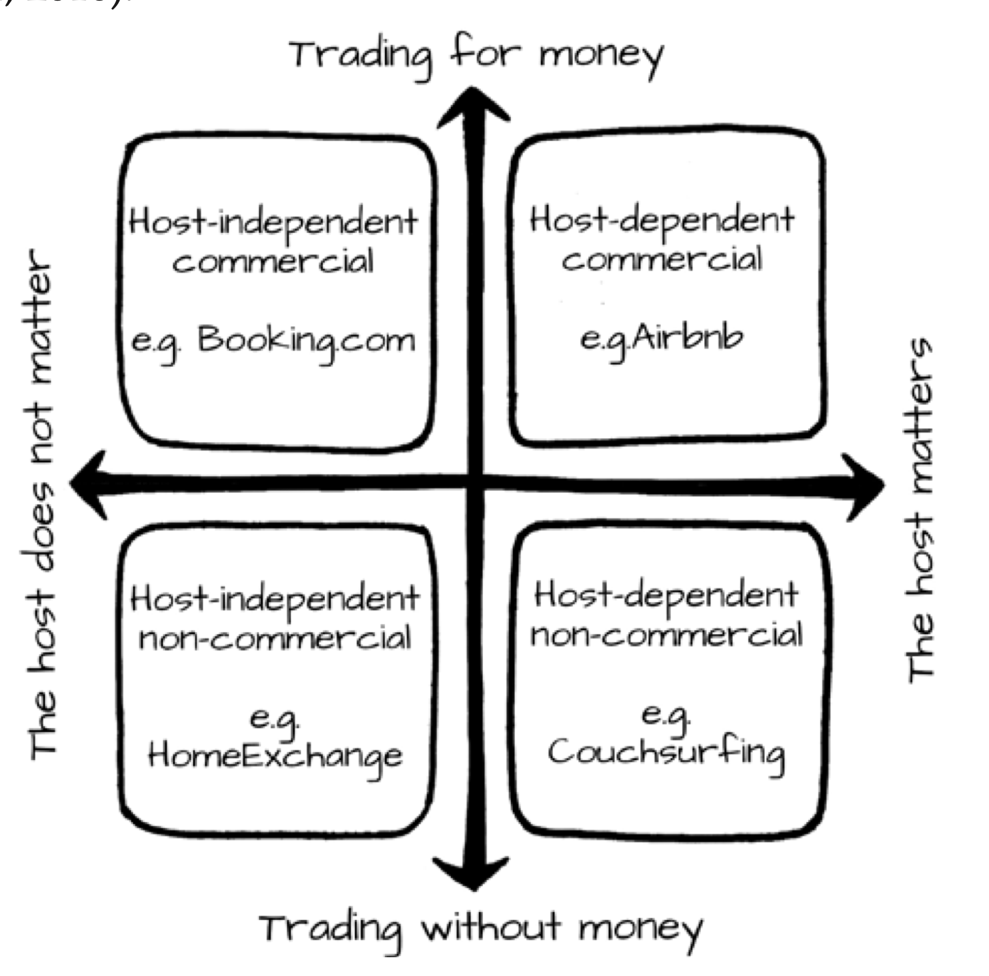
Business model
A business model is “a versatile management concept that creates, captures, and disseminates value” (Dolnicar, 2017)
(Dolnicar, 2017)
Notes:
Timmers defines a business model as “An architecture for product, service, and information flows, including a description of various business actors and their roles, a description of the potential benefits for the various business actor and a description of the source of revenue”. Dave Chaffey defines a business model as “how a company will generate revenue, identifying its product offering, value-added services, revenue sources and target customers”. In comparison, the definition provided by Dolnicar is, a “versatile management concept that creates, captures, and disseminates value”. Osterwalder and Pigneur state that a business model was the missing link between strategy and business processes.
As stated in table 6.1 most facilitators charge a commission for the service they provide and also enable their hosts to charge a fee, with the exceptions of Home Exchange, GoCambio and Wimbify, these facilitators all work under a model called the barter model where accommodation is exchanged for a different service, this is one of the differentiators alongside how valued the hosts are, according to Dolnicar. As can be seen on the slide, in figure 6.1 Dolnicar identifies four types of facilitators. Airbnb is a host-dependent commercial facilitator. Airbnb is the prototype for this type of facilitator, in these types of facilitators guests pay money in return for a space, with the credibility of the host crucial in this model, which is why Airbnb have host reliability standards, which consist of commitment, cleanliness, accuracy and communication.
According to Barbu et al, there are three types of business models within the sharing economy, these are the access-based business model, the marketplace or platform economy, and the on-demand service provider. Of these three Airbnb falls into the access-based business model, this model is based on providing access to underutilized resources using an online platform. In contrast Dolnicar states that Airbnb uses the multi-sided business model, this model is also based on underutilized resources whilst connecting two or more parties. These two models are very similar, however, Dolnicar's model best represents Airbnb as it highlights the peer-to-peer network, unlike the access-based model. Another way of identifying business models is using Tapscott’s business webs, there are five types of business webs, these are agora, aggregation, value chain, alliance, and distributive networks. Of these five Airbnb fall primarily into the aggregation model, as it's based on an intermediary between producers and customers just like in Dolnicars multi-sided platform where there is a facilitator connecting two or more parties. Within the aggregation model, the intermediary takes control of value selection and fulfilment, pricing, and market segmentation as is the case in Dolnicars multi sided platfrom.

Slide 8


Value
How did Airbnb bring value to the existing market?
Notes:
Airbnb utilised the internet and online platforms to offer value that traditional hotels could not offer, this is known as digital disruption, which is defined by Dave Chaffey as “Creating innovative omnichannel experiences by exploiting new digital technologies to drive incremental revenue by delivering relevant propositions, real-time contextual communications and experiences across all touchpoints”. At the heart of digital disruption is “value innovation”. Kim and Mauborgne define value innovation as “new e-business entrants have often been able with limited resources to undermine existing competition in the industry through the use of new business models”.
When looking at value it's important for a facilitator like Airbnb to consider the value they offer for guests, hosts, suppliers, and stakeholders. The value proposition that Airbnb offer its guests is, as stated by Dolnicar in table 6.2, they help them to find suitable accommodation, provide free access to their convenient and easy-to-use platform, help to mitigate any potential risks they may encounter and help improve their overall experience. The value proposition Airbnb offers its hosts include, providing them with the opportunity to generate income, be part of a community and provide the opportunity to meet new people. Dolnicar and Reinhold state in “the evolution of Airbnb’s business models” that Airbnb also creates value for hosts by mitigating risks, handling monetary transactions and identifying suitable guests and offering third parties the ability to engage with new clients.
Airbnb also creates value for its guests, hosts and third parties through its key activities, this is done by utilising its key resources. According to Dolnicar, their first key activity is attracting and maintaining their network of guests and hosts, and this is achieved due to their effective platform and marketplace. According to Feldman and Pentland, as the number of hosts increases the more effective Airbnb’s platform which leads to greater success, this is known as the network effect. The second key activity is matching the best-suited guests and hosts with one another, this is achieved by using their clever search algorithms which allows them to micro-segment which gives them a competitive edge compared to their rivals. Another key activity Airbnb takes part in is helping to mitigate the risks for both guests and hosts, and this was a major concern prior to Airbnb’s success, there were huge concerns regarding strangers coming into other people's spaces. For example, one way in which Airbnb mitigate risks for guests is by using peer-to-peer CVs, which allow guests to see reviews of their chosen host, to ensure they provide the service the guests require, this also works for hosts whereby can see reviews of other hosts regarding the potential guests they may be hosting, this means both parties must be happy with one another before the transaction takes place.
Regarding value communication and transfer, Airbnb’s primary communication methods are email, advertising, and their website and app. This helps them to communicate with hosts and guests to ensure the process is as smooth as possible. Next, I will be looking at how Airbnb captures value. As mentioned previously Airbnb charges a small commission which is split between the guests and hosts, 3-5% for hosts, and 6-12% per transaction of the total cost for guests respectively.
Finally, I will be looking at value dissemination, according to Dolnicar, hosts risk property, risk their reputation and there's a risk to community goodwill, to counter this hosts can remove their property from the site. The guests risk their life, there's a small risk of being scammed, they risk their privacy and finally, there's a risk of their expectations not being met to counter this guest can decide not to use the platform. Airbnb itself risk its reputation and profitability. Neighbours of hosts and the community in which they live deal with more noise, a potential reduction in safety and a potential increase in littering to combat this they could write complaints to Airbnb.

Slide 9


Chapter 14
Digital Disruption and risks to employment
Notes:
The third and final chapter I will be looking at is chapter 14 and, in this chapter, I will be looking at how Airbnb has disrupted the market and the potential risks it has on traditional employment.

Slide 10


Risks to employment & digital disruption
How has Airbnb disrupted the current market and what effect will this have on traditional hotels?
Notes:
Airbnb has undoubtedly caused a disruption within the hospitality and tourism industry, rivalling renowned traditional hotels in the commercial sector. One great tool to use to highlight these values is Kim and Mauborgne’s value curves, the value curves are a strategic tool used to see how successful an organisation's strategy is compared to its competitors, when looking at the value curves there are four key questions to answer.
The first question to answer is how Airbnb has raised the standard in the hospitality and tourism industry, Airbnb offers hosts the opportunity to generate an income and guests have many more accommodation choices compared to commercial hotels, Airbnb also offers guests a much more authentic and unique experience compared to traditional hotels. The second question to answer is what Airbnb has eliminated that the industry takes for granted and in this case, it’s the need for physical hotels, Airbnb's peer-to-peer model allows individuals to rent out their own personal space which negates the need for hotels the third question to answer is what has Airbnb offered that has not been offered before, Airbnb offer accommodation to guests without actually owning any of the premises themselves. Finally, there is the question as to how Airbnb has reduced the industry standard, as not everything Airbnb offer is better than traditional hotels, for example, hotels offer a service, such as making food for guests and cleaning their rooms, whereas Airbnb this would have to be done by the guests themselves.
These factors are causing a reduction of jobs in hotels as they simply cannot compete in price with Airbnb and one-way traditional hotels are reducing their own costs is by cutting jobs, in some cases, hotels are forced to close due to the disruptive innovation and value that Airbnb has brought to the market leading to fewer job opportunities in the established accommodation sector. Airbnb’s innovative model also brings positives, it allows people to have an of extra income. Platforms like Airbnb also could provide managerial opportunities, where individuals require a manager to manage their properties.

Slide 11

Conclusion
Final thoughts
Notes:
In conclusion, it's clear to see that Airbnb is at the heart of the sharing economy, the emergence of Airbnb has radically changed the face of the hospitality and tourism industry as we know it, due to its innovative business model and ever-improving platform at the expense of traditional hotels. Airbnb brings along both positives and negatives, however, it's undeniable the impact that Airbnb has had on the market leading the way for Peer-to-peer accommodation networks in the sharing economy.

Slide 12
Bibliography
About Us. Airbnb Newsroom. (2022, December 2). From https://news.airbnb.com/about-us/
Allen, D. (2015). THE SHARING ECONOMY. Review - Institute of Public Affairs, 67(3), 24-27.
BARBU, C. M., BRATU, R. T., & SÎRBU, E. M. (2018). Business Models of the Sharing Economy. Review of International Comparative Management, 19(2), 154–166. https://doi.org/10.24818/rmci.2018.2.154 Belk, R. (2014) Sharing versus pseudo-sharing in Web 2.0, The Anthropologist, 18(1), 7-23, DOI: 10.1080/09720073.2014.11891518
Botsman, R., & Rogers, R (2010), What’s mine is yours. The rise of collaborative consumption 1.
Breidbach, C.F. and Brodie, R.J. (2017) Engagement platforms in the sharing economy: Conceptual foundations and research directions, Journal of Service Theory and Practice, 27 (4), 761–777.
C. Michael Hall, Girish Prayag, Alexander Safonov, Tim Coles, Stefan Gössling & Sara Naderi Koupaei (2022) Airbnb and the sharing economy, Current Issues in Tourism,25:19, 3057-3067, DOI: 10.1080/13683500.2022.2122418
Chaffey, D. (2019, December 20). Digital Disruption / digital disruptors definition - what is? - digital marketing glossary. Dr Dave Chaffey : Digital Insights. From https://www.davechaffey.com/digital-marketing-glossary/digital-disruption-digital-disruptors/
Chaffey, D. (2019, January 23). Business Model Review definition - what is? - digital marketing glossary. Dr Dave Chaffey : Digital Insights. From https://www.davechaffey.com/digital-marketing-glossary/business-model-review/
Dolnicar, S. (2017). Peer-to-peer accommodation networks: Pushing the boundaries. Goodfellow. Retrieved December 3, 2022, from https://library.oapen.org/bitstream/id/8c26ef66-8bbd-4aa2-ad44-e0e47d3bcc9e/640674.pdf.
Feldman, M.S. and Pentland, B.T. (2003) Reconceptualizing organizational routines as a source of flexibility and change. Administrative Science Quarterly, 48(1), 94-118.
Habibi, M.R., Kim, A., and Laroche, M. (2016) From sharing to exchange:
An extended framework of dual modes of collaborative nonownership consumption, Journal of the Association for Consumer Research, 1 (2), 277–294. https://www.proquest.com/scholarly-journals/sharing-economy/docview/1735010807/se-2

Slide 13
Bibliography
John, N. (2013). (working paper). Sharing, collaborative consumption and Web 2.0. London School of Economics and Political Science. from https://www.lse.ac.uk/media-and-communications/assets/documents/research/working-paper-series/EWP26.pdf.
Kim, W. C., & Mauborgne, R. (1997). Value innovation. Havard Business Review, 1.
Kim, W. C., & Mauborgne, R. (1999). Creating new market space. Harvard business review, 77(1), 83-93.
Muñoz, P. and Cohen, B. (2017) Mapping out the sharing economy: A configurational approach to sharing business modeling, Technological Forecasting and Social Change, DOI: 10.1016/j.techfore.2017.03.035.
Osterwalder, A., & Pigneur, Y. (2002, October). Business models and their elements. In Position paper for the international workshop on business models, Lausanne, Switzerland.
Phua, V. C. (2019). Perceiving Airbnb as sharing economy: The issue of trust in using Airbnb. Current Issues in Tourism, 22(17), 2051–2055. https://doi.org/10.1080/13683500.2018.1440539 [Taylor & Francis Online], [Web of Science ®], [Google Scholar]
Reinhold, S. and Dolnicar, S. (2021) The evolution of Airbnb’s business model, in S. Dolnicar (Ed.) Airbnb before, during and after COVID-19, University of Queensland DOI: https://doi.org/10.6084/m9.figshare.14195957
Rowe, P. C. M. (2017). Beyond Uber and Airbnb: The Social Economy of Collaborative Consumption. Social Media + Society, 3(2). https://doi.org/10.1177/2056305117706784
Tapscott, D., A. Lowi, D. Ticoll, (2000). Digital Capital - Harnessing the Power of Business Webs, Harvard Business School Press.
Timmers, P. (1998) Business Models for Electronic Markets. Electronic Markets, 8, 3-8.
http://dx.doi.org/10.1080/10196789800000016 Value of the global sharing economy 2014-2025. Statista. (2022, July 6)., from https://www.statista.com/statistics/830986/value-of-the-global-sharing-economy/

