Slide 1
Reverse Logistics
Thursday 26th January 2017

Slide 2
Definition
“The series of activities required to retrieve a (used) product from a customer for re-use or disposal”
Harvard Business Review 2002

Slide 3
Five Key Principles
Product Acquisition – obtaining used product from point of use
  Customer returns – quality issues, unsuitable
  Collection from retailers
  Return of overstocked inventory
  Outdated merchandise
  End of life products

Slide 4
Five Key Principles
2. Reverse Logistics – transportation to location for inspection, sorting and/or refurbishment
Key considerations
    Shipping
    Handling
      bulky materials
      Hazardous materials
    Outsourcing
    Cost

Slide 5
Five Key Principles
Inspection and Disposition
  Key Considerations
  Bar coding to identify and track products
  Automation to avoid labour intensive sorting processes
  Make disposition decisions as early as possible to eliminate Logistics costs and to return remanufactured products to market as quickly as possible
  Recyclable materials

Slide 6
Five Key Principles
Reconditioning / Remanufacturing
  Disassembly
  Returning product to its original specification
  Salvage components and recondition for sale

Slide 7
Five Key Principles
5. Remarketing / Reselling
  Distribute and re-sell products or components
  Create market for re-conditioned components
  Outsourcing / approved agents

Slide 8
Key Drivers For Reverse Logistics
Legislation
Corporate Social Responsibility
  Sustainability
Customer / Consumer behaviour
  Rise of online retailing
  Can lead to improved customer satisfaction
Competitive advantage
  Profitability
  Supplier of choice due to successful, user friendly reverse logistics process

Slide 9
Q&A - Discussion
What impact does Reverse Logistics have on:
  Product Design
  Supply-Chain

Slide 10
Examples
Forward thinking pays dividends
Bosch builds sensors into the motors of its power tools, which indicate whether the motor is worth reconditioning. The technology dramatically reduces inspection and disposition costs, enabling the company to make a profit on the remanufactured tools. Even with reverse supply chains, forward thinking pays big dividends.
Bosch has created a very successful reconditioned tool market
http://www.cpotools.com/bosch-reconditioned-power-tools/bosch-reconditioned-power-tools,default,sc.html

Slide 11
Examples
Automotive Industry
Driven by legislation for end of life products
  End-of-life Vehicle Directive" (2000/53/EG) – UK March 2003
  Manufacturers are obliged to take back end of life vehicles
  http://www.chevrolet.co.uk/what-drives-us/end-of-life-disposal.html
Volvo anticipated the Swedish government passing legislation for the disposal of vehicles.
  Implemented a reverse logistics process of salvaging and dismantling cars,
  Generated revenues by selling components.
  Resulted in a reduction of transaction costs to approximately 5%

Slide 12
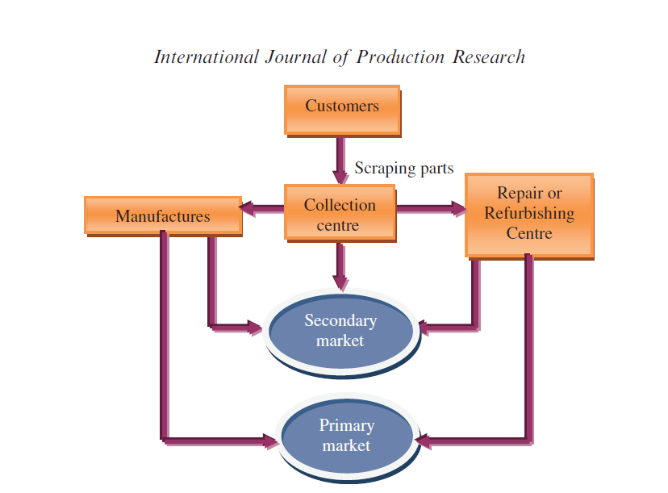
Examples
Automotive Industry

Slide 13
Online Retailing
High frequency of customer returns
No “high street” presence for acquisition
Third party logistics for transportation
Use of bar-coding technology for identification and tracking reducing labour intensive processes
https://www.wiggle.co.uk/secure/account

Slide 14
Activity
Using the 5 principles below, describe a Reverse Logistics process for an organisation of your choice
  Product Acquisition
  Reverse Logistics
  Inspection and Disposition
  Reconditioning / Remanufacturing
  Remarketing / Reselling

