Slide 1
The Humanistic Approach
(Humanistic, Humanism, Humanist)
WEEK 9

Slide 2
Origins & History
Looks at the whole person and their uniqueness.
Grounded in the belief that people are innately good.
  Morals
  Ethical Values
  Good Intentions
Arose in the late 1950’s as a rebellion to Behaviorist and Psychodynamic approaches
The driving forces of our behaviour

Slide 3
Humanistic Approach
The humanistic approach is therefore called the ‘Third Force’ in Psychology, (Fernald, 2008)
It offered
New values for approaching an understanding of human behaviour
New methods of inquiry
New effective methods in treatment (psychotherapy)

Slide 4
Humanistic Approach
What we Experience is central to our behaviour
Especially the subjective experience
  Personal feelings
  Tastes
  opinions
An accurate understanding of human behaviour cannot be achieved by studying animals.
Free will exists… not all behaviour is pre-determined
  Personal agency
    Choices we make
    Paths we choose
    consequences
Self-actualisation is normal. (Gross, 2015)

Slide 5
Humanistic Approach
People are inherently good, and will experience growth if provided with suitable conditions, especially during childhood.
  The study of consciousness and the direct experience
As people are basically good, We have an innate need to make ourselves and the world around us, better!
Each person & each experience is unique
  Psychologists should treat each case individually
  No group studies

Slide 6
Humanistic Approach
Emphasises the personal worth of the individual
  Human values and the creative, active nature of humans
  Optimistic – focuses on the noble human capacity to overcome hardship, pain and despair
Psychological therapies should be client centered and involve warmth, empathy and genuineness.

Slide 7
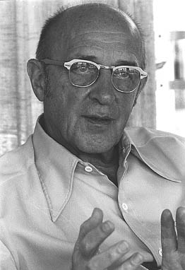
Carl Rogers (1902-1987)
Key theorist in Humanistic Psychology.
Considered by many to be the founder of the approach.

Slide 8
“The organism has one basic tendency and striving - to actualize, maintain, and enhance the experiencing organism”
(Carl Rogers, 1951)

Slide 9
Carl Rogers believed that…
Humans have a basic need to feel nurtured & valued by significant people in their lives, such as parents (love, praise & acceptance).
If this is given freely, without conditions (unconditional positive regard), then people will develop a healthy sense of self-worth, recognising their abilities & difficulties.
Children who receive negative regard, such as criticism & blame, develop low self-esteem.
To avoid this, the parents should blame the behaviour not the child.

Slide 10
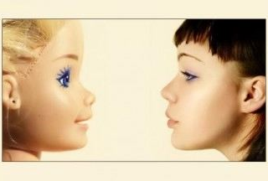
Ideal self versus real self

Slide 11
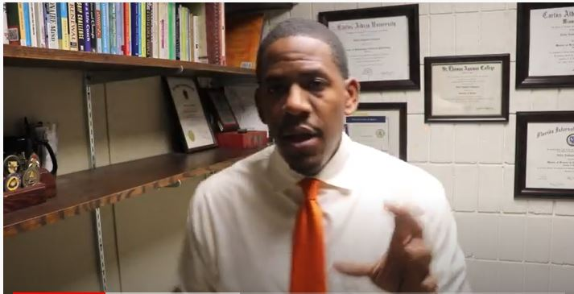
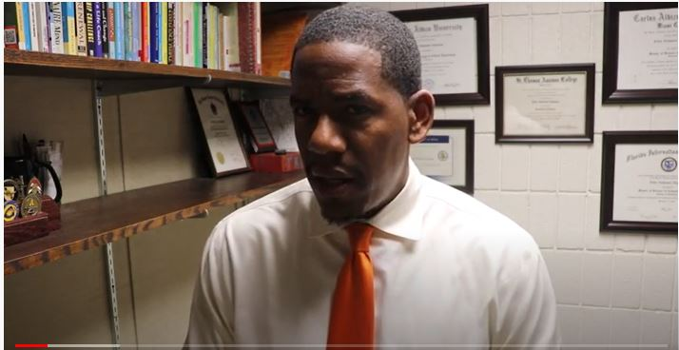
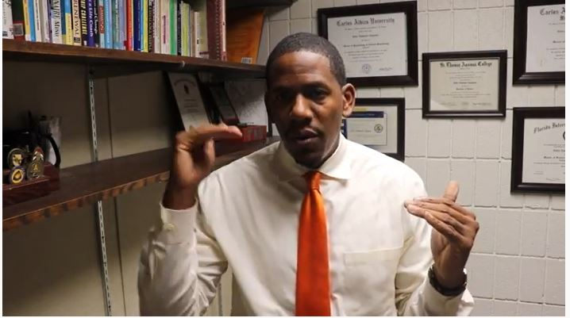
Activity – 25 minutes
Watch the videos – take notes and be ready to discuss.
Ideal self vs Real self video Part 1
Ideal self vs Real self video Part 2
Ideal self vs Real self video Part 3

Slide 12

What were your thoughts?
After watching the videos does it cause you to reflect on your own behaviours/hobbies/interests?
Or the interests/behaviours of others?

Slide 13
A sense of wellbeing
Perceived-self – actual-self – Ideal-self
A healthy sense of wellbeing is established if an individual maintains a reasonable consistency between ideal self & actual self. This is known as congruence.
The greater the gap between the ideal self and the actual self, the greater the incongruence.
Incongruence can lead to low self-worth and maladjustment.
  Failing to cope with normal social situations

Slide 14
ROGERS….
Rogers believed that every person could achieve their goals, wishes and desires in life.
When they did so self actualisation or self fulfilment took place.
People who are able to self actualise are referred to as a fully functioning person.

Slide 15
How did Carl Roger’s define a fully functioning person?
Open to experience
Existential living
  defining the essence of who we really are and accepting our unique place in the world.
  Living life to the full.
Trust feelings
Creativity
Fulfilled life

Slide 16
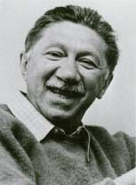
Abraham Maslow (1908-1970)
Tries to understand and measure human motivation.
Maslow stated that human motivation is based on people seeking fulfilment and change through personal growth.
(Carlson & Buskist, 2013)

Slide 17
QUESTION......
WHAT DO YOU THINK IS NEEDED TO LEAD A HAPPY AND FULFILLING LIFE?

Slide 18
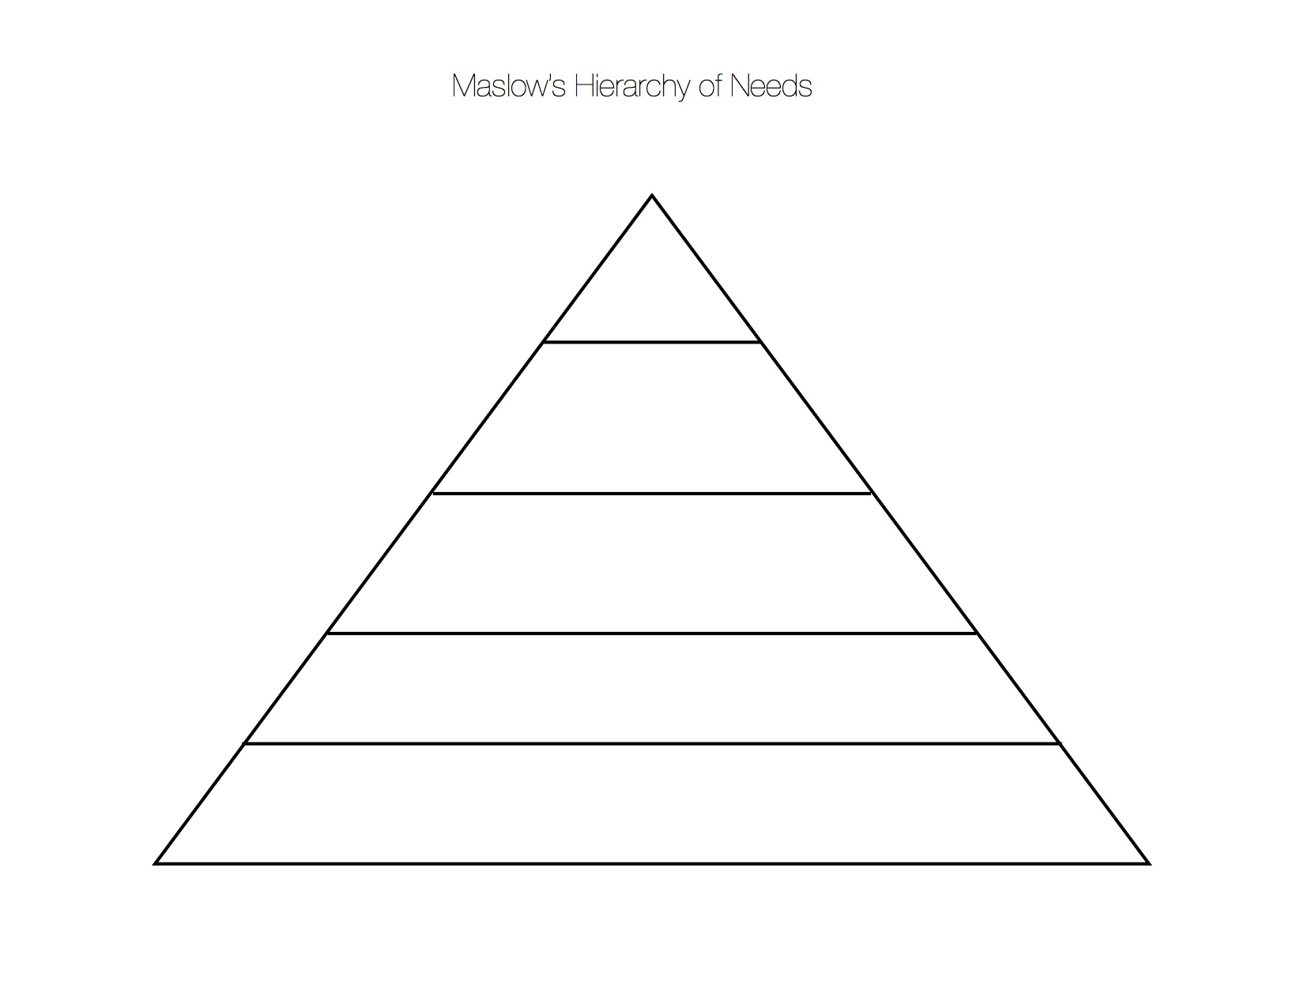
Prioritise…..
Self esteem needs
Physiological needs
Belongingness & love
Safety needs
Self actualisation

Slide 19
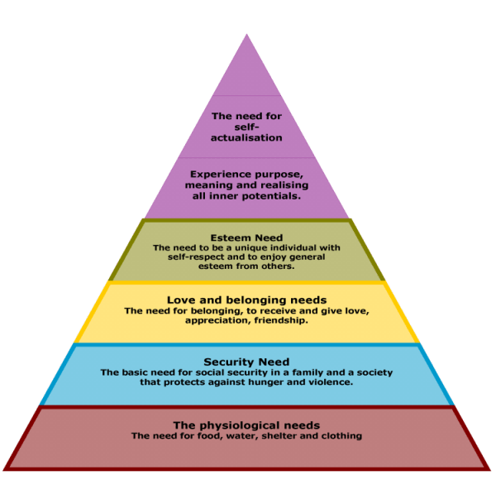
Maslow’s hierarchy of needs

Slide 20
MASLOW….
Maslow’s theory emphasises uniquely human motivational factors.
Survival or deficiency needs (BASIC NEEDS) are engaged in because they are a means to an end.
Self-actualisation is intrinsically satisfying.
  As are all needs but self-actualisation more so.
Maslow regards human motives as more than just drives.

Slide 21
MASLOW…
Maslow described the experience of self-actualisation as having a ‘peak experience’.
Some may regard self-actualisation as a deeply religious experience or mythical experience that is of great significance in their life.
Moments of self-actualisation do not often occur in life and some people may never achieve this.

Slide 22





Key characteristics of people who self-actualise (Maslow 1970)
Accurate perceptions of the world;
Acceptance of other people;
Creative;
Good sense of humour;
Can Detach and need privacy.

Slide 23
TO WHAT EXTENT DO YOU AGREE WITH THE HUMANISTIC PERSPECTIVE?

Slide 24
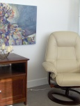
TREATMENT…
The humanistic approach’s primary application has been to therapeutic treatment.
Client-centered therapy- whereby the client is encouraged to develop positive self-regard & overcome mismatch between their perceived self, actual self & ideal self.
Gestalt therapy- developed by Fritz Perls, the aim is to help the client become a ‘whole’ (gestalt) person by getting them to accept every aspect of themselves.
Techniques of gestalt therapy include confrontation, dream analysis, and role playing.

Slide 25
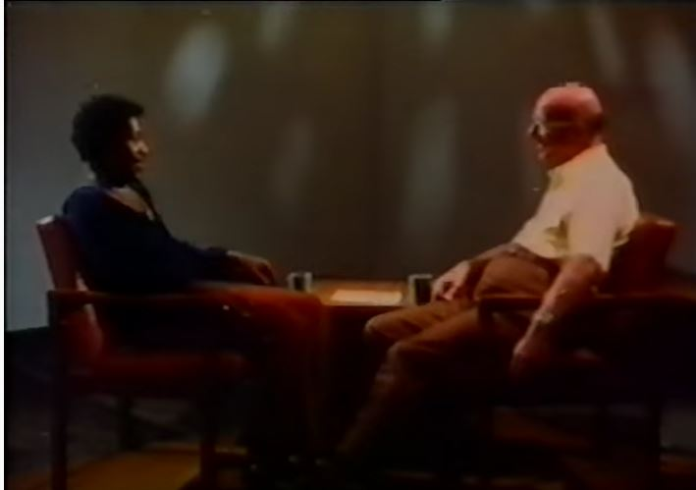
TREATMENT…
Humanists take a phenomenological approach
(a method used to examine a human experience and how people should live their lives)
Therefore, they use methods such as:
Unstructured interviews
Diaries, letters and biographical material
This is a video of a full therapy session between Carl Rogers and a man experiencing anger and hurt after an illness. The interview is 1 hour long, so may be something you are interested in watching in your own time.

Slide 26
Strengths of the Humanistic Approach
Emphasises the need to study consciousness and human experience.
Looks to fill the gaps not explained by other approaches.
Emphasises individualism – personality and abnormality are not uniform.
Emphasises motivation and self-actualisation.

Slide 27

Strengths…
The Humanistic approach has contributed to Psychology by:
Emphasising the importance of self actualisation, responsibility, freedom of choice and social context in therapy.
Highlighting the value of more individualistic methods of study, particularly in the areas of personality and abnormality.

Slide 28
Criticisms OF THE HUMANISTIC APPROACH
The belief in individual free-will goes against the deterministic nature of science.
Focuses too much on individualism and not on theories that can be generalised.
Humanistic psychology reads more like a philosophical guide on how to live a fulfilling life rather than a scientific explanation of people.
Things like consciousness and emotion are among the most difficult aspects of Psychology to study – due to their subjective nature.

Slide 29
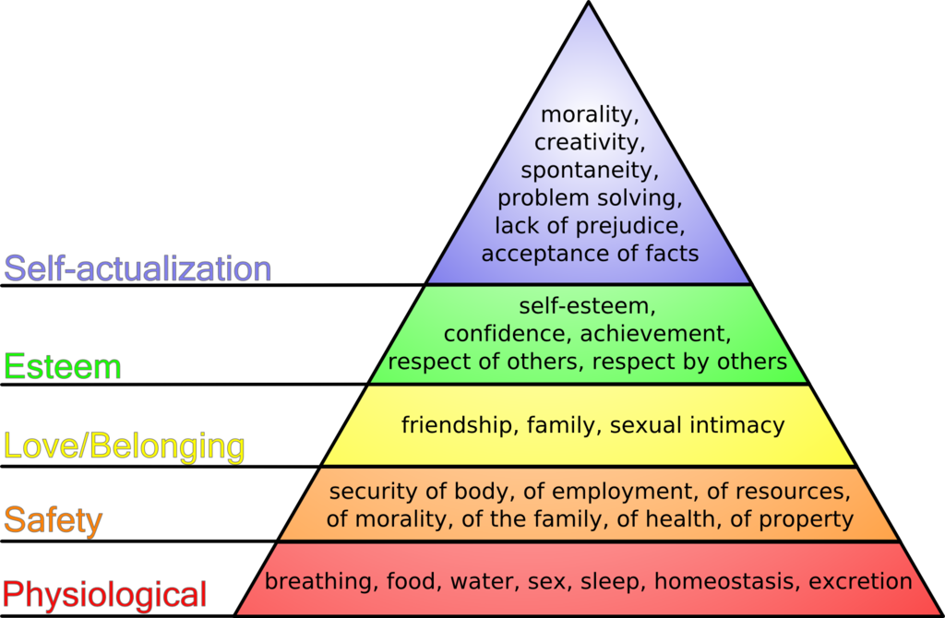
Activity.
Complete the ‘Hierarchy of needs’ task (word or moodle version)

Slide 30
Module Feedback Questionnaire
Can you please now take the time to fill in the Student Module Feedback Questionnaire
You will find this at the top right of the Module Moodle Page
This will give you the opportunity to share your opinions on this module
The questionnaire is anonymous so please answer the questions freely

Slide 31
References
Carlson, N, R., Buskist, W., (2013), Psychology : UEL, Pearson Education UK, ProQuest Ebook Central.
Chapmancoaching, (2018), Self Concept Part #3 – What you can do!, [video] Available at: https://www.youtube.com/watch?v=ydPf2WwZQFU (Accessed: 12 October 2022).
Chapmancoaching, (2018), Self Concept Part #1 – Carl Roger’s Theory on Self Esteem, [video] Available at: https://www.youtube.com/watch?v=gVlxu7PwvZU (Accessed: 12 October 2022).
Chapmancoaching, (2018), Self Concept Part #2 – Conditions of worth, [video] Available at: https://www.youtube.com/watch?v=5aNYVW2g1Nw (Accessed: 12 October 2022).
Fernald, D., (2008), Psychology – Six Perspectives, London: Sage Publications.
Gross, R, D., (2015), Psychology: The Science of Mind and Behaviour, 7th edn, Hodder Education Group, EBSCO Publishing : eBook Collection (EBSCOhost)
Hill, A.,(2017), Carl Rogers Counsels An Individual On Anger, [video] Available at: https://www.youtube.com/watch?v=uRCD3anKsa0 (Accessed: 12 October 2022).
Rogers, C., (1951), Client Centred Therapy, Kindle Edition.

Slide 32








NEED SOME HELP?

