Slide 1
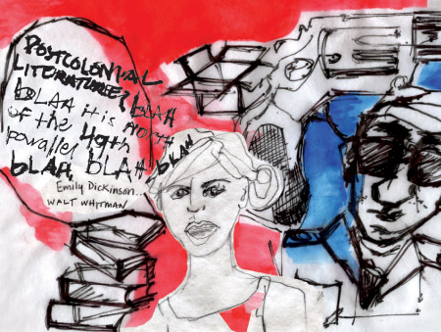
HPAR5010
Postcolonialism

Slide 2
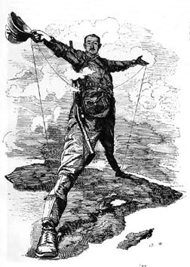
What is Postcolonialism?
Postcolonialism = after colonialism
A reaction to dominant narratives
Challenges predominantly western, male, upper class voice that dominated academic discourse in 19th & early 20th century

Slide 3
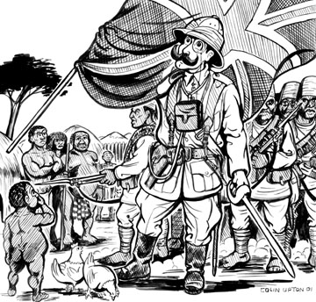
What is Postcolonialism?
Colonialism: language of domination, subjugation, oppression
A academic response to colonialism, initially on the part of the colonized
  How ‘the “west” attempts systematically to cancel or negate the cultural difference & value of the “non-West”’ (Ghandi 1998: 15)

Slide 4

Postcolonialism
Colonial discourse: internalised the colonised through imposition of western values
Postcolonial approach highlights the oppression of the colonized:
  Political, economic, social, cultural, psychological

Slide 5
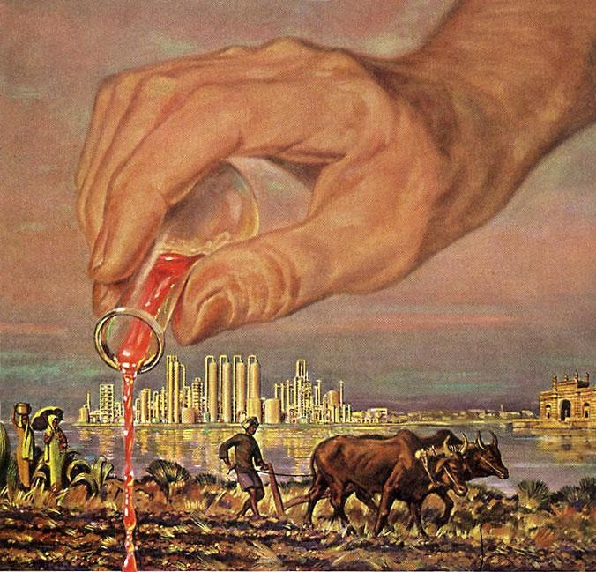
Postcolonial Critique
Questions & evaluates the effects of imperialist views in (post)colonial societies
Theory developed to examine literature, culture, political history of the former European colonies
Assesses effects of empire, exploitation, subordination & looks at the relationship between the coloniser & colonised
Gives the colonised a voice

Slide 6
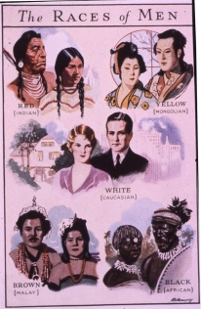
Intellectual Origins: Othering
How the west excludes those they want to subordinate
Creates & highlights the differences between “us” & the other:
  Production of narratives & representations of peoples which demonise & dehumanise
  Justification for treating the “other” as inferior
Embedded in Enlightenment thought & Social Darwinism

Slide 7

Creating the Other
Animalisation:
  Represents the Other as wild animals
Naturalisation:
  Less western/European & less “cultured”
  Closer to nature
Infantilisation:
  At an early stage of human development
  Uncivilized & child-like
  Cannot be educated

Slide 8
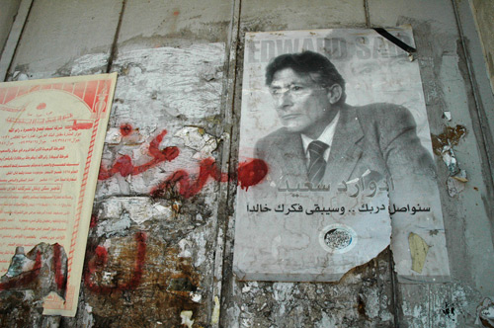
Said, Orientalism
Highlighted the distorted perception of the Orient in western thought
Orientalism: systematic, negative & Western way of discussing the Orient
Western academic, artistic & cultural engagement with the Middle East is paternalistic & inextricably linked with imperialism

Slide 9
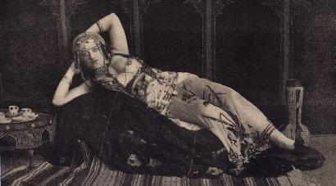
The Orient & Orientalism
The West viewed the Orient as the other: inferior & alien to the West
Orientalism = a western representation of the East:
  A single essentialist image
  Effete & corrupt
  Passive
  Exoticised, mysterious, different
  Paternalistic, imperialistic perception

Slide 10
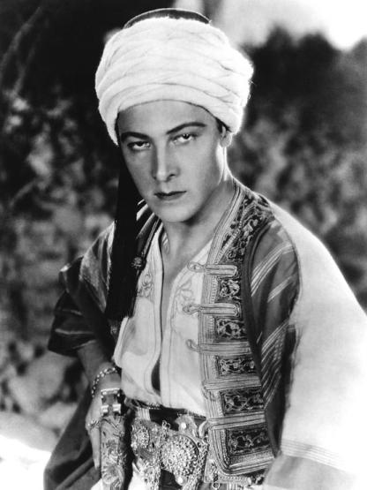
Exoticism
Art, literature, popular culture, intellectual discourse emphasised the otherness of the East
The dominant western culture defined other, “marginal” cultures in its own terms
  Europe was naturalised & the rest of the world exoticised

Slide 11
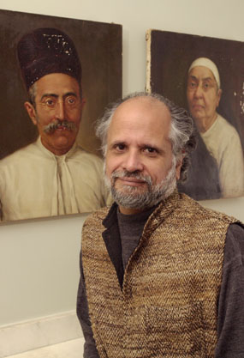
Homi Bhabha
Indian postcolonial theorist
Disputed the single essentialising truth (western imperialist narrative)
Stressed the importance of the middle ground or third space
  Places where people & ideas meet & mix
  A marginal & ambiguous place
Cultural hybridity

Slide 12
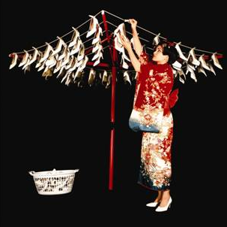
Hybridity
Bhabha: Cultural Diversity & Cultural Differences
Emphasised the interdependence of the coloniser & colonised
Argued that the inherent purity & originality of cultures was untenable
Cultural contact inevitably means cultural mix

Slide 13

Hybridity
“the creation of new transcultural forms within the contact zone produced by colonisation” (Ashcroft et al. 2007: 118)
How local identities are reworked by peoples living in colonial situations
Recognises the agency of the indigenous population

Slide 14

Hybridisation
“…cultural mixture is the effect of the practice of mixed origins”
(Friedman 1995: 84)
Construction of a new identity & new social practices in a contact zone
More than a simple fusion of colonial & indigenous features:
hybridisation is social practice involving active social agents

Slide 15
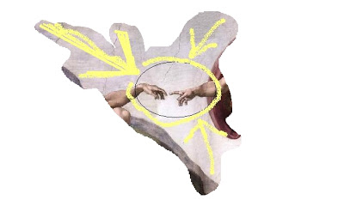
Common Ground: Third Space
Assumes mutually beneficial interaction between cultural groups
A creative space where people of diverse cultural backgrounds come into contact
Neither group is subordinate or predominant
People accommodate very different values:
  Adopt, reinterpret & frequently misconstrue each other’s social practices & ideologies
  Creation of shared new social structures

Slide 16
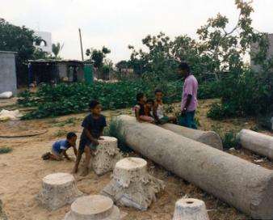
Postcolonial Archaeology
Postcolonialism focuses on the local context, the diversity of local cultures & their agency
What does this mean for archaeological interpretation & practice?
Application of hybridity to archaeological interpretation
Archaeology has become more political engaged
Tell Sannam, Gaza

Slide 17
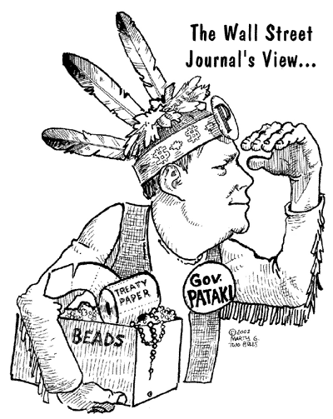
Indigenous Rights
Uncomfortable relationship between “impartial” archaeologist & indigenous peoples
“indigenous people have viewed archaeology as the final act of usurpation in which white society...has now removed any control over the construction of the past
  (Gosden 2002: 249)

Slide 18
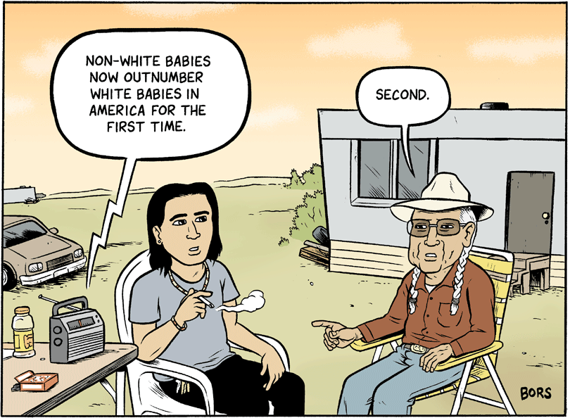
Indigenous Rights
Archaeologists prioritise freedom to research & excavate
Interested in metanarratives
Prioritise Issues of “world heritage”
Less concerned with local histories & alternative voices of the past

Slide 19
Indigenous Rights
Debate is most evident in study of human remains
NAGPRA: a process for museums & Federal agencies to repatriate Native American cultural items to lineal descendants
  Repatriation is contingent upon demonstrating ‘a relationship of shared group identity which can be reasonably traced historically between a present day Indian tribe… and an identifiable earlier group’
Debate has also impacted upon cultural property & cultural restitution

Slide 20
Postcolonial Archaeology
Postcolonial approach is part of wider post-processual thought
Emphasis is on plurality of identity & experience, social relations, gender....
Habitus & social reproduction give framework for interpretation
Hybridisation has been particularly useful in interpreting archaeologies of culture contact

Slide 21
Summary
Postcolonialism: reaction to dominant western narrative
Emphasises plurality, the local context & indigenous agency
Particularly influential is concept of hybridity & cultural mix
Huge impact on many areas of scholarship including archaeology
Interpretation of contact situations
Empowerment of local peoples

