Slide 1
University of Wales Trinity Saint David Birmingham
Module: Professional Development with Health and Social Care
Module Code: LCHS4009
Name of the student: Shabinah Nargas
ID number: 2418906
Name of the lecturer: Wafa Nazir

Slide 2
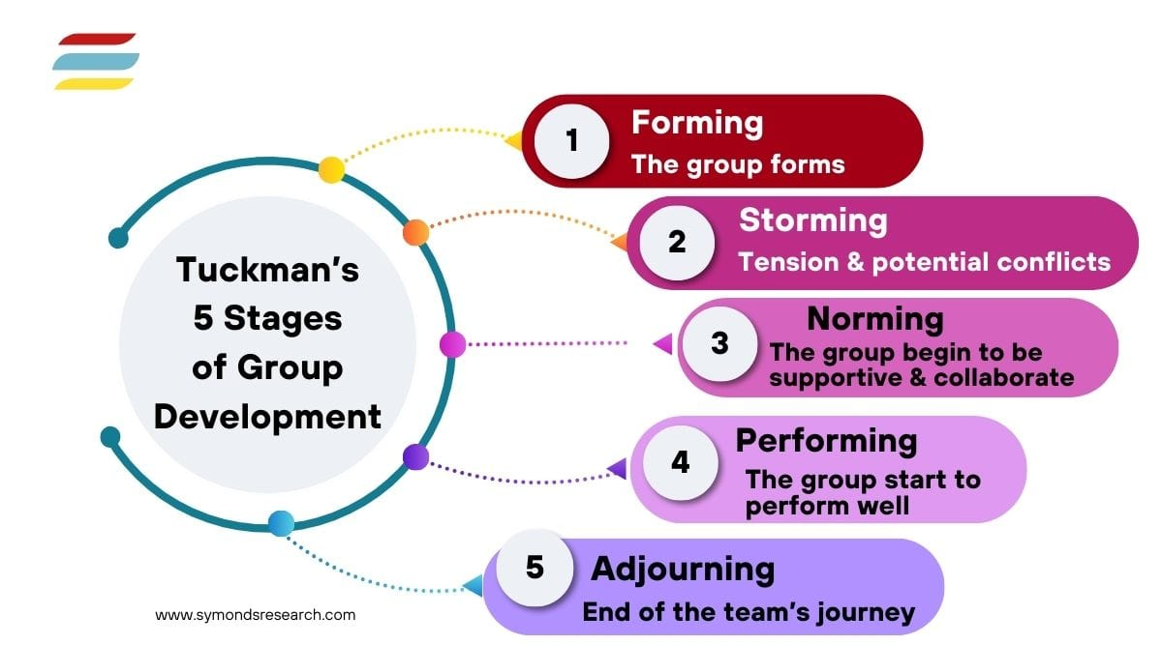
Self-Awareness Presentation
Why is team work important in Health and Social Care
Bruce Tuckman, a psychologist, developed a 5-stage theory to explain how teams develop over time.
The process of assembling people with complementary abilities and knowledge to work together towards a common goal is known as team. It involves building connections, outlining expectations, and establishing circumstances in which individuals can contribute effectively. The objective is to create an effective team that can produce reliable results over the course of a task. (Drumm, 2024)

Slide 3

Define Teamwork
Being aware that people cannot accomplish their objectives on their own is fundamental to the concept of collaboration. When people work together to achieve a common goal while utilising their particular skills and viewpoints, this is known as teamwork. Because each member contributes to the group's success, this partnership enables increased productivity, creativity, and innovation. (Cambridge Dictionary, 2019)

Slide 4
Importance of Teamwork in Health and Social Care
Care
Better quality of work
Lesser work-load
Improved communication
Support
Personal growth
Leadership/ development
Effiency

Slide 5
Communication
When working in the health and social care sectors, effective communication is essential. Professionals from different backgrounds work together in order to meet the social, emotional, and physical needs of individuals in need of medical care. Working together improves safety and creates a pleasant workplace. (SemiColonWeb, 2021)
Nobody has all the knowledge or abilities. Collaboration guarantees that no important detail is overlooked, improving outcomes for patients. (Care Learning, 2025)

Slide 6

Problem Sovling
Professionals in health and social care can improve their problem-solving abilities by working as a team. People may share ideas, come up with solutions, and join to resolve problems more successfully when they work together.
Professional Development
Professionals can learn from each other, improve their understanding and skills, and stay updated with developments in their field by collaborating with colleagues from various professions and backgrounds. (SemiColonWeb, 2021)

Slide 7

Practical example of how working in a team skill is applied in health and social care
In health and social care settings, workload can frequently feel excessive. Duties are distributed when a team works together. This lessens the burden of providing care.
When groups divide up the work properly, it lowers the stress that each employee experiences, avoids errors brought on by exhaustion or rush, ensures continued care even in the event of a team member's absence.
For example, if a member of staff in Health and social care couldn't finish a job, another can help. Regular, care delivery is ensured by this type of mutual support. (Care Learning, 2025)

Slide 8
Emergencies
During an emergency, working in a team is cruicial. Whether it's a medical emergency or a safeguarding issue, health and social care facilities need to react fast. A strong team is able to operate quickly and efficiently.
For example, in a case if a patient unexpectedly slips, an organised team can: Assign one employee to make a medical assistance call.
Assign a different employee to administer first aid. Make sure others stay calm and provide comfort. During emergencies, collaboration improves results and speeds up reaction times.
(Care Learning, 2025)

Slide 9
References
SemiColonWeb (2021). [online] Healthcarecourses.org.uk. Available at: https://www.healthcarecourses.org.uk/articles.aspx?CourseTitle=Importance+of+teamwork+in+Health+and+Social+Care+Management&id=6656. (Accessed 16 Jun. 2026).
Care Learning (2025). 1.1 Describe the purpose of team working – Care Learning. [online] Care Learning. Available at: https://carelearning.org.uk/qualifications/level-3-diploma-care/hsc-l14-effective-team/1-1-describe-the-purpose-of-team-working/. (Accessed 17 Jun. 2026).
Drumm, S. (2024). The Tuckman Ladder Model (5 Stages of Team Development). [online] ProjectManagers.net. Available at: https://projectmanagers.net/tuckman-ladder-model/.
Symondsresearch.com. (2025). Available at: https://symondsresearch.com/wp-content/uploads/2025/02/5-stages-tuckmans-group-development.jpg.
Cambridge Dictionary (2019). TEAMWORK | meaning in the Cambridge English Dictionary. [online] Cambridge Dictionary. Available at: https://dictionary.cambridge.org/dictionary/english/teamwork. (Accessed 20 Jun. 2026).

